Slide 2
Aims of this talk:
Provide an overview of who the ADS are and what we do
Briefly look at the ADS archive and how we approach preservation
Describe how CAD is used in archaeology and what we as an archive get deposited
Look at some of the more complex ways in which CAD works with other datasets
Describe how ADS deals with CAD data and the wider issues

Slide 3
The Archaeology Data Service:
set up in 1996
one of five AHDS subject centres
based within the University of York
Funding:
initially received funding from
  Arts and Humanities Research Board (now AHRC)
  Joint Information Systems Committee (JISC)
Presently receives core funding from AHRC alongside a range of project-based funding.

Slide 4
Our remit:
“To support research, learning and teaching with high quality and dependable digital resources.”
In practice this means three key things:
That ADS collect and preserve datasets
That we allow full, easy and free access to these
And that we additionally provide guidance and support to data creators

Slide 5
HE projects
(AHRC, British Academy, Leverhulme Trust)
Varying Scale
Varying Complexity
Varying Size
Commercial archaeology projects
English Heritage, RCAHMS, etc. datasets and R&D projects

Slide 6
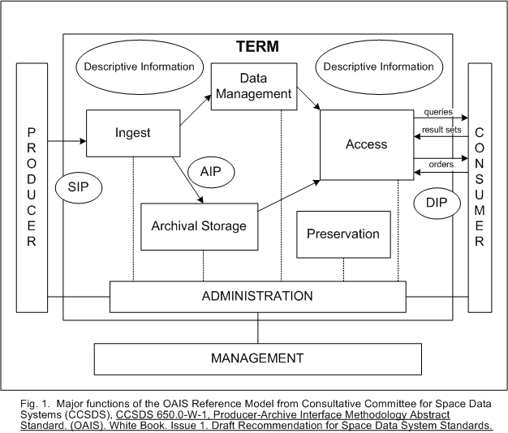
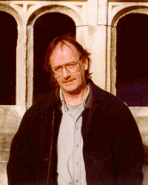











OAIS based archive
Picture from DLib

Slide 7
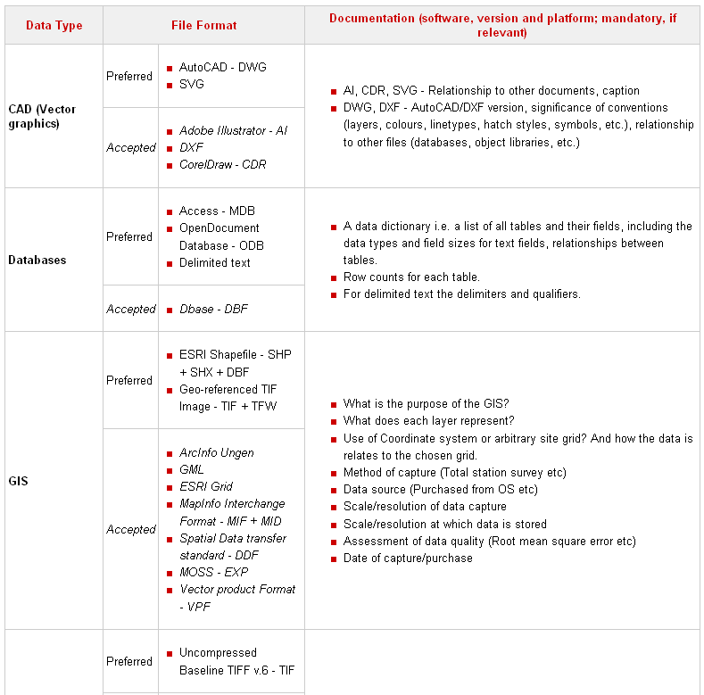
Migration based approach with controlled ingest

Slide 8
Aerial Survey
Geophysics
GIS
CAD
Virtual Reality
Excavation & Fieldwork
Marine Remote Sensing
Laser Scanning
Photogrammetry
ADS Guides to Good Practice
Currently
being
revised
and
updated
New
guides
being
created
Aim to connect with data producers early on in their project lifecycles to ensure that preservation planning is a key consideration during the project rather than an afterthought.

Slide 9
Results of the Big Data Project
(ADS 2006)
Technologies used
3D Laser Scanning
12%
12%
Sidescan Sonar
Multibeam Scanning
3%
4%
Single Beam Scanning
Geophysics
4%
Acoustic Tracking
14%
3%
Sub bottom profiling
Geographic (eg GIS)
8%
Lidar
Digital Video
7%
1%
Video Movie Clips
3%
Still Images
9%
11%
CAD (2D or 3D)
9%
Other

Slide 10
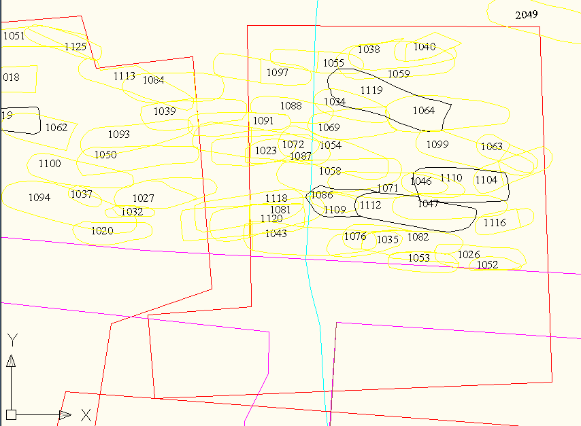
Site plans i.e. flat two-dimensional plans of a site’s extent together with contexts and features (ditches, post-holes and so on).

Slide 11
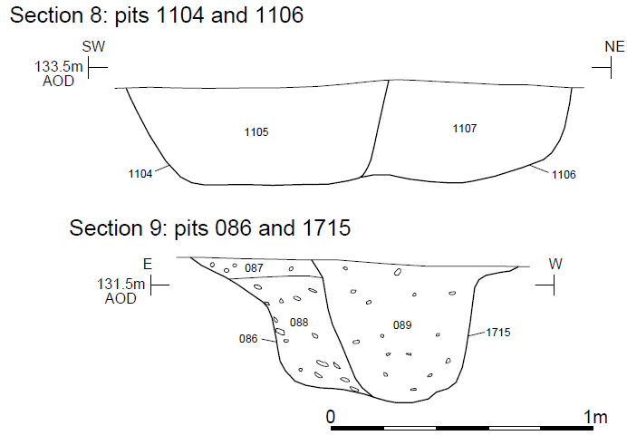
Section drawings i.e. flat illustrations of the cross-section of features.

Slide 12
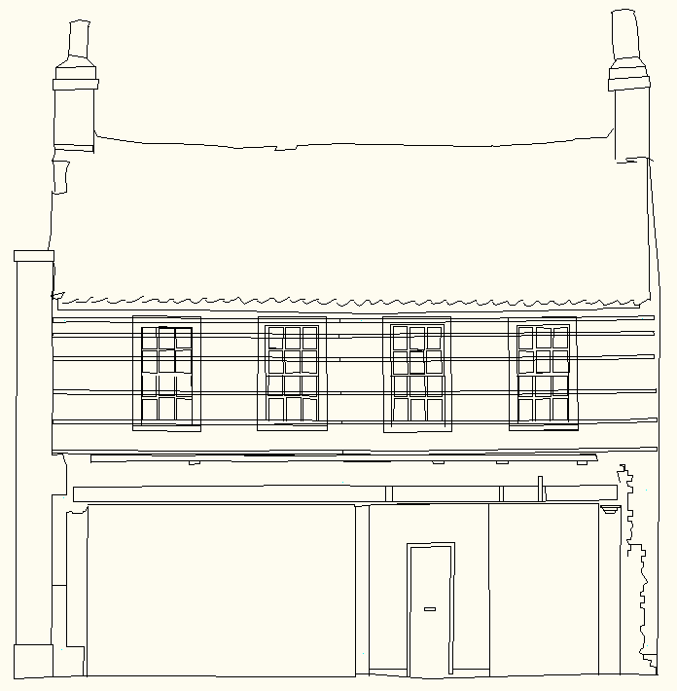
Two-dimensional building elevations, often produced as a result of standing building assessment.

Slide 13
Possible Workflows
(and what to archive)
Paper drawings
Total Station
CAD
Raster or Vector Illustrations
GIS

Slide 14
Possible Workflows
(and what to archive)
Laser Scanning
Paper drawings
Total Station
Photogrammetry
CAD
Raster or Vector Illustrations
GIS
3D Modelling
Video or Images

Slide 15
How ADS archives CAD
Majority of data we receive created in AutoCAD
Files deposited as either DWG or DXF files
ADS follows a migration-based approach to preservation - files are preserved and disseminated in DXF format.
Depositors include basic metadata in order to assist archiving and reuse
  Software and file format used to create and store the file.
  Description of layers and conventions used with the files
  The relationship between the CAD data and other files within the archive (e.g. images, databases, GIS etc.)

Slide 16
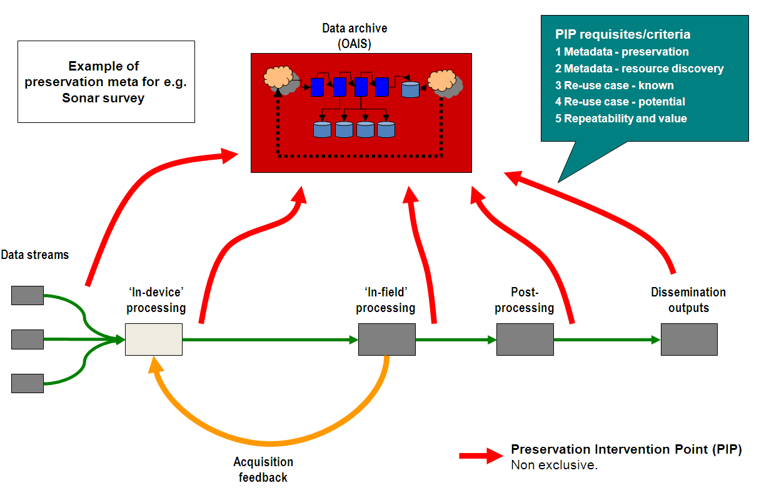
Preservation Intervention Points

Slide 17
Future Directions
Non-proprietary open formats key e.g. OpenDWG
Other tools may offer new solutions
Better understanding of workflows
More comprehensive metadata
Updated Guides to Good Practice

Slide 18

Thank you!
Archiving CAD in Archaeology:
Ingest to Dissemination
(or The ADS experience to date)
Further information:
Contact Kieron Niven at kjn103@york.ac.uk
Guides to Good Practice:
http://guides.archaeologydataservice.ac.uk

