Slide 1
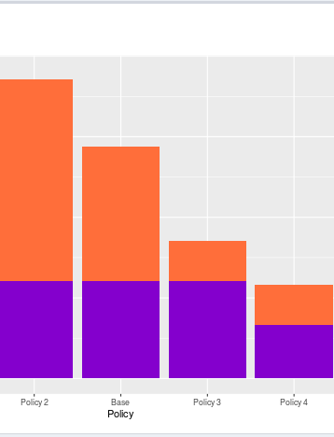


Introducing DiAGRAM: The Digital Archiving Graphical Risk Assessment Model
Hannah Merwood and David Underdown
16 June 2020

Slide 2
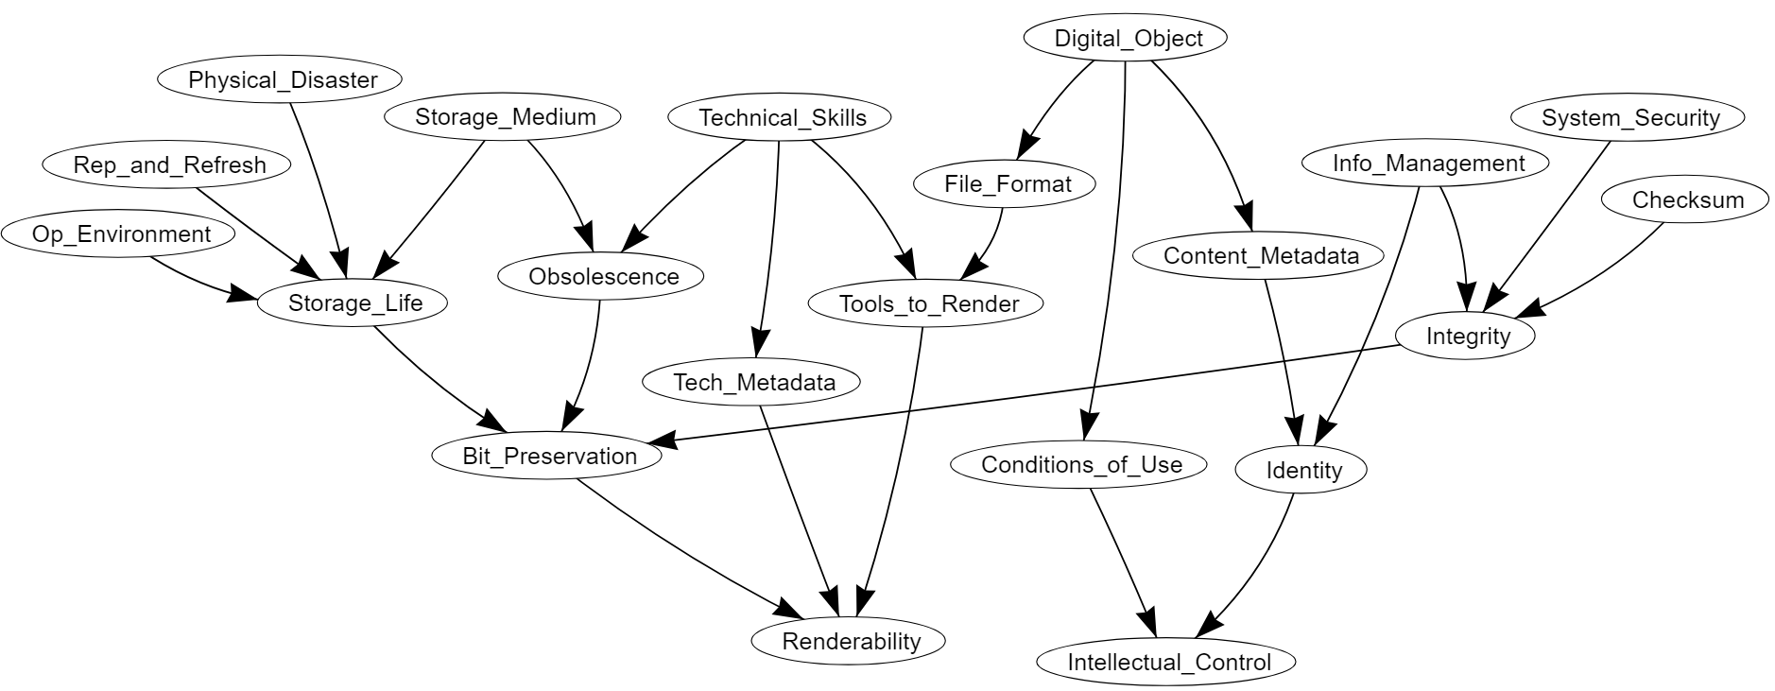
DiAGRAM Bayesian Network
Renderability: The object is a sufficiently useful representation of the original file.
Intellectual control: Having full knowledge of the material content, provenance and conditions of use.
Digital preservation outcomes
Notes:
This is our Bayesian network of digital preservation risks. Ultimate aim is for renderability and full intellectual control. All other factors can affect this.
Renderability: The object is a sufficiently useful representation of the original file.
Intellectual control: Having full knowledge of the material content, provenance and conditions of use.
Obsolescence: Essential equipment, hardware or software required to access the bit stream becoming out of date or unusable. For example, hardware no longer being produced or essential software to access the media no longer supported.
Depends on the storage medium used. D-1, an early Digital Video format, is far more risky than an LTO tape. But if you have good technical skills you may be able to recover the bit-stream.

Slide 3
Data sources
Expert elicitation session, held in April 2020 with 22 participants from 10 different UK institutions involved in digital archiving and/or digital preservation.
Data from the 2019 JISC digital skills survey, answered by over 300 UK archive professionals.
Data from TNA on file formats by digital object type.
Data from cloud data storage providers on access and durability.
Data from gov.uk on the long-term flood risk of UK postcodes.
Notes:
Some nodes are also deterministic, where we have defined risks in such a way their states can be certain. For example, if you do not have sufficient content metadata, you cannot identify the material, and if you cannot identify the material, you don’t have intellectual control.

Slide 4
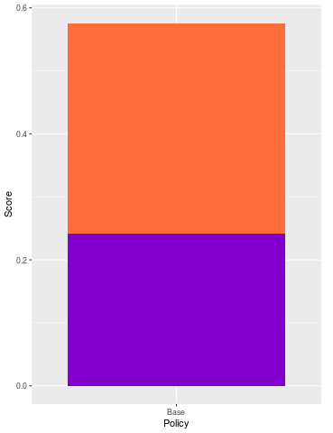
Renderability score
Intellectual Control score
Risk score
a higher score
means
lower risk
Score for intellectual control
0.33
Score for renderability
The overall risk score is…
0.33 + 0.24 = 0.57
0.24
Notes:
Score will be based on renderability and intellectual control scores. Currently these scores are the probabilities of having renderability and intellectual control but we are going to be reviewing this and are open to suggestions on what is the most intuitive way to score the policies. Each of these probabilities are given out of 1, so the overall risk score will be out of 2.
An example…

Slide 5
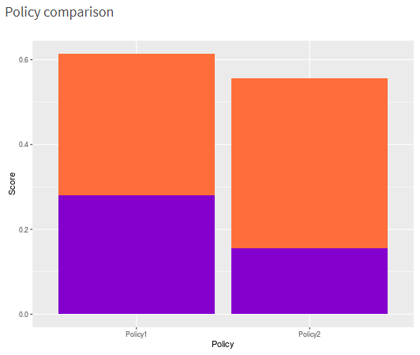
Comparing two policies
‘Policy1’ has a score of 0.613984517687047 which rounds to 0.61
‘Policy2’ has a score of 0.555750321794773 which rounds to 0.56
Overall ‘Policy1’ is better than ‘Policy2’.
‘Policy1’ has a higher score for renderability, however ‘Policy2’ has a higher score for intellectual control.
Notes:
Policy1 might be increase the rendering tools at the archive.
Policy2 might be put more focus on improving metadata documentation.

Slide 6
Risks mapped to OAIS Functional Entities
Preservation Planning
Technical Skills
System Security
Tools to Render
Obsolescence
File Format
Physical Disaster
Access
Data Management
Ingest
Intellectual Control
Information Management
Digital Object
Checksum
Identity
Content Metadata
Technical Metadata
Renderability
Conditions of Use
Archival Storage
Bit Preservation
Integrity
Storage Medium
Storage Life
Operating Environment
Replication and Refreshment
Notes:
This is an optional part of the tool.
To help make the 21 risks more relatable, we have mapped them to 5 of the Open Archival Information System Functional Entities (all but ‘Administration’). This way, when you come to testing different policies, you can filter by functional entities instead. For example, if you’re looking to review your storage policy, you can select this category and then test these 6 nodes only.

Slide 7


Live Demo
https://nationalarchives.shinyapps.io/DiAGRAM-dev/
Notes:
Live demo in workshop, but screenshots are included in the slide pack.

Slide 8
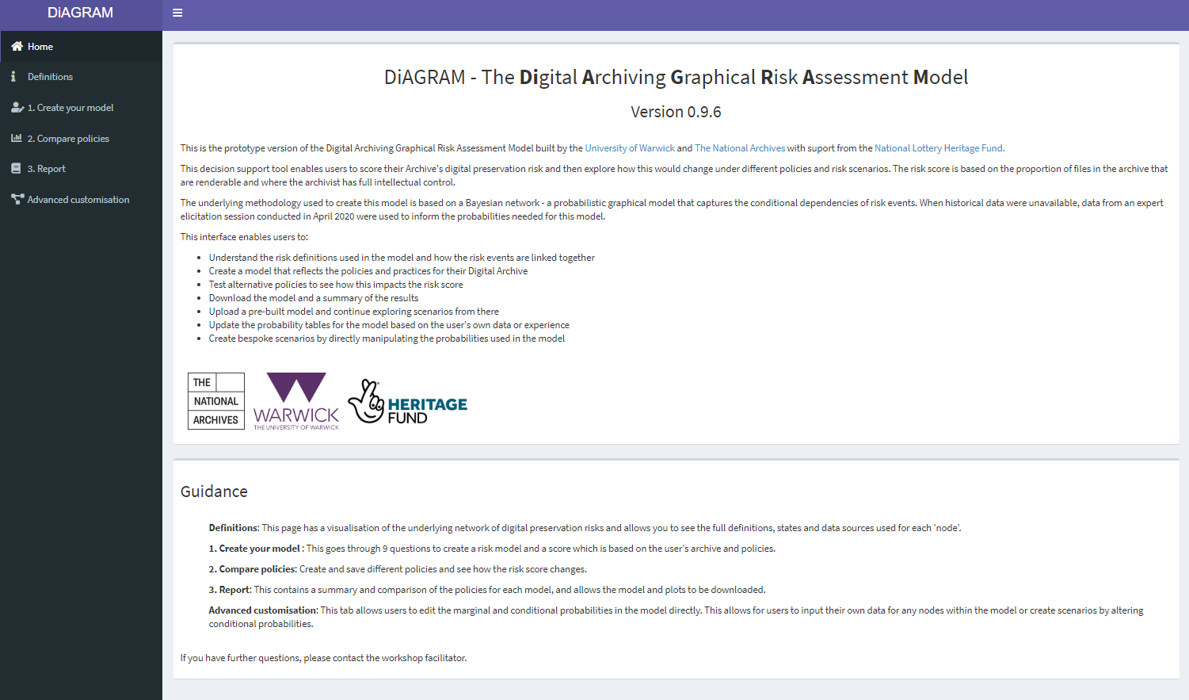
DiAGRAM home page
Notes:
Home page

Slide 9
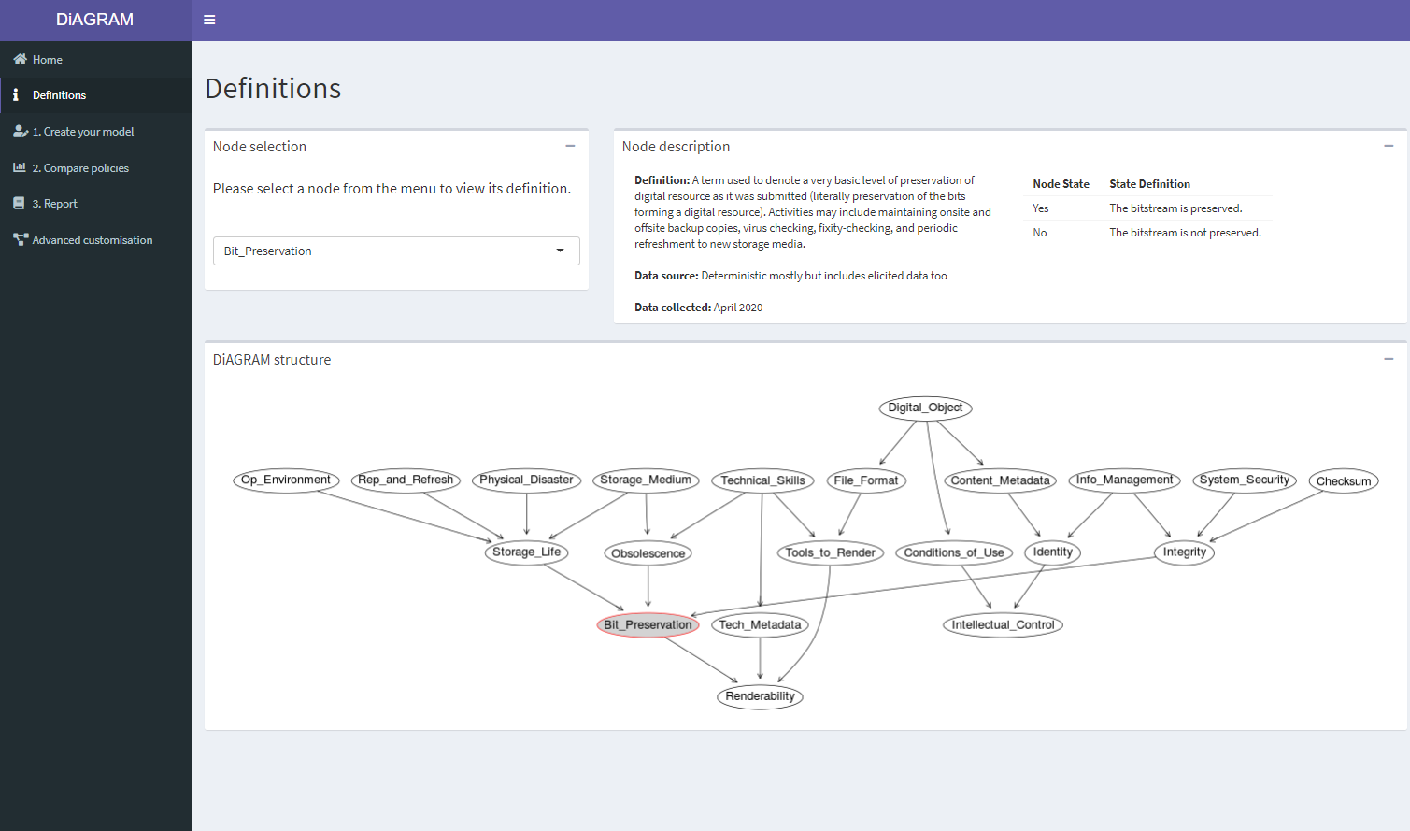
Definitions page, showing details of the Bit_Preservation node
Notes:
Definitions page – initial view which defaults to Bit_Preservation node (as first in alphabetical order)
So we have Node description, broken down into Definition of the term, we have tried to take these from existing sources, or agreed clarifications through discussions in our modelling workshops, or the digital archiving department at The National Archives.
Data Source: where did we get data, Hannah explained deterministic earlier, elicited data is arrived at using the structured elicitation of expert judgement process described earlier. Here the value we get for Bit_Preservation depends on the values of the Storage_Life, Obsolescence and Integrity nodes.
Node states – what at the possible states for the node within the network, how are these defined. So this first node should be pretty self explanatory, either we have exactly the same bitstream as we started with or not.

Slide 10
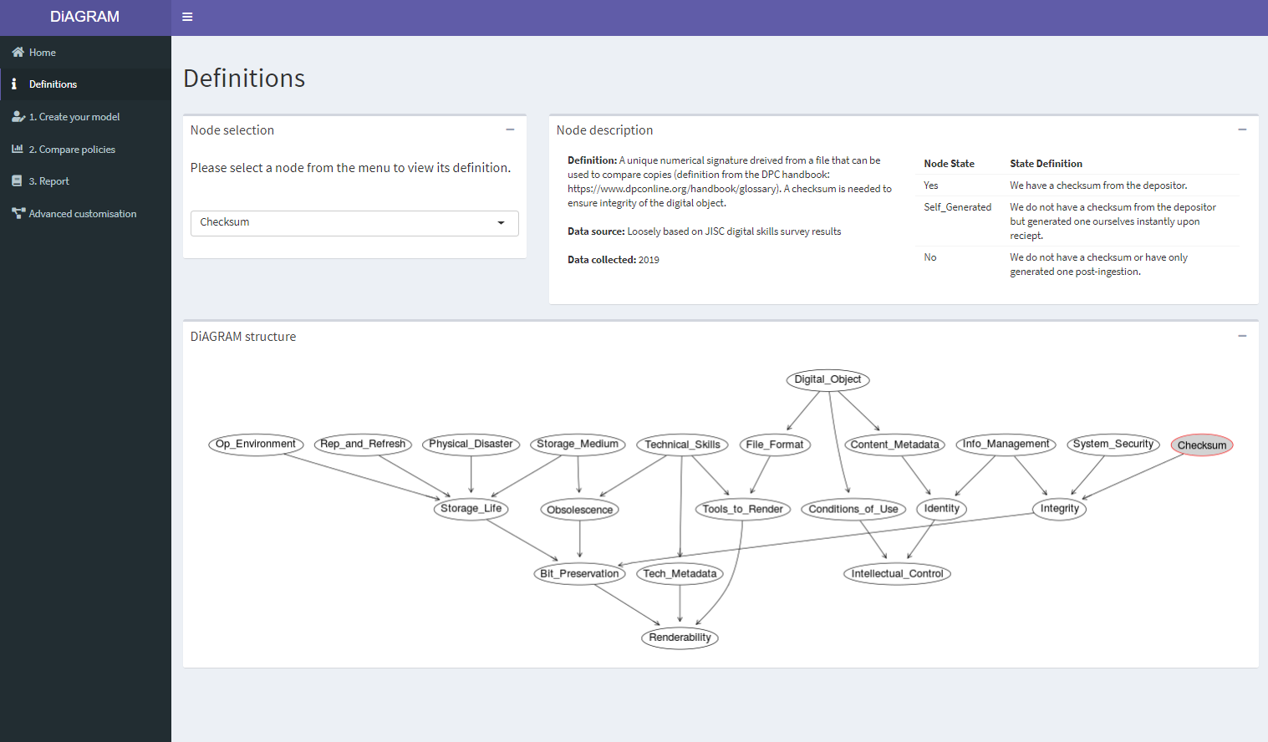
Definitions page, showing details of the Bit_Preservation node
Notes:
A slightly more complex node, having three states. Here we take the definition largely from the DPC handbook, with a brief explanation of why it is required. For the default model we have taken information from JISC digital skills survey so that the default position represents an “average” UK archive. As there are no other nodes pointing into this one it is an input node, so when we move on to setting up the model to reflect a specific archive, this is one of the nodes we’ll have to provide a value for.

Slide 11
Modelling your archive

Slide 12
The resource poor, but skills rich, archive
At our digital archive, we have
some very skilled and passionate members of staff but increasingly strained resources
an already fairly substantial digital collection and we are finding it hard to keep on top of everything,
a need to prioritise which preservation activities will have the most impact
on top of that, there is a budget review coming up shortly and we will have to make a strong case if we don’t want to see our funding reduced further.

Slide 13
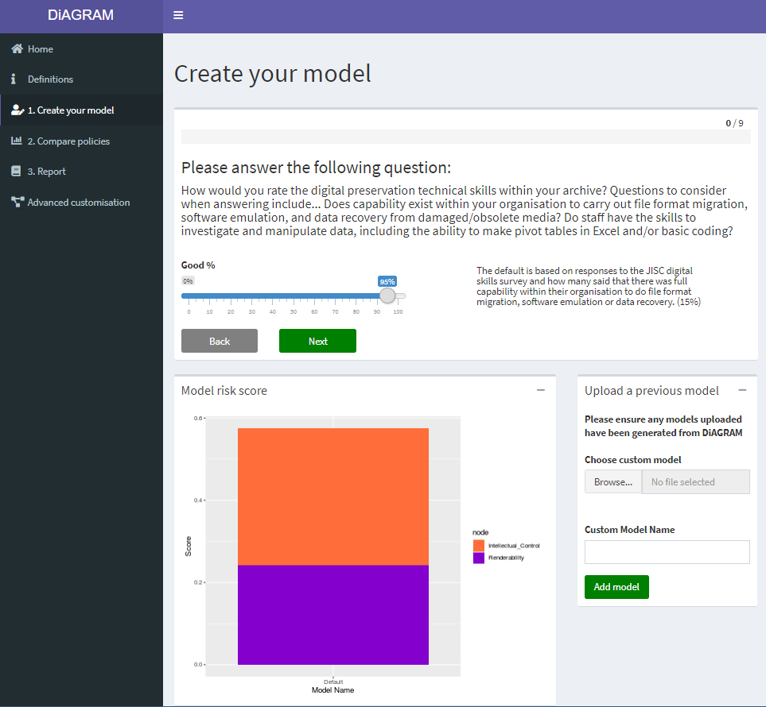
Question 1 - Technical Skills
95% - can never be perfect but we are fortunate to have some real experts in the digital preservation field.

Slide 14
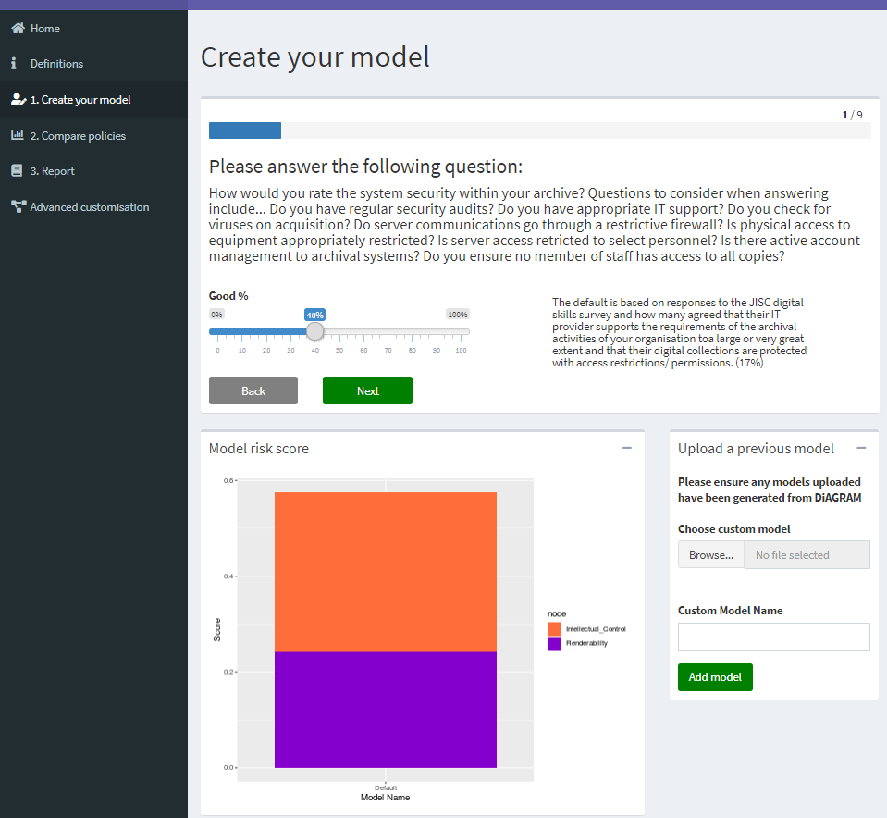
Question 2 – System security
40% - more work needs to be done here as our IT resource and support from the wider organisation is very limited

Slide 15
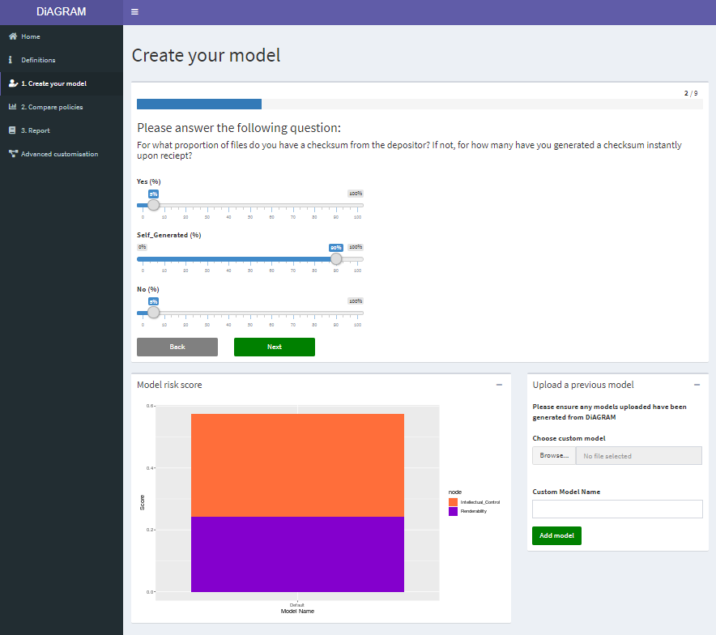
Question 3 - Checksums
Yes - 5%
Self_Generated - 90%
No - 5%
For some time we have been generating checksums when we receive material and performing fixity checks, and we are now encouraging depositors to generate these themselves

Slide 16
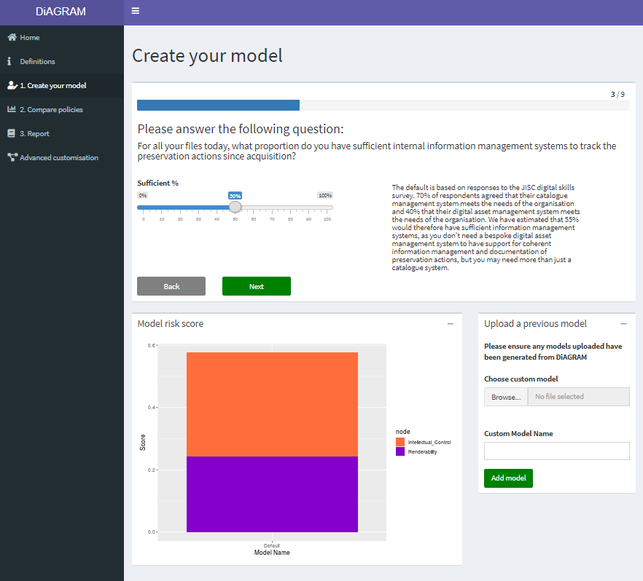
Question 4 – Information Management
50% - we have some systems in place but it is a struggle keeping on top of their maintenance and they aren’t really scalable for the size of the collection now

Slide 17
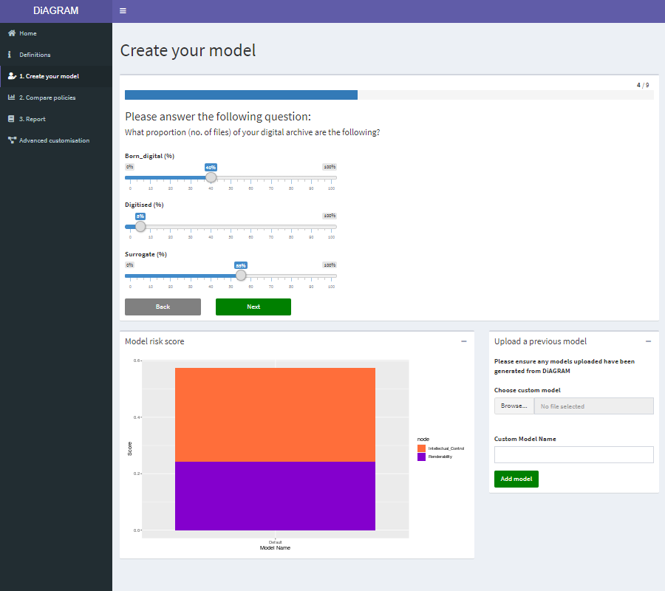
Question 5 - Digital Object
Born_digital - 40%
Digitised - 5%
Surrogate - 55%
Compared to others we do have a lot of born-digital material, though the majority are surrogates.

Slide 18
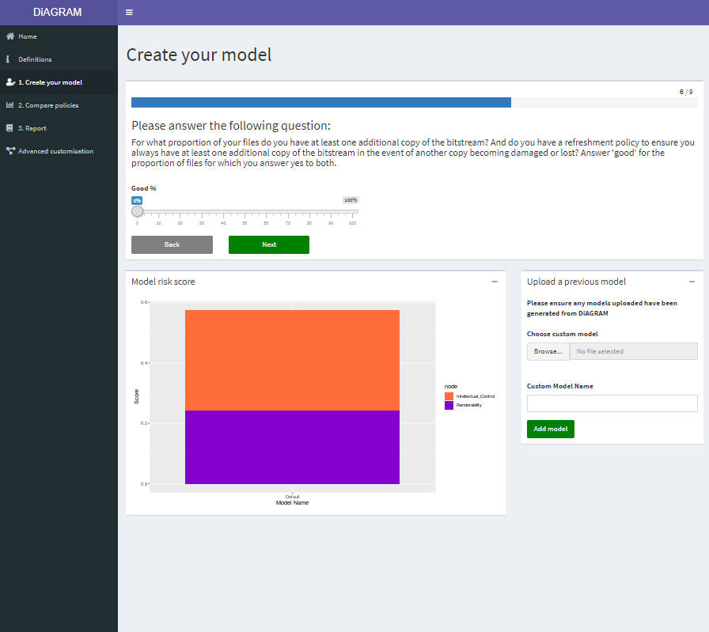
Question 6 - Storage Medium
A - 0%
B - 100%
C - 0%
We keep everything on LTO tapes, a stable storage medium

Slide 19
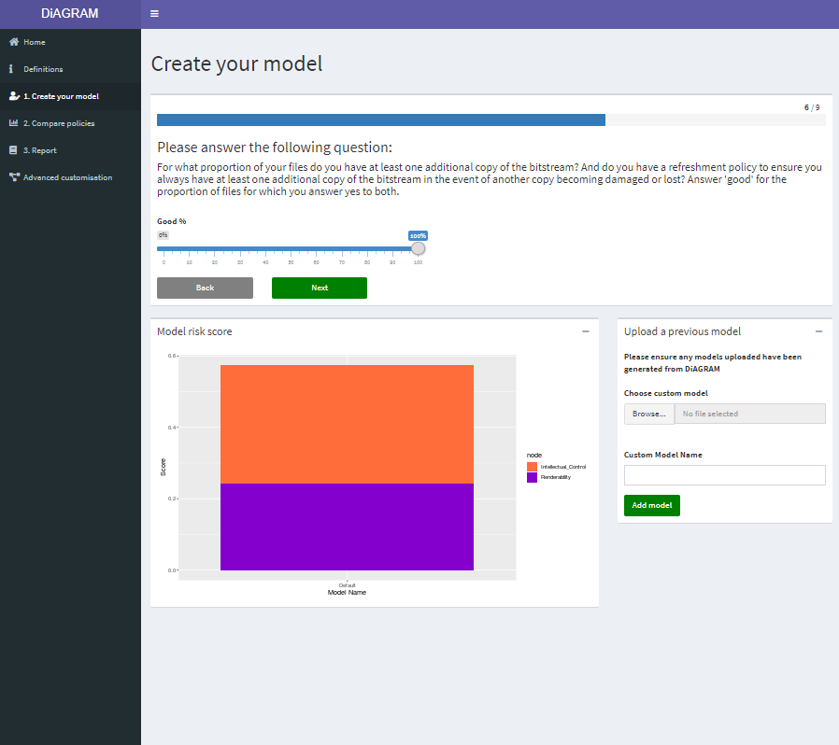
Question 7 - Replication and Refreshment
100% - we always have three copies of our digital objects

Slide 20
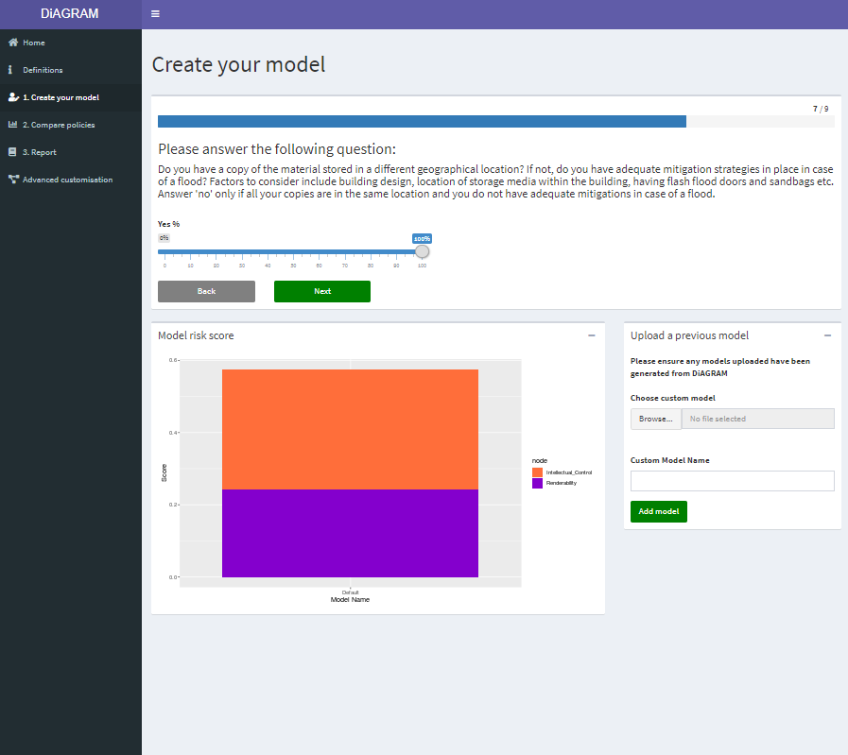
Question 8 - Operating Environment
100% - we have a separate copy of every record held off-site

Slide 21
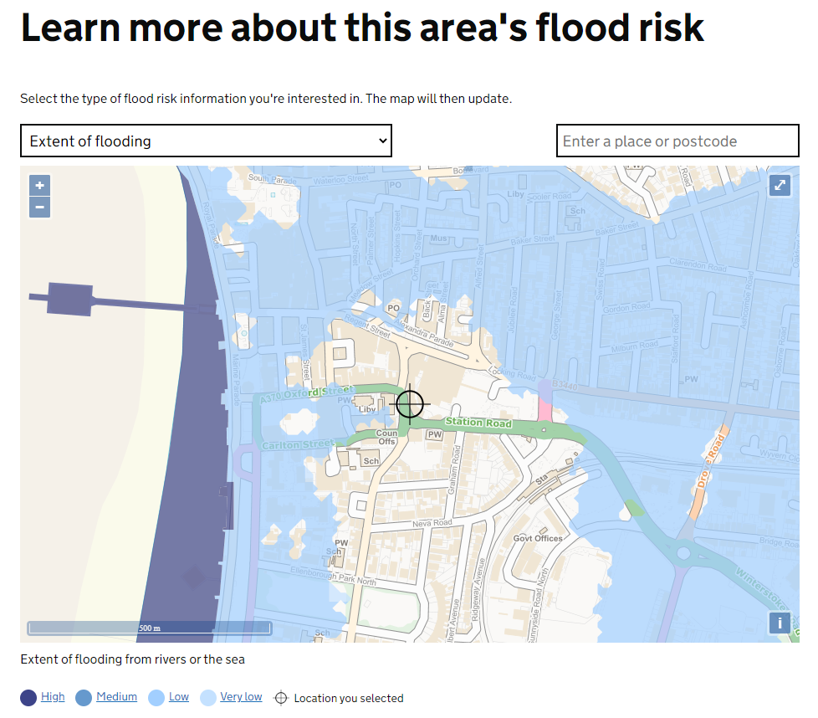
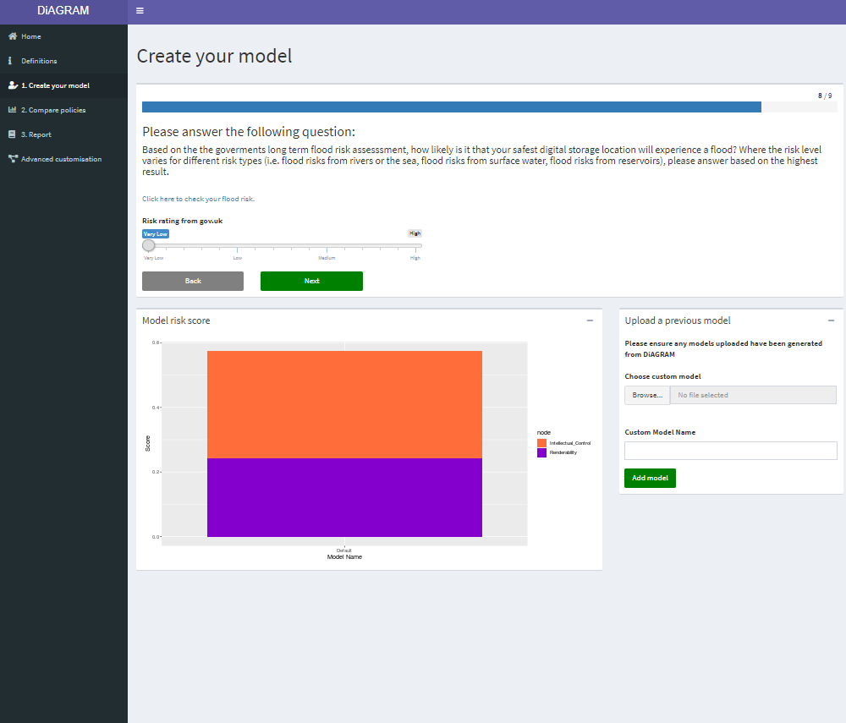
Question 9 - Flood Risk
https://flood-warning-information.service.gov.uk/long-term-flood-risk/postcode
Using the postcode BS23 1US we have a very low flood risk
Notes:
The link is included on the model page.

Slide 22
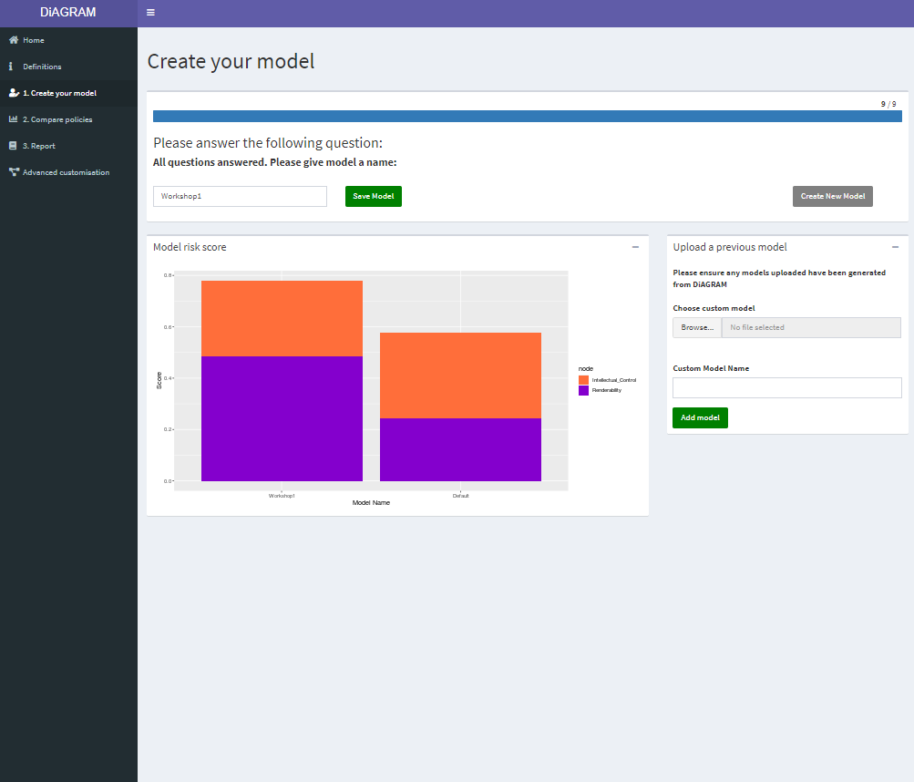
Save model
Enter a name for your model and click “Save Model”
  this will be displayed as a label on the graph, comparing your situation to the default model
The two risk profiles are shown side by side
  The default is based on “average” UK archive
Can now click “Create Model” and go round to add a further model to graph
Or upload a model you downloaded previously

Slide 23
Comparing policies

Slide 24
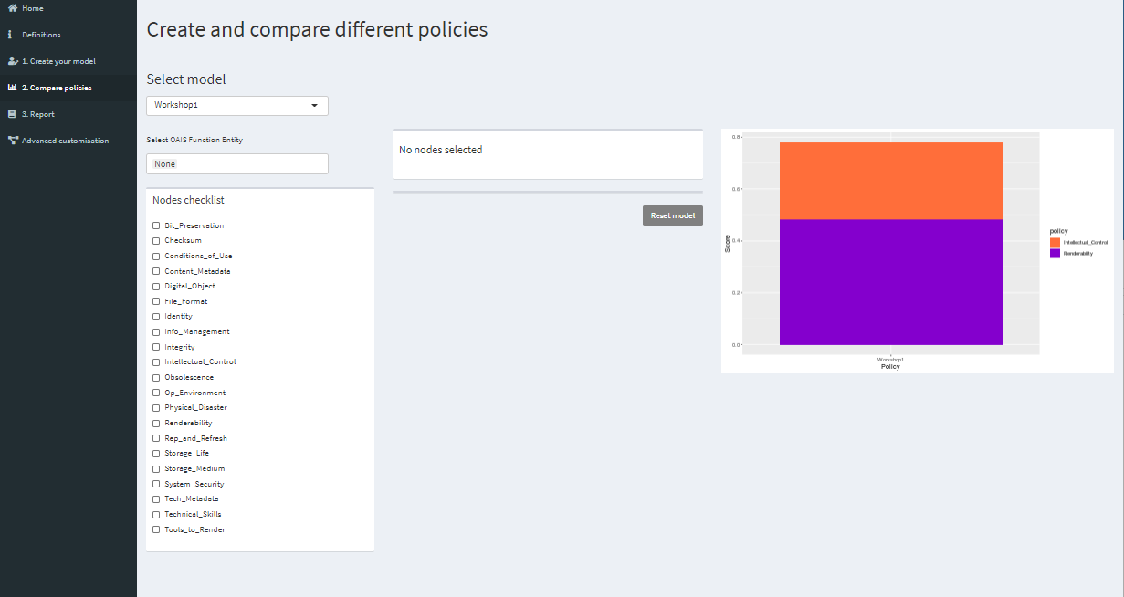
Compare Policies initial screen – our Workshop1 model has been selected as the basis for comparison
Notes:
Will initially see a warning to remind you to select the model most relevant to you, rather than the default, and suggesting you go and create one if you haven’t already.
Will start on default model – need to choose Workshop1 from the “Select model” dropdown.

Slide 25
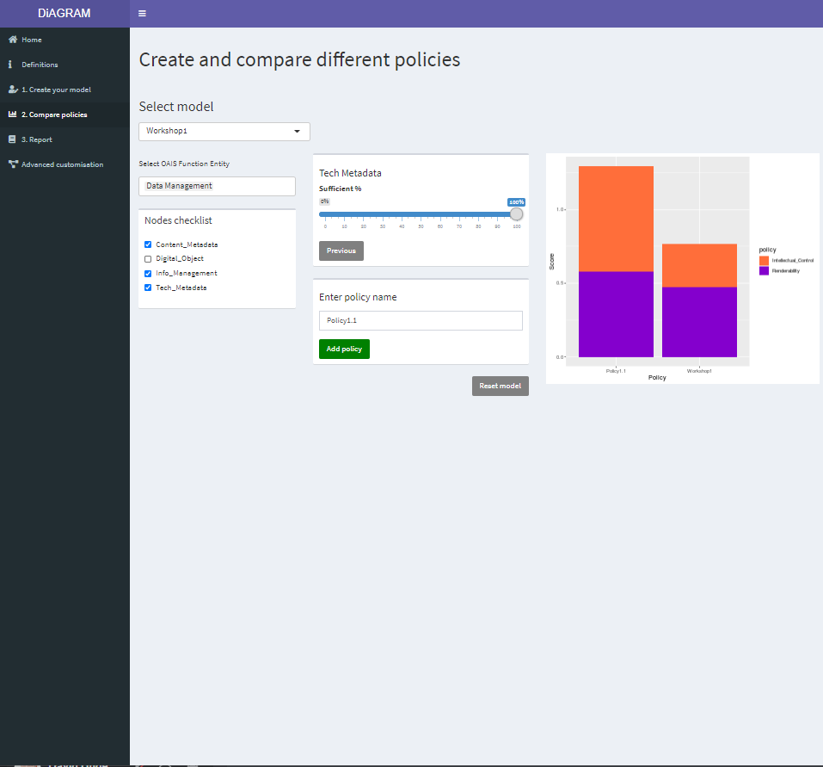
Policy 1.1 – better data management
Here we use the OAIS Functional Entity option to initially reduce the number of nodes under consideration
Choose “Data Management”
Deselect “Digital Object”
Set “Content Metadata” to 100% - “Next”
Set “Info Management” Sufficient to 100% - “Next”
Set “Tech Metadata” Sufficient to 100%
“Enter policy name” – Policy1.1
Click “Add policy”
  Score improves by 0.53
Notes:
This time don’t reset the model as we want to build on this policy

Slide 26
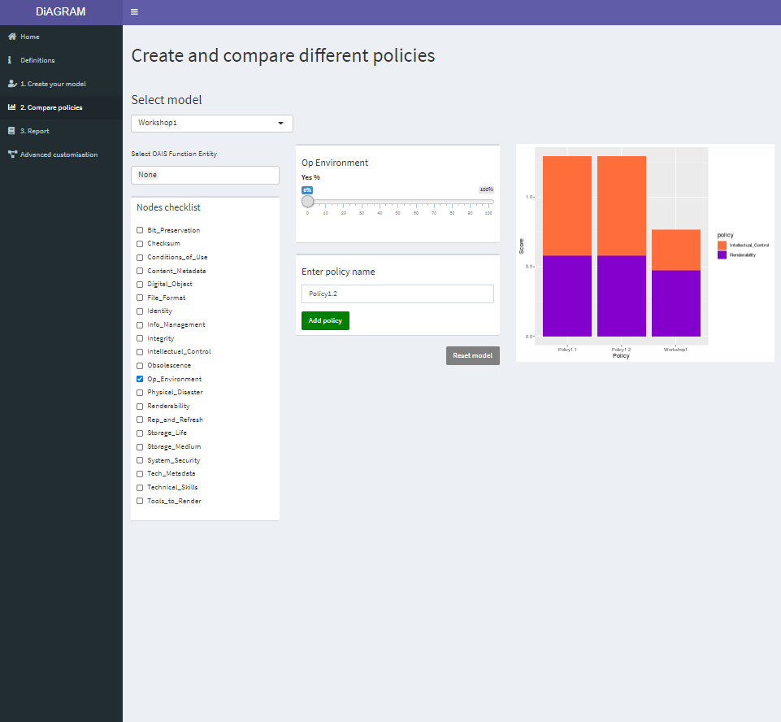
Policy 1.2 – retain metadata improvements, but poorer storage
Retain settings for Policy 1.2, but our offsite storage contract has been cancelled
Set “Content Metadata” to 100% - “Next”
Set “Info Management” Sufficient to 100% - “Next”
Set “Op Environment” to 0%
Set “Tech Metadata” Sufficient to 100%
“Enter policy name” – Policy1.2
Click “Add policy”
  Score decreases negligibly by 0.000003
Note that policies always shown in
decreasing order of score
Reset model
Notes:
Previously selected nodes will diappear from selection, but are still taken into account (we’re looking into this)
Not much change, but remember our archive site had a very low flood risk, and we still have multiple copies

Slide 27
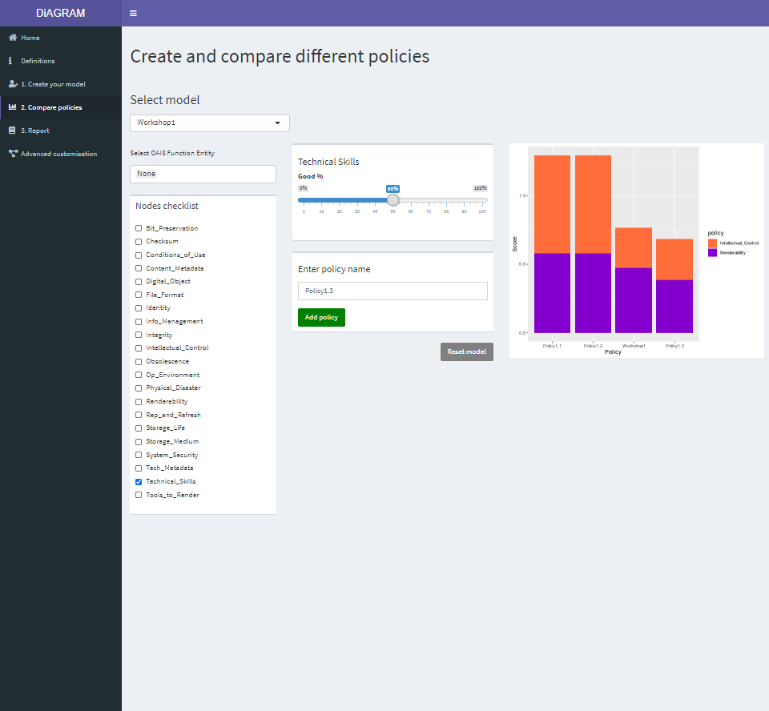
Policy 1.3 – staff turnover reduces skill levels
Unfortunately our most skilled member of staff is likely to leave, and it’s unlikely any replacement will have the same skill levels
Select “Technical_Skills”
Set to 50%
“Enter policy name” – Policy1.3
Click “Add policy”
  Decrease score by 0.088 from Workshop 1 model, but notice it’s mostly on the renderability side.
Reset model
Notes:
This change perhaps seems smaller than we might expect, we might need to look at this again, or perhaps in reality if staff skills were to change, particularly so radically, other areas would change too, or does this accurately reflect that we have a solid start with generally good systems in place, and the fact that much of digital material is relatively homogeneous surrogates.

Slide 28
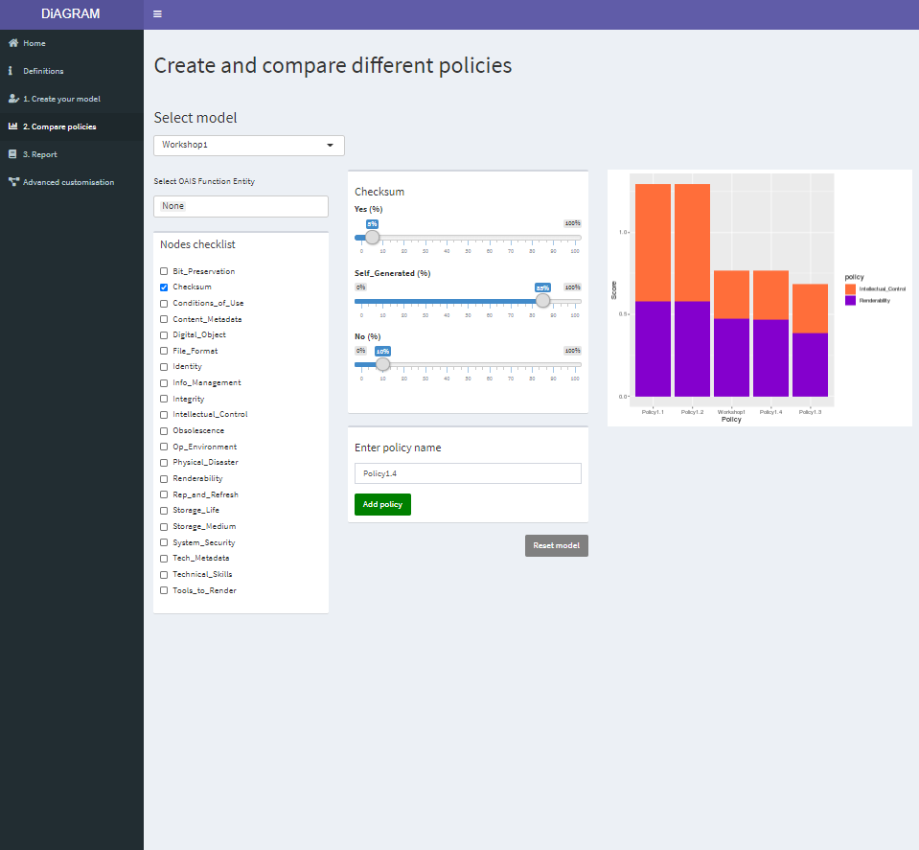
Policy 1.4 – stop generating checksums on receipt if not provided
We decide that if the depositor does not provide a checksum with their materials, we will not generate one either. Over time, this will lead to a greater proportion of files for which we have no checksum
Select “Checksum”
Set Yes – 5%
Self_generated – 85%
No – 10%
“Enter policy name” – Policy1.4
Click “Add policy”
  Decrease score by 0.003 from Workshop 1

Slide 29
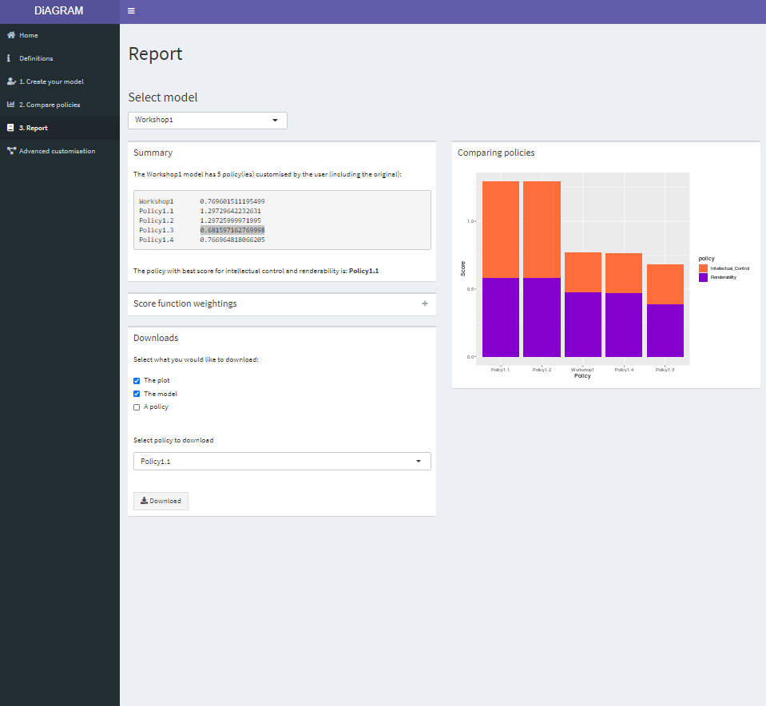
View report
If we now click on 3. Report we see a textual report of the scores and can also choose to download various aspects of our work:
The plot – save as an image
The model – a BIF file that we can reload into the model on another occasion (so we can try further policies more easily)
A policy – save details of an individual policy
Notes:
Again, need to select the Workshop1 model rather than default

Slide 30
Advanced modelling

Slide 31
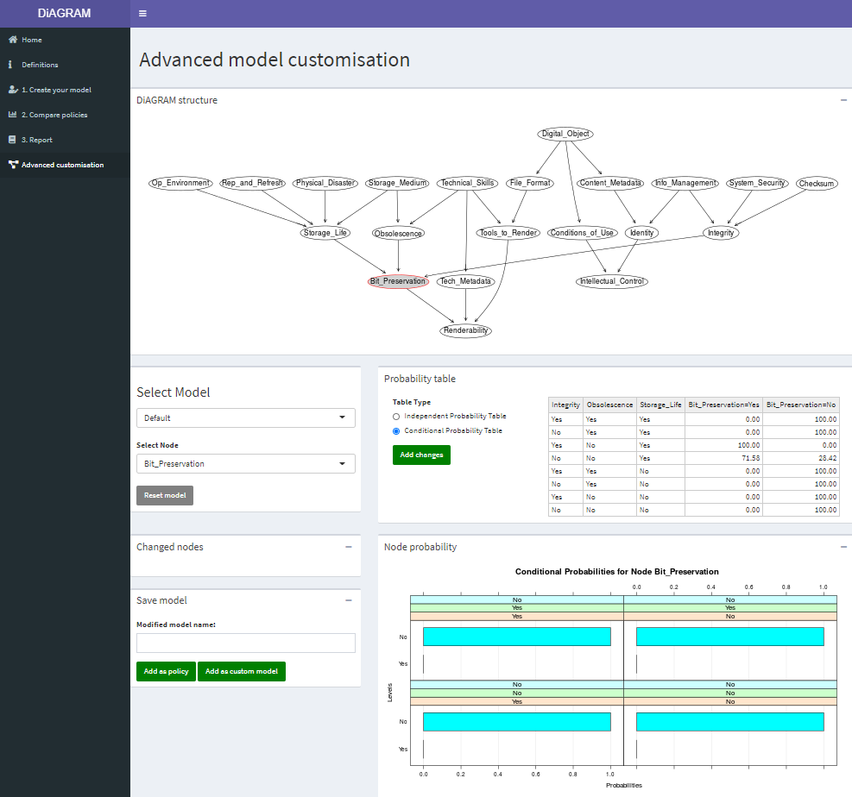
Advanced customisation – probability tables
This page allows direct access to the underlying probability tables for each node
This gives a greater amount of control over potential model changes
Requires greater understanding of the underlying model to be effective
Imagine we know a bit more about our specific storage system, so amend the Bit_preservation values for Integrity=No, Obsolescence=No, Storage_Life=Yes to Bit_Preservation=Yes to 60% and Bit_Preservation=No to 40%

Slide 32
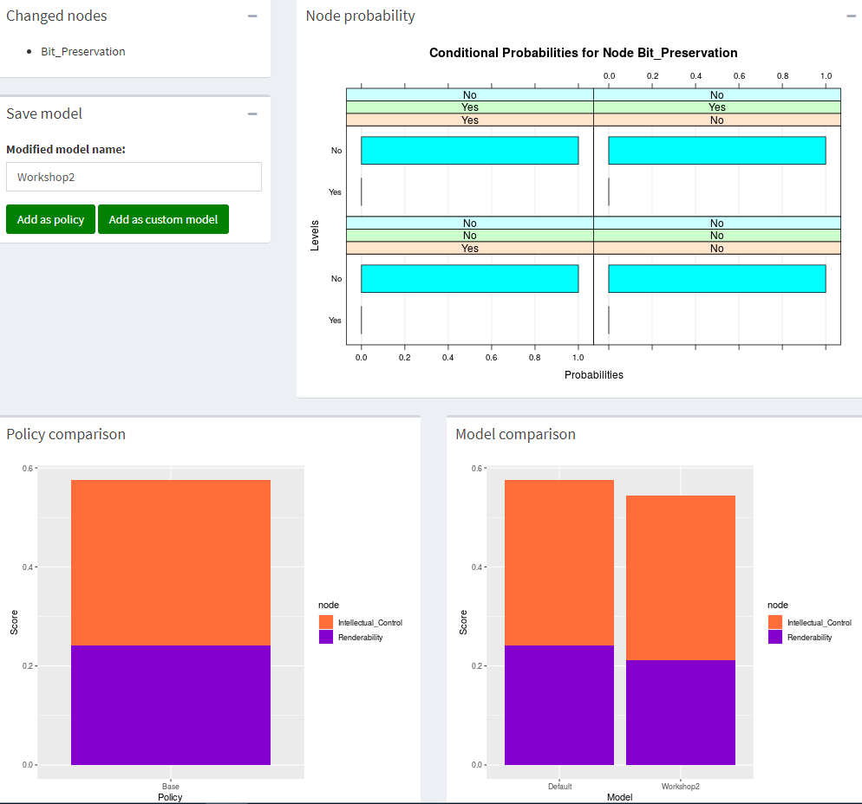
Advanced customisation – graphs
Having updated one or more node probability tables, we can then save as a new model, or a policy.
The updated risk score will then be shown on the relevant graph again.

