Slide 1
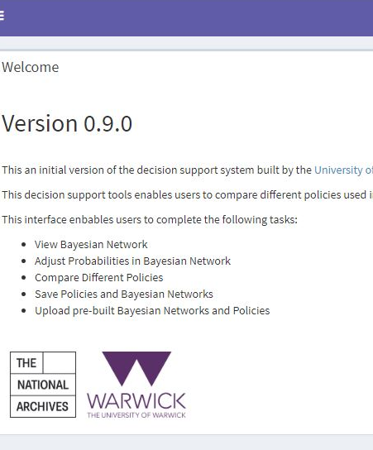


Quantifying Digital Preservation Risk: introducing a new tool for decision making
Alex Green
16th May 2020

Slide 2

Why do we need a risk model for digital preservation?
Our digital heritage is rich, complex and fragile. It's under threat from:
- Rapidly evolving technology
- Outdated policies and standards
- A skills gap across the archives sector
Photo by Marvin Esteve on Unsplash

Slide 3
What will DiAGRAM do?
Creating a new risk management framework for digital archivists on digital preservation risks.
DiAGRAM is The Digital Archiving Graphical Risk Assessment Model
DiAGRAM will:
Improve users' understanding of the complex digital archiving risk landscape and of the interplay between risk factors.
Empower archivists to compare and prioritise very different types of threats to the digital archive: from software obsolescence to natural disaster.
Aid in quantifying the impact of risk events and risk management strategies on archival outcomes to support decision making, communication with stakeholders and developing business cases for targeted action.

Slide 4

Who is involved?
Joint project between the National Archives and the Applied Statistics & Risk Unit, University of Warwick
UK archive partners:
- Dorset History Centre
- Gloucestershire Archives
- TfL Corporate Archives
- Special Collections, University of Leeds
- Design Archives, University of Brighton
The Digital Preservation Coalition for dissemination events and project evaluation
This project is receiving funding from the National Lottery Heritage Fund

Slide 5
What is DiAGRAM?
DiAGRAM is an interactive tool for UK digital archivists and enable them to better understand their own risks and explore different scenarios.
Note: the model is a prototype – it will change!
“What is the impact if we do not know the custodial history for half of our records?”
“If we improve our system security, how much will this decrease our risk?”
“Should we prioritise diversifying our storage media or tackling poor content metadata?”

Slide 6
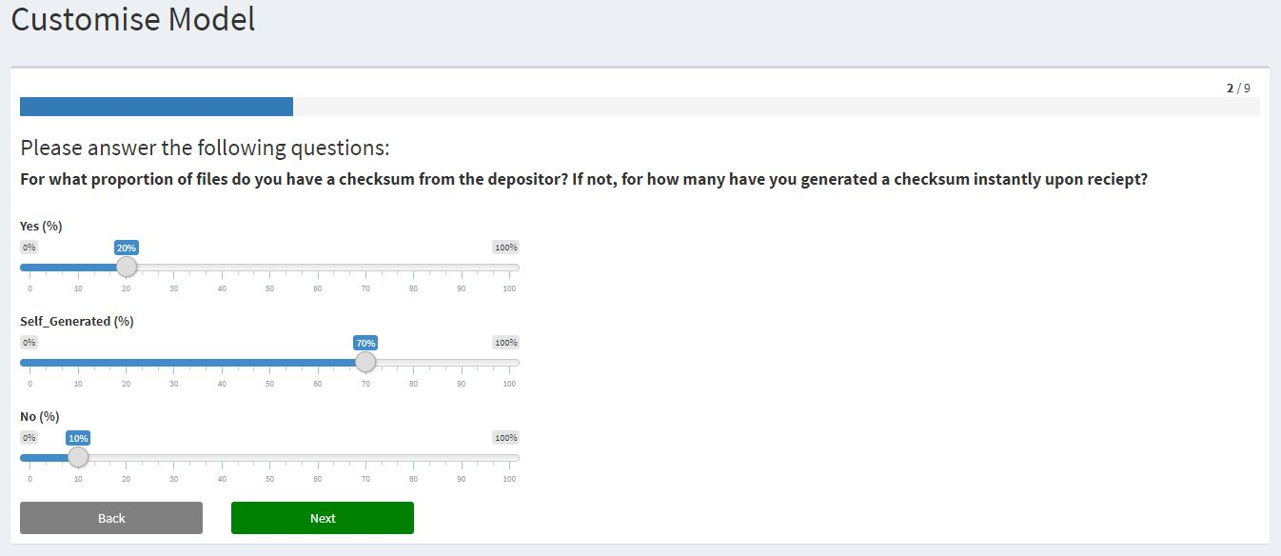
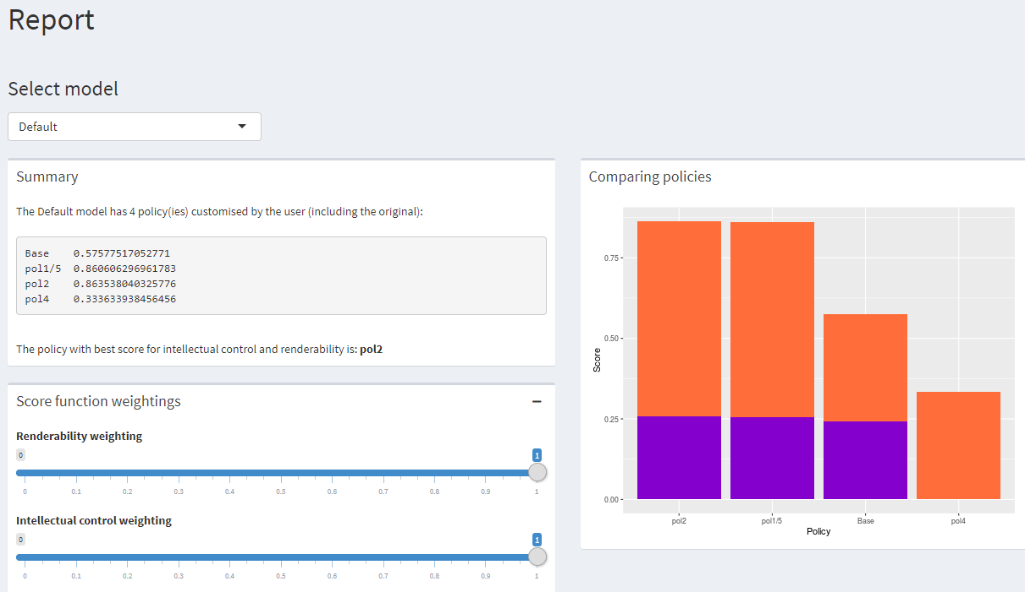
How to use the tool
Customise the model to reflect the situation at your institution
Create different policies/scenarios and compare their scores

Slide 7
Aims for today
Learn about the how the model was created so you know what it is based on and what it can tell you
Try it out for yourselves with data about your own archive (if you have it)
Ask questions to learn more (and alert us to where we need more explanation or more detail when we describe the model in future)
Give us feedback to improve the model: this is a prototype and almost anything can change or be considered for a future version.

