Slide 1
E-mail Archives at the British Library:
The Papers of Wendy Cope
Callum McKean, Curator of Contemporary Literary
and Creative Archives

Slide 2
What We’re Going to Discuss
A general overview of the Library’s priorities and workflows for the processing of Born Digital material.
A look at how these workflows impact upon e-mail in particular.
A case study of the Wendy Cope e-mail archive (comprising c.25,000 messages) – focusing on curatorial challenges, including sensitivity review.

Slide 3
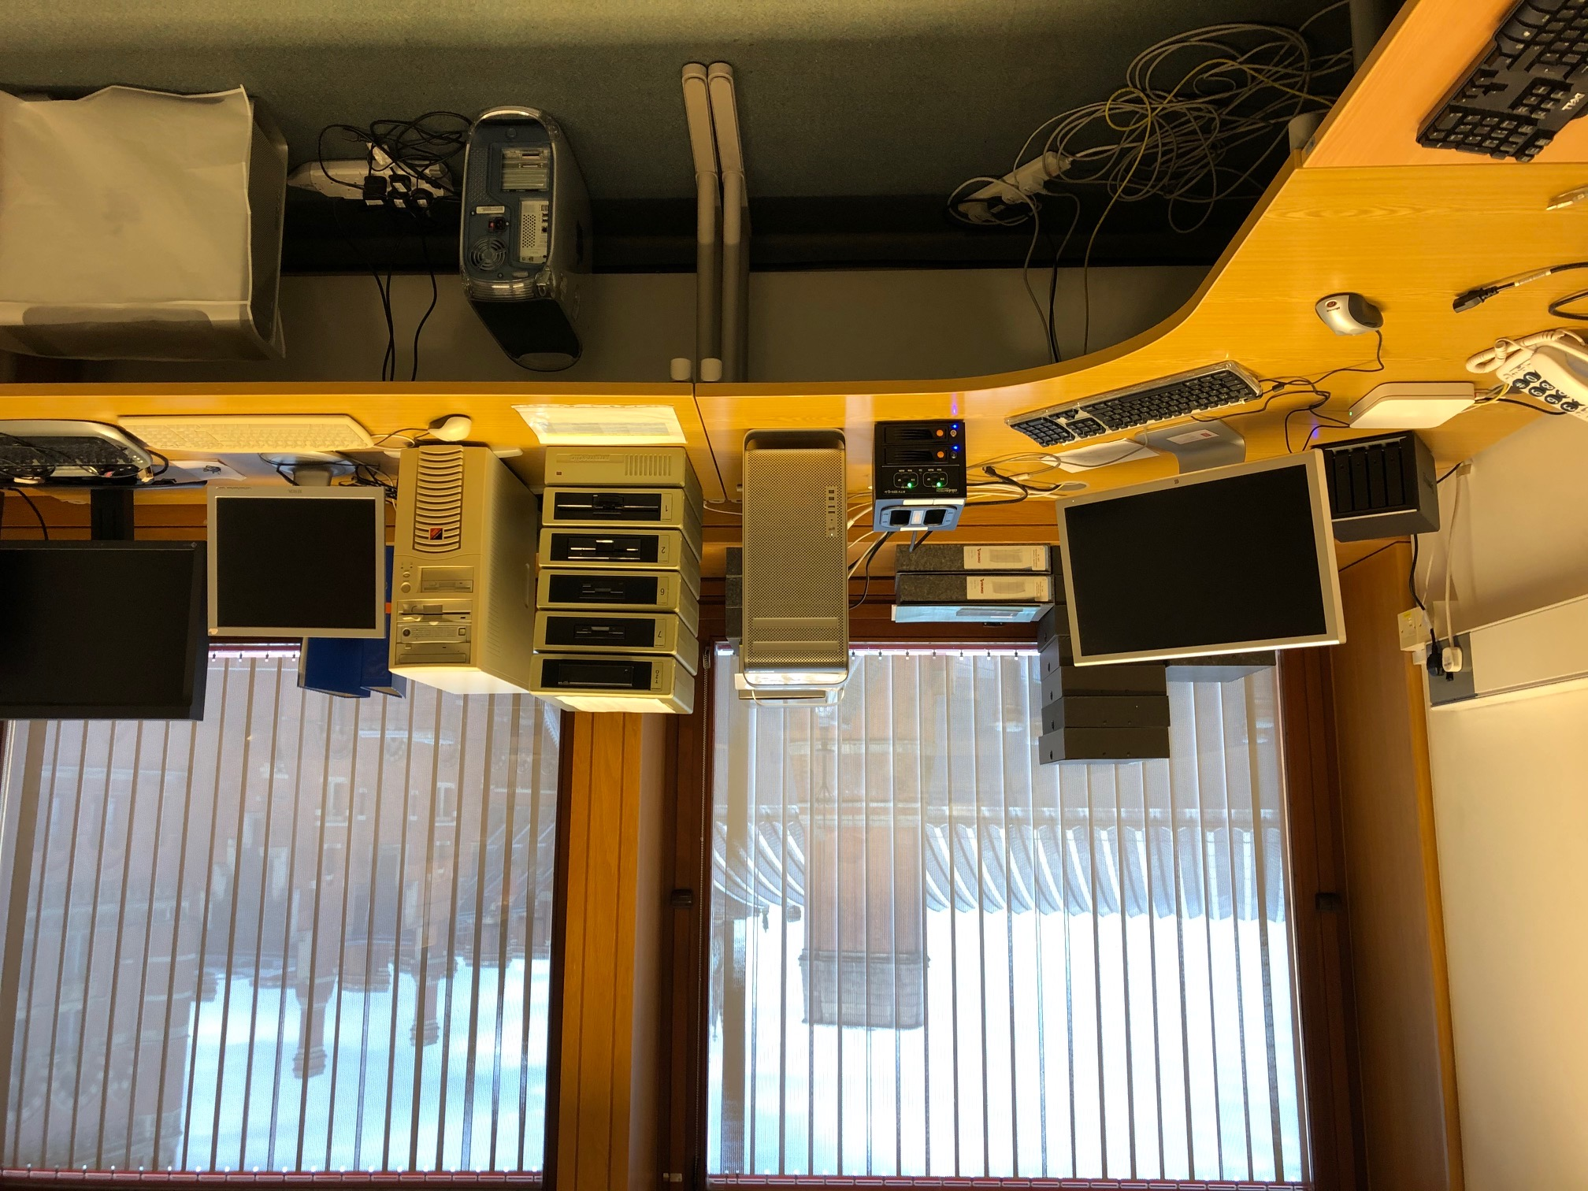
Born Digital Processing at the Library
Notes:
This is where we do most of our processing work. Point out the stack of floppy readers. Explain the concept of a write-blocker and the importance of the Mac Pro with virtual machines.
The idea is to be able to cover as much material as possible – that’s why we have such a variety of machines and readers – and to be able to capture and reproduce it as accurately as possible, which is why we use specialist equipment like write-blockers etc.

Slide 4
Born Digital Processing at the Library
Our workflow aims to preserve and back-up data forensically.
Appraisal works exclusively with ‘Extracted Captures’.
Access to restricted copies is provided via a dedicated terminal in the Manuscripts Reading Room.
Notes:
This means that in an ideal case we first forensically capture a disk – be it a floppy, a HDD or USB – then extract a copy from this capture before beginning archival appraisal or description. This stage of the process (creating a “capture”) ensures that all original data is securely backed up in multiple locations, and available to future digital archivists with possibly more advanced methods for working with raw or .e01 files, allowing data that is perhaps invisible or unpresentable using our current methods to be accessed in the future. In a fast moving technological environment, this seems like the safest approach.
ie. logical drives cloned from an .E01 file. This process is lengthy and aims to bring data in line with the Library’s cataloguing and Data Protection limitations, as well as renaming files in-line with our own ordering system, and converting text documents into PDF/A compliant files to be viewed in the Reading Room, and disposing of files which cannot be represented in this format (from the extracted captures). This is the stage at which an archival arrangement is created.
And this access is highly restricted. Researchers are granted access to text files only in PDF/A format, one file at time, in a way analogous to the way paper material is made available. With digital as well as paper material we think in terms of ‘Deliverable Units’.

Slide 5
  We work with donor’s to select appropriate material and understand their organizational methods (or lack thereof)
Acquisition
Capture/ Extracted Capture
  We forensically image the donor’s disk, place physical media in secure storage and create automatic backups of the forensic images.
  We create ‘Extracted Captures’ and catalogue collections in ways analogous to paper material.
Appraisal
Notes:
So this stage by stage diagram goes over how we move from one part of the process to the other
Go through each stage step by step.

Slide 6
  We generate metadata for each file in the collection and use a Python script to prepare it for upload to our bespoke cataloguing system, IAMS.
Metadata
Migration
  We convert files to PDF/A and re-name them in line with our cataloguing standards for manuscripts, assigning a unique ‘Add MS’ number.
  We upload these files to an FTP server which is accessible through dedicated terminals in the Manuscripts Reading Room.
Access

Slide 7
Sensitivity Review for Born Digital Material
Sensitivity review for Born Digital material takes place in much the same way as for paper material.
With automatically generated metadata (through DROID) and some in-house Python code used for data cleaning and visualisation, we are able to isolate some material deemed likely to be sensitive more easily.
The problem of scale persists, though, and each file must be thoroughly checked before being released to Readers.

Slide 8
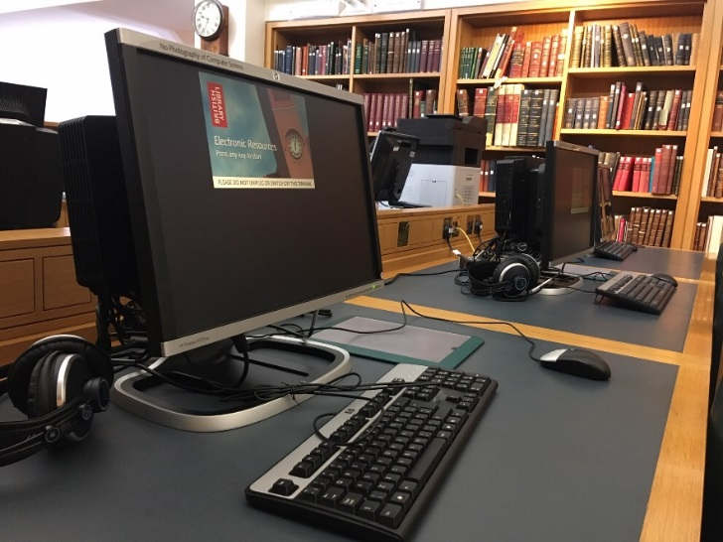
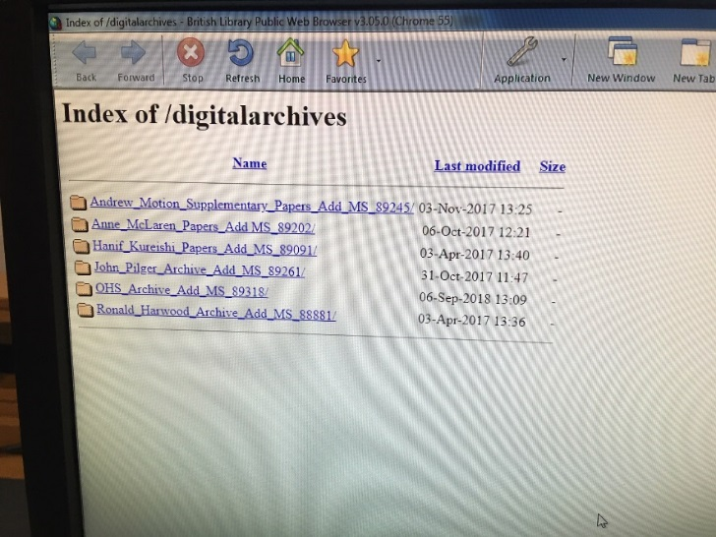
Born Digital Processing at the Library
Notes:
And here you can see what it looks like in the Reading Room and the kinds of access which we’re currently able to provide. Although there are obvious limitations, the system works fairly well (and most importantly it works reliably) for particular kinds of files – literary drafts, pdfs and powerpoint presentations etc. Obviously the system has limitations in dealing with the kinds of scentists archives which Jonathan looks after, but even in the context of literary material which I work with there are limitations.

Slide 9
The Technical Challenges Posed by E-mail
E-mail is a highly distributed service involving several actors that play different roles to accomplish end-to-end mail exchange.
Without universally adopted forms of digital signature verification (ie. DKIM) it is impossible to verify the authenticity of senders.
E-mail is threaded, so therefore not totally amenable to the same logic of ‘deliverable units’ as other materials.
E-mail is increasingly rich – including attachments, images, links, calendars etc.
Notes:
Which brings me to e-mail
In the context of this workflow, e-mail represents a number of challenges:
A forensically water-tight preservation methodology for e-mail would therefore have to record all of the connections made from the sender’s outbox to the receiver’s inbox. These steps, whilst not displayed in most consumer level mail clients, would be preserved through the e-mail Header, but would remain inaccessible and hidden to the donor and our researchers. Our current metadata practice – which struggles already to deal with Born Digital material – would not be able to incorporate this sometimes important information in a metadata field. In some ways it is equivalent to removing post-marks, stamps or envelopes from physical letters.
E-mail is notoriously easy to ‘spoof’ and presents problems in this area for law enforcement too. This presents questions for curatorial practice – how can we financially place value on files, for instance, which could quite easily be ‘spoofed’ in this way, especially as a high-profile institution which might be targeted by scammers. In the case of text files it’s fairly simple to cross-reference and guarantee the authenticity of a single user using Checksums. Luckily, Cope used the provider BT internet which uses DKIM for outgoing mail.
This point is fairly self explanatory but for researchers can present a real headache, when each message must be called up individually, it removes some of the original context for the files.
And all of these components impact upon accessibility and data-quality.
E-mail sits somewhere between the manuscript and the emanuscript, inadequately accounted for in either paradigm.

Slide 10
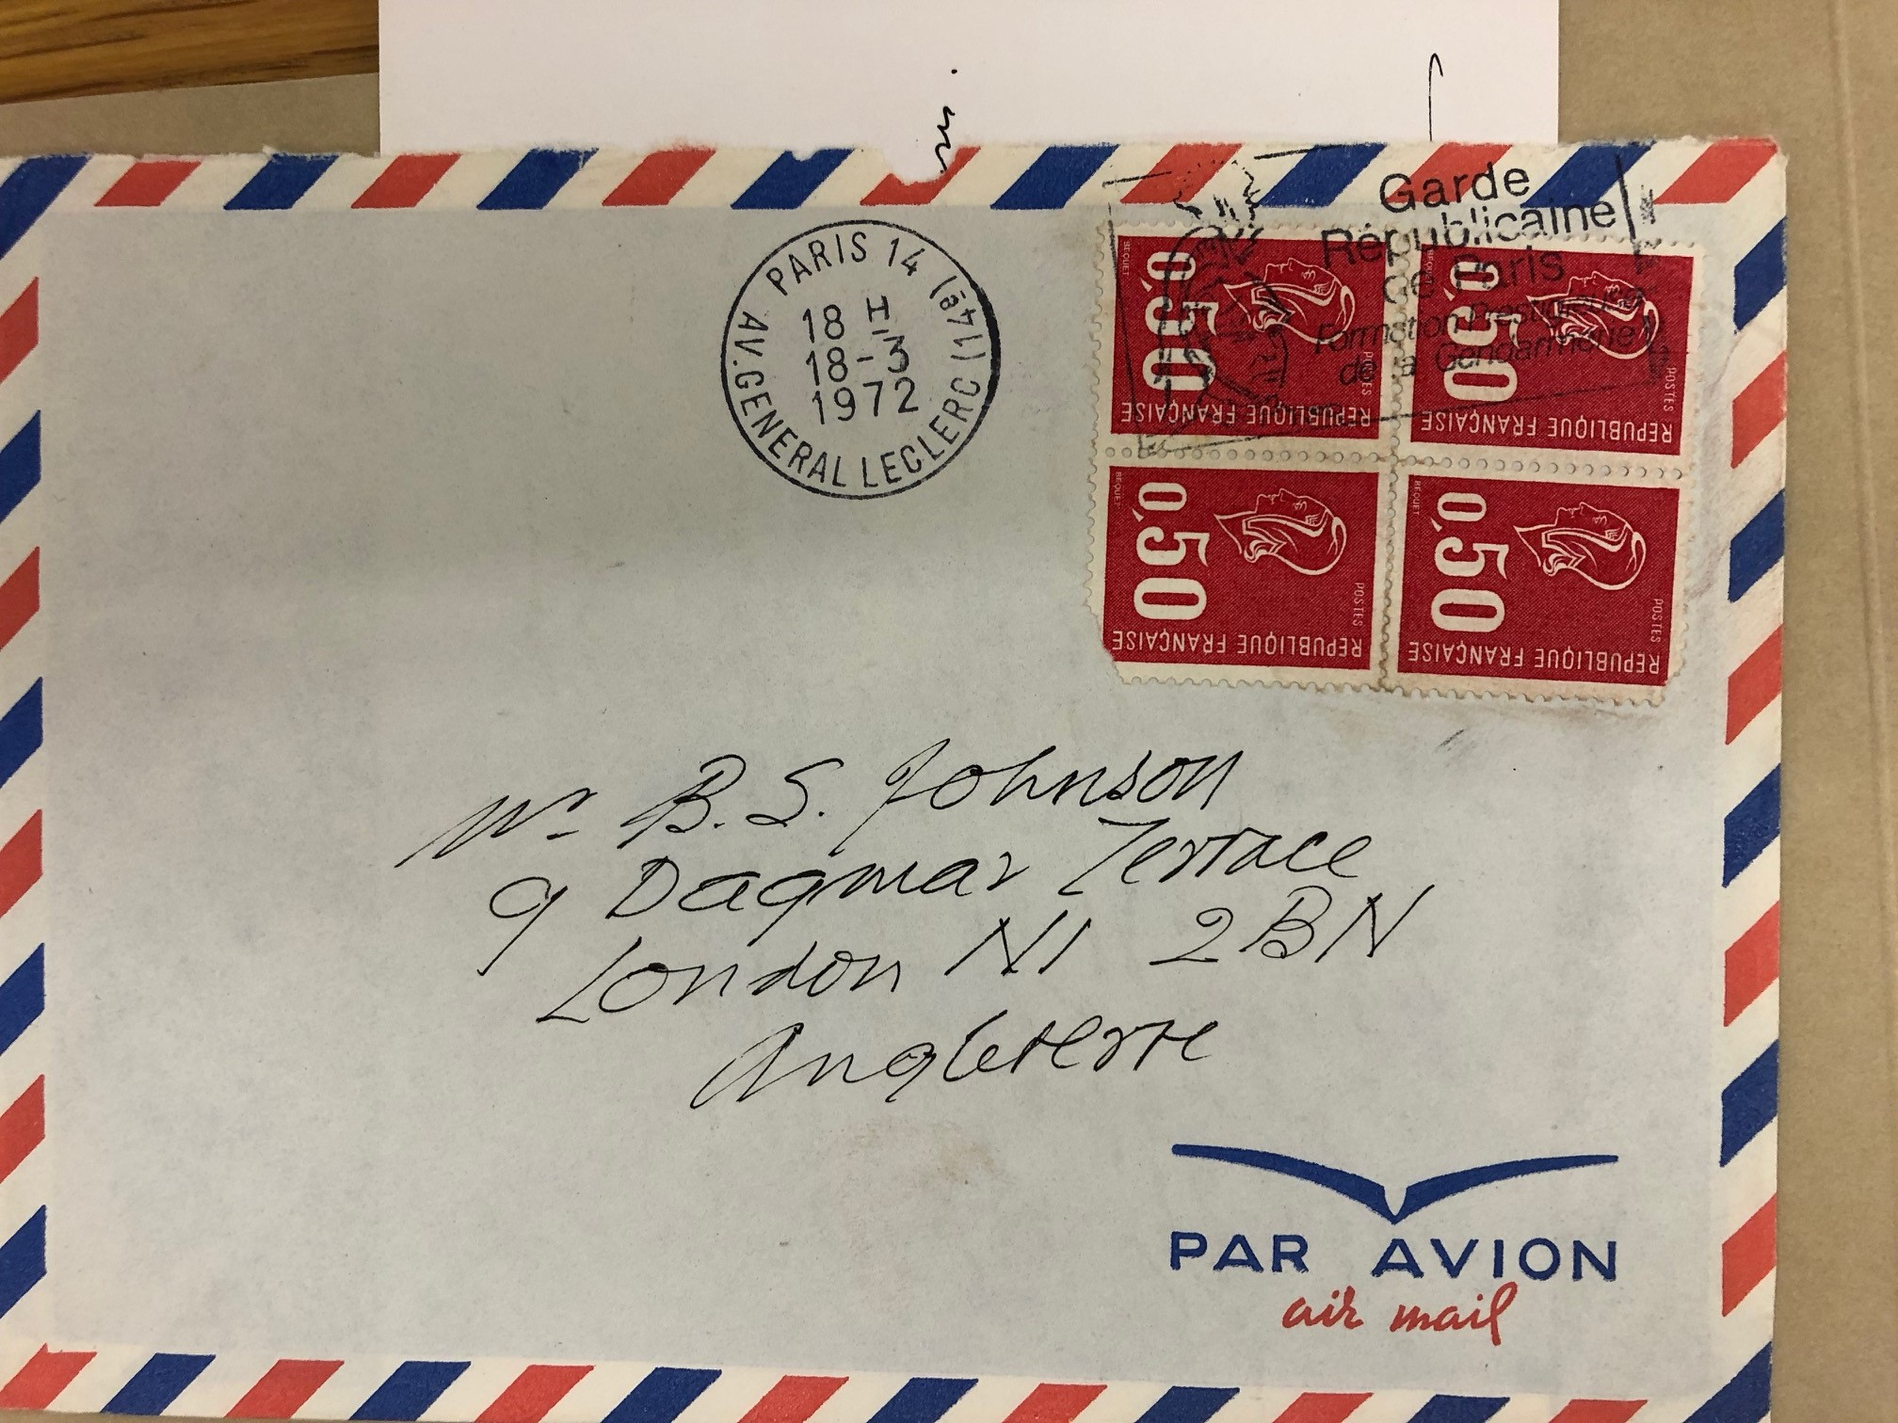
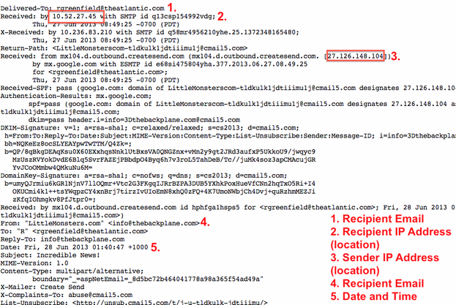
The Manuscript Analogy
Notes:
Although they appear very different, these two sets of metadata are in fact comparable.
In the Beckett/Johnson letters the stamps effectively chart the physical objects movement through space, providing clues – at least to those in the know – about when the letter was sent, which places it moved through, where and when it arrived etc.
The e-mail metadata provides a similar trail; but rather than tracking a physical object through space it tracks a digital object as it moves from server to server, with far more precise measurements of time and space. Also included is information about the software versions used to create the e-mail and security information verifying authenticity. This kind of information might prove useful to historians of the future, either of literature or computing, as well as to law enforcement agencies. This image was taken from an article in the Atlantic which examined the importance of e-mail metadata to the NSA.

Slide 11
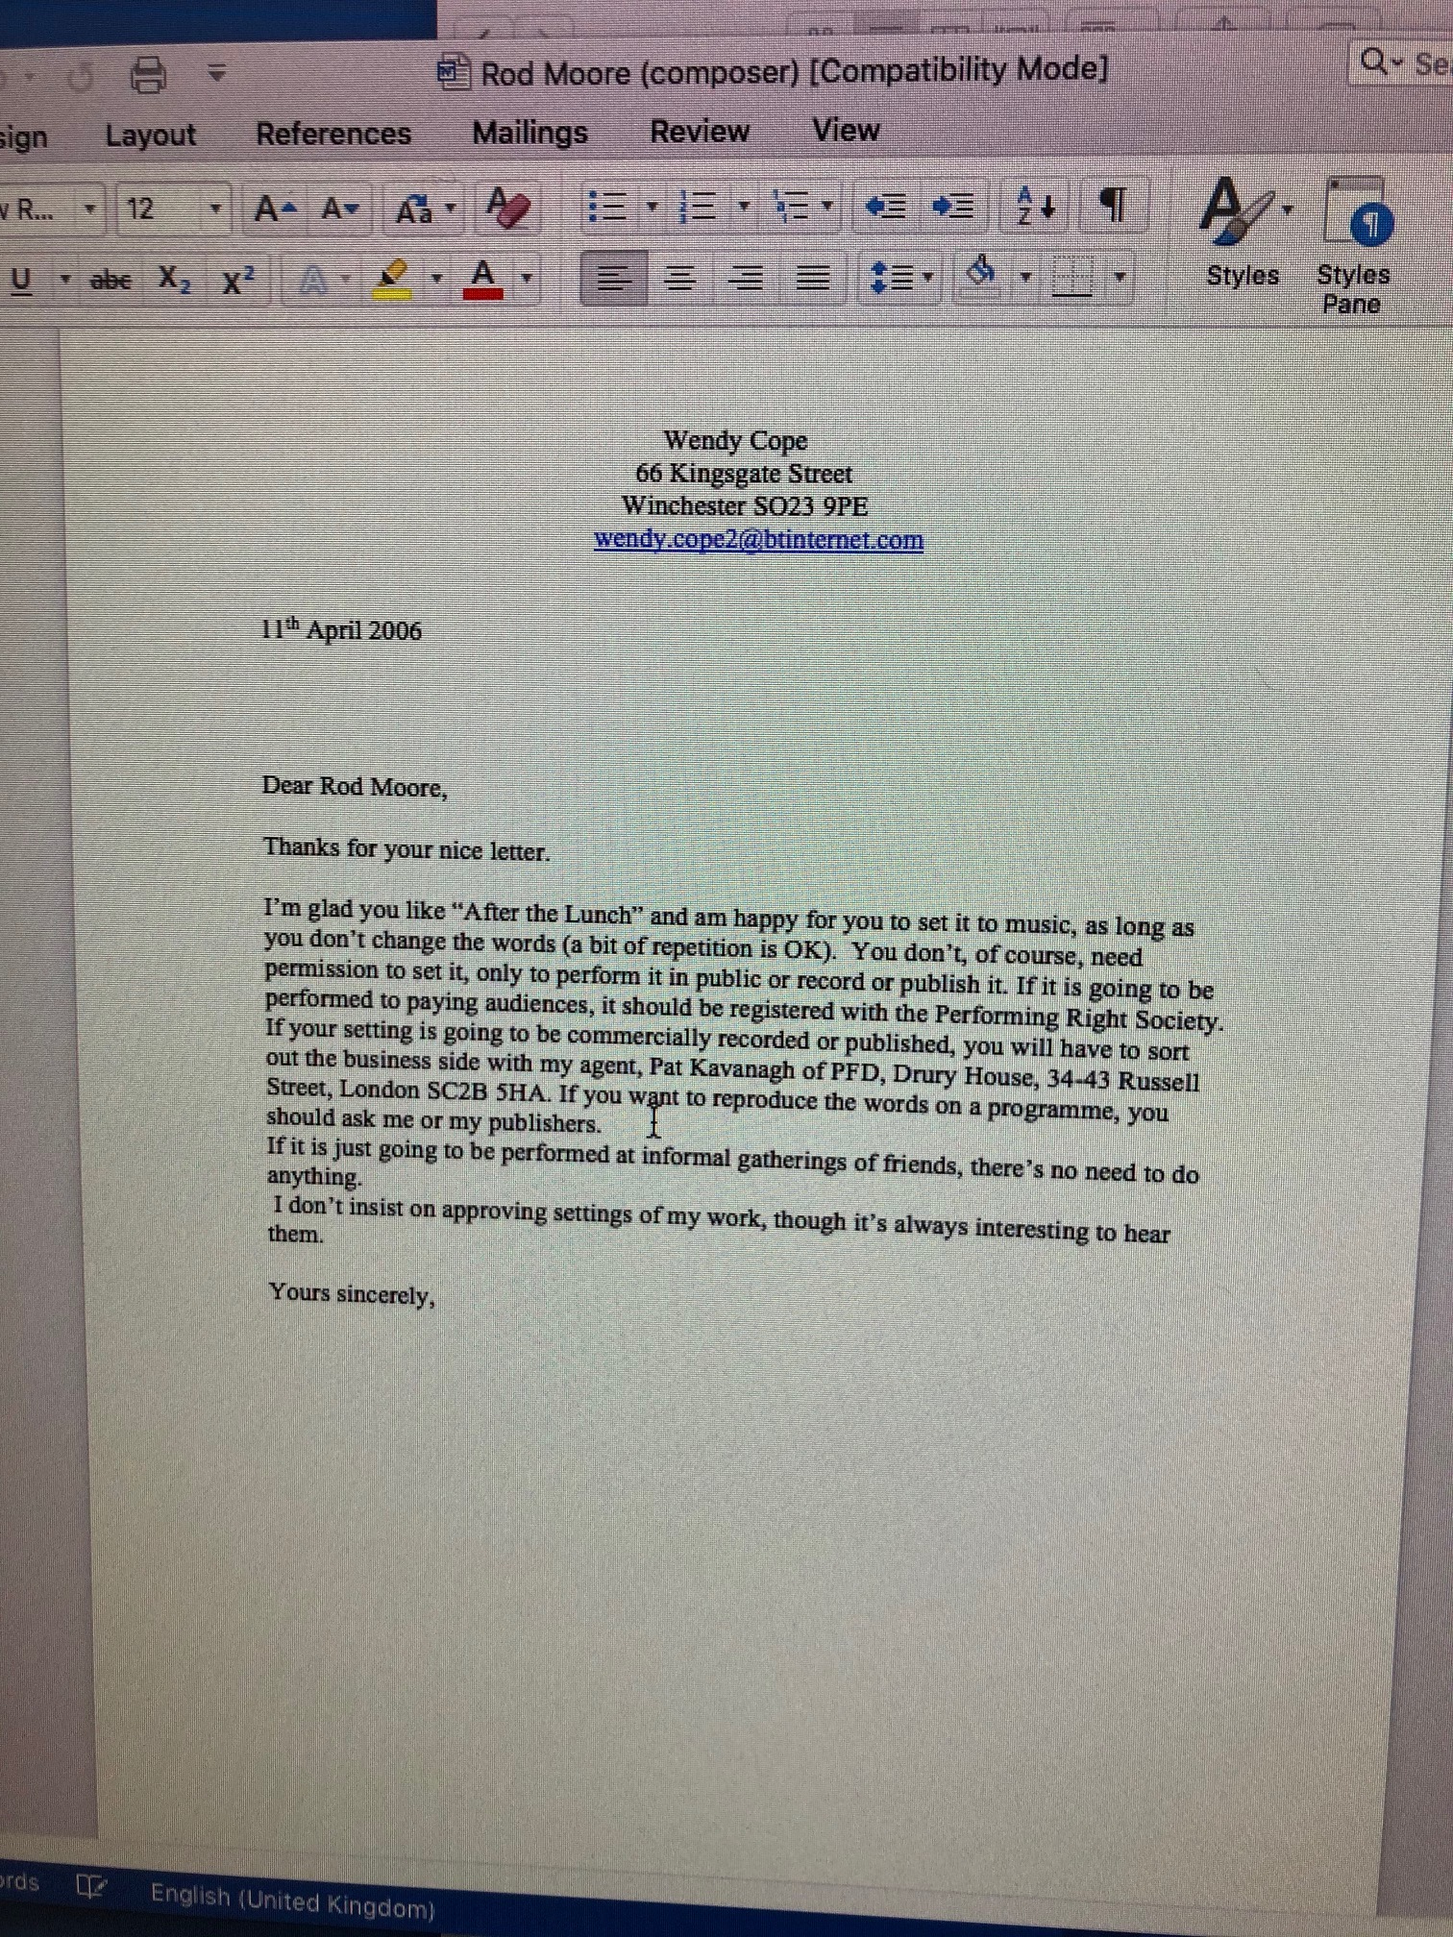
The eManuscript Analogy
Notes:
Here we can see the analogy between an eManuscript and a thread of e-mail messages.
The former is isolated within a window, the latter can only really be understood as a thread.

Slide 12
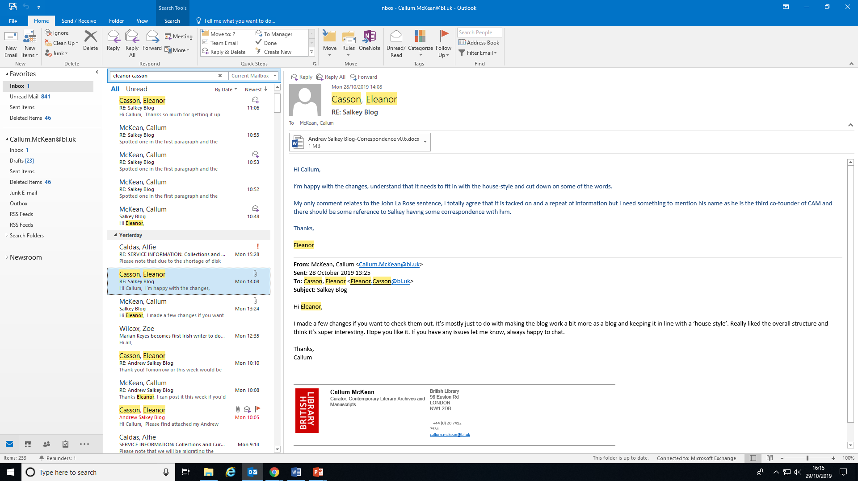
The eManuscript Analogy
Notes:
Here we can see the analogy between an eManuscript and a thread of e-mail messages.
The former is isolated within a window, the latter can only really be understood as a thread.

Slide 13
Processing Wendy Cope’s E-mails
Cope’s e-mails came to the Library as a .PST file stored on a USB Flash Drive.
This drive was captured forensically using FTK Imager and the PST file was converted to an .mbox file using Aid4Mail
The .mbox file was then loaded into ePadd, an application developed at Stanford University intended to guide e-mail archives from ingestion to access.
Notes:
Cope used a web-based client (BT Internet) and a desktop client (Outlook) for e-mail. We asked her to sort through the content she’d like to pass to us and dispose of everything she didn’t want to pass to us. She found this process arduous and tedious, as well as anxiety inducing, because e-mail is so personal and there’s so much of it.
Aid4Mail was scoped as the preferable application for this work because it can rebuild emails, producing a format that is as faithful as possible with the original RFC message. Source metadata like SMTP header fields are recovered, status information and dates restored, and attachments and embedded contents copied back into the email.
Aid4Mail seemed popular with government agencies, intelligence and military organizations, law firms, large corporations and financial institutions, audit firms, as well as consultants and students of computer forensics.

Slide 14
Sensitivity Review for E-mail
The problem of scale is amplified for e-mail and our existing metadata automation tools do not work for collections at ‘message’ level, but rather at the level of the .mbox file.
Almost all e-mail material is sensitive when compared to draft material, which comprises the majority of what we currently make available in the Reading Room.

Slide 15
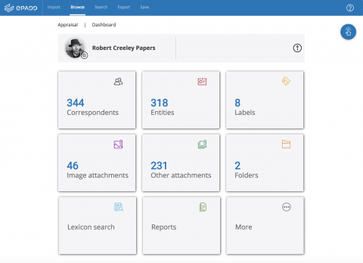
Advantages of ePadd

Slide 16
Advantages of ePadd
ePadd is exceptionally easy to use for non-technical researchers and donors.
ePadd makes possible a universal environment which would save training time for archivists, curators and researchers having to learn and re-learn bespoke systems.
Lexicon search makes making GDPR decisions more efficient (sometimes).
Entity filtering allows us to exclude sensitive correspondents with a single click.
Notes:
The UI retains the threaded browsing of a traditional e-mail client, but increases the power of the search functionality by using ‘lexicon’ searches. It allows for ‘entity’ searching which conflates different e-mail addresses referring to the same person or institution. It allows easy image browsing and customised marking for cataloguers to close material in line with GDPR etc. It also represents a potentially universal environment which would save training time for archivists, curators and researchers having to learn and re-learn bespoke systems.
And in an environment where it’s difficult for institutions like the BL to make large digital collections available at all, this is not a small point. One of the biggest hurdles we face is raising awareness and confidence around digital content both inside and outside of the Library, so anything which streamlines this process in line with a developing international standard must be welcomed.
The trade-off with ePadd’s simple, client-mirroring UI is that technical metadata present in the original .pst and .mbox files is not visible within ePadd.

Slide 17
Limits of ePadd
Technical metadata is not easily accessible in the Reading Room
Lexicon search is still limited.
Lexicon search does not work on attachments.
GDPR decisions are complex and not amenable to the kinds of automation which fall within our current capacity.
Notes:
The trade-off with ePadd’s simple, client-mirroring UI is that technical metadata present in the original .pst and .mbox files is not visible within ePadd. If we take the ‘stamp’ analogy further, we know from our every day interactions with researchers how many of them value the materiality of the envelope and stamp, either as a means of tracking movement of individuals and items, or as an aesthetic experience.
The kinds of search its possible to execute given the limitations of our current computing paradigm mean that there is no foreseeable way of dealing with thousands of intimate messages, especially from writers who have a larger than usual vocabulary and propensity for innuendo -- like Cope – for potentially problematic content. If it takes literary biographers years to uncover the meaning of certain correspondence series, I doubt a computer will be able to do it effectively any time soon.

Slide 18
What is feasible?
Highly curated selections of e-mail archives available selected with the aid of tools like ePadd’s Lexicon and Entity Search.
Metadata available to researchers and messages only made available in an ad-hoc way, on demand, after manual GDPR check.
Machine learning and AI tools to make this process more efficient, but likely never eliminate the labour-intensive human element.

Slide 19

Any Questions?

