Slide 1


Sensitive data in a research context
Zosia Beckles
Research Information Analyst | Library Research Support | University of Bristol

Slide 2
University of Bristol Research Data Service
Advice and support for data management planning, and data collection, storage, and publication
data.bris Research Data Repository for publication of open and access-controlled datasets
Dataset disclosure risk assessment
2014
RDM support and training for academic staff and PGRs
2015
2017
Service launched
data.bris Research Data Repository launched
Open data only
Restricted/Controlled data publication available for sensitive data
bris.ac.uk/staff/researchers/data

Slide 3

Open research mandates
Increased pressure on researchers to share data in order to maximise the benefit of high-quality research, facilitate innovation and safeguard good practice:
  Funding bodies
  Institutions
  Journals
  Disciplines

Slide 4
Research data sharing risks
Sharing any research data must include consideration of risks, harms and impact of disclosure. Sensitive research data brings additional issues:
harm to research participants
harm to institution/funding body
impact on future research
risks for researchers
risks for repositories

Slide 5
Sources of disclosure risk
Direct and indirect identifiers
Data environment
Data linkage

Slide 6
Managing risk in sensitive data release
Policies
Guidelines for data management, sharing, and security
Processes
Workflows to ensure safe, transparent and auditable data release
Tools
Software and infrastructure to support data sharing processes

Slide 7
Policies
Research data management and open data policy
  Data ownership
  Researcher responsibilities in data management & sharing
  Institutional responsibilities for services and infrastructure to support this
http://www.bristol.ac.uk/research/environment/governance/research-data-policy/
Information security policies
  Researcher responsibilities and standards required in data security, including information governance, encryption and third party compliance
  Institutional responsibilities for services and infrastructure to support this
http://www.bristol.ac.uk/infosec/policies/docs/
Data protection policy
  Expected standards for researchers processing personal data collected for research purposes
  Participant fair processing notices
  Legal basis and exemptions for processing of personal data for research purposes
http://www.bristol.ac.uk/secretary/data-protection/policy/

Slide 8
Processes
Data publication workflow
Sensitive data assessment workflow
Data request workflow

Slide 9
Data publication workflow
Dataset publication request received by Research Data Service
Does dataset contain information on human participants?
Yes
No
Standard dataset pre-publication checks
Extended dataset pre-publication checks
Contact depositor to request amendments
Is dataset ready for publication?
No
Yes
Publish dataset

Slide 10

Sensitive data assessment workflow
Standard pre-publication checks
Dataset complies with data preparation rules
Dataset contents match file inventory
File functionality (for large datasets, checks may be carried out on a sample only)
Third party data licensed appropriately
Correct/appropriate metadata in deposit record
Additional checks for datasets containing sensitive data:
Consent form and patient information sheet included in dataset, if applicable
Dataset access level is appropriate to contents and, if applicable, matches terms of consent
Assessment of dataset key variables and data environment for additional disclosive information
Checks for direct identifiers
For quantitative datasets, assessment of disclosure risk via statistical measures

Slide 11
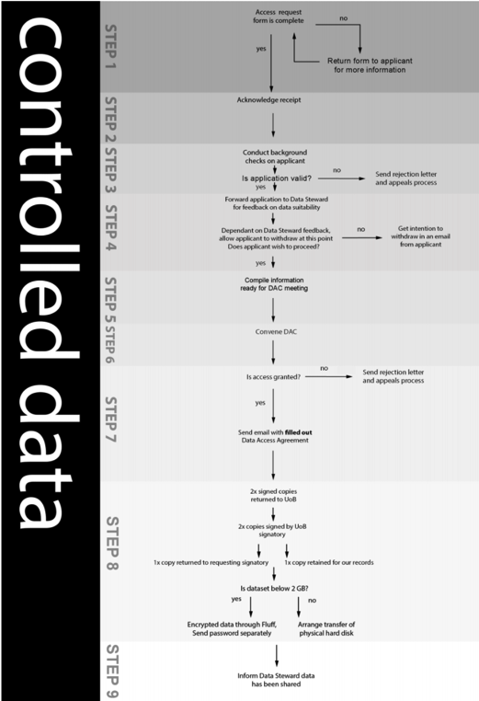
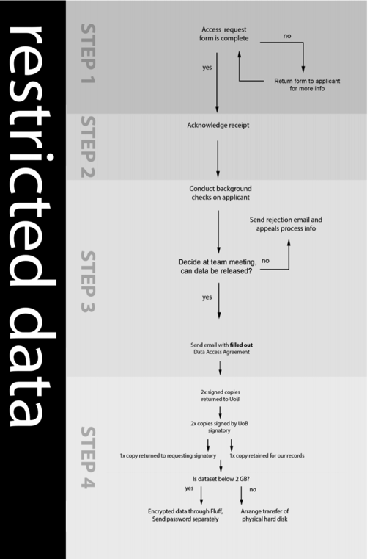
Data request workflows
Request received
Acknowledge receipt
Validate request form (evidence of institutional affiliation, institutional signatory, ethical approval, funding/sponsorship)
Data Steward assessment of proposed data use
Convene Data Access Committee (for controlled data requests only)
Notify applicant of decision
Signed Data Access Agreement received
Data Steward informed
Data released

Slide 12
Tools
sdcMicro
QAMyData
Case management system

Slide 13
Selecting tools for active management
Selection criteria (from Software Sustainability Institute Software Evaluation Guide):
  Usability
  Sustainability and maintainability
  Task-specific criteria
https://software.ac.uk/sites/default/files/SSI-SoftwareEvaluationCriteria.pdf

Slide 14
Roadblocks
Training
Staff
Researchers
Staff time
Variable service demand
Establish service limits
Software
Establish requirements
Installation, maintenance and interoperability issues
Cross-institutional support
Legal
Research office
IT Services
Academic community

Slide 15

Future developments
Workflow automation
Researcher training
Outreach activities

