Slide 1
The problem of sensitive data in digital records from a humanitarian aid organization
Montserrat Canela Garayoa,
Chief of the Records and Archives Section,
United Nations High Commissioner for Refuges

Slide 2
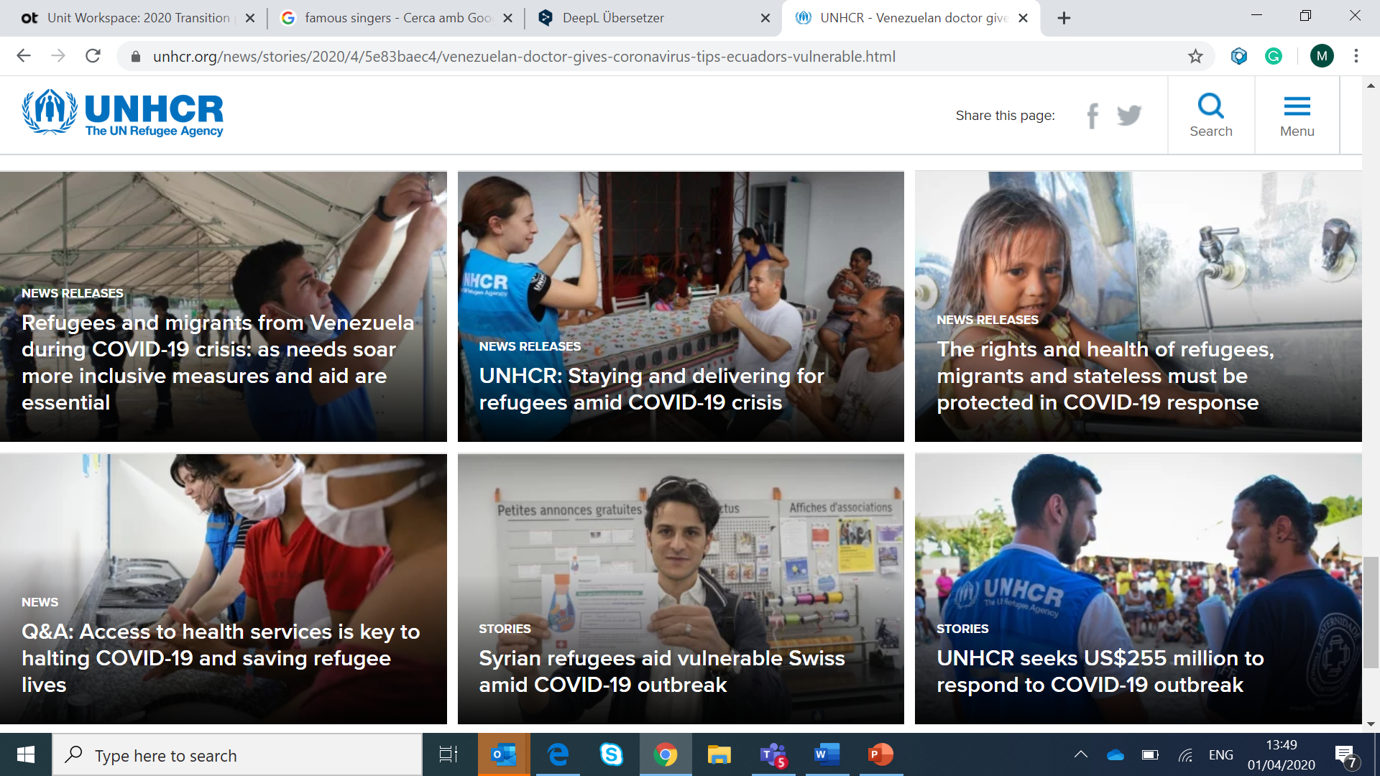

Slide 3
Refugees
Asylum seekers
Stateless
Internally Displaced People
Returnees

Slide 4
The fundamental question is always
Why?

Slide 5
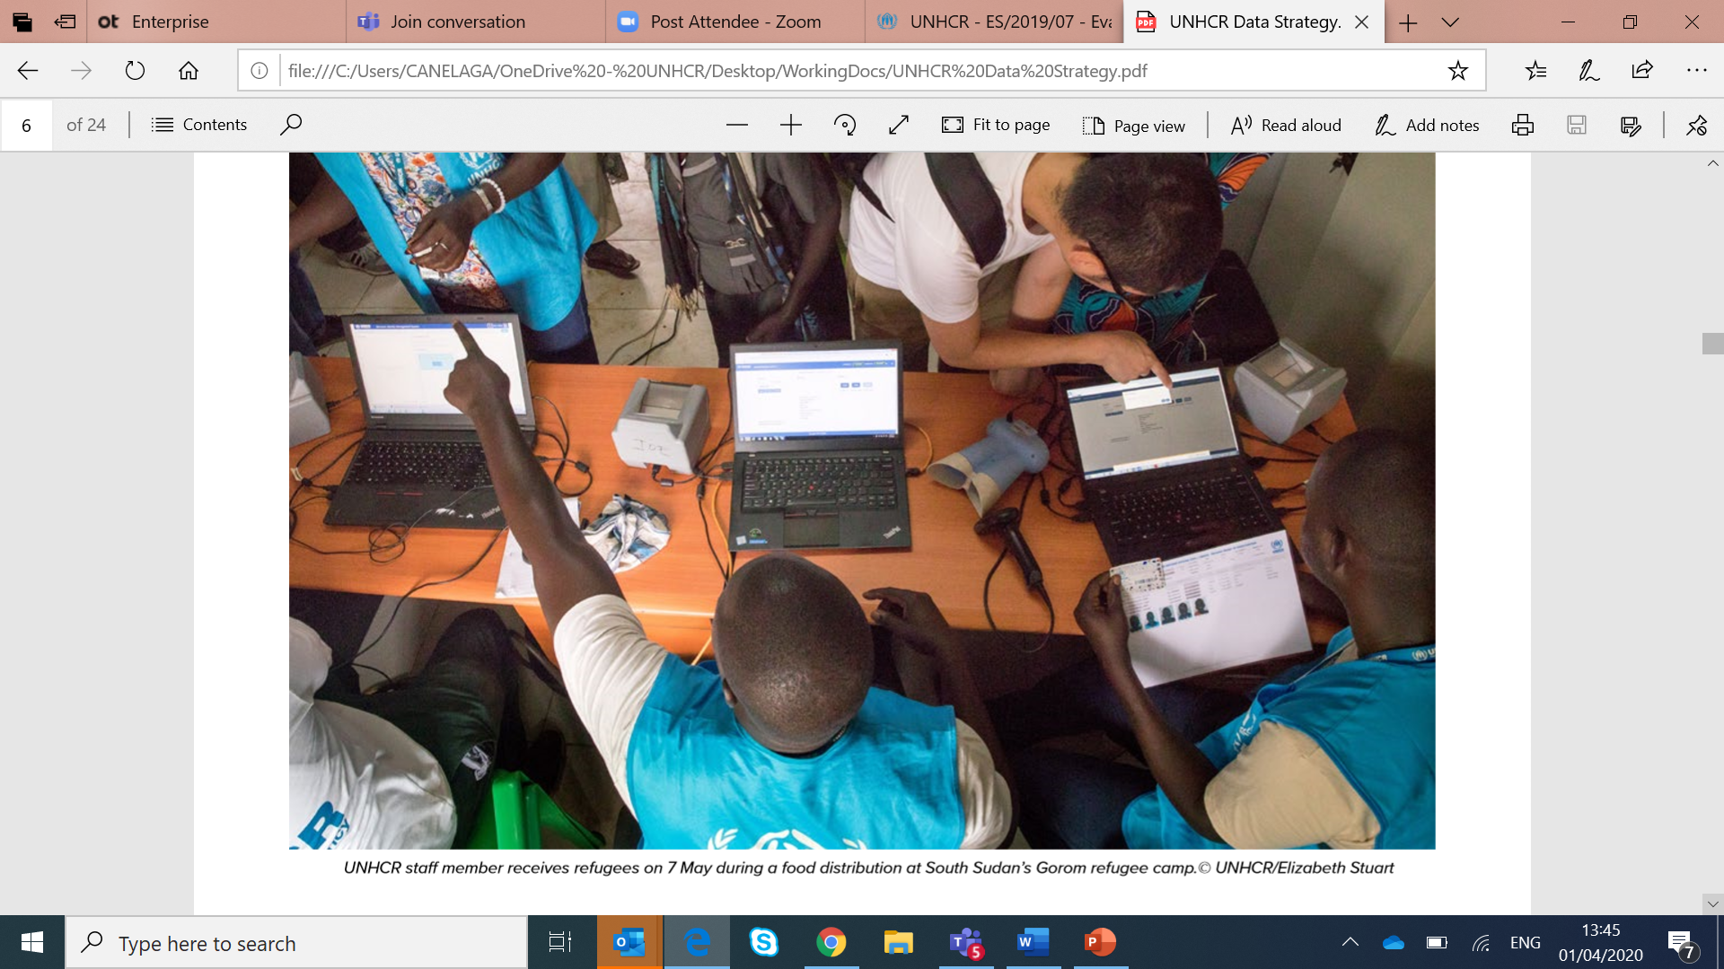

Slide 6
Data
People

Slide 7
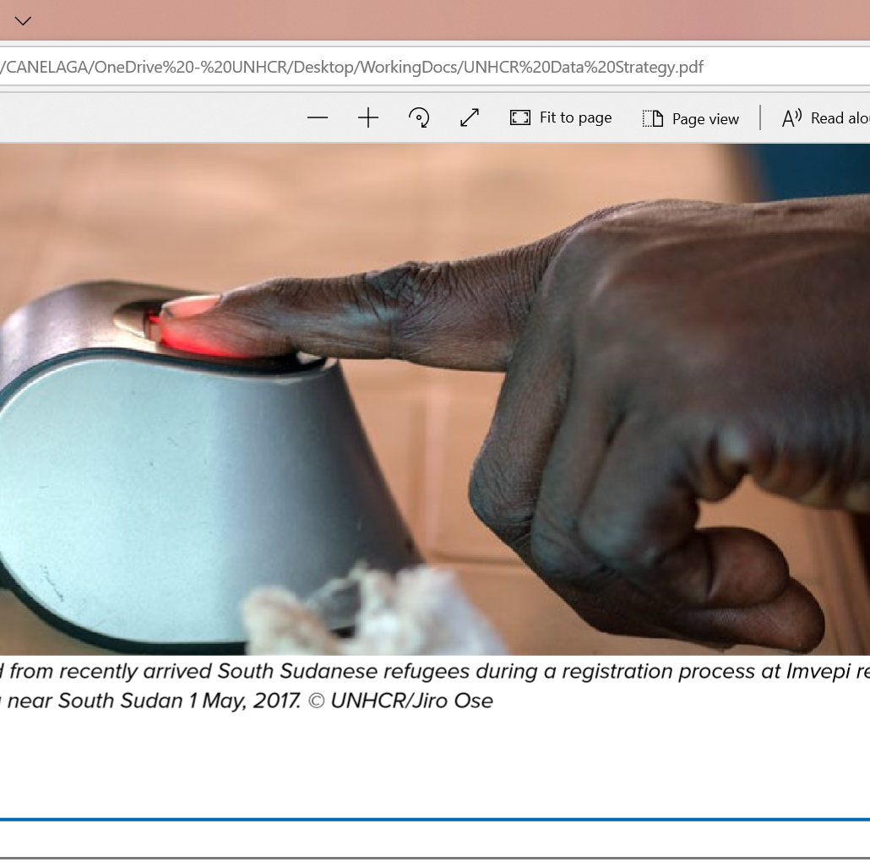
Registration
The first protection action
Identity data
Biographical data

Slide 8
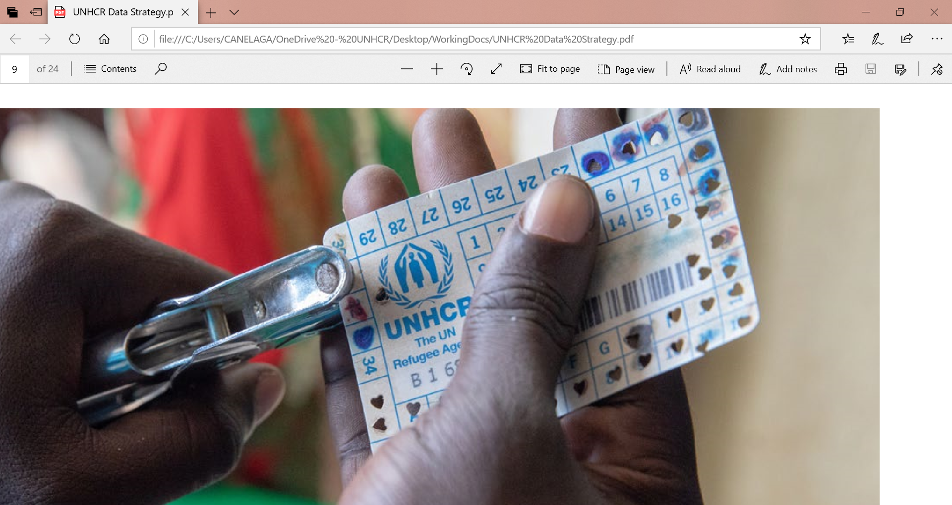
Individual protection and access to aid

Slide 9
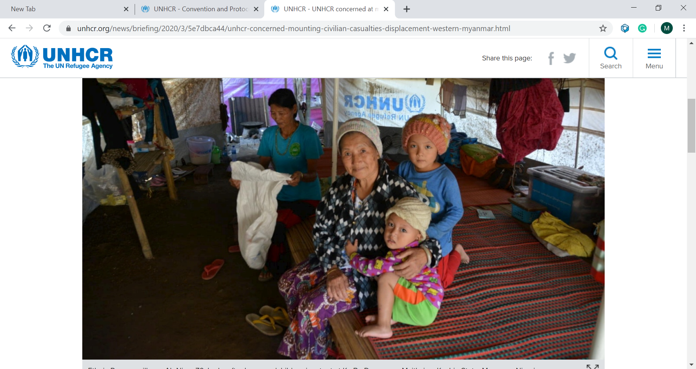
How many?

Slide 10
Data for planning
How many tends? How many rations? How many hospitals? How many schools? How many latrines? How many showers? How many food rations?

Slide 11
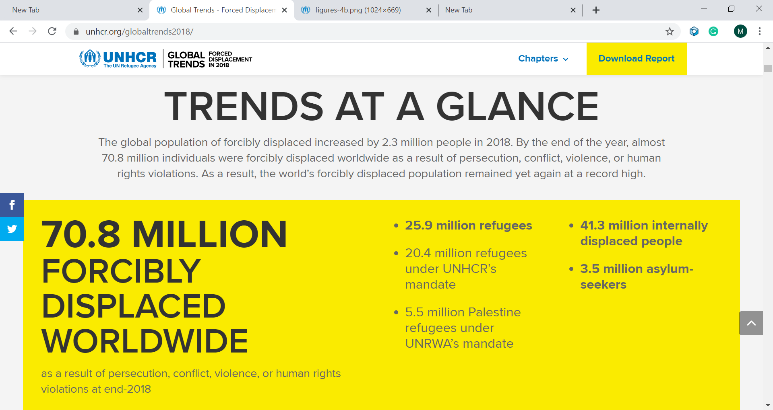

Slide 12
Data for
Advocacy
Fundraising
Reporting

Slide 13
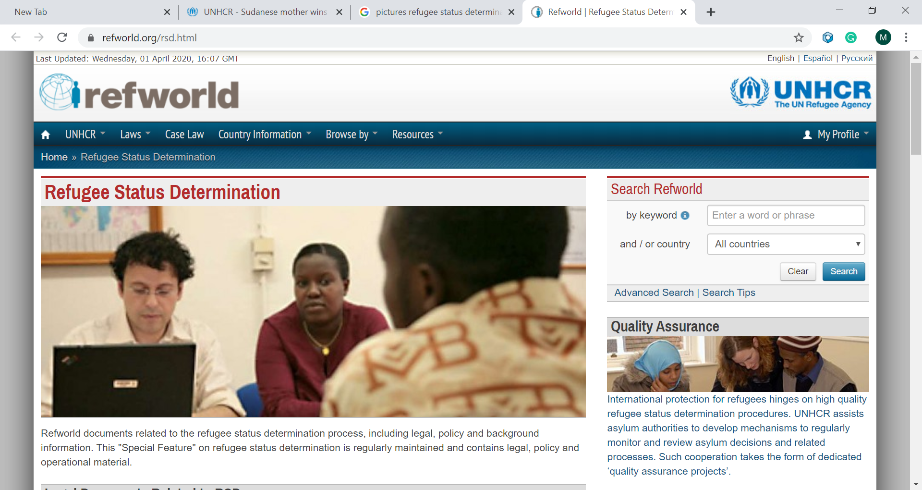
Data for individual protection

Slide 14
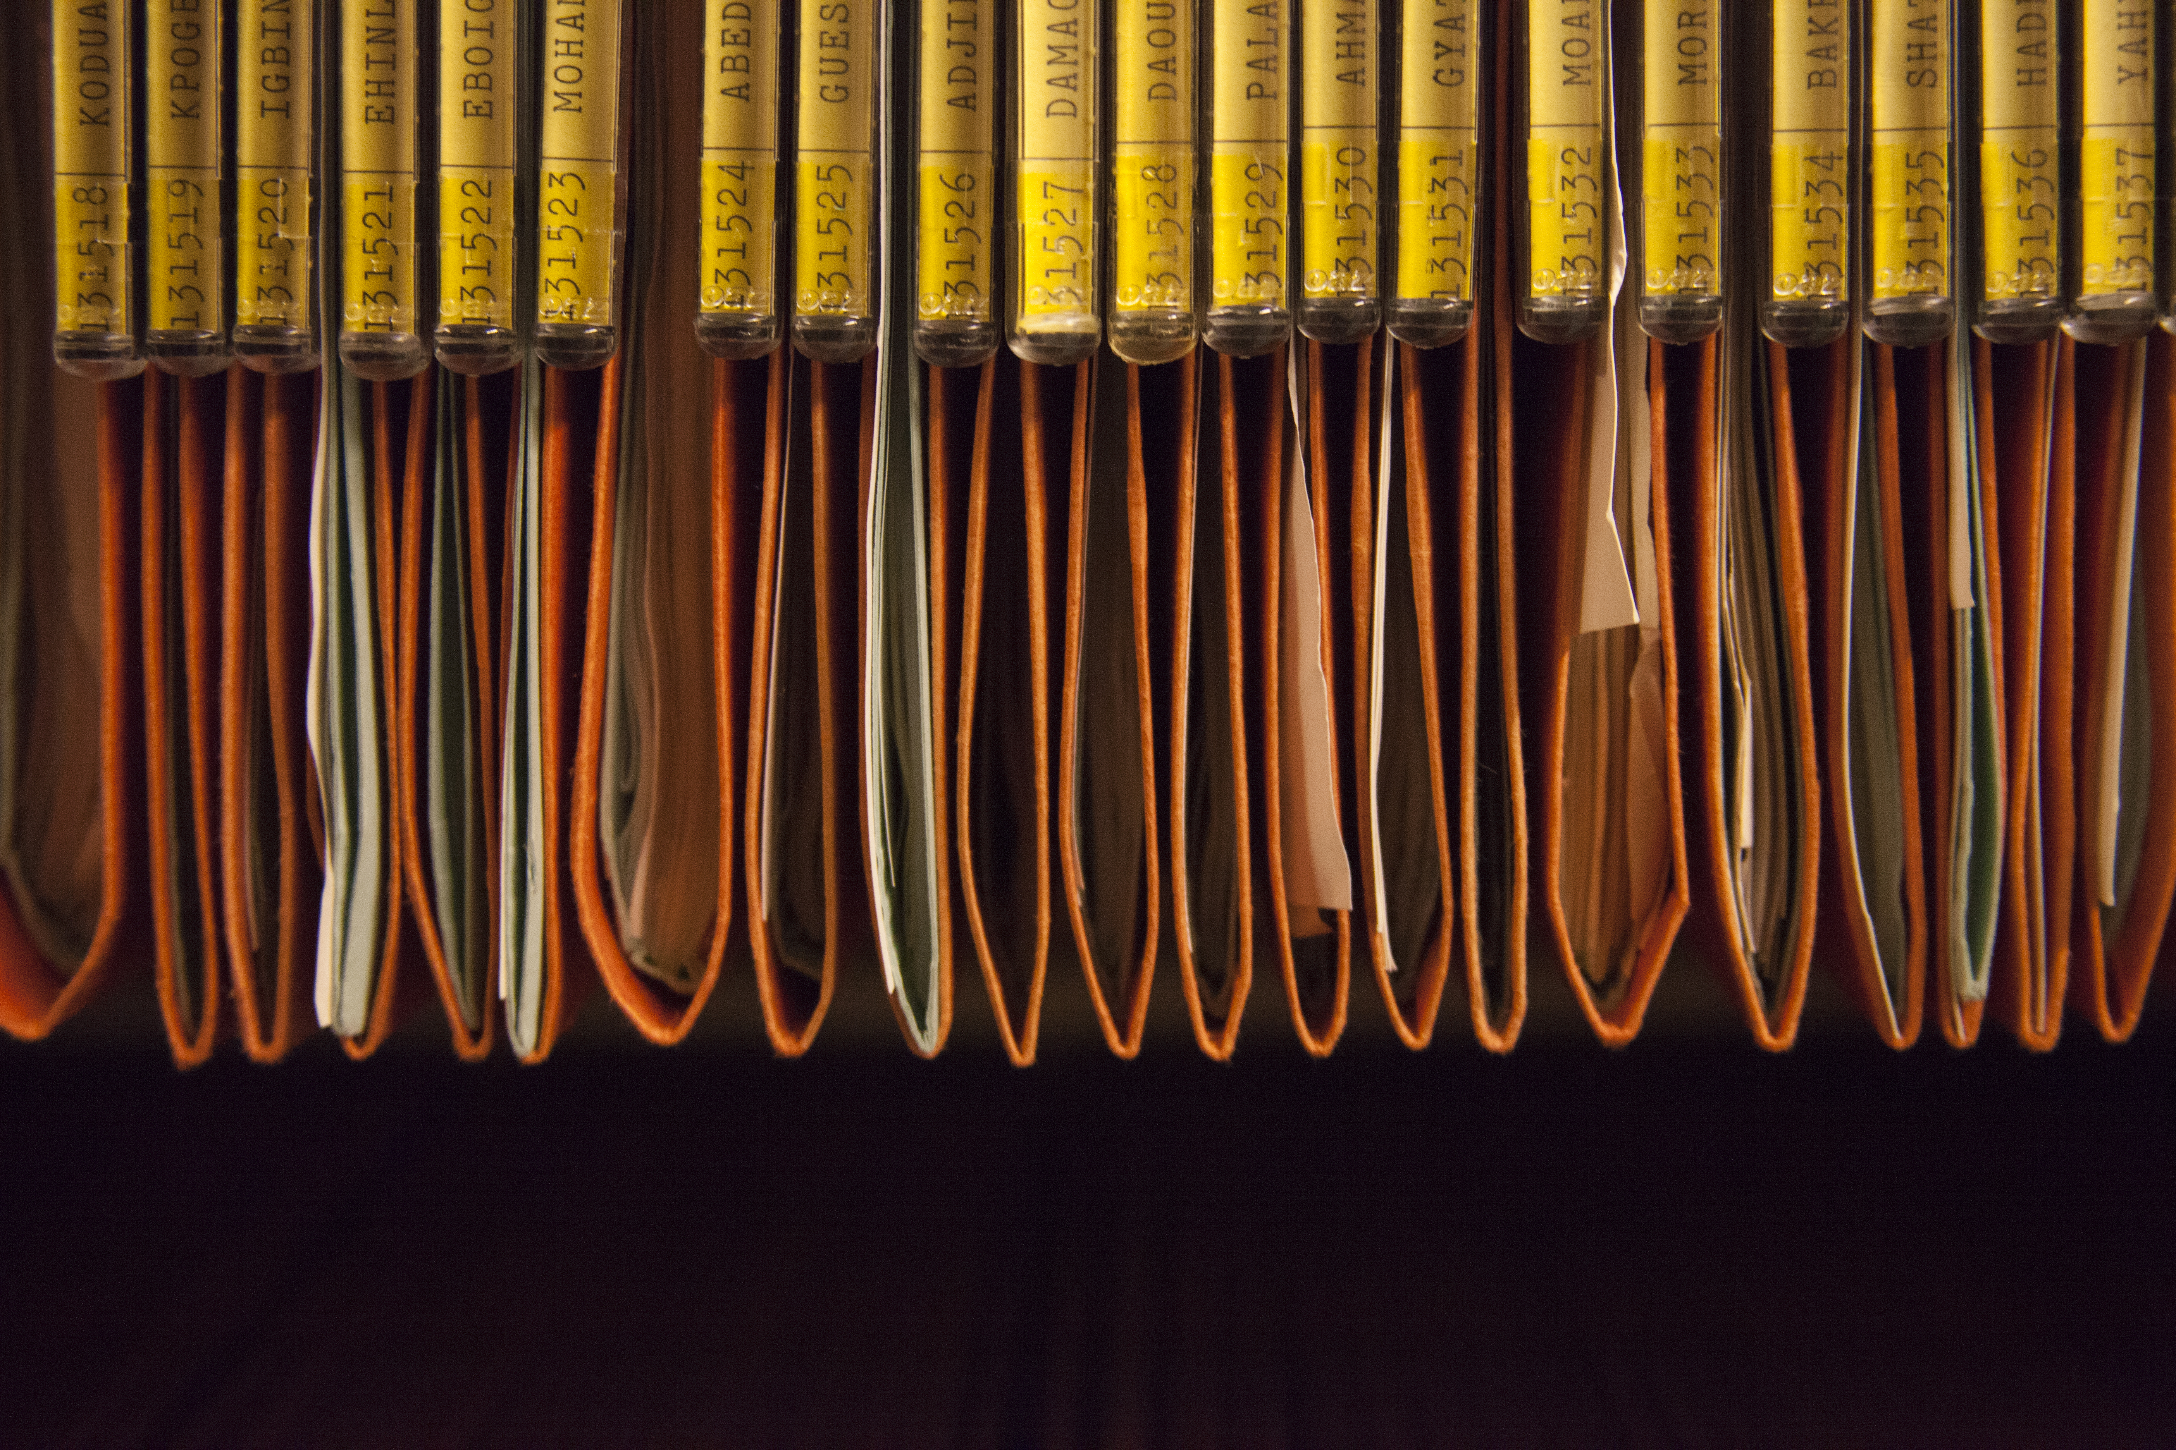
Refugee Individual Case Files

Slide 15
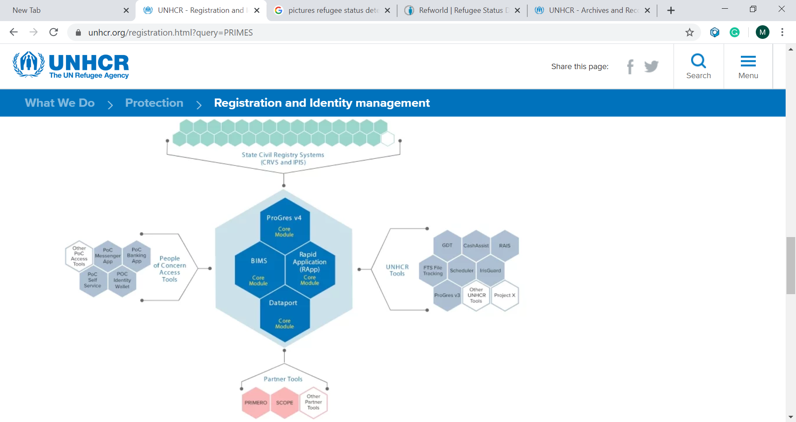

Slide 16
Why?

Slide 17
What?

Slide 18
How?

Slide 19
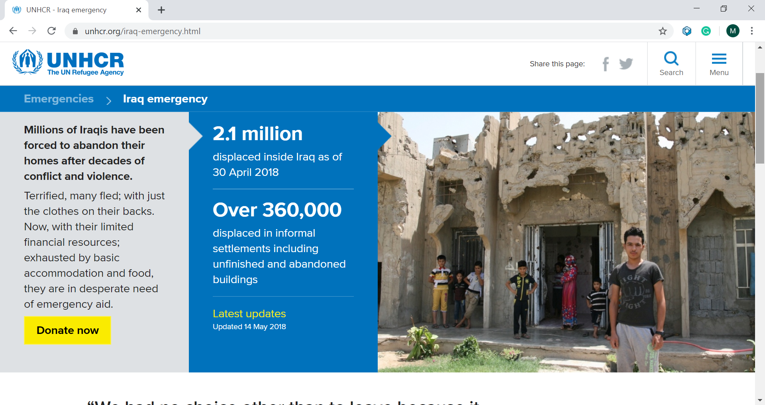
Unstructured information

Slide 20
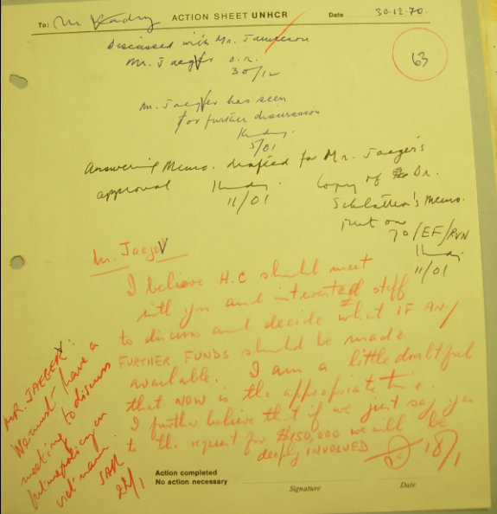
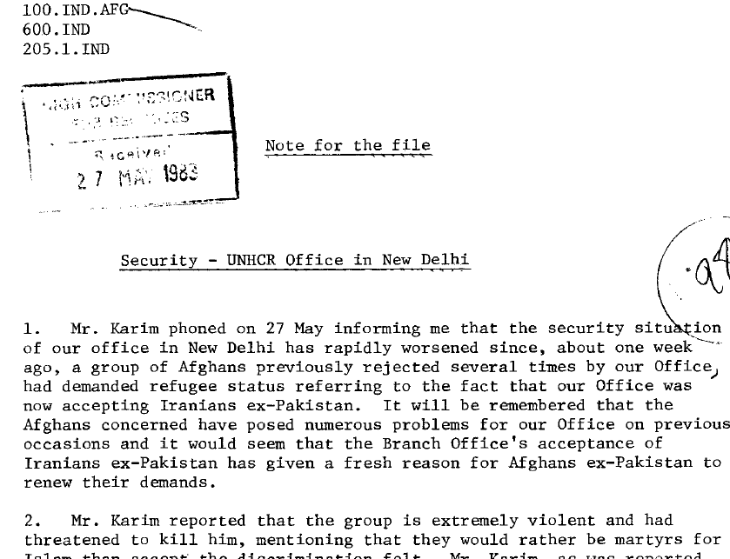
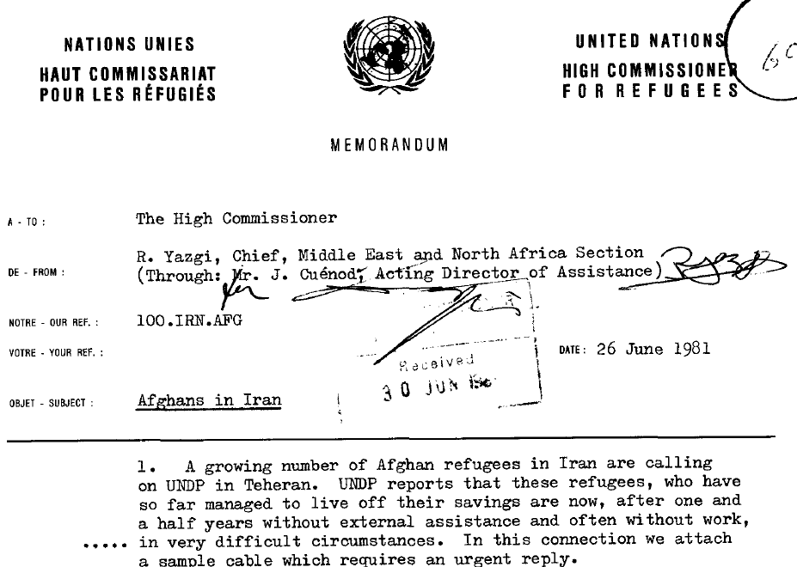
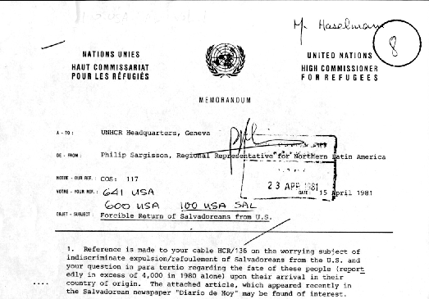
If these documents held in the UNHCR Archives were written today they would be …

Slide 21
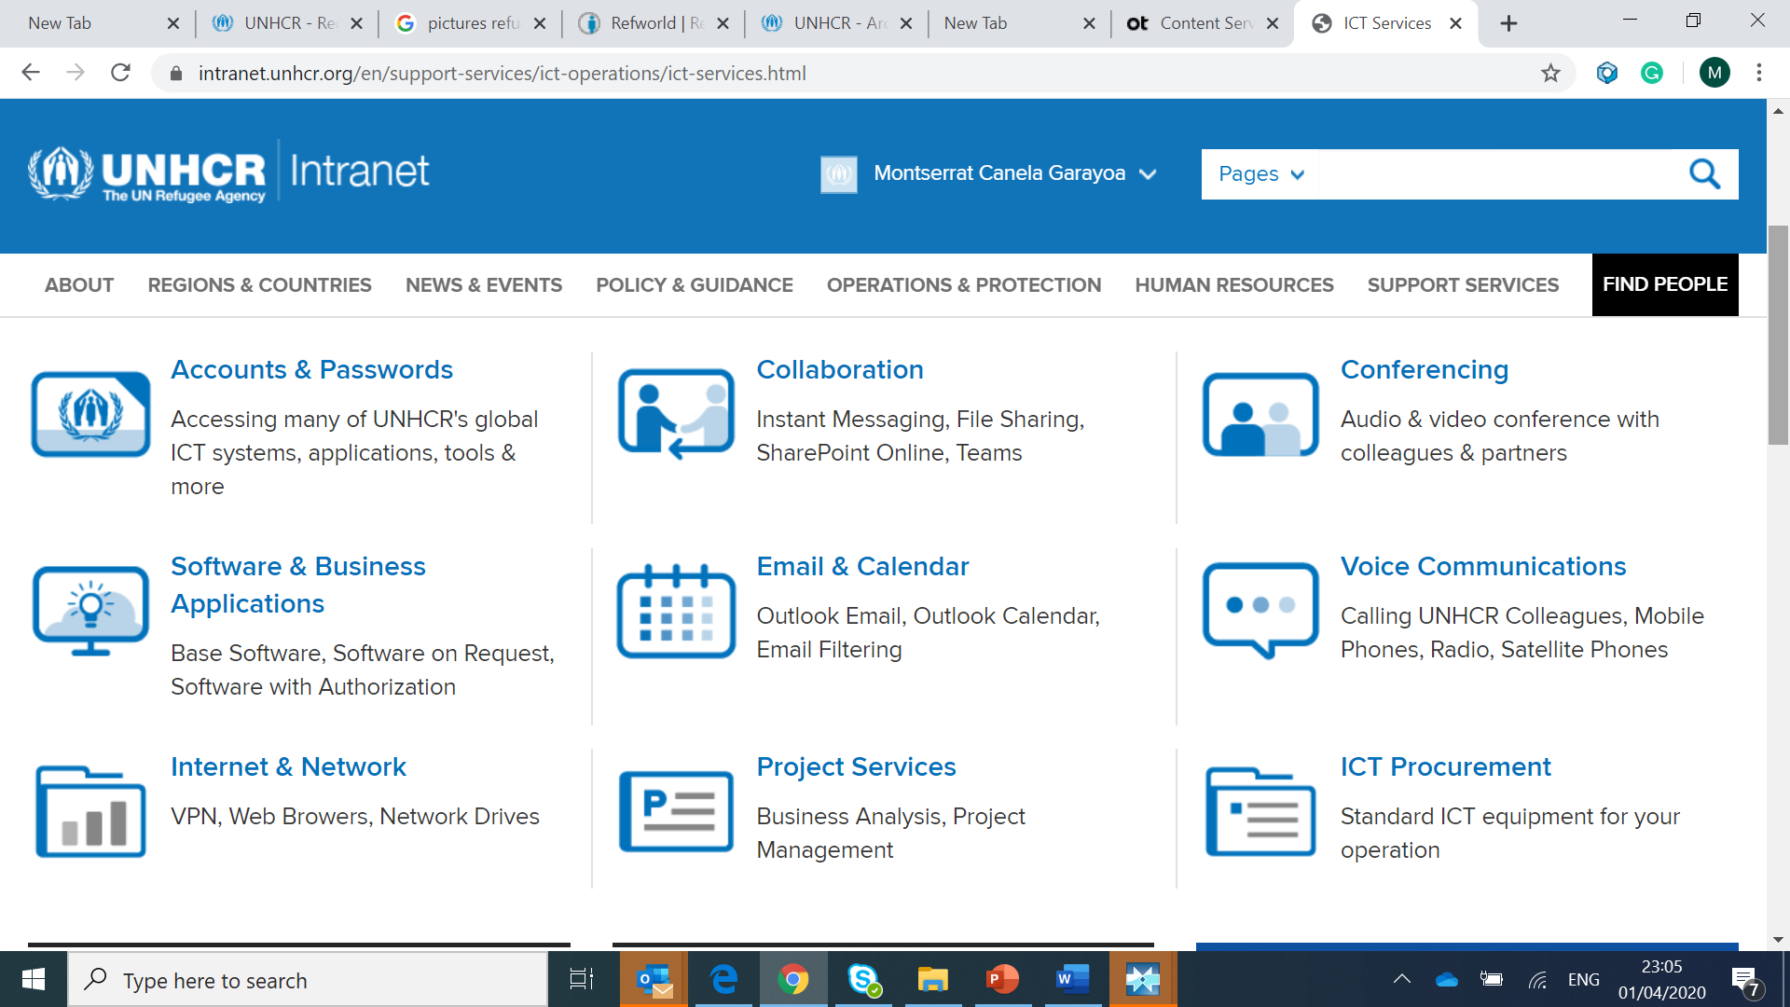

Slide 22
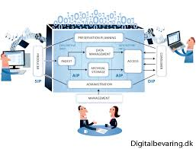
Access

Slide 23
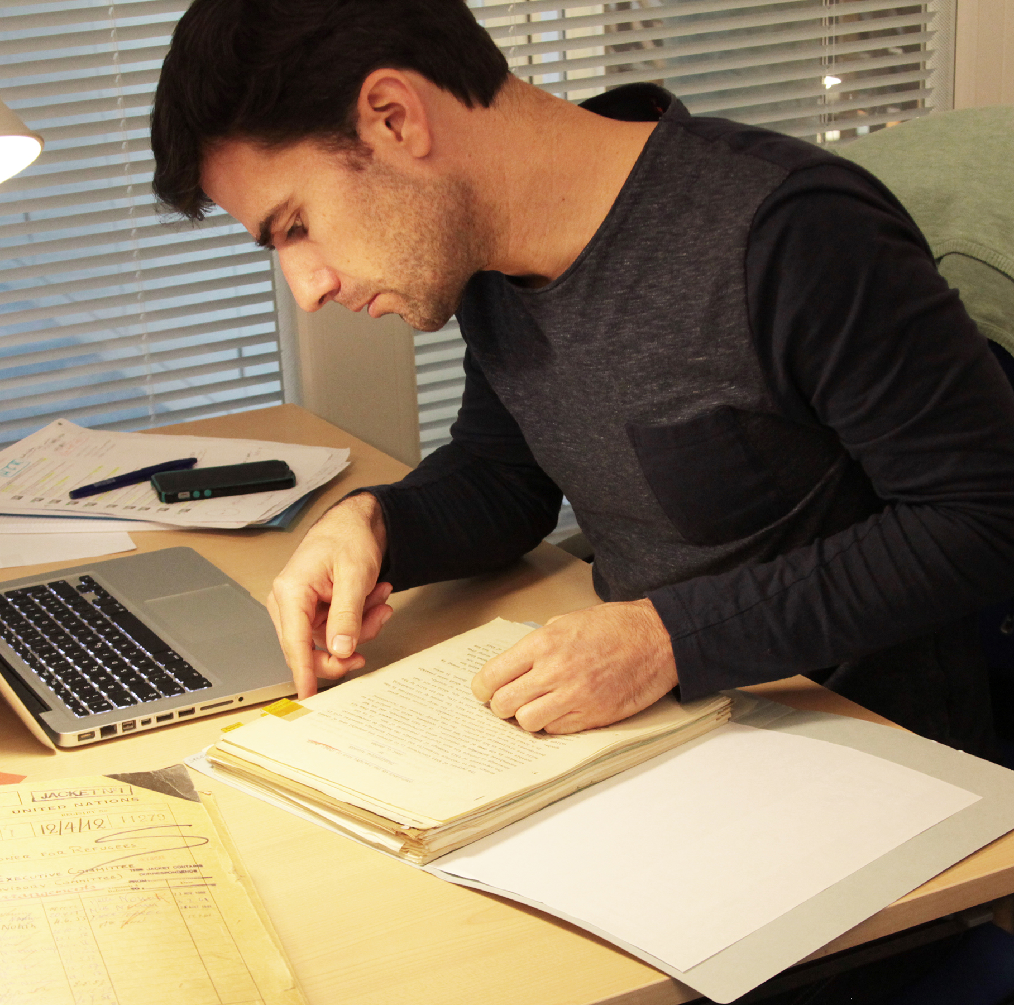
Paper archives process
Revision
Redaction
Documenting
Filing

Slide 24
Principles
Balance
Transparency
Equal access

Slide 25
Policy
Personal Data Protection
Classification Policy
Archives Access Policy

Slide 26
Context

Slide 27
How to reproduce the same results in digital born archives?

Slide 28
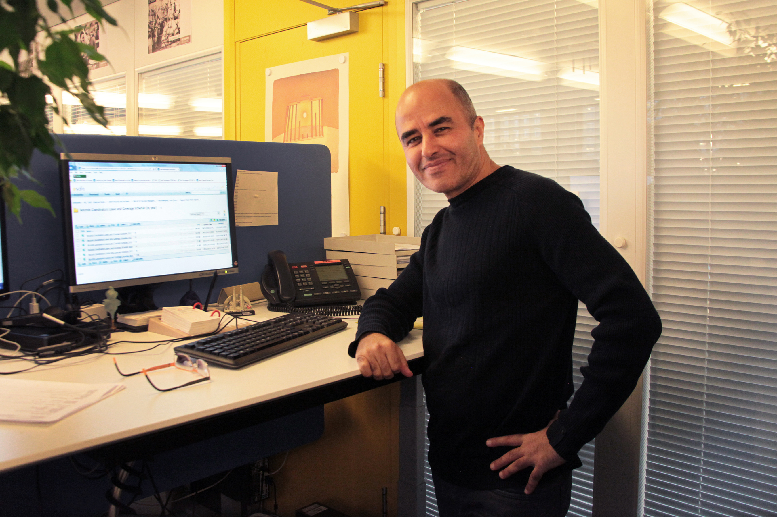

Slide 29
SIP classification
- Open
- To review
- Confidential

Slide 30
2- Assisted revision upon access request
-

Slide 31
Facilitate reading process
Friendly display of text
Identify conversation threats
Versions
Tools to flag confidential documents

Slide 32
Support analysis process
Identify personal data in documents
Assist to identify sensitive documents

Slide 33
Implementation
Document
Redact
File
Manage

Slide 34
Why?
UNHCR preserves sensitive information because it contains the voices of those suffering the history

