Slide 1





Managing
at PRONI

Slide 2




Slide 3
Background
Public records
PRONI holds public records mainly dating from around the formation of Northern Ireland (1921) to the present day. A small number date back to the 19th and late 18th centuries. ‘Public record’ generally refers to any document created by ‘official’ sources such as:
government departments
non-departmental public organisations
(courts of law, local authorities, non-departmental public bodies/quangos)
Privately deposited archives
These include business records and church registers and can range from a single emigrant letter to a vast landed estate archive containing thousands of items and spanning a 300 year period.

Slide 4
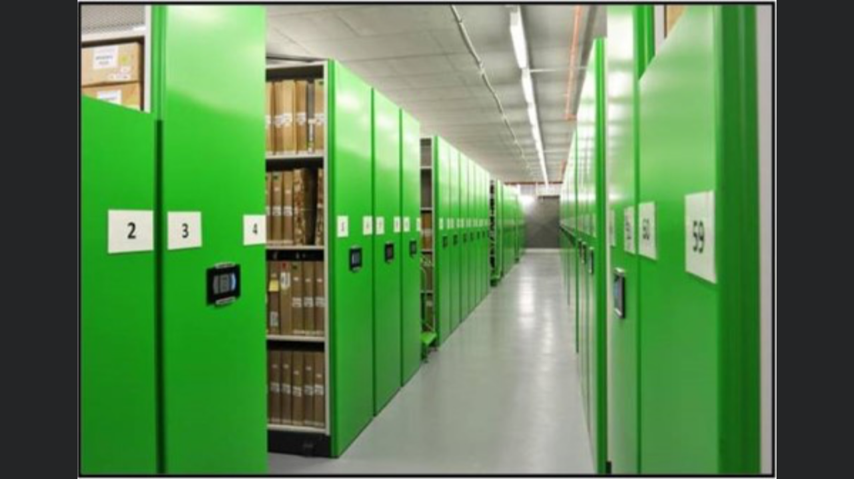

Slide 5
PRONI Annual release of files
This process involves the referral of the files to the Responsible Authority for sensitivity review. This entails a page by page examination to make sure that a record contains nothing sensitive as defined by the Freedom of Information Act (FOI), General Data Protection Regulation (GDPR) and the Data Protection Act (DP).

Slide 6
PRONI Annual release of files

Slide 8
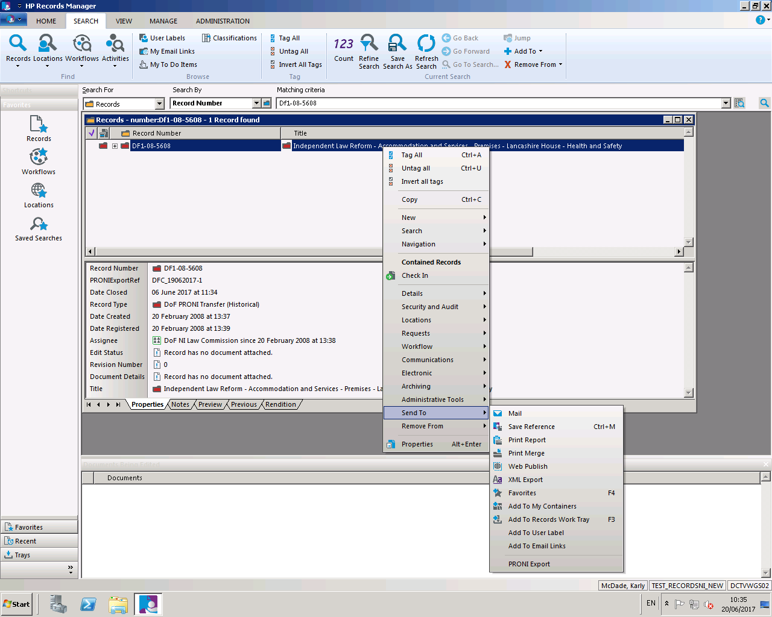
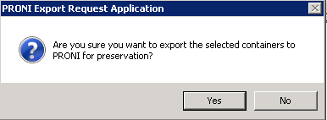
Source - HPRM

Slide 9

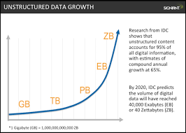
Big issue
Average yearly estimates
Paper files – 1,122
EDRM folders – 14,300+

Slide 10
Issues
Users require read/write access – this means they can write!
Password protected files
No pre-transfer analysis
Active Directory groups and permissions
IL3+

Slide 11


DigitalPreservation@communities-ni.gov.uk
028 9053 4834

