Slide 1

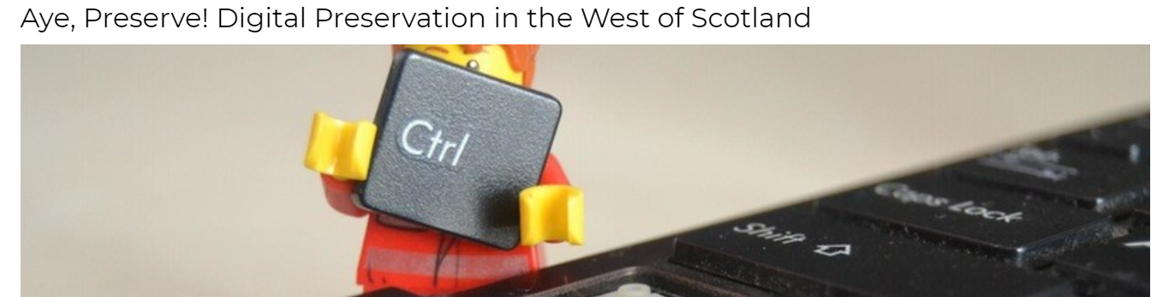

Welcome
#ayepreserve

Slide 2
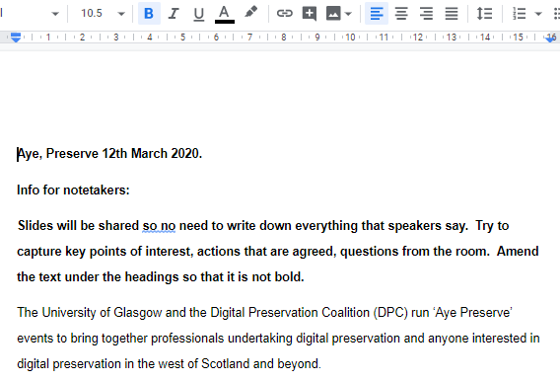
Housekeeping
Fire alarm
Toilets
Photos
Tweet #ayepreserve
Notes
Facilitators
Wifi
#ayepreserve

Slide 3
Agenda
09.30 Registration
10.00 Welcome
10.30 Update from the University of Glasgow
10.10 Digital Preservation Overview and Developments from DPC
10.50 Update from Falkirk Community Trust by Paul Choi
11.10 Update from HarperCollins by Dawn Sinclair
11.30 Questions & Issues
11.40 Open Session: Discussion and Brainstorm Activity
11.55 Conclusions
12.00 Lunch
#ayepreserve

Slide 4

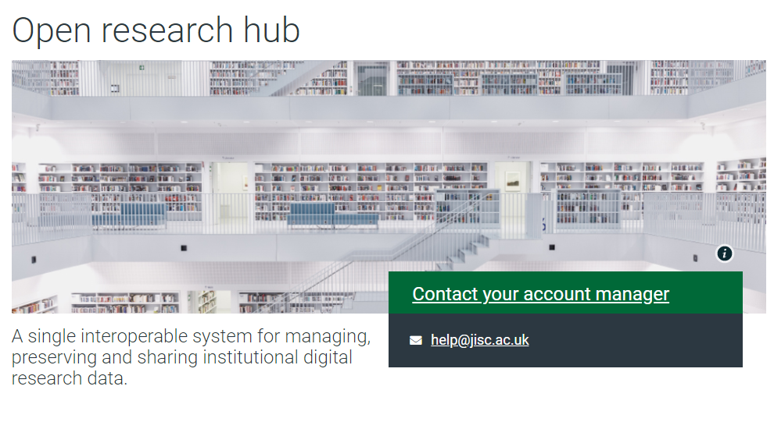
Update from the University of Glasgow
Finally Live February 2020

Slide 5
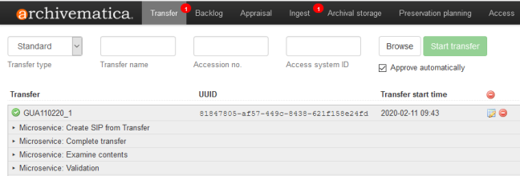
We chose Archivematica
#ayepreserve

Slide 6
Why?
We already had infrastructure to manage files so just wanted to add the preservation functions.
Preservica is a digital asset management tool that also performs preservation functions, so implementing it would have an impact on other systems.
#ayepreserve

Slide 7
Challenges?
Budget for software and storage small
Staffing – no additional allocation
Advocacy
Clarity of roles
#ayepreserve

Slide 8
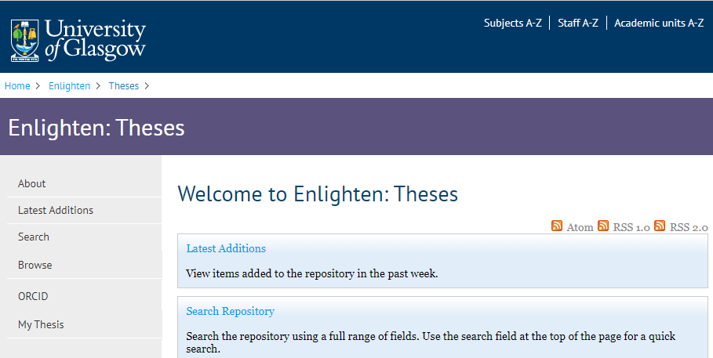
#ayepreserve

Slide 9
Early Days
Glasgow specific Archivematica guide
Setting up a processing configuration specifically for thesis.
What metadata do we want to upload?
Do we want to normalise any or all of the original files?
Range of formats to set up workflows for – pdf, audio, video
Next record series and system integrations to be decided – specific historical collections, estates drawings, minutes of University Committees?
#ayepreserve

Slide 10

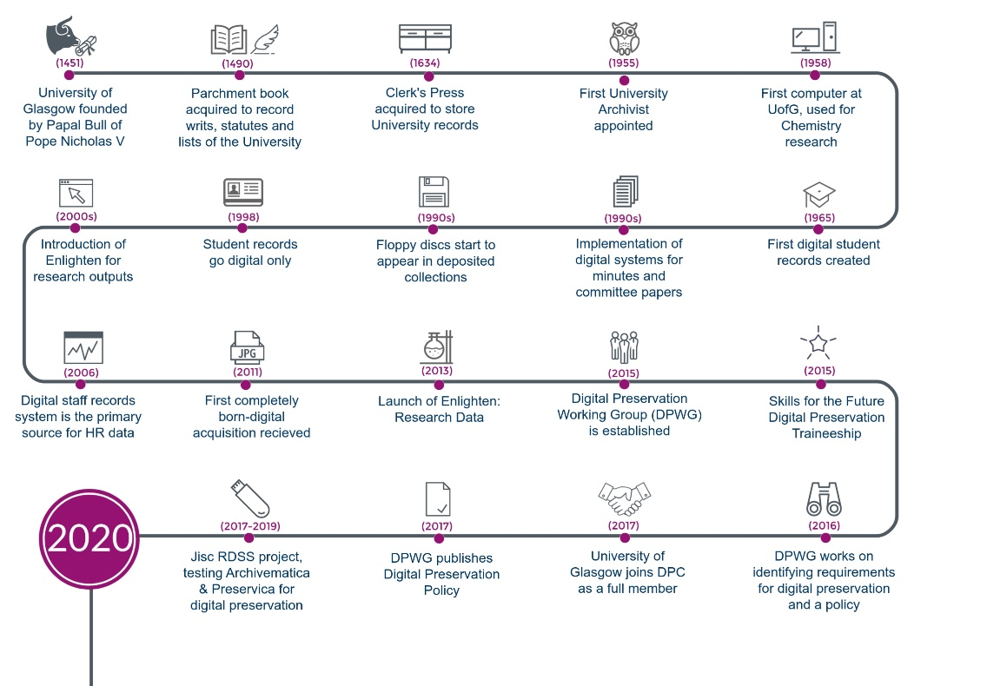
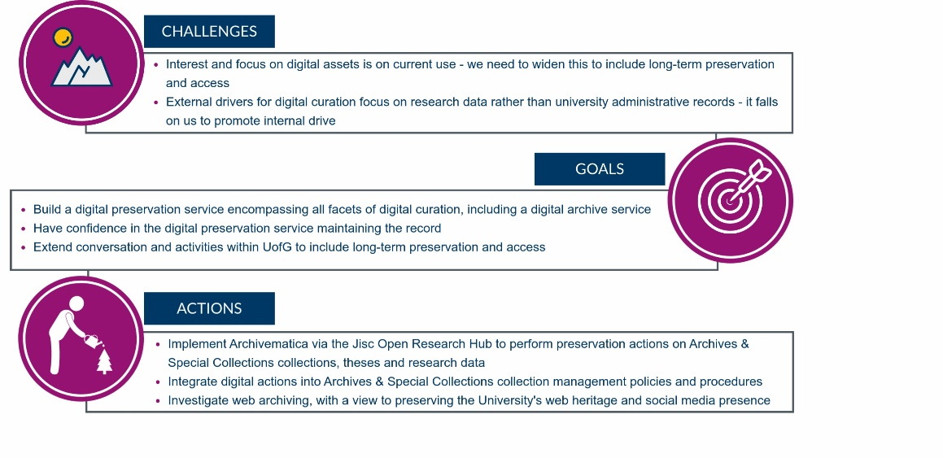


Our digital transformation
University of Glasgow Archives & Special Collections cares for records that the University has been creating and curating since 1451.
As early adopters of digital records and processes, we need to ensure continuity of care for these records. This is particularly important as the University’s ongoing world-changing transformation harnesses digital to enhance the staff and student experience.
We are working towards ensuring that our digital records created today remain accessible in another 569 years.

Slide 11
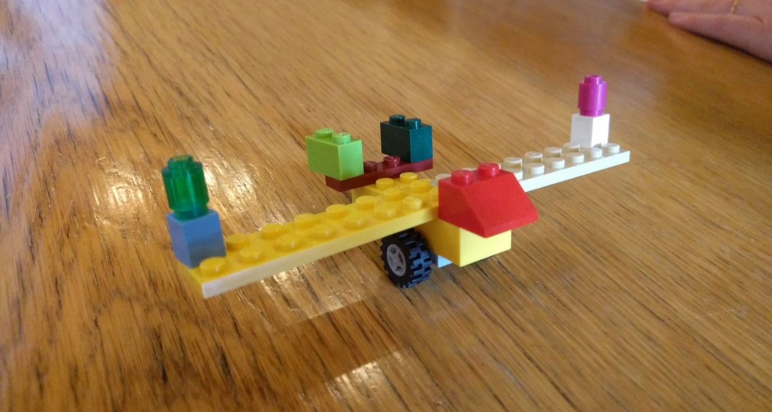
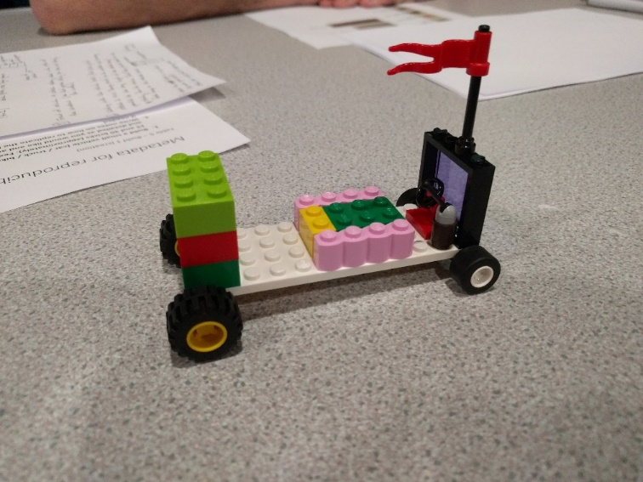
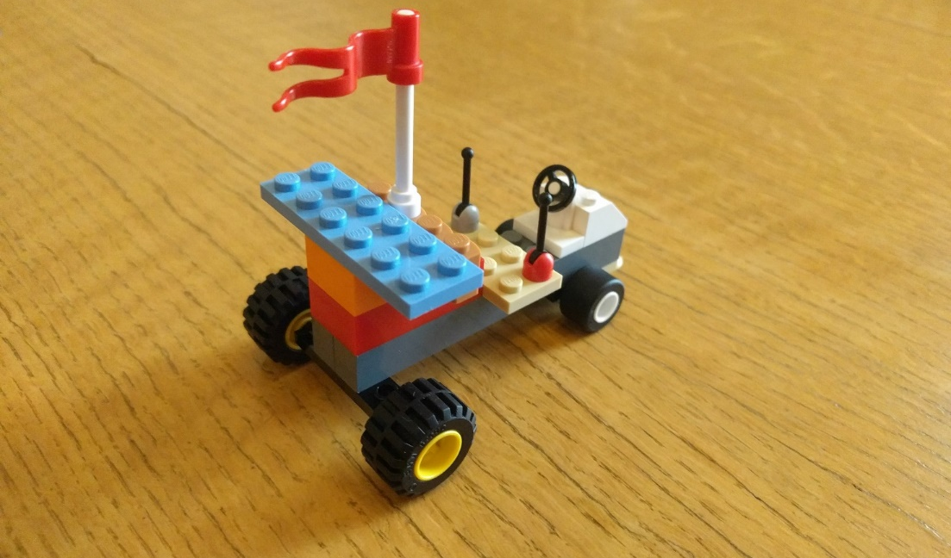
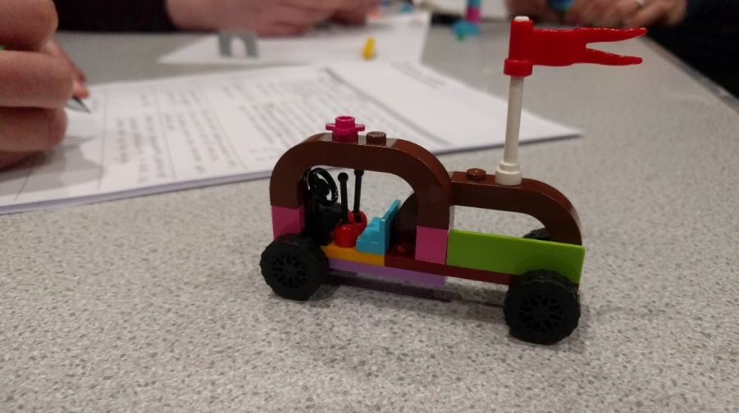
Image credit © 2019 Mary Donaldson
#ayepreserve

Slide 12
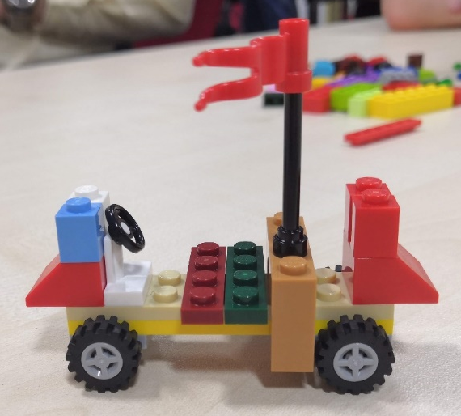
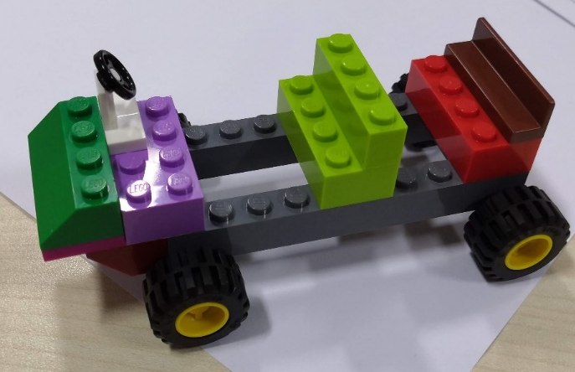
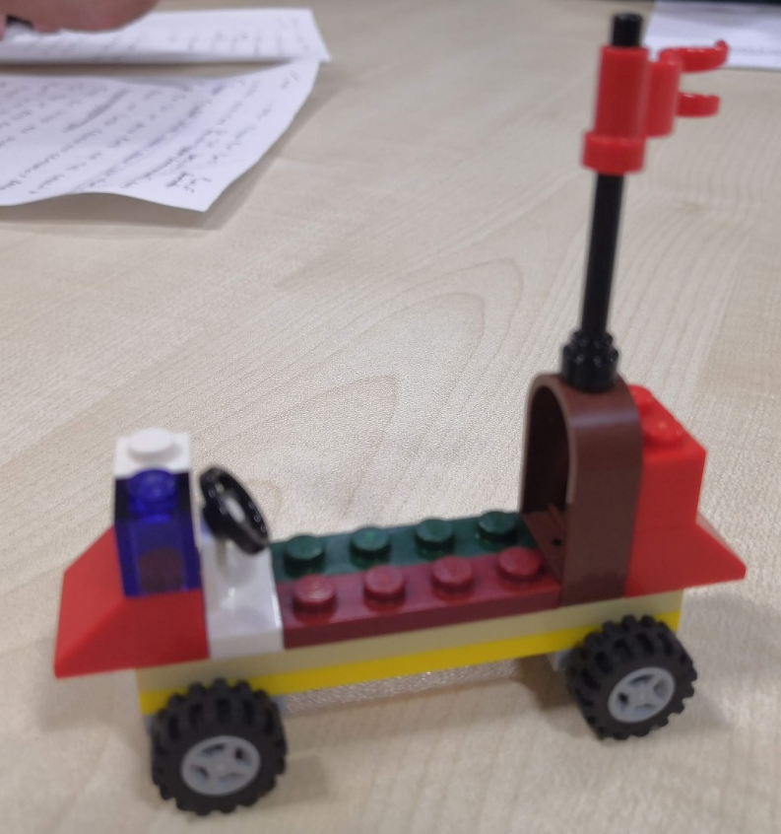
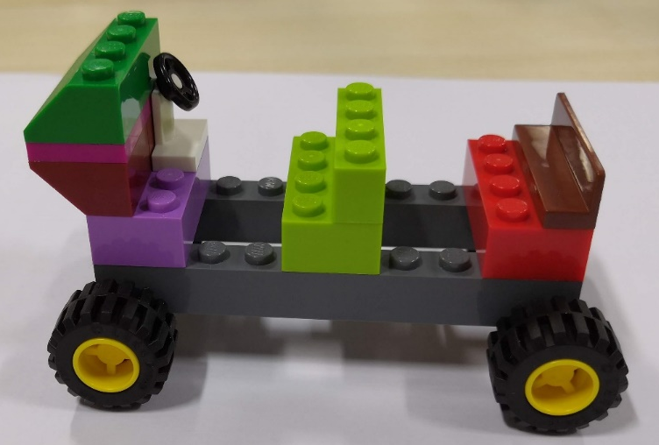
Lego: Metadata for reproducibility
Image credit © 2019 Mary Donaldson
#ayepreserve
Game pack http://dx.doi.org/10.36399/gla.pubs.196477

Slide 13
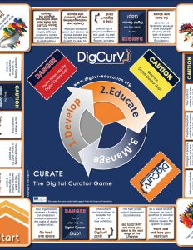
Digital Preservation Game
http://schreibman.eu/digcurv/curate-game/
#ayepreserve

Slide 14
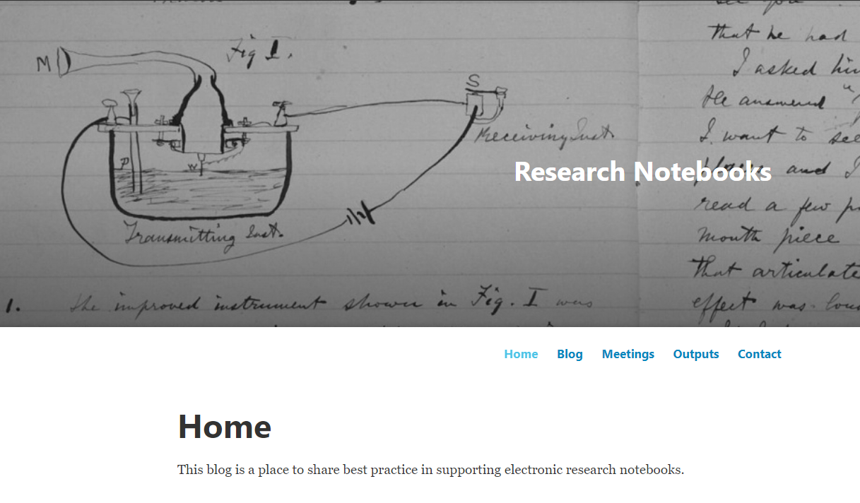
Electronic Research Notebooks
#ayepreserve
https://researchnotebooks.wordpress.com/
Notes:
Back up
Share/collaborate
Preserve

Slide 15
Dataset Licencing Project
Ownership of Rights in Research Data http://eprints.gla.ac.uk/171314/
Making Research Data Available http://eprints.gla.ac.uk/171315/
Choosing a Licence for Research Data http://eprints.gla.ac.uk/171316/
FAQ: Using Research Data http://eprints.gla.ac.uk/171317/
Unfinished business:
Agreements between data depositors and the repository
How to sustain community resources
Terminology - also came up at International Digital Curation Conference
#ayepreserve
https://datasetlicencing.wordpress.com/

