Slide 1
Introduction to
Digital Preservation
and the DPC
dpconline.org
sara day thomson
tw: @sdaythomson

Slide 2
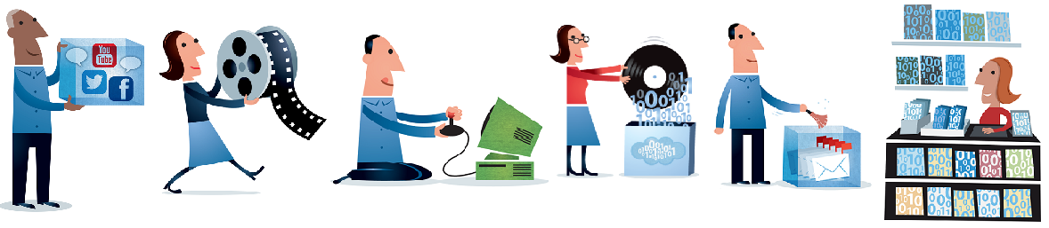
What is Digital Preservation?
“the series of managed activities necessary to ensure continued access to digital materials for as long as necessary”
(Digital Preservation Handbook)
I’m free and open on the DPC website!
Illustration by Jørgen Stamp digitalbevaring.dk CC BY 2.5 Denmark
Notes:
Basic definition of DP
‘Managed activities’ important, could be rephrased as managing the risks that threaten digital objects

Slide 3
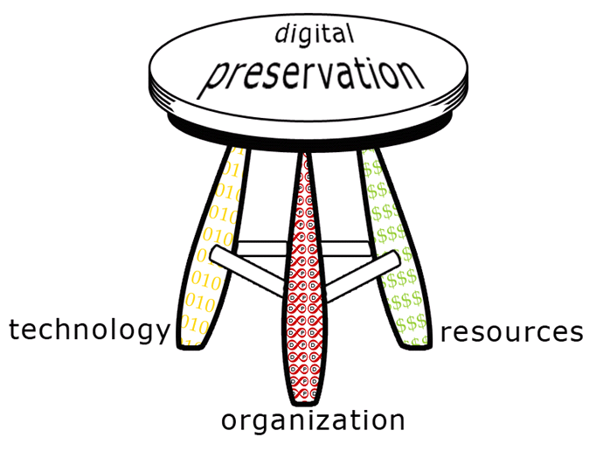
3-Legged Stool
Technology
Resources
Organisation
http://dpworkshop.org/dpm-eng/conclusion.html

Slide 4
Getting Started
Notes:
https://dpconline.org/handbook/getting-started: Contains recorded videos of compressed training sessions

Slide 5
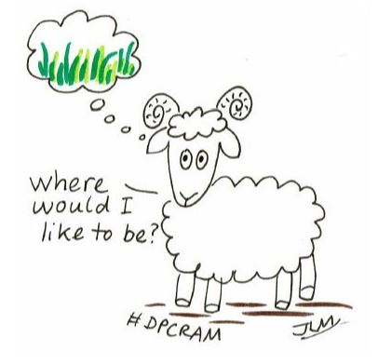
Maturity Modelling
Helps with:
Identifying stress points & risks
Setting objectives & advocacy
Prioritising developments
Options include:
DPC Rapid Assessment Model (RAM)
  Applicable for all organisations who have digital content of long term value
  Agnostic to solution and technology
  Focused on continuous improvement
NDSA Levels of Digital Preservation
I’m on the DPC website!
Illustration by Jørgen Stamp digitalbevaring.dk CC BY 2.5 Denmark
Notes:
DPC Rapid Assessment Model: https://www.dpconline.org/our-work/dpc-ram
NDSA Levels: http://www.digitalpreservation.gov:8081/ndsa/activities/levels.html (about to be updated so keep an eye on digital-preservation@jiscmail.ac.uk

Slide 6
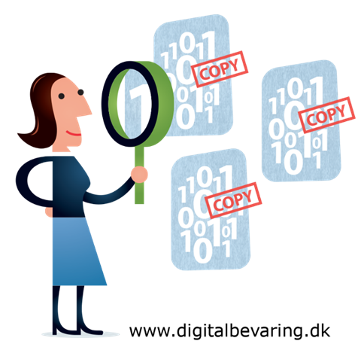
Bit-Level Preservation
Addresses risks such as:
Media obsolescence
Media failure
Natural or human-made disaster
As a minimum:
Keep more than one copy
Refresh storage media
Integrity check your data (also “Fixity”)
Notes:
Fixity Checking: https://dpconline.org/handbook/technical-solutions-and-tools/fixity-and-checksums
Free Tools for Fixity:
AV Preserve Fixity (https://www.weareavp.com/products/fixity/)
BagIt’s Bagger tool (http://coptr.digipres.org/Bagger) or (https://github.com/LibraryOfCongress/bagger)
TNA’s DROID for creating hash sums / check sums (http://www.nationalarchives.gov.uk/information-management/manage-information/preserving-digital-records/droid/)

Slide 7

Characterisation
Understand your data so you can assess
risks, plan, take action to preserve
Characterisation:
  How many files?
  How big are the files?
  What file formats?
  Does it contain personal information?
  Is it encrypted?
  What risks are associated?
Scale = automation = software tools
Tools: DROID, FITS….
Specific guidance for different types of content can be found in DPC Technology Watch Reports!
Notes:
Technology Watch Reports: https://www.dpconline.org/knowledge-base/tech-watch-reports
DROID: http://www.nationalarchives.gov.uk/information-management/manage-information/preserving-digital-records/droid/
FITS: https://projects.iq.harvard.edu/fits/home

Slide 8

Risk Management
Identifying risks is a key stage in successful digital preservation
Useful for:
Policy development
Building a business case
Identifying requirements
Making preservation decisions
Resources: DRAMBORA, SPOT, TNA
Notes:
DRAMBORA: www.repositoryaudit.eu/about/
SPOT: www.dlib.org/dlib/september12/vermaaten/09vermaaten.html
TNA digital continuity service: www.nationalarchives.gov.uk/information-management/our-services/dc-risk-opportunities.htm

Slide 9
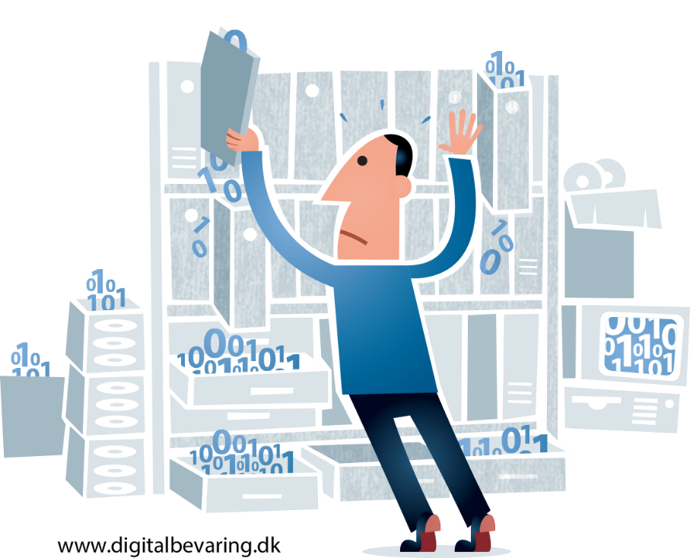
Digital Asset Registers
Gathers information about digital content in one place
Coordinates digital preservation actions
Retains valuable knowledge
Logs preservation risks
Promotes best practice
Supports advocacy
Notes:
See recording in ‘Getting Started’ in DP Handbook: https://dpconline.org/handbook/getting-started

Slide 10
Making Progress

Slide 11
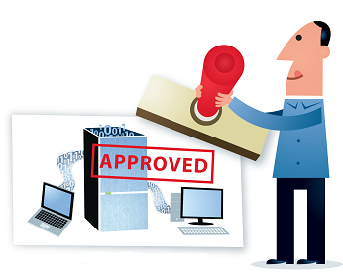
Business Case & Advocacy
Key step in gaining (financial) support and resources for programme/project
Objectives
Stakeholders
Financial Analysis
Benefits & Risks
Resources
DPC Executive Guide
DPC Procurement Toolkit (draft preview available for Members)
Business Case Toolkit
Curation Costs Exchange
Cost of Inaction Calculator
Coming June 2020 for DPC Members!
DPC update coming soon!
Illustration by Jørgen Stamp digitalbevaring.dk CC BY 2.5 Denmark
Notes:
DPC Executive Guide: https://www.dpconline.org/our-work/dpeg-home
SPRUCE Toolkit: http://wiki.dpconline.org/index.php?title=Digital_Preservation_Business_Case_Toolkit
Curation Costs Exchange: http://www.curationexchange.org/
Cost of Inaction Calculator: https://coi.weareavp.com/

Slide 12

Skilled Workforce
New and developing field
  Constantly moving target!
New skills required
  Training for existing staff and structuring CPD
  Job descriptions for changing roles and new hires
Staff retention
  Staff are both a key resource and asset
  Ensuring continuity
More coming soon!
Resources
Novice to Know-How Online Digital Preservation Training
DigCurV Framework
Illustration by Jørgen Stamp digitalbevaring.dk CC BY 2.5 Denmark
Notes:
Novice to Know How (formerly Novice to Ninja): https://www.dpconline.org/blog/n2n-blog1
DigCurV: http://www.digcur-education.org/

Slide 13
Digital Preservation
Policy Development
Written representation of the aims and objectives
Sets the environment for all other activities
  Framework for Business Plan/Strategy
Should be flexible and subject to regular review
A digital preservation policy is the mandate for an archive to support the preservation of digital records through a structured and managed digital preservation strategy. (The National Archives)
Policy guidance from
Jisc
Library of Congress
APARSEN
SCAPE
DPC Policy Toolkit for Members coming soon!
Notes:
Difficult to make policy in new & developing areas
Jisc: http://www.jisc.ac.uk/publications/reports/2008/jiscpolicyfinalreport.aspx
Library of Congress: http://blogs.loc.gov/digitalpreservation/2013/08/analysis-of-current-digital-preservation-policies-archives-libraries-and-museums/
APARSEN: http://aparsen.digitalpreservation.eu/pub/Main/ApanDeliverables/APARSEN-REP-D35_1-01-1_0.pdf
SCAPE Catalogue: http://wiki.opf-labs.org/display/SP/Policy+Elements
SCAPE List of Policies: http://wiki.opf-labs.org/display/SP/Published+Preservation+Policies

Slide 14
What is the DPC?

Slide 15
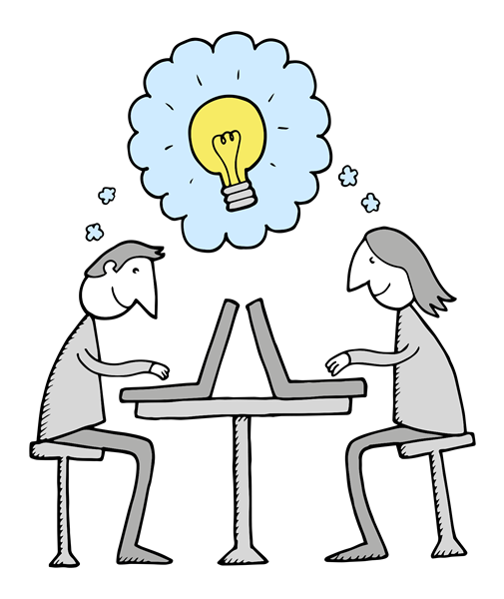
Digital Preservation Coalition
working with members to build…
Supportive Community
More Responsive and Better Informed Institutions
Prepared Workforces
High Quality and Sustainable Services
Good Practice and Standards
Coalition Focussed on Member Needs
All Illustrations available under CC BY-NC 3.0 licence
Digital Preservation Business Case Toolkit http://wiki.dpconline.org/
Notes:
A dynamic and mutually supportive community
A political and institutional climate more responsive and better informed
workforces ready to address the challenges
high quality and sustainable services
good practice and standards
a sustainable organization focussed on member needs

Slide 16






























































































Slide 17

DPC Resources
www.dpconline.org
Digital Preservation Handbook
Technology Watch Reports
Rapid Assessment Model
Executive Guide
Procurement Toolkit (draft preview available)
Policy Toolkit (coming soon)
Business Case Toolkit
Novice to Know-How online training (coming soon)
Blog
Members-only
Mix of open and Members-only

Slide 18

DPC Events
2 April Salford | For Your Eyes Only: Scalable Approaches to Identifying, Managing, and Securing Sensitive or Restricted Information
3 April Online | Enacting Environmentally Sustainable Preservation - Webinar
30 April York | Building a Digital Future : Challenges & Solutions for Preserving 3D Models
22 June London | Getting Started with Advocacy
23 June London | Connecting the Bits - DPC Unconference
24 June London | A Guide to Procurement: Launch Event, Workshop
23 July Belfast | Web Archiving & Preservation Working Group Meeting
5 November Earth | World Digital Preservation Day
www.dpconline.org
info@dpconline.org
@dpc_chat

Slide 19

Thank You!
Sara Day Thomson
Research Officer
sara.thomson@dpconline.org
@sdaythomson

