Slide 1
Engaging Audiences with
Web Archives
Jason Webber
DPC Webinar – 5 March 2020

Slide 2
UK Web Archive – ‘Open’
Started in 2005
Collected websites by permission only
Openly available through www.webarchive.org.uk
Approx 15,000 - 2005-Present

Slide 3
UK Web Archive – ‘Legal Deposit’
Started in 2013
Collects 6-10 million websites (once per year)
Only available in reading rooms of UK Legal Deposit Libraries

Slide 4
A Partnership
The UK Web Archive is a partnership of all six UK Legal Deposit Libraries, working together to collect and give access to the UK web space.

Slide 5
Engagement strands
Funded academic research
Talks and engagement with ‘Gatekeepers’
  Universities
  Libraries and Archives
  Museums and Art Galleries
Big data analysis projects
Journalists and the media
Blogs and social media

Slide 6
Big UK Domain Data for Arts and Humanities
Big UK Domain Data for Arts and Humanities
  buddah.projects.history.ac.uk/
  10 Bursary places (very wide research areas)
    Army Recruitment
    Poetry
    Accessibility guidelines
    French diaspora communities in London
    Public archaeology

Slide 7
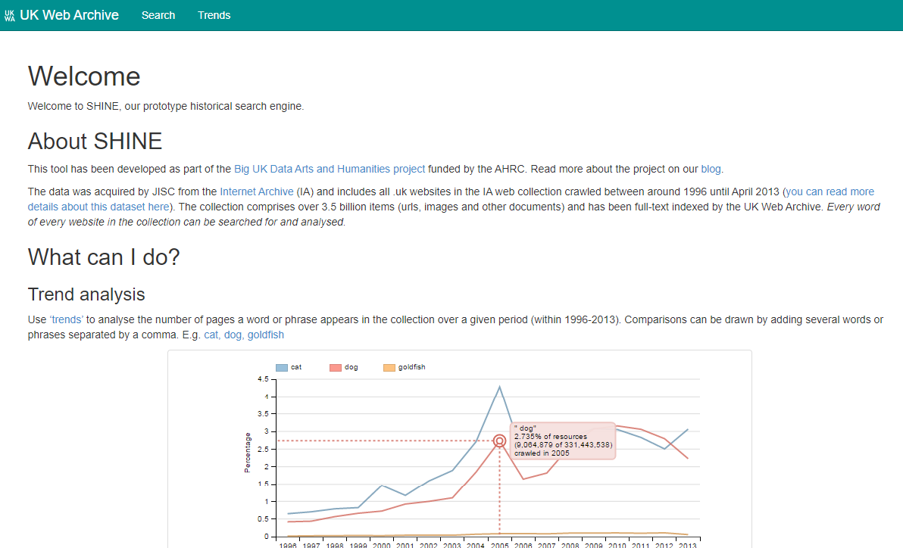
www.webarchive.org.uk/shine

Slide 8
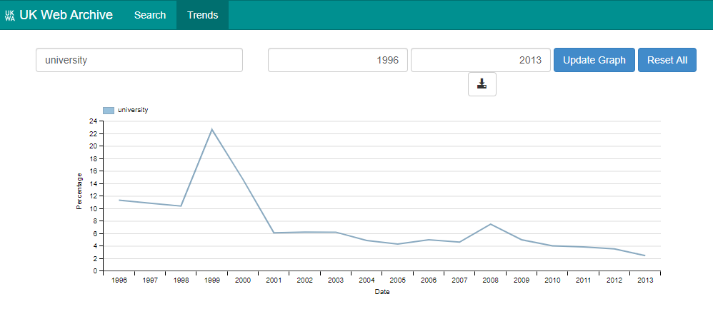
www.webarchive.org.uk/shine

Slide 9
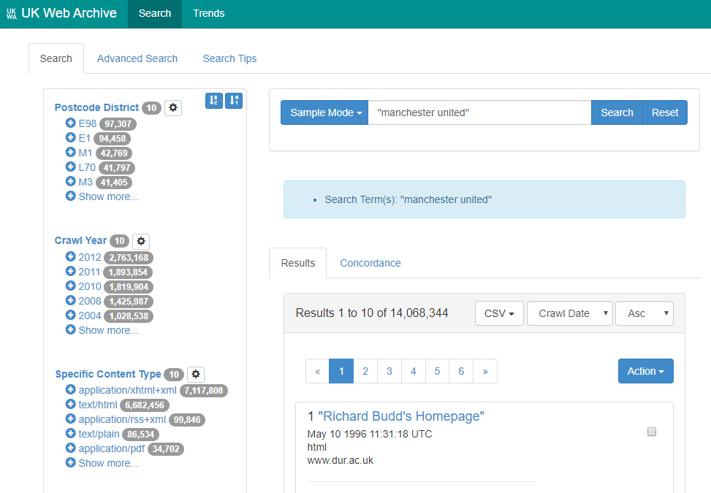

Slide 10
Funded academic researchers
Caio Mello (Phd) – Olympics Legacy
Liam Markey (Phd) – Militarism 1918 Onwards
Hannah Connell (Phd) – Russian Community in UK
Emmanouil Tranos (Phd) – Geospatial research
See blogs by these researchers: https://blogs.bl.uk/webarchive/
Secondary data: https://data.webarchive.org.uk/

Slide 11
Talks and Engagement with ‘Gatekeepers’
King’s Digital Lab
Stirling University
Open University
CILIP
Archives and Records Association
First World War Centenary (IWM)
Association of Librarians and Information Professionals in the Social Sciences (ALISS)
National Football Museum

Slide 12

Big Data

Slide 13
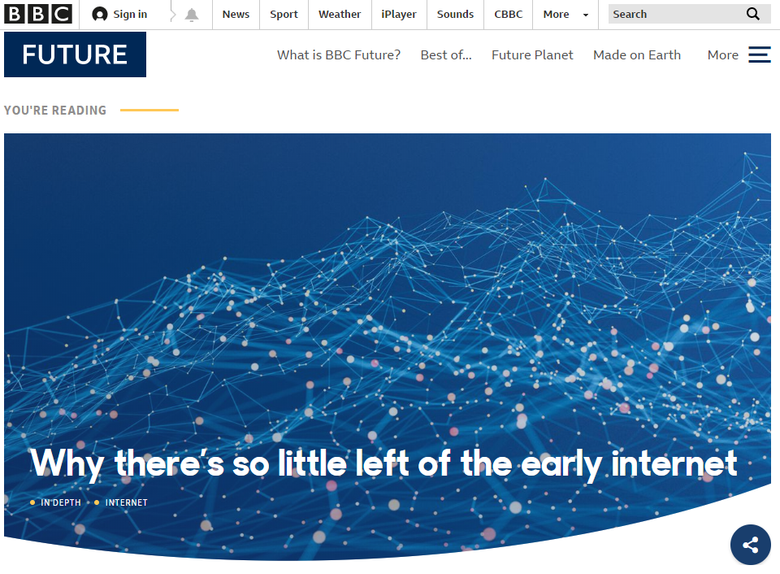
Journalists and the media

Slide 14
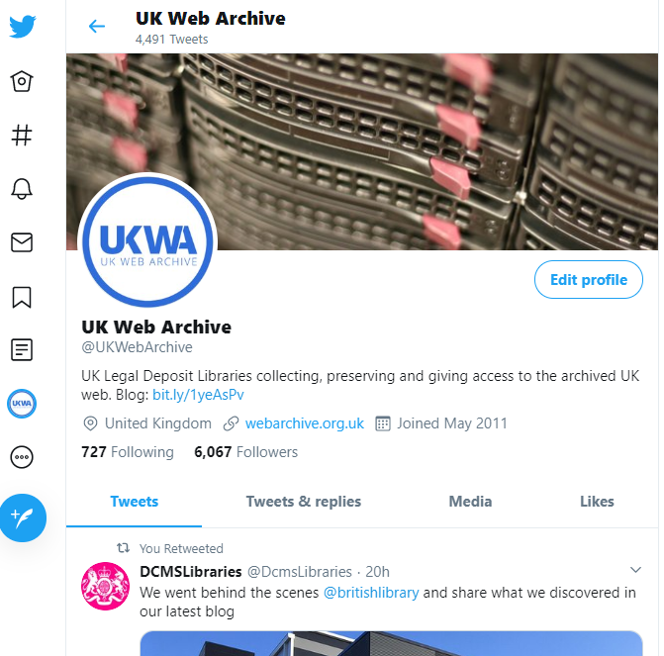
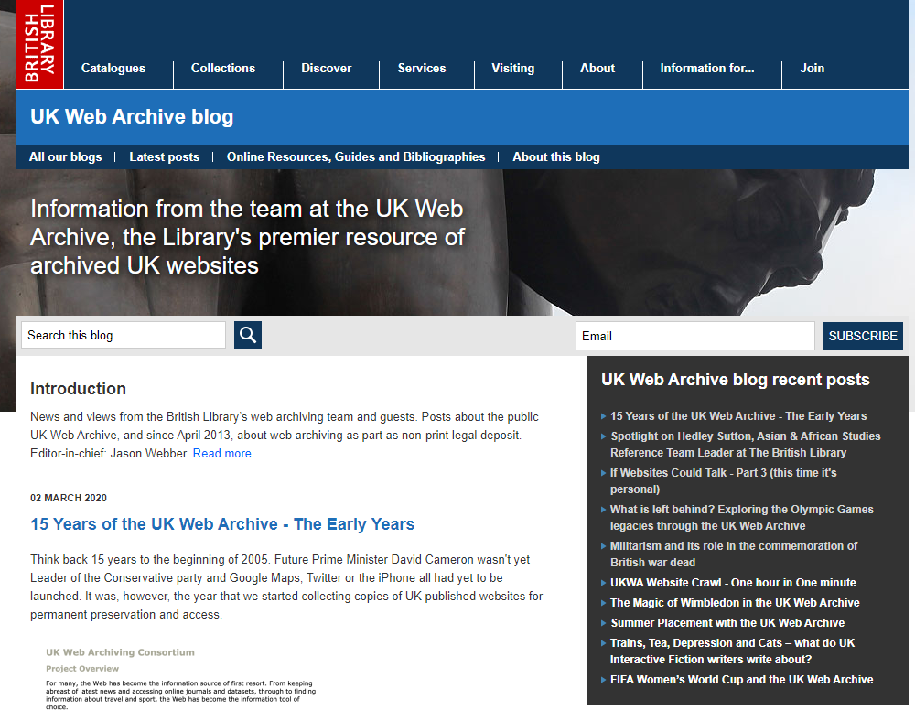
Blogs and Social Media

Slide 15
Questions
1. What is an archive?
2. What is an web archive?
3. What is a legal deposit library?
4. Why can’t I access this at home?
5. Why are you doing this when there is the Internet archive?
6. Both too big and not big enough
7. Do you collect all of twitter?
8. What about Video’s and apps?

Slide 16
What now?
Raise general awareness of the existence and need for web archives
Explain what web archives are and how they can be useful
Recruit ‘champions’ to spread the word

Slide 17
www.webarchive.org.uk/
www.webarchive.org.uk/shine
blogs.bl.uk/webarchive/
#15YearsOfUKWA
jason.webber@bl.uk
@UKWebArchive

