Slide 1
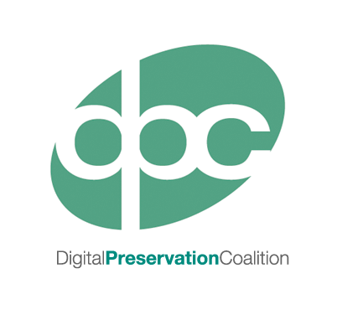
Introduction to DIY
Web & Social Media Archiving
Approaches & Tools
dpconline.org
sara day thomson
tw: @sdaythomson

Slide 2
Why archive web and social media content?
what do you think…?
_____________________
_____________________
_____________________
_____________________
. . .
community memory
institutional memory
historical research
context or supplementary to other collections
collecting policy
evidential value
Notes:
Articulating the motivations and purposes for archiving web and social media content will help to inform both policies about what to collect and the individual strategies or combination of strategies that will best suit this aim for collecting and preserving.

Slide 3
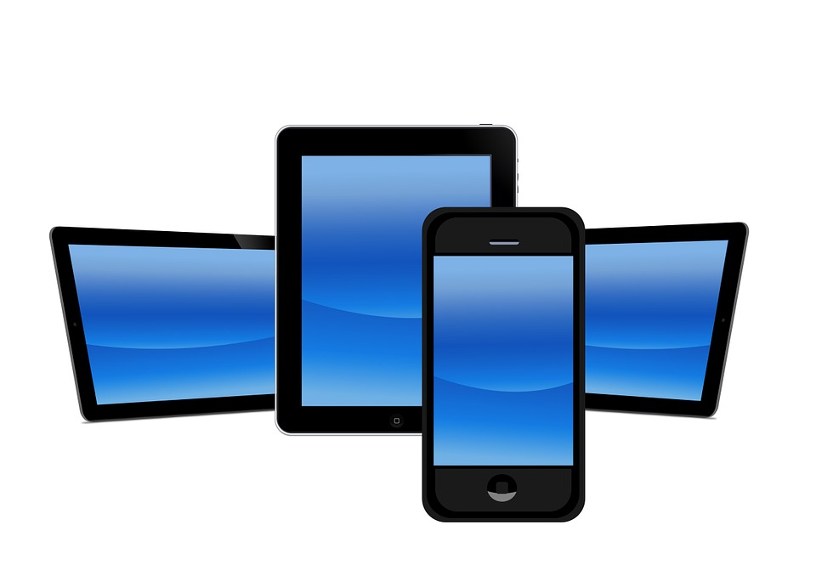
Web & social media content are NOT exempt from selection and appraisal!
What are your priorities?
look and feel
browser or platform versions
browser or platform functionality
multiple devices or interfaces
machine-readability
content format or formats
output format or formats
context and relationship to other web content
creators and account owners
Notes:
What information are you trying to capture and how is that information expressed uniquely through a particular platform? Or, what role does the particular function of the platform play in providing meaning or structure to the content you want to preserve? Equally importantly, how does that content relate to a larger collection or collections?
Is it the data you want? Parsed and anonymised as much as possible? Or it is named and identifiable interactions between identified people? Such as the interactions between a company’s official Twitter account and it’s users? Or is it the content you want? A video of a major national event captured on a mobile phone and uploaded to YouTube or caught as an Instagram video, to add to a collection about a particular place or event?
Knowing what exactly what you want to capture will help to decide what method to use for capture. Different methods of capture have different strengths for depending on your priorities.
Slide content:
Look and feel – the experience
Multiple interfaces – mobile, browser
Platform functionality – networks, embedded content
Platform restrictions – privacy, copyright
Metadata – how much do you need, what is available
Machine-readability – do you users want to run analytics
Format or formats – text, images, video?
Platform versions – is it important for it to render the same as the version it was captured in, including old features? Do you also need to captures specs about a particular platform version before it is updated and that info disappears?
Context and relationship to other web content
Account owners and users – are you going to try to notify the account owners represented in what you capture? Eg Doc the Now

Slide 4





Transparency
Web technologies and social media platforms shape the content published on the web.
Archiving tools shape the archive.

Slide 5
what are you collecting and why?

Slide 6
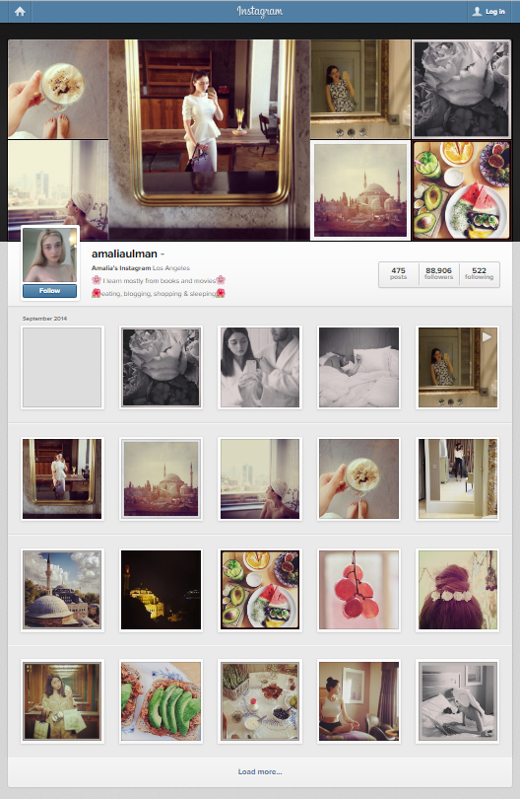
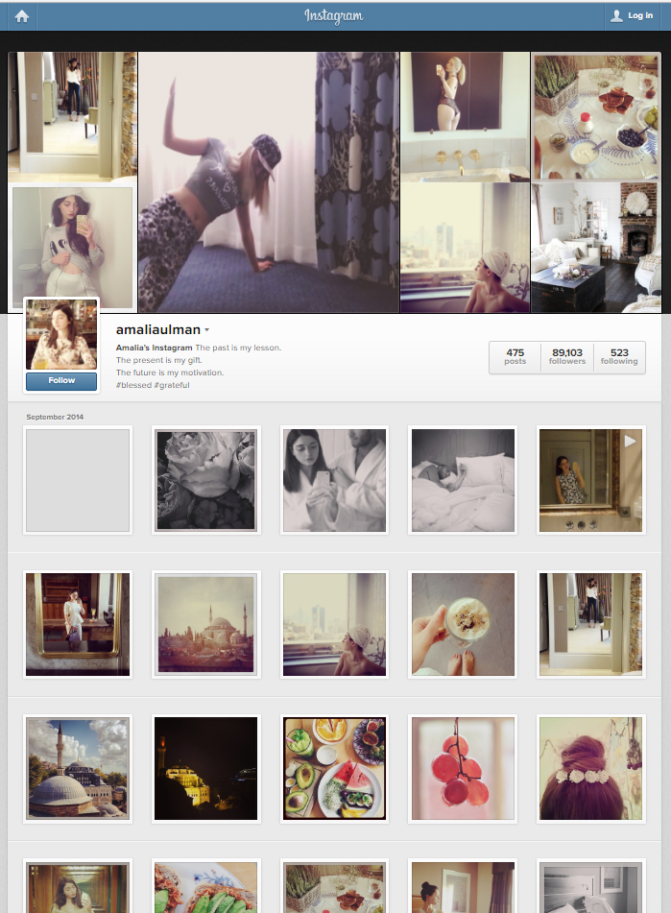
Art
Amalia Ulman’s ‘Excellences & Perfections’, Rhizome’s Webenact
Notes:
Art work created on a specific version of a social media platform, to be viewed on a particular version of a browser.

Slide 7
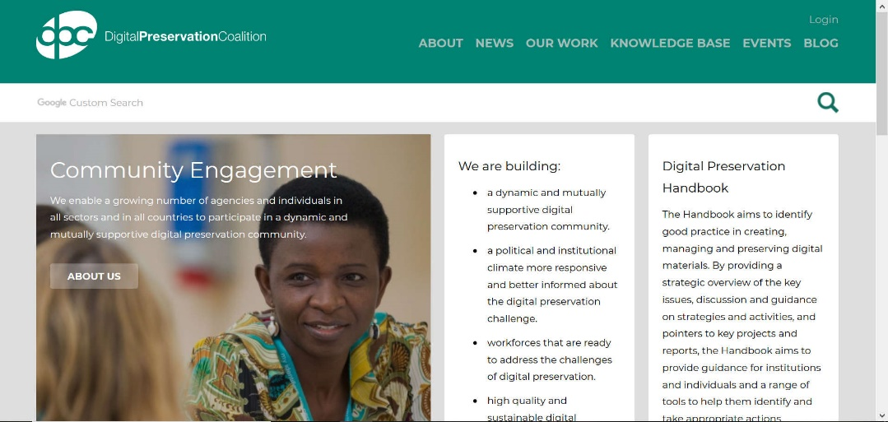
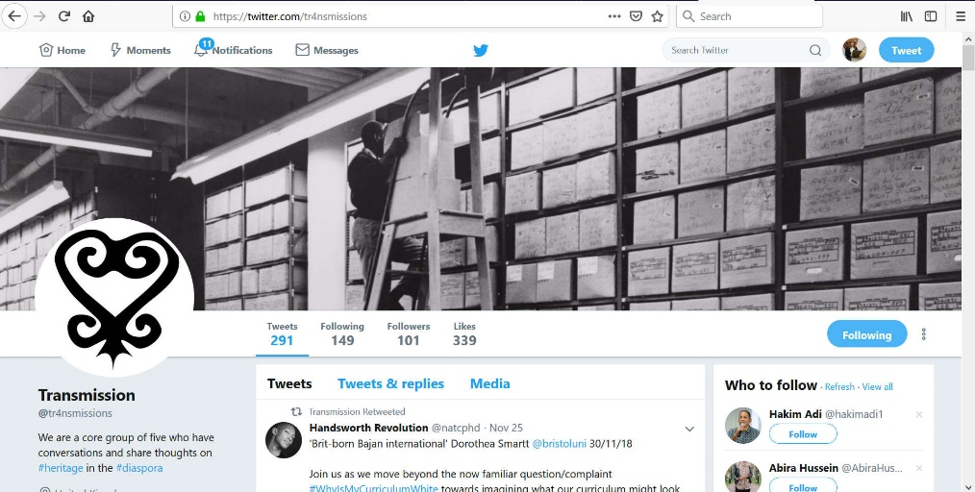
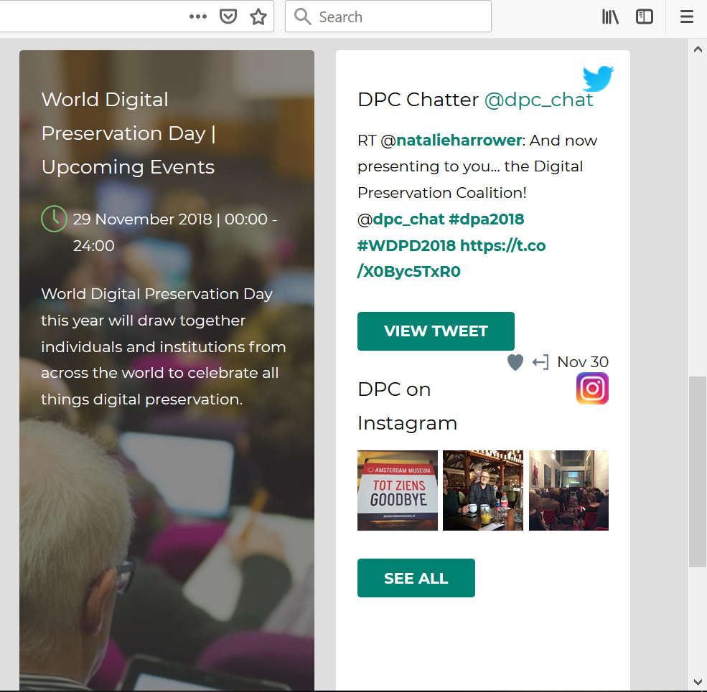
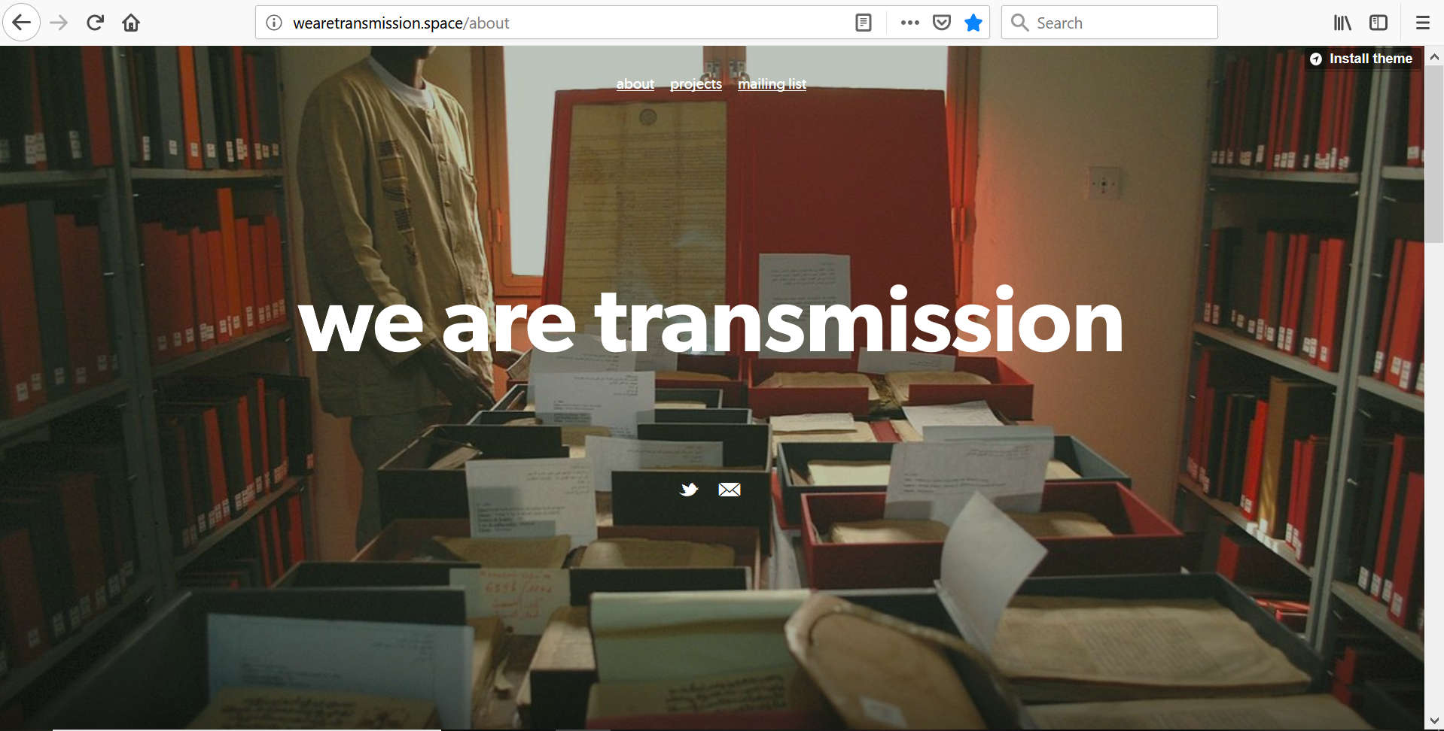
Organisational Web Content
Transmission
Website & Twitter Account
DPC Website
Notes:
We are TRANSMISSION, a collective of archivists and historians of African descent working to support and build archives and heritage in and with African diaspora communities.
-multiple contributors

Slide 8
Challenges to Social Media
Selection & Appraisal
The ‘Conversation’
  across users
  across social media services
Embedded Media
  images
  audio
  moving images
  URLs
Uniformity of language, tags, and keywords
Spelling errors
Obscenity or libel
Shortened Links (eg bitly, tinyurl)
Relevance
Rights & Ownership
Notes:
Selecting social media content might not be as straightforward as with other traditional archival formats because the boundaries around an object or collection of objects can be difficult to discern and are often fluid – one conversation leading into the next. Challenges such as embedded media or shortened URLS should be taken into account when making strategy decisions and when evaluating the capability of different tools that are available for archiving web content.

Slide 9

Policy and Regulations
Ownership & Intellectual Property
Data Protection & Privacy (GDPR)
Platform Terms and Conditions
Notes:
Platform Terms & Conditions, also regulate copyright

Slide 10
Social Media
Platform Terms and Conditions
Common Policies
Terms of Service
User Agreement
Privacy Policy
Terms of Use
Developer Agreement or Developer Policy
Developer Agreement or Policy: Common Characteristics
Controls use of API
Forbids sharing of data (incl. cloud storage)
Forbids preservation of deleted data
Notes:
Forbidden to preserve deleted data – many speculate this may be one of the bigger hurdles for LoC
Tweet IDs

Slide 11
Are the T&Cs of social media good enough to fulfil your personal or institutional ethical obligations?

Slide 12

Web Long-term Preservation
Might be the only record of an event
Might contain only copy of a document or other file
Updates and migrations can cause broken links
New technologies emerge and replace older ones
Not necessarily an obligation for creator to archive

Slide 13




Social Media Long-term Preservation
Vulnerable to loss
No legal or regulatory requirement for platform to preserve
Changes in platform policy and ownership
Historical data less commercially valuable
Expensive to curate and store
Shut down by Yahoo in Oct 2009
Shut down by Twitter in Sept 2014
Flickr will restrict free storage and delete excess user photos Jan 2019

Slide 14
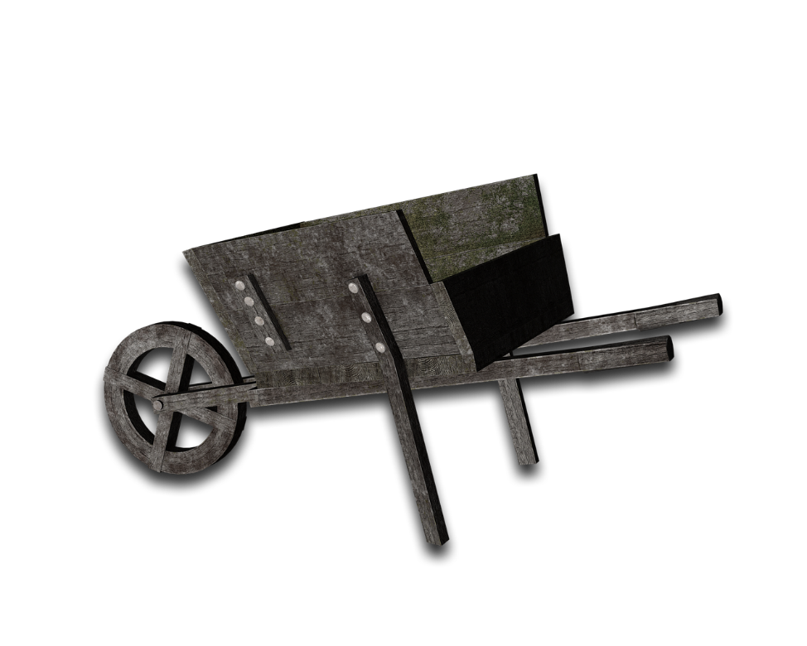
Tools: how do we capture, curate, and preserve web & social media content
web crawlers (eg Heritrix)
platform self-archiving services
api-based tools
third-party services
data resellers
Notes:
Using a web crawler to harvest social media has some disadvantages. A web crawler scrapes a page but ‘flattens’ it in the process, losing functionality, therefore the archived data is far more difficult to make searchable. The best way to create a searchable, discoverable social media archive is to request data through an API. Unfortunately, not all social media services provide access to a content streaming API. Facebook, unfortunately, does not allow this level of access, but they do provide a self-archiving service. Beware, the data made available through the self-archiving function (or the ‘download your data’ function’) changes with privacy and other account policies, so the data captured from year to year might not be uniform.
Purchasing data through a data reseller (who usually provide data on behalf of the platforms themselves, like Gnip for Twitter) might be an option if you need historical data that predates your social media archiving programme. However, these resellers are aimed at large commercial organisations who want the data for consumer analysis and may not be affordable. It is also important to remember that even data purchased from a data reseller will be subject to the same sharing restrictions. Even if you pay big bucks for the data, you will still not be able to make that data openly available or share with external parties.

Slide 15
HTTrack
‘Website Copier’

Slide 16
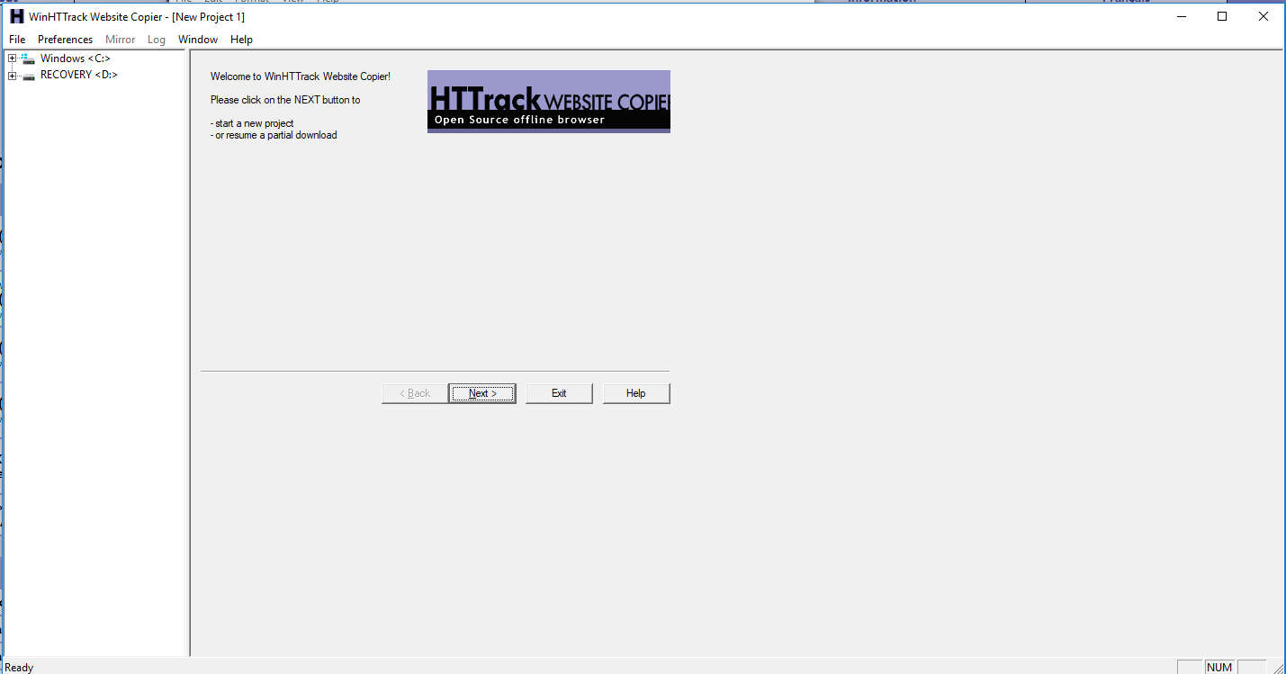
About
Download a website to a local directory – ‘mirror’
WinHTTrack for all versions of Windows
Also WebHTTrack (GUI Linux/Unix), command line
Access online or offline
Update a ‘mirror’ or resume interrupted mirror
Capture files embedded in website
Generates .html files, other embedded files, a .whtt file (‘mirror’) and index.html
Works best on simple, ‘flat’ websites
Struggles with dynamic content and complex style sheets
Notes:
This is your low hanging fruit, first, bare bones step
You’re not done yet – this is only the first part of a preservation strategy for web content

Slide 17
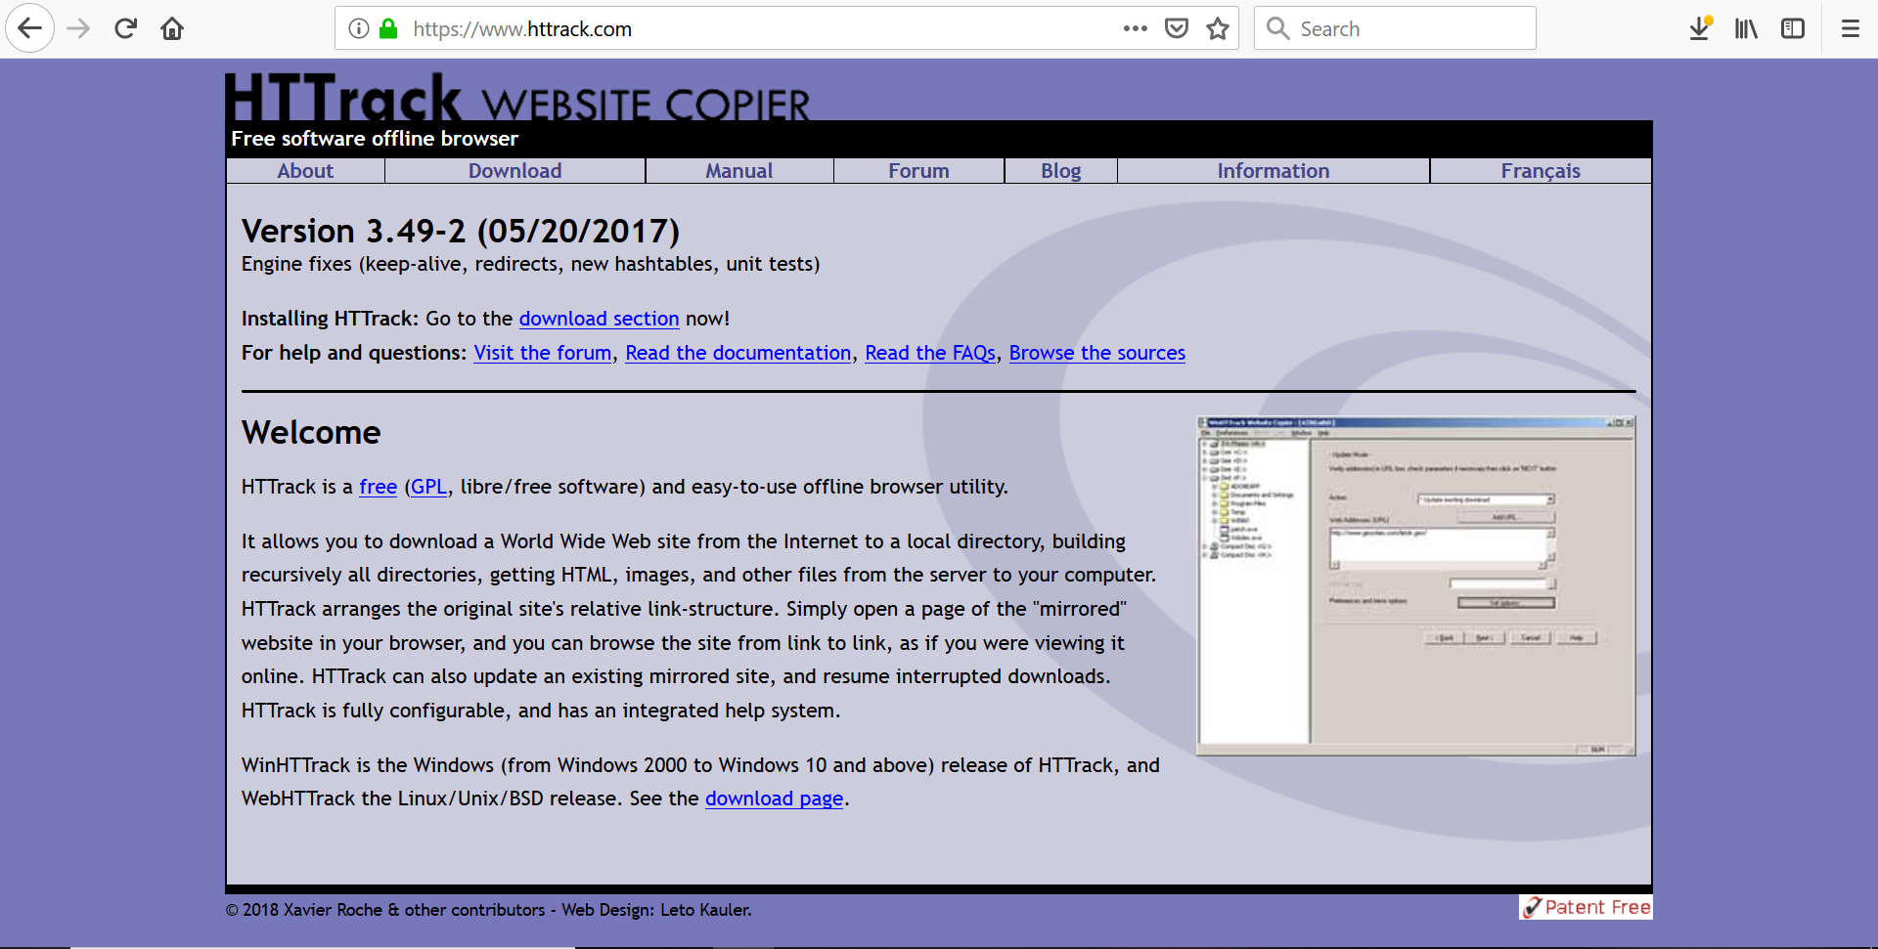
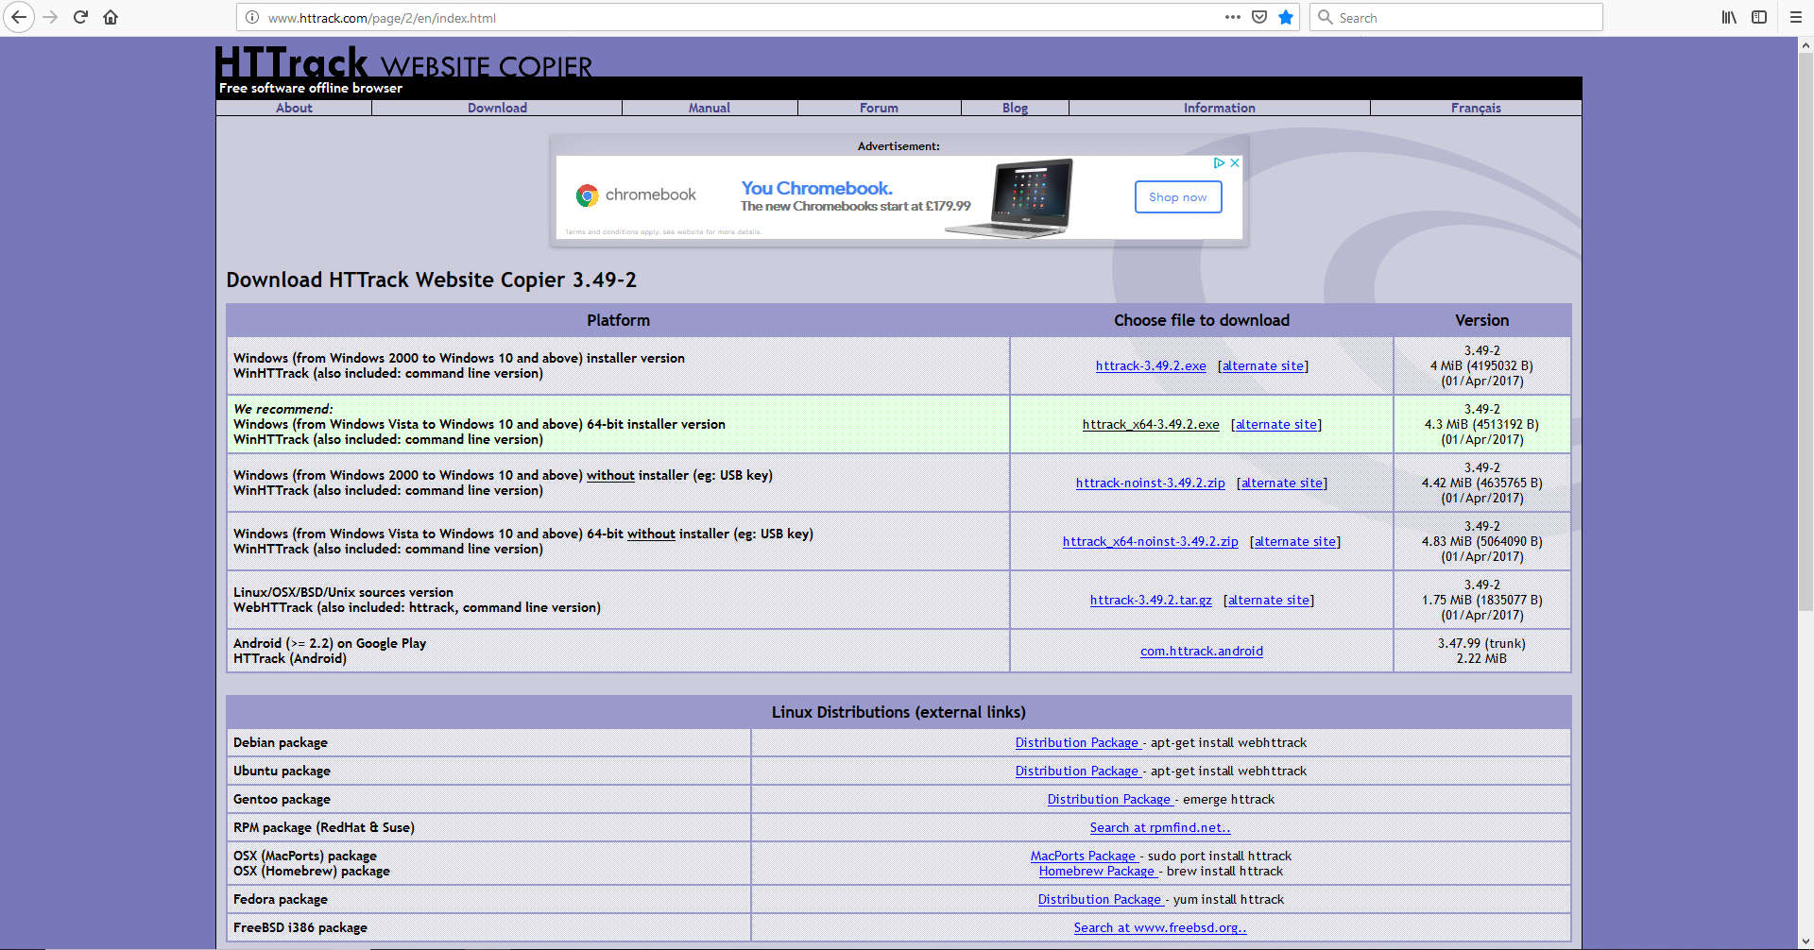
Step 1: Download

Slide 18
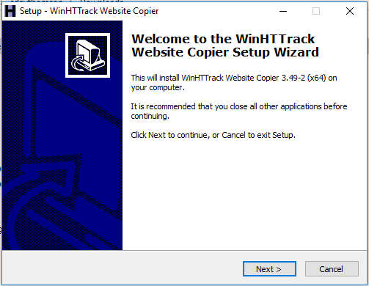

Slide 19
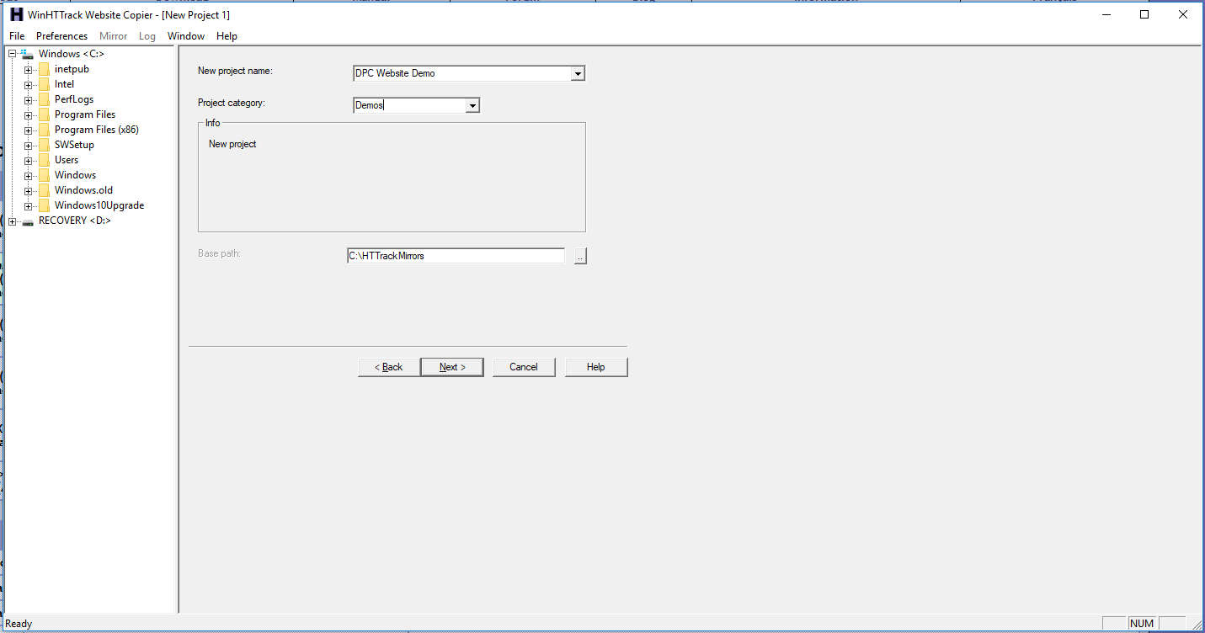
Step 2: Create a New Project
(“Mirror”)

Slide 20
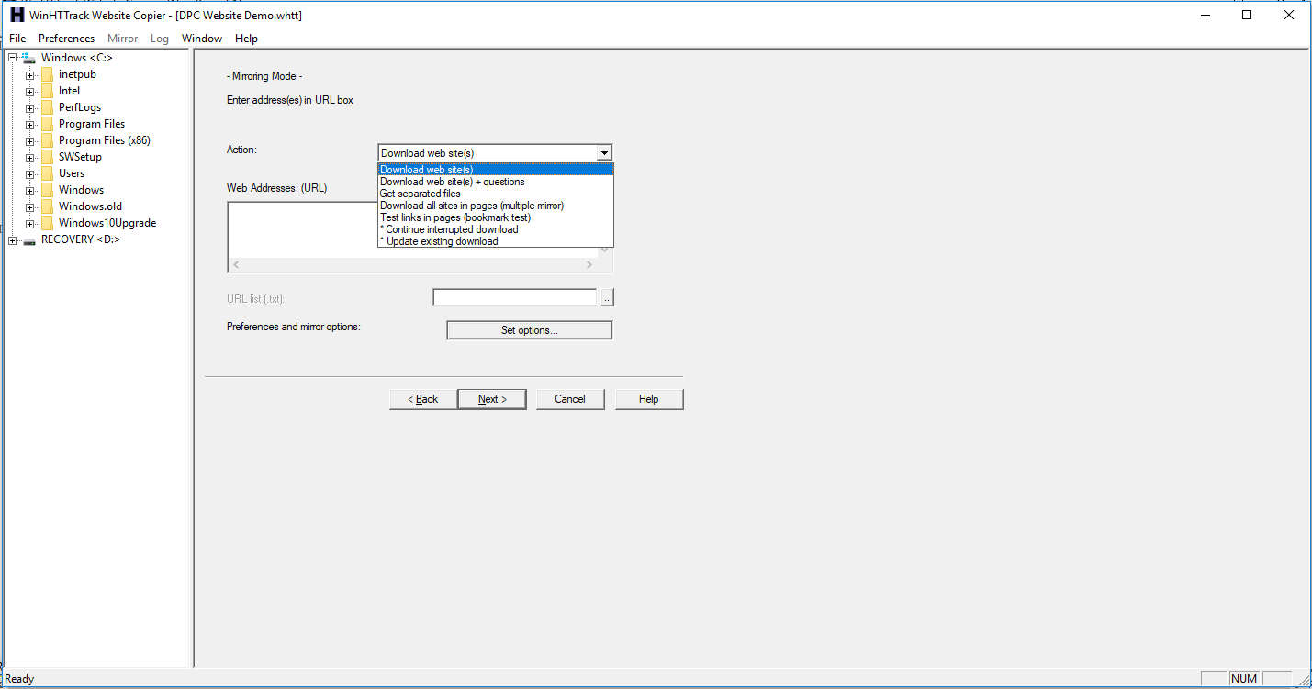
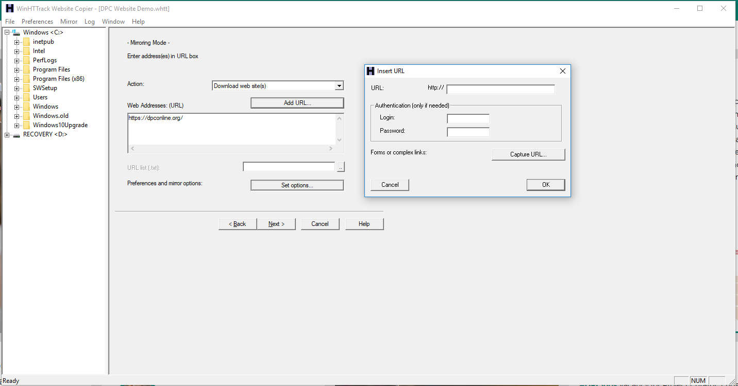
Step 3: Set Actions & Seed URLs (websites)

Slide 21
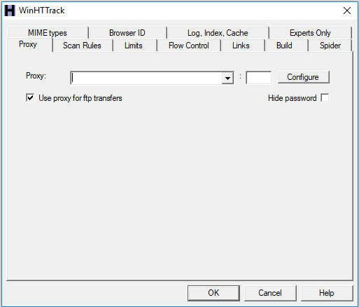
Step 4: Options

Slide 22
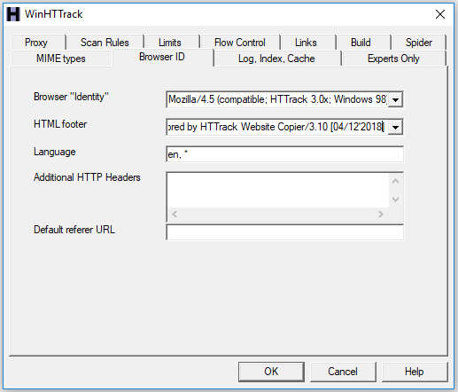
Options: BrowserID

Slide 23
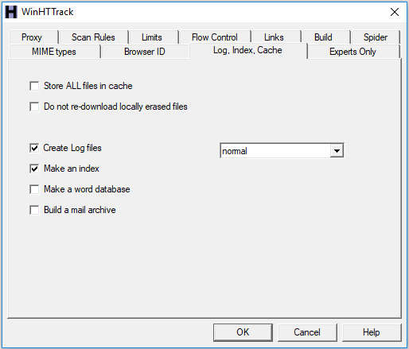
Options: Log, Index, Cache

Slide 24
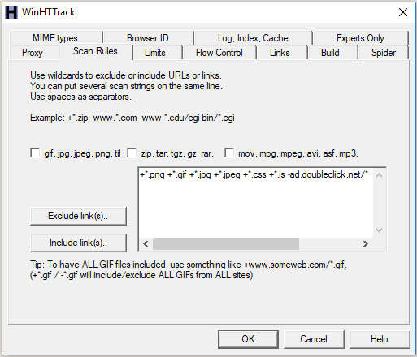
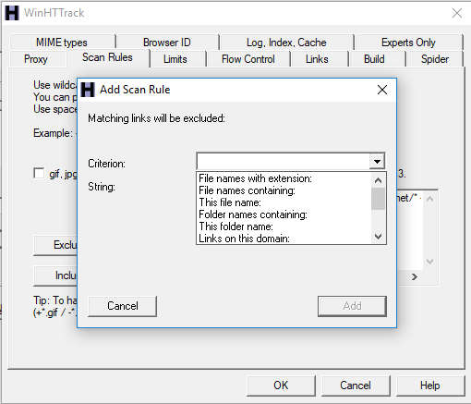
Options: Scan Rules

Slide 25
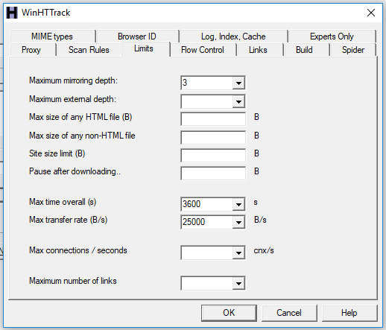
Options: Limits

Slide 26
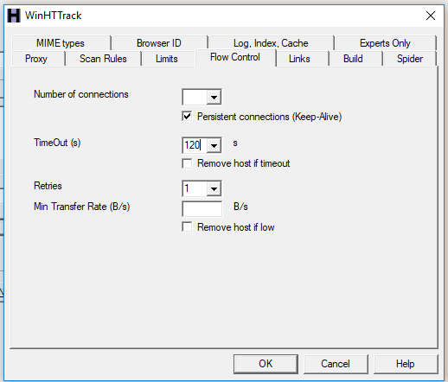
Options: Flow Control

Slide 27
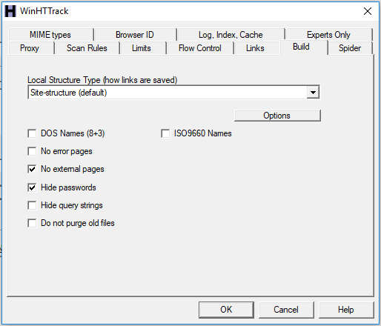
Options: Build

Slide 28
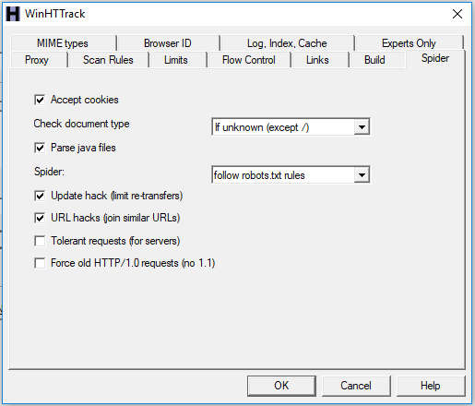
Options: Spider
Notes:
If you do not accept cookies, some "session-generated" pages will not be retrieved

Slide 29
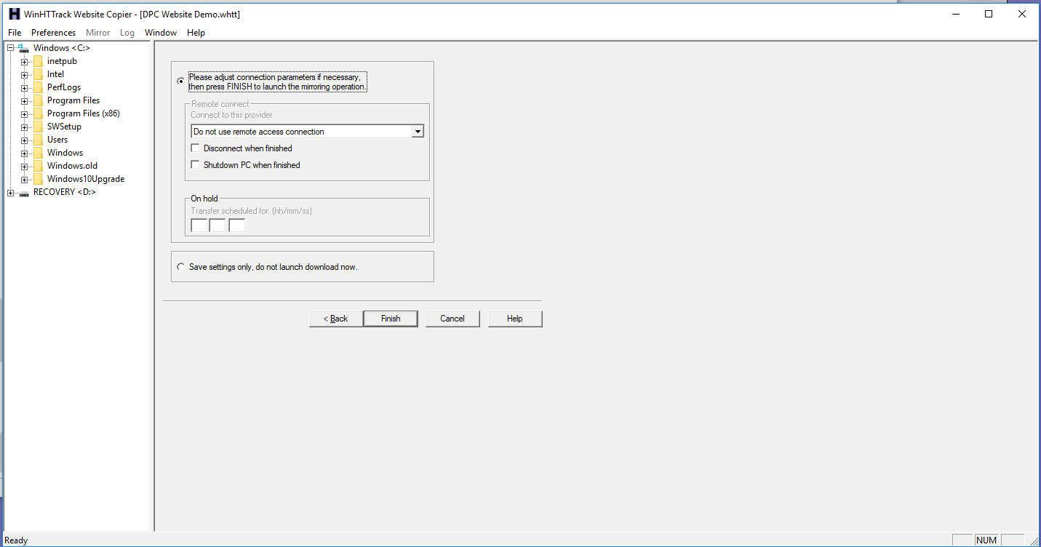
Step 5: Launch or Save / Delay

Slide 30
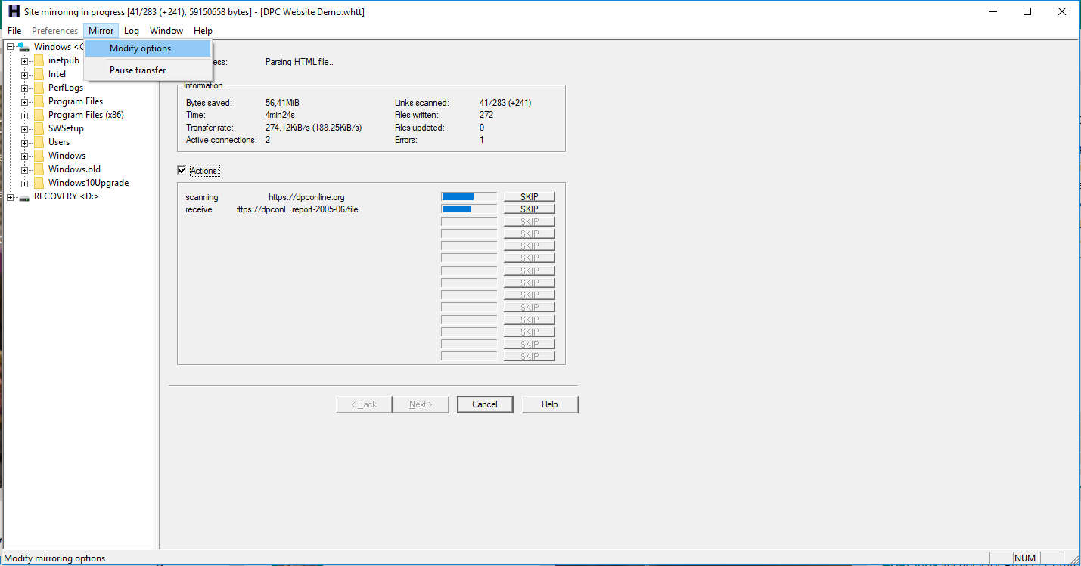
Step 6: Monitor
(& adjust Option Settings)

Slide 31
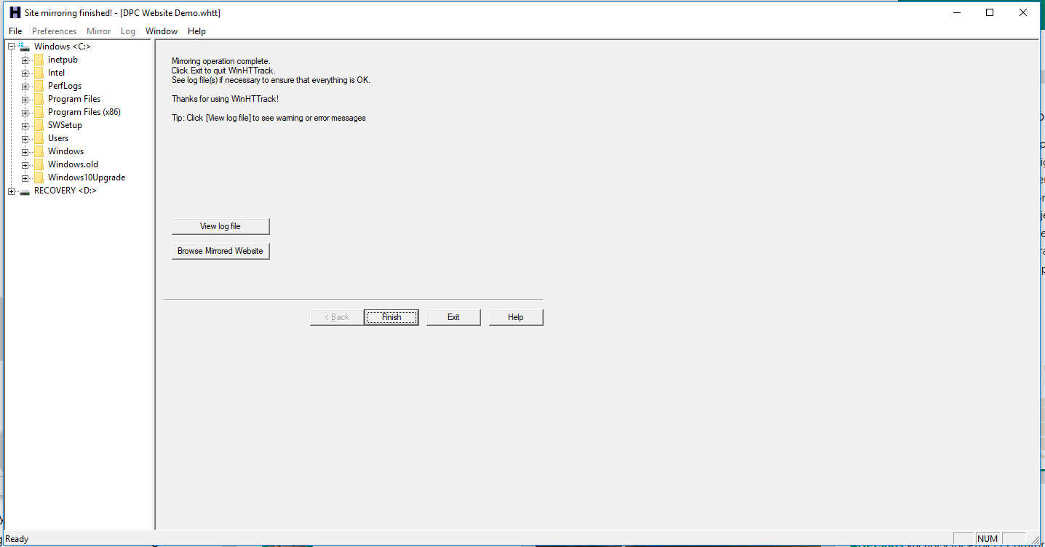
Step 7: Mirror Complete

Slide 32
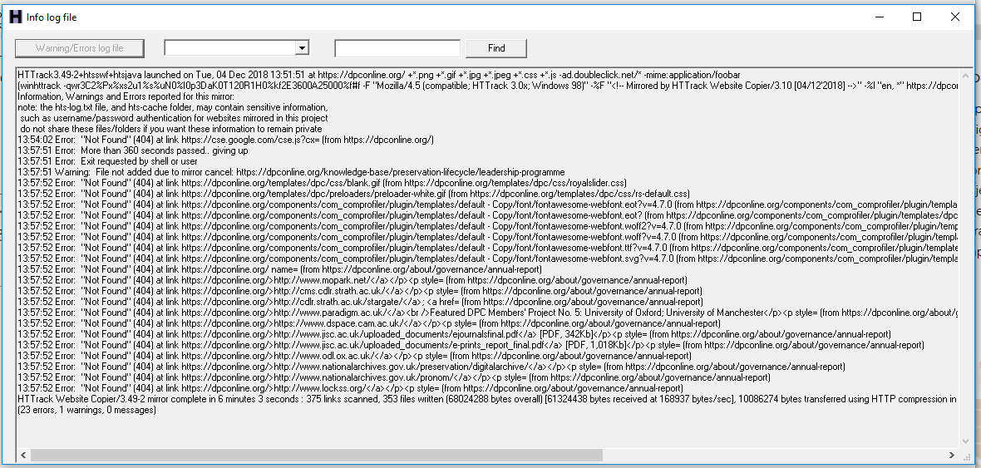
Step 8: Review Log (Errors)

Slide 33
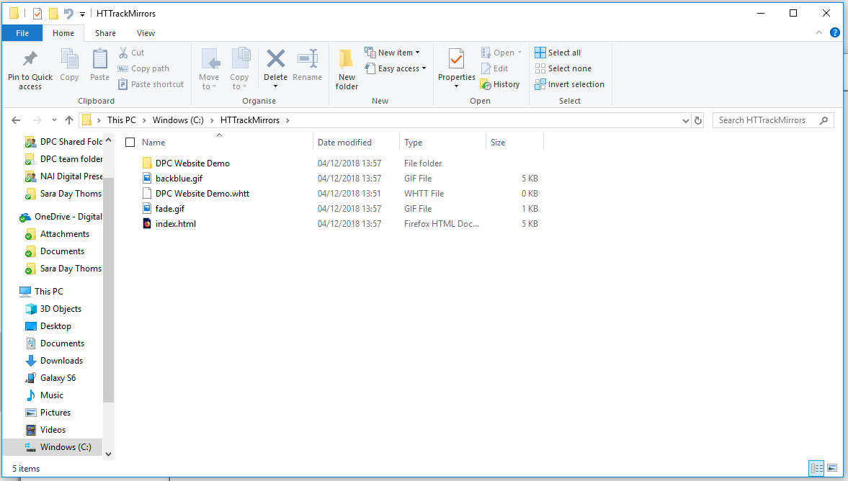
Step 9: Review files in ‘mirror’

Slide 34
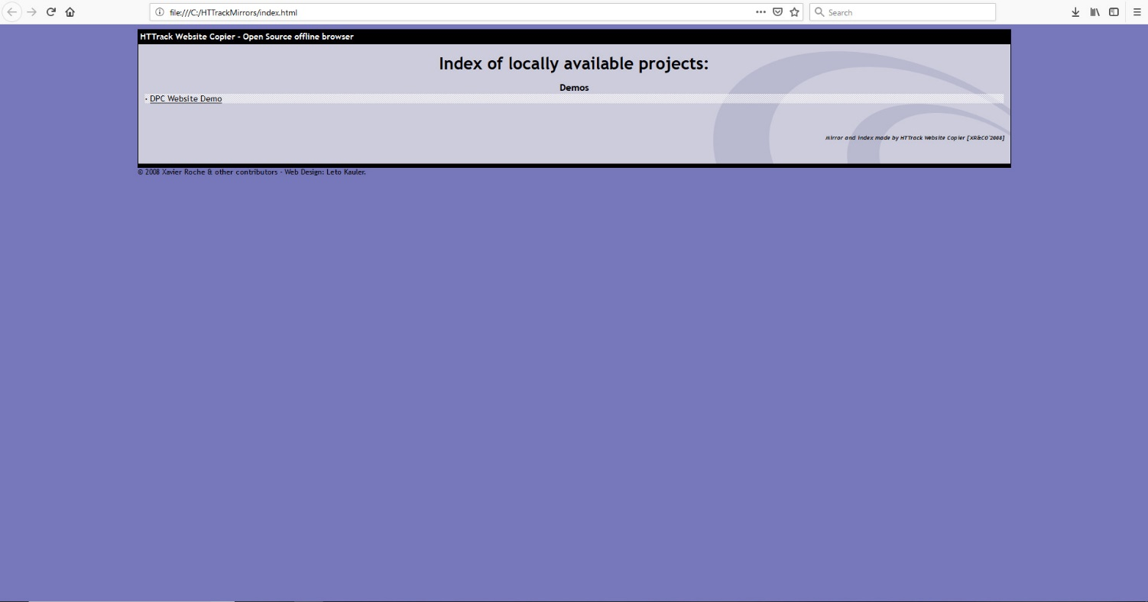
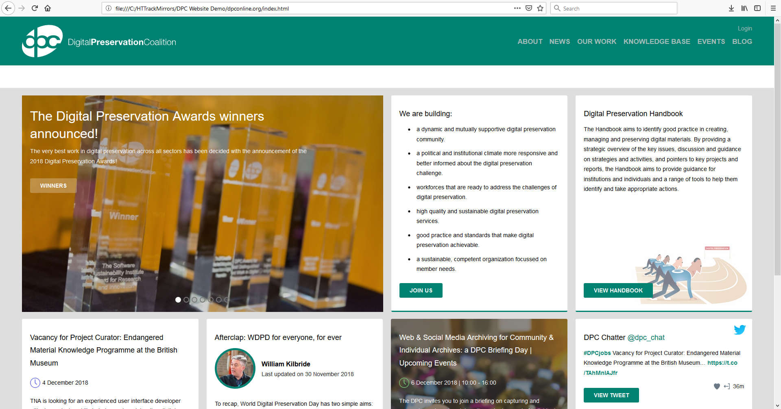
Step 10: View on Browser

Slide 35
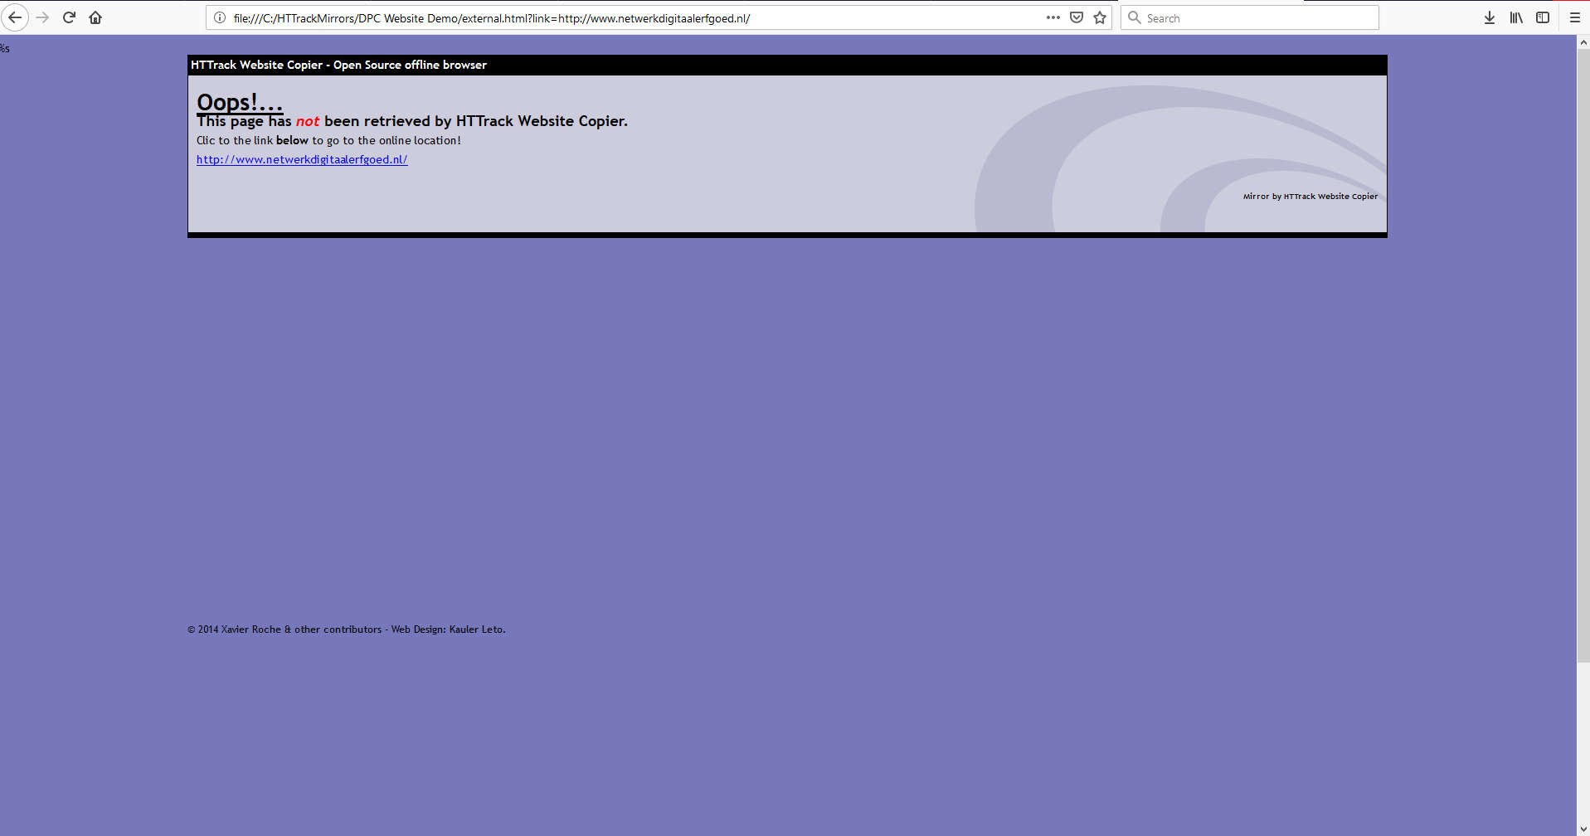
Option Settings in Action: ‘No External Pages’ (Build)

Slide 36
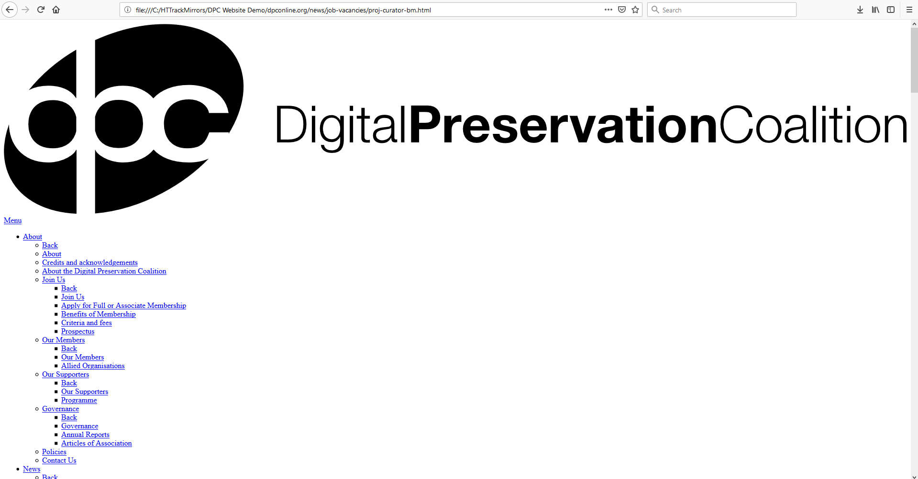
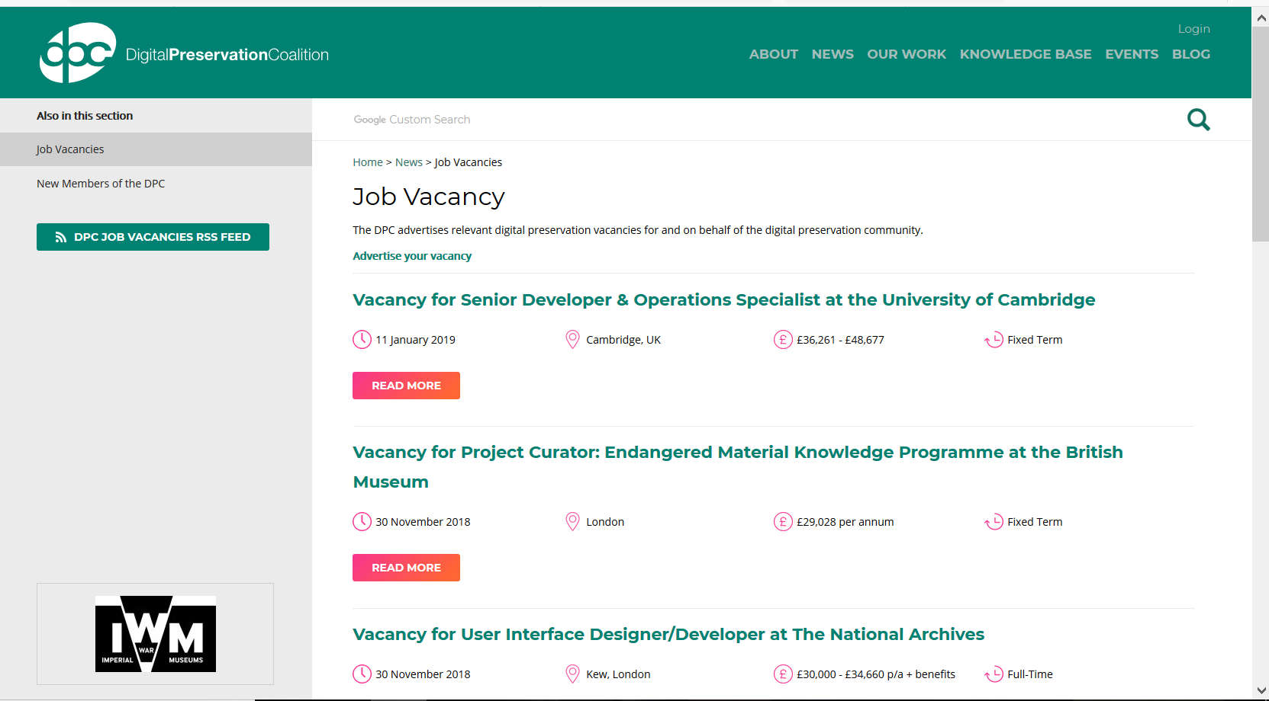
What does an error look like?
Notes:
Style Sheet

Slide 37
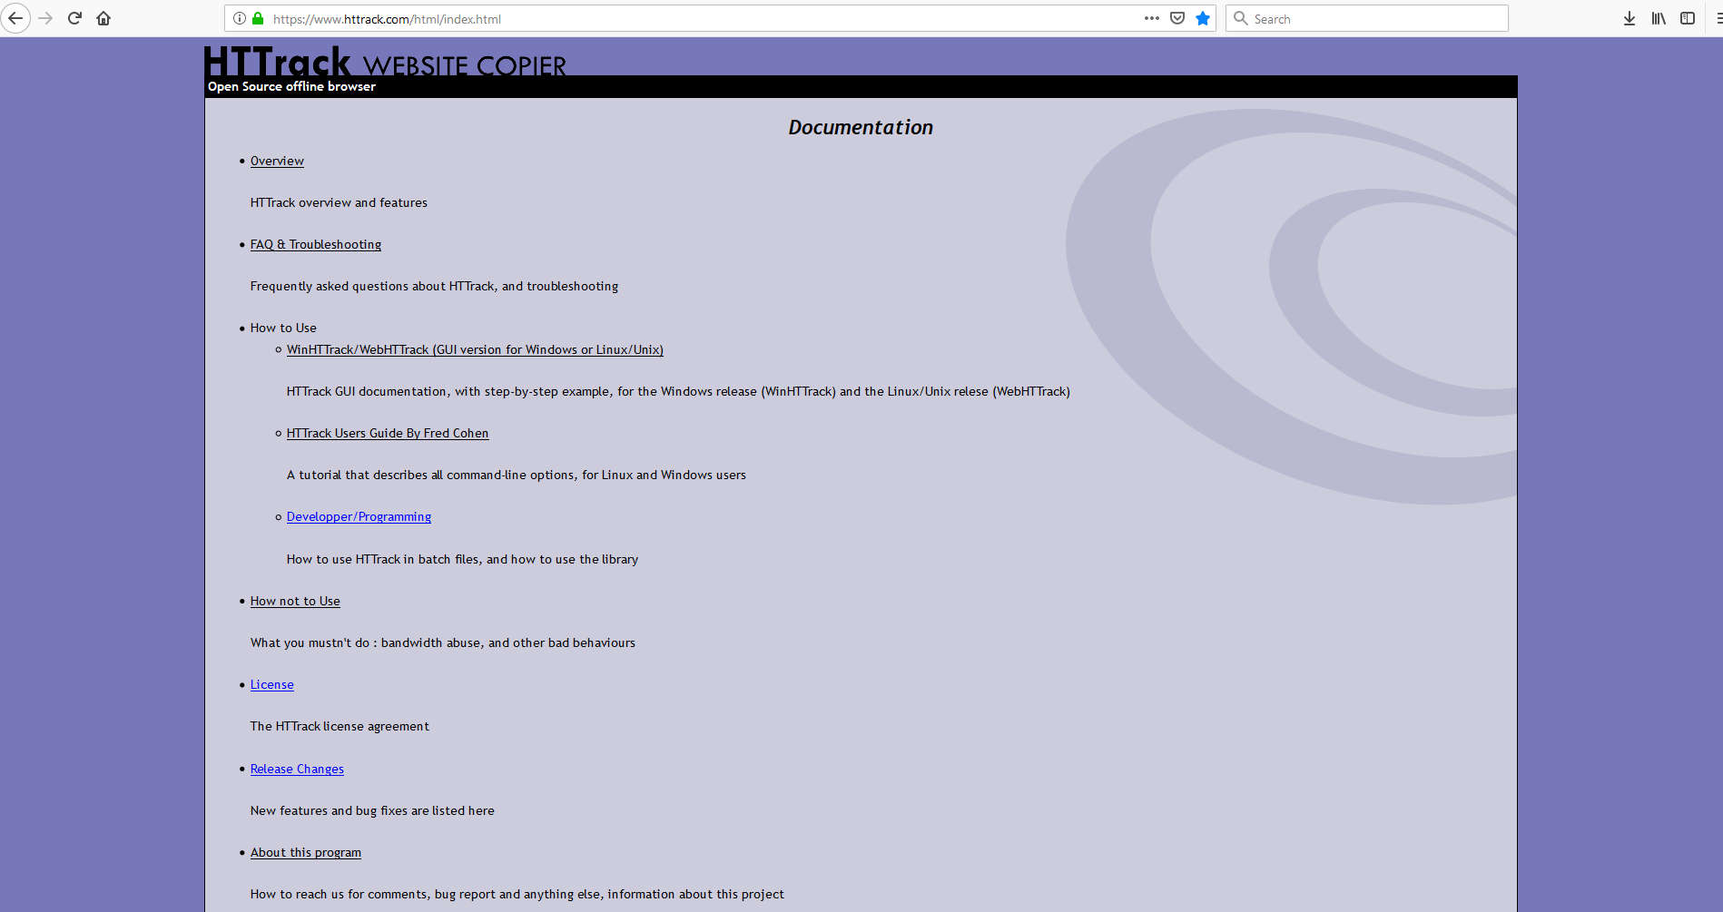
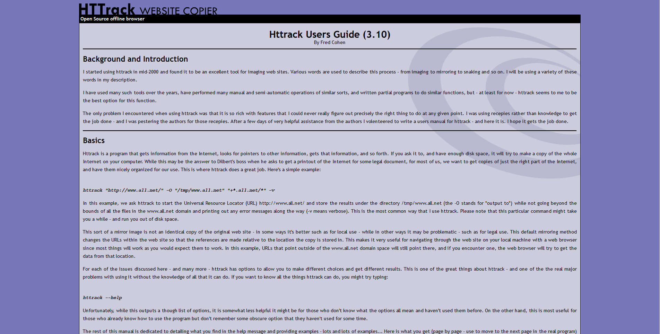
Support & Documentation
User Guide for Command Line
http://www.httrack.com/html/index.html

Slide 38
social media platform self archiving:
Twitter

Slide 39
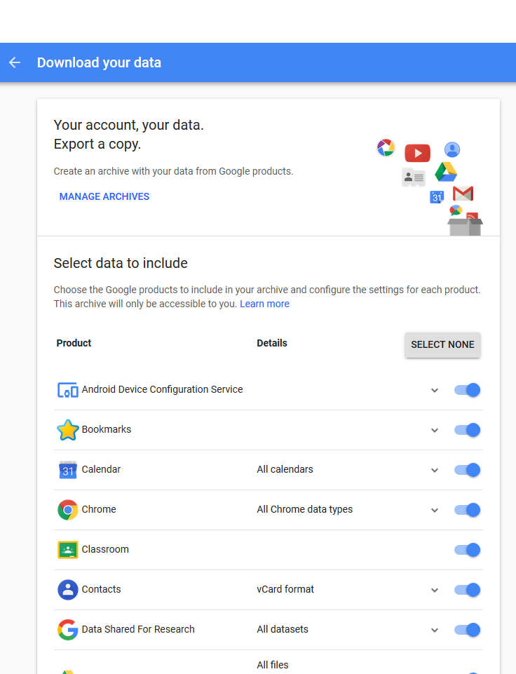
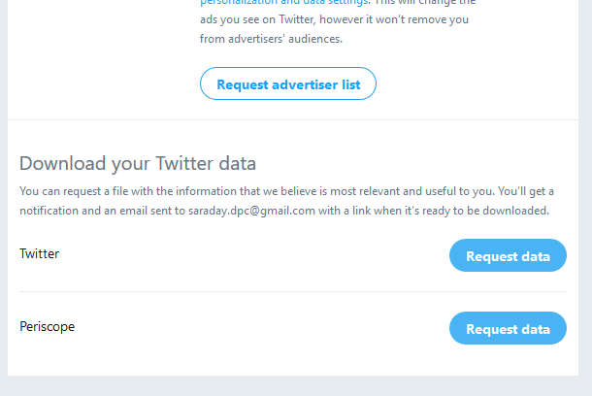
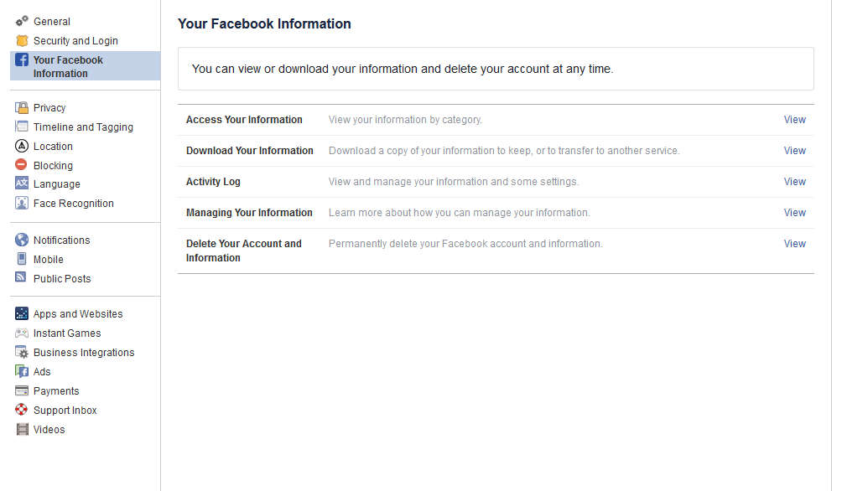
a quick win: platform ‘self-archiving’
download your social media
service for account owner
structured and unstructured data
JSON files with metadata
Twitter
Google
Facebook

Slide 40
download your tweets
account settings
only permitted for the account owner
good practice for institutions with one or more public-facing social media accounts
good practice for personal digital archiving
Notes:
The cvs file – the tags listed may change as Twitter updates the platform so the documentation that describes the data in these categories will disappear as they are updated. When you capture this data, also a good idea to scrape the Twitter documentation the corresponds.
Also, it’s useful to be aware of new restrictions to sharing Tweet IDs - F.2.b.a of Developer Policy - https://gwu-libraries.github.io/sfm-ui/posts/2017-05-18-twitter-policy-change

Slide 41
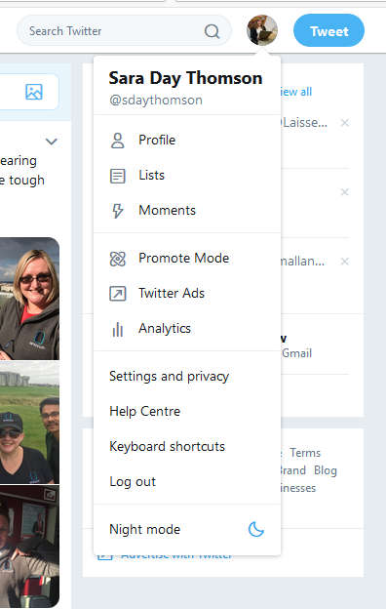
Step 1: Navigate to Settings

Slide 42
Step 2: Request Data from ‘Your Twitter Data’
Notes:
Click on Download -> this will take you to Twitter’s live site where you click ‘Download’ again and a zip file will download.

Slide 43
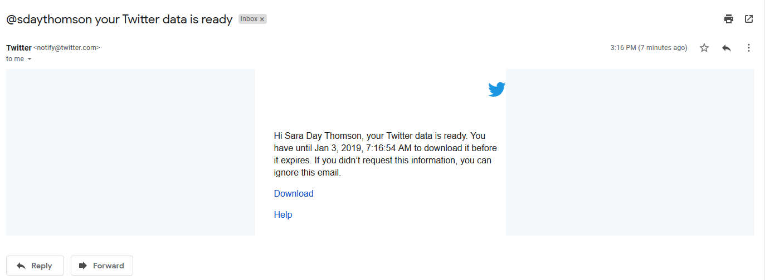
Step 3: Open email (address associated with Twitter account)

Slide 44
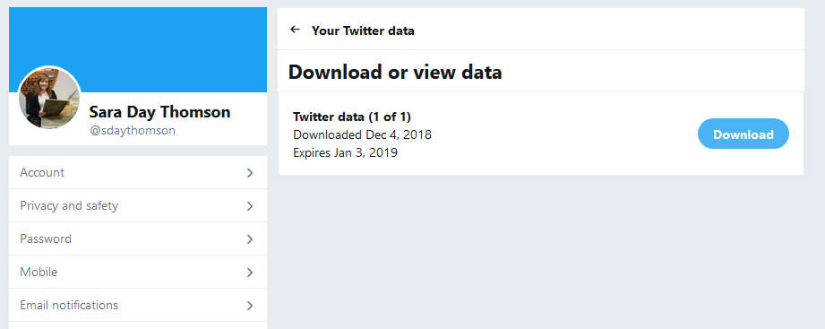
Step 4: Download your data

Slide 45
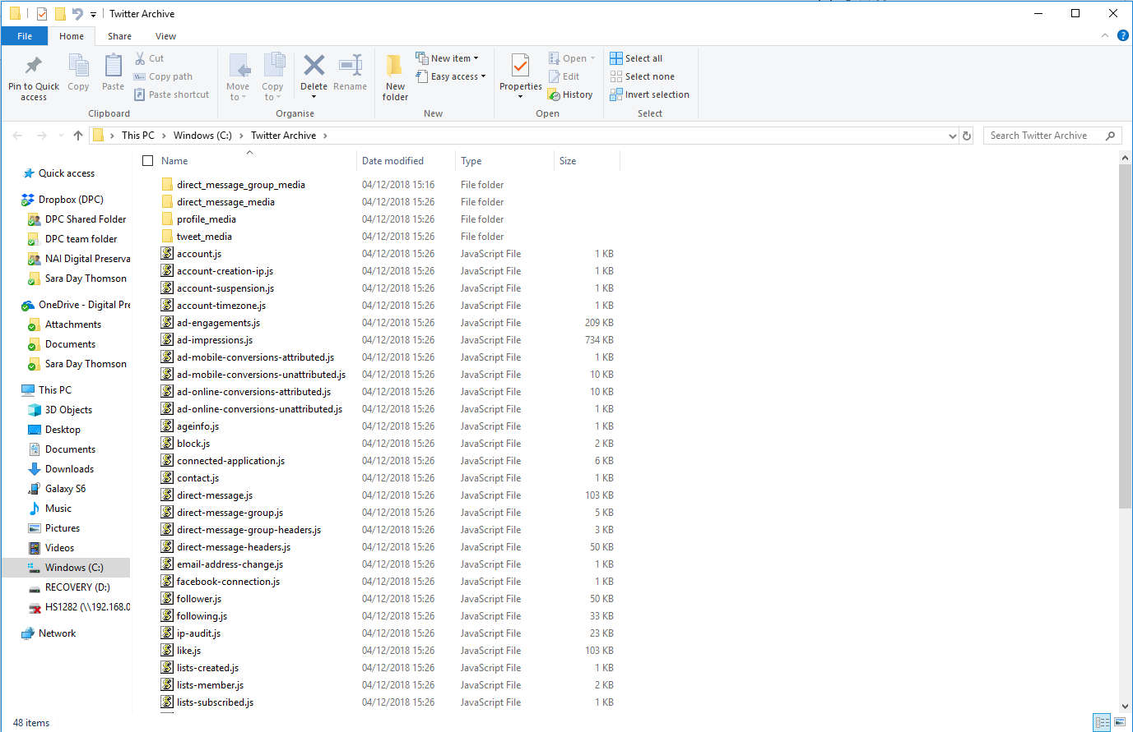
Step 5: Review & Save

Slide 46
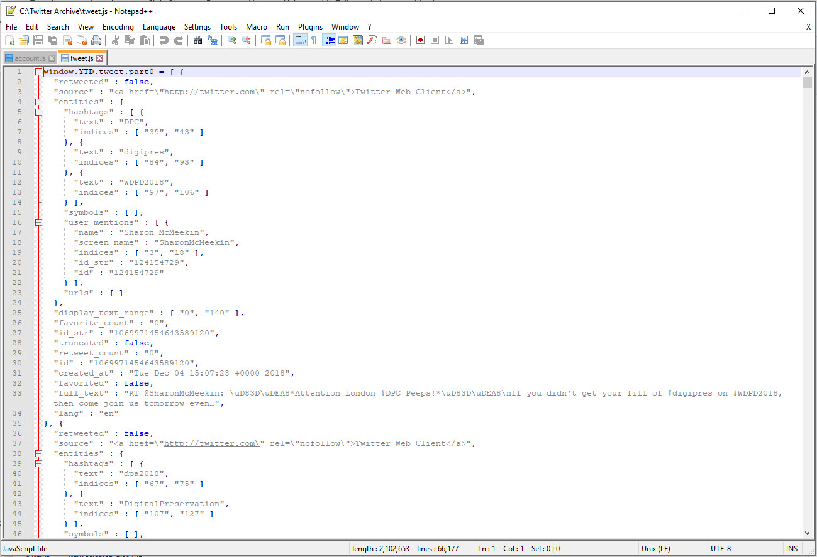
Tweet JSON (Notepad++)

Slide 47






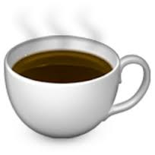

#thanks!

