Slide 1
‘DIY’ Digital Preservation
Managing your personal digital archive

Slide 2
Plan & housekeeping
10:30am-10:35am Intros and housekeeping
10:35am- 10:45am Introduction to Digital Preservation
10:45am – 11:00am
11:00am – 11:10am Locate, Identify, Appraise
11:00am – 11:25am
11:25am – 11:35am Arrange, Store, Maintain
11:35am – 11:45am
Exercise: What do you want to preserve?
Exercise: Document Archaeology
Questions
Notes:
Please keep your microphone on mute when not speaking, but feel free to ask questions in the chat. Ellie will be monitoring it.
The sections in black boxes will be interactive

Slide 3
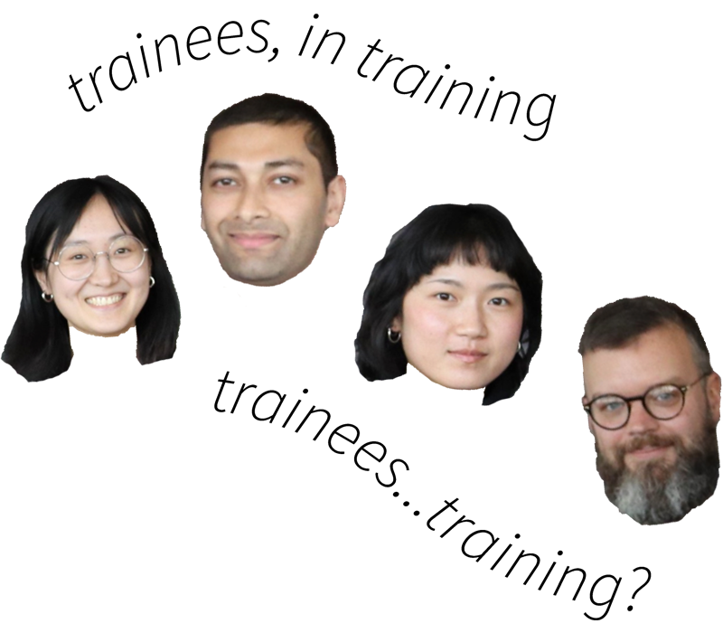
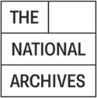




Who are we?
Bridging the Digital Gap traineeship scheme
UK National Archives
(National Lottery Heritage Fund)
bringing ‘digital’ skills into the archives sector
Notes:
Disclaimer: scope of the session is personal digital archiving. I will not be talking about research data, participants should consult the material available from the university research office on this.

Slide 4
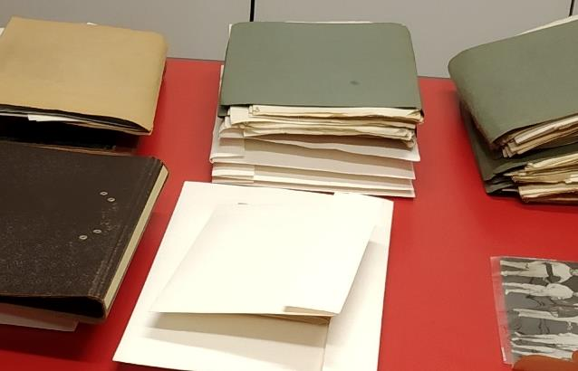
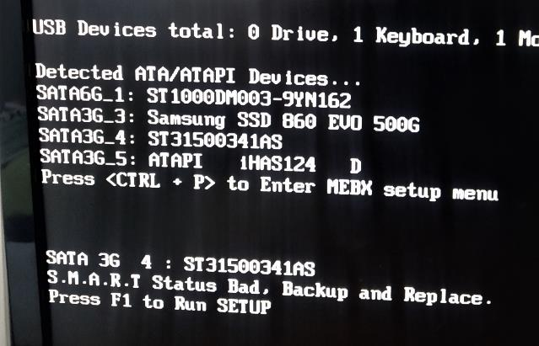
What is digital preservation?
Digital material is vulnerable in different ways to analogue material
Digital preservation:
  “a series of managed activities undertaken to ensure continued access to digital materials for as long as necessary” The Digital Preservation Coalition
Notes:
Digital material is different to, say, paper records. A paper file, provided it is kept at a relatively stable temperature and humidity can be expected to survive through ‘benign neglect’
This is not the case with digital materials, they need to be actively selected and preserved. Storage media such as hard drives degrade over time; hardware, software and file formats can become obsolete; and because digital files are so easy to copy, edit, and share, they can be difficult to keep track of.
Digital preservation then, is the ongoing work of ensuring digital materials remain accessible. This could range from relatively simple DIY processes to a complex workflow for analysing digital material, making access and preservation copies and storing them in a monitored digital repository, while maintaining a ‘technology watch’ for looming threats such as obsolescence.

Slide 5
Challenges for digital preservation
Technical
hardware failure
file corruption, bit flipping
virus/malware
obsolescence (file format, hardware, software)
Non-technical
unclear ownership/responsibility
lack of documentation or long-term planning (neglect)
overdependence on third-party solutions (e.g. Google Drive)
loss/theft, natural disaster
Notes:
Obsolescence – for example MacOS Catalina will no longer run 32-bit software, similarly we have seen formats like flash. Hardware like optical drives
In both cases, resources in the sense of time, or in some cases financial resources (if deciding to purchase cloud storage or external drives for instance), can also be barriers to personal digital preservation.

Slide 6
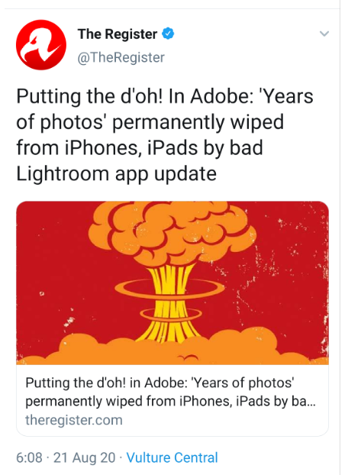
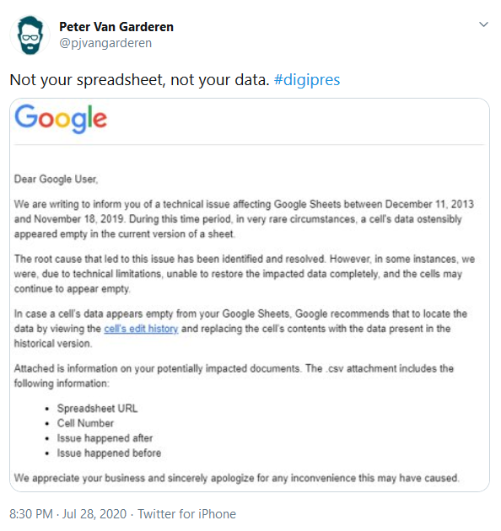
Will the cloud save us?
Notes:
Well, perhaps. But it’s not a silver bullet.
Cloud services, especially free services, are often not very accountable to their users.
Furthermore, as cloud services like dropbox often synchronise with your local machine, if your local files are deleted or compromised by malware, those issues can be replicated on the cloud. Cloud storage also doesn’t deal with problems of obsolescence, if you have a file safely backed up but no way of opening it, it’s not really being preserved.
It’s better to think of cloud services as a potential component in a preservation strategy rather than being a complete solution.

Slide 7
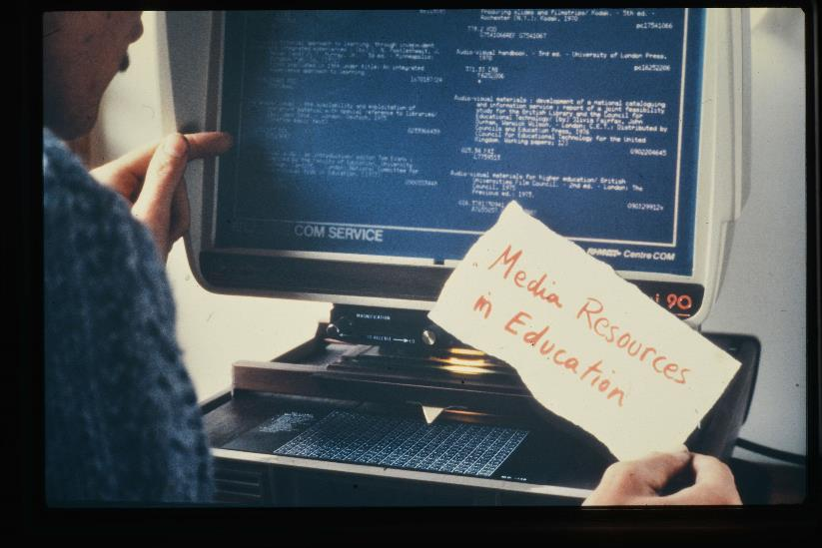
Why do personal digital preservation?
Your digital assets have value to you as an individual
Through personal digital preservation we can work to redress power imbalances in the cultural record
Personal digital preservation is empowering!
Notes:
The digital material that you create and use will be important to you for all sorts of reasons: your personal images and videos may have huge emotional value, your documents may be vital for your studies or for activities like job applications or proving your identity or you may create important digital works of music or art or literature.
There is also a wider value to personal digital preservation. If only big institutions and private corporations have the resources and technology to preserve their digital material, then we risk losing the voices of ordinary people and especially people who are already marginalised or under-represented.
Personal digital preservation gives you an opportunity to think carefully about what you value and you record your lived experience. It gives you the opportunity to share your stories if you choose.
[Image: PCL/2/Lib/6/14, Slide: Introduction to PCL Library Services, https://westminster-atom.arkivum.net/index.php/pcl-2-lib-6-14]

Slide 8
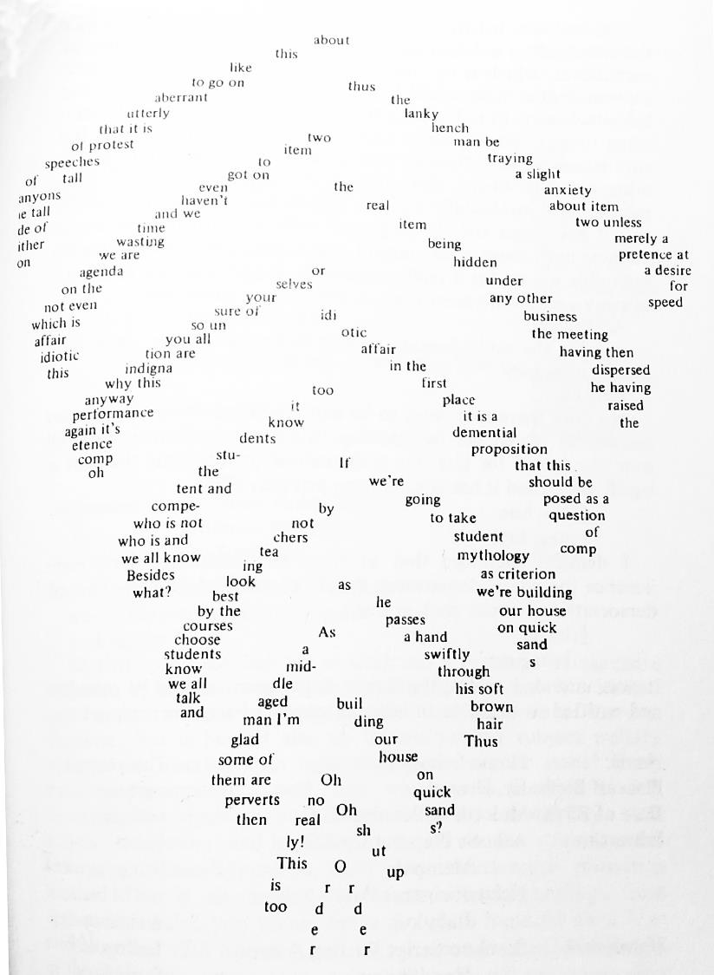
What do you care about?
What digital material do you care about that you would like to preserve?
What is important about:
  The content of the material
  Any other significant properties of the material
Notes:
Significant properties – e.g. the layout of text in a document, the ability to run formulae in a spreadsheet, the ability to click through a website etc.
The image on the right is from a piece by the experimental writer Christine Brooke-Rose. If an archive preserved just the raw text, but not the formatting, the meaning of the original piece would be lost.
[image is of page 734 from Christine Brooke-Rose, The Christine Brooke-Rose Omnibus: Four Novels: Out, Such, Between, Thru, (Carcanet Press, Manchester, 2006)]

Slide 9
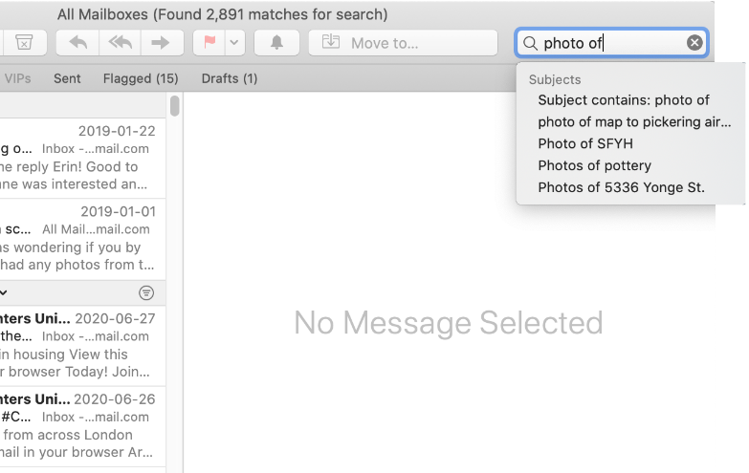
(1) Locate your material
hardware: CDs, DVDs, USB/Flash drives, camera, mobile device
shared drives: Google, DropBox, OneDrive, your institution/workplace
other places to look: email, attachments, chat history, social media, personal websites
Determining when and in which contexts specific files were used is easier for more recent projects, but can become increasingly difficult the longer you leave them.

Slide 10
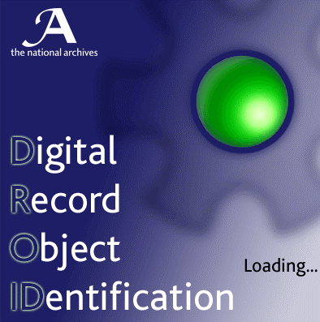
(2) Identify what you have
Knowing what file formats you have will support you in determining how to care for them
You can use free file format identification tools like DROID or MediaInfo
Think about whether the file formats you have are the best way to preserve the significant properties of your material
Notes:
No exact order for identification and appraisal, they often support one another and isn’t really a clear-cut process for personal archives
https://www.nationalarchives.gov.uk/information-management/manage-information/policy-process/digital-continuity/file-profiling-tool-droid/
https://mediaarea.net/en/MediaInfo

Slide 11
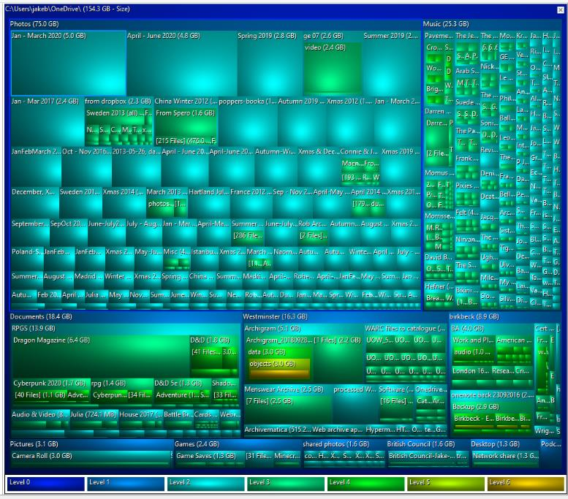
(3) Appraise your digital material
Think about what you want to retain and why: project files, final files, drafts?
Consider deleting duplicates or other files you no longer need
TreeSize Free (Windows) or GrandPerspective (MacOS) can help visualise your files according to size and maintain any existing folders
Screenshot of a TreeSize Free scan of my ‘Documents’ folder.
Notes:
Consider environmental and cost implications of storage

Slide 12
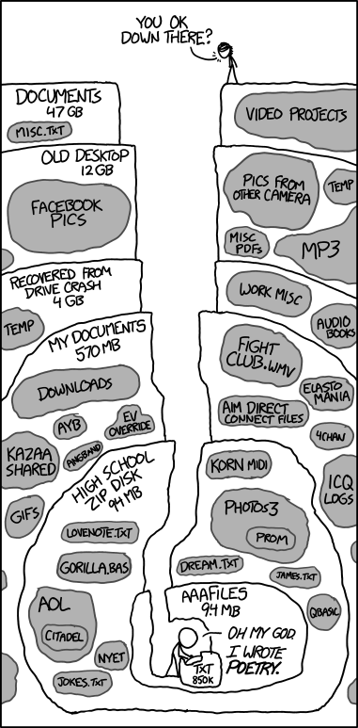
Document Archaeology
What is the oldest document you can find on your computer?
When was it from? Could you open it?
Think about your folder structure and file names. Did they help make things easier to find?
Do you have duplicates or different versions of the same file?
Notes:
Don’t worry if you find this difficult, think of it as an experiment.
You may find files from 31/12/1979 or 01/01/1980 – this is the ‘year zero’ for files stored using the FAT file allocation system. So if there is no stored date for the file it might default to that.
[image is a comic called Old Files from XKCD, https://xkcd.com/1360/, this is referenced in Trevor Owens’ The Theory and Craft of Digital Preservation]

Slide 13
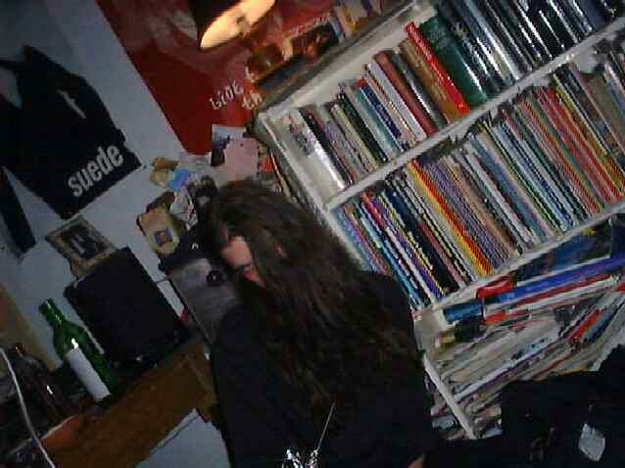
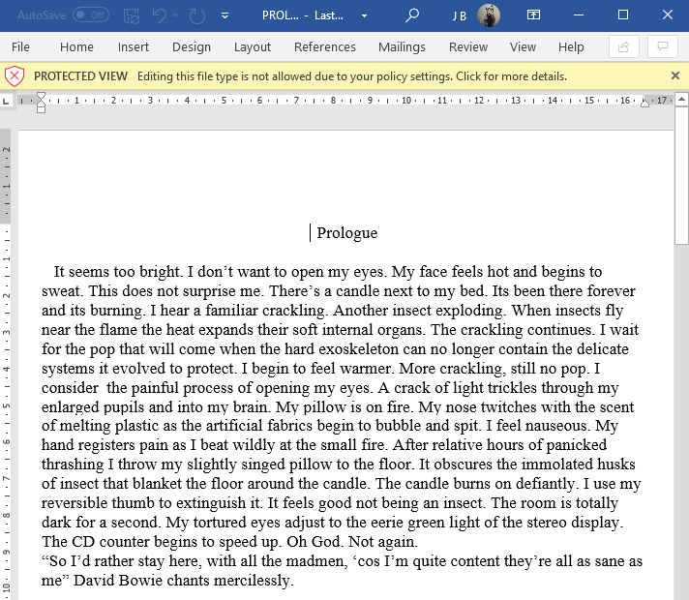
C:\Users\jakeb\OneDrive\Photos\old\DSC00007.JPG
from 08/09/1998
C:\Users\jakeb\OneDrive\Documents\Old Documents\College\PROLOGUE.DOC from 10/10/1998
Notes:
Good news: I could still open both files, though the Word file format was not editable without changing settings.
Bad news: they weren’t easy to find and it’s not clear from the titles or folder what they are… someone other than me wouldn’t really be able to tell much about them.
Common file formats likely to be easy to open, but other things like software may be more problematic, the oldest item I found was a piece of logic software called TWOOTIE.EXE, originally from 1991 – this wouldn’t run at all.

Slide 14
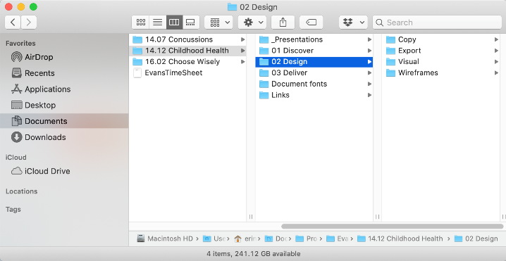
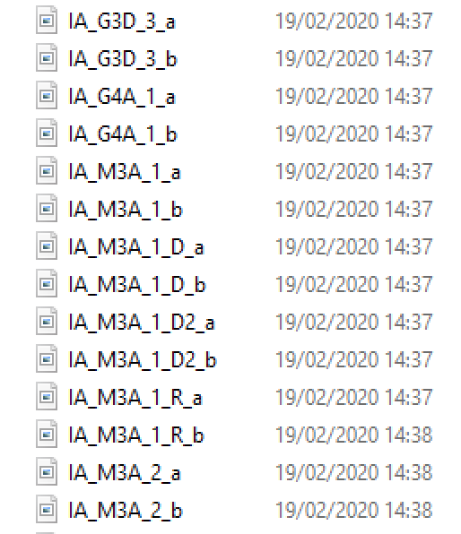
(4) Organise your files
Think about what belongs together
Use concise, consistent but meaningful file and folder names e.g. date, project, number. Avoid special characters
Use version control (not FINAL_final2_draft_dissertation.doc)
If you use a Mac you can bulk rename files in finder, Windows tools include Bulk Rename Utility
You may already have a file-naming and folder-organising convention. The key is to think
about how you’d like to access your files long-term, bearing in mind what relationships need
to be maintained among your files to enable access/use.
Notes:
Where applicable, indicate where a document is ‘Draft’ or ‘Final’. You can also indicate the version of a document by the inclusion of a ‘V’ followed by the version number.
UoW guidance https://universityofwestminster.sharepoint.com/sites/Resources/Shared%20Documents/2017BasicNamingConventionsGuidance.pdf
Stanford Library guidance https://library.stanford.edu/research/data-management-services/data-best-practices/best-practices-file-naming

Slide 15
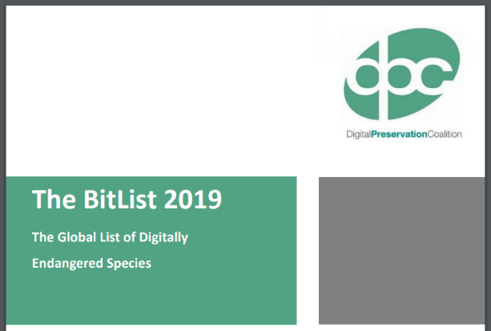
(5) Consider migrating file formats
Consider migrating file formats that are at risk of obsolescence or proprietary formats
Different formats may be appropriate for different stages of your workflow (e.g. PDFs for final documents)
Tools include:
  Open/Libre Office for documents
  Audacity with FFmpeg for audio
  ImageMagick for images
  Handbreak or FFmpeg for video
You can find information about ‘at-risk’ formats via the DPC’s BitList: https://www.dpconline.org/digipres/champion-digital-preservation/bit-list
Or via the Library of Congress: https://www.loc.gov/preservation/digital/formats/
Notes:
This is a live debate in digital preservation
Think about at the end of your studies, you might lose access to specialist software that you get through the university,

Slide 16
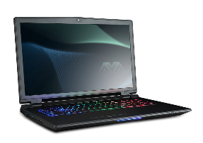
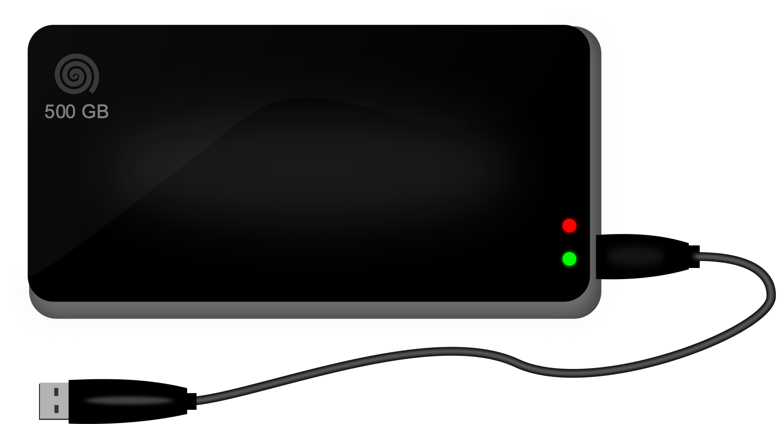
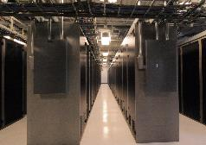
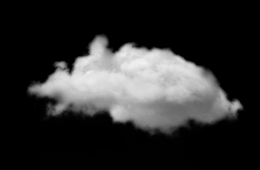
(6) Storing your digital files
Copy 1
(for immediate access)
LOCKSS =
Lots of Copies Keep Stuff Safe
Save copies (ideally at least three) in multiple locations, ideally using different media
When one location fails, restore from one of the other locations
Verify your copies
Back-up Copy 1
(e.g. external hard drive)
Back-up Copy 2
(e.g. cloud storage)
Ideally, back-up
copies would be stored across
different media and different geographical locations
Notes:
LOCKSS – fundamental principal in digital storage

Slide 17
(6) Storing your digital files
Copy 1
(for immediate access)
External hard drives
Cloud storage (be aware of any legal or privacy obligations)
Optical media – especially rewritable media - are not an archival storage medium
Back-up Copy 1
(e.g. external hard drive)
Back-up Copy 2
(e.g. cloud storage)
Ideally, back-up
copies would be stored across
different media and different geographical locations
Notes:
All hard drives will fail at some point.
Field studies have suggested that manufacturer estimates of reliability can be over optimistic
Average lifespan is 3-5 years, but studies suggest that 5% of hard drives actually fail within one year

Slide 18
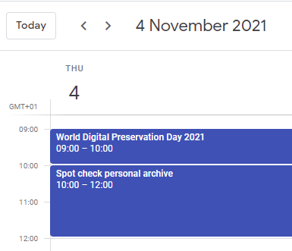
(7) Maintaining your files over time
Replace storage media, ideally at least every five years
Test access to files, spot-check at least once a year
Bear in mind digital preservation when creating files, particularly when using subscription software or emerging software/formats
Taking care of your digital material can be low-demand when scheduled at regular intervals, like other forms of housekeeping.
Notes:
DPC World Digital Preservation day – first Thursday of November every year

Slide 19
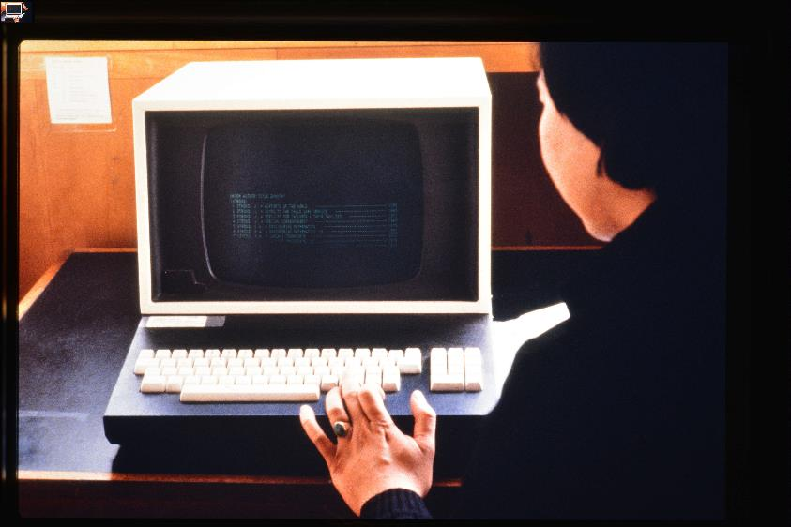
Discussion
Think about your personal digital preservation strategy
Questions
Notes:
[image: PCL/2/Lib/6/39, Slide: Introduction to PCL Library Services, https://westminster-atom.arkivum.net/index.php/pcl-2-lib-6-39]

Slide 20
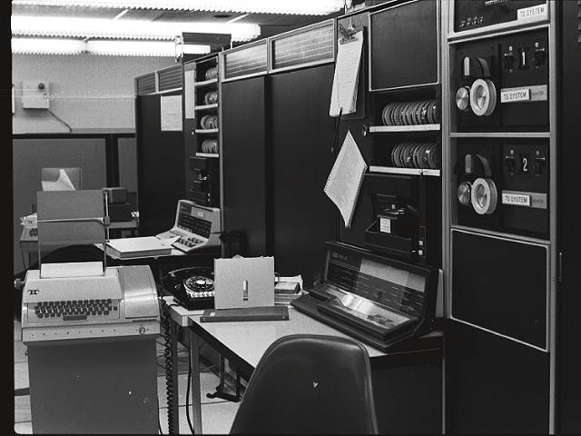
Bonus content: email
Email is often used as an ‘informal archive’ – but it is frequently held by an unaccountable cloud-based service provider.
Be careful: remember that you are working with material that contains your personal information and that involves others.
First do some appraisal, try to delete unimportant things as you go along, move important things to a special folder.
Make a local copy of your email via Google takeout or by using an email client like Thunderbird or Mac Mail.
Export your email into an open format like mbox.
Keep it safe, make backup copies.
Notes:
[image credit: Wikimedia Commons, Timesharing and Development KA-10s at BBN, circa 1970.jpg, https://commons.wikimedia.org/wiki/File:Timesharing_and_Development_KA-10s_at_BBN,_circa_1970.jpg]

Slide 21
Bonus content: email
Getting your email:
  Gmail – go to https://takeout.google.com/ - you can specify which folders you want to get, they will be exported as mbox files. Google will email you when they are ready to download.
  If your email provider does not offer this option (e.g. Outlook), download a mail client such as Thunderbird https://www.thunderbird.net/en-GB/ and set it up to work with your email account, this will create a local copy on your machine. To back it up, install the ImportExport Tool add-on and export as an mbox file.
  Alternatively save individual emails and add them to relevant project files in your archive.

Slide 22
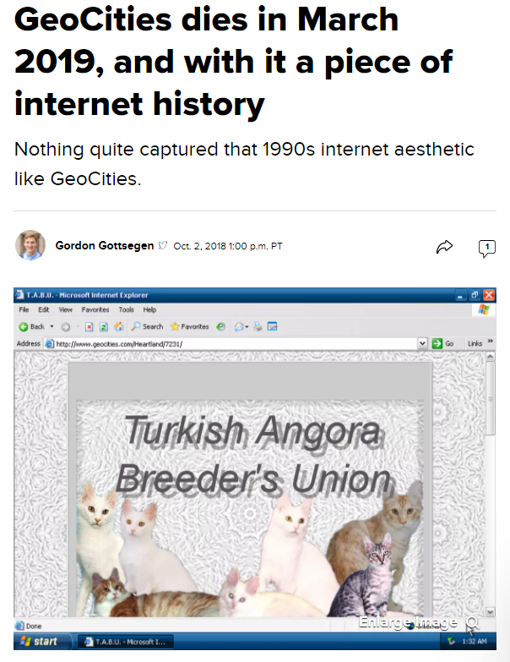
Bonus content: archiving the web
Our websites and blogs often feel like a ‘personal archive’
But the web is an unstable place, the average life of a website is just 100 days
Even where a site stays up, links break and content is frequently overwritten
Hosting providers, especially those providing free services, may unexpectedly shut down or change their terms of service
Notes:
[image from CNet, GeoCities dies in March 2019, and with it a piece of internet history, https://www.cnet.com/news/geocities-dies-in-march-2019-and-with-it-a-piece-of-internet-history/]
See also: https://www.newyorker.com/magazine/2015/01/26/cobweb

Slide 23
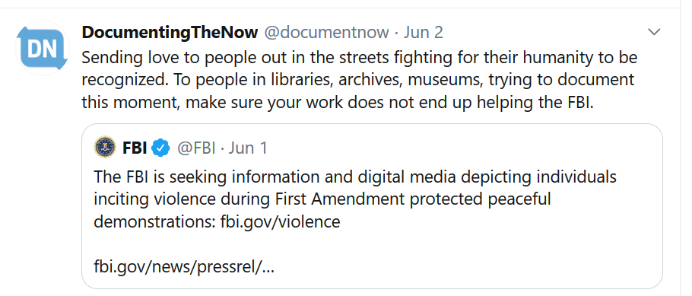
Bonus content: archiving the web
You can nominate sites to be archived by third parties such as the Internet Archive and the UK Web Archive, but access may be an issue
Alternatively, you can make your own web archive using a free service like Conifer
Download your archived sites as WARC files and keep a local copy
Social media and proprietary web services such as Wix and Squarespace can be hard to capture
Always consider the ethical implications of web archiving, especially if you are capturing social media.
Notes:
See the recently updated Conifer user guide: https://guide.conifer.rhizome.org/

Slide 24
Further reading
The Digital Preservation Coalition, see in particular the ‘Topical Note’ and ‘Technology Watch’ reports on personal digital archiving
https://www.dpconline.org/digipres/discover-good-practice/tech-watch-reports
The National Archives, digital preservation workflows
https://www.nationalarchives.gov.uk/archives-sector/projects-and-programmes/plugged-in-powered-up/digital-preservation-workflows/
Social Control 2019 zine, from Documenting the Now: A guide to owning your social media content
https://www.docnow.io/workshops/social-control-2019/

