Slide 1

Digital Collections and Access for Disabled Users
Digital Preservation Coalition
19 June 2025
Dr Maria Castrillo Llamas
Dr Ann-Marie Foster
Collections Access and Research

Slide 2
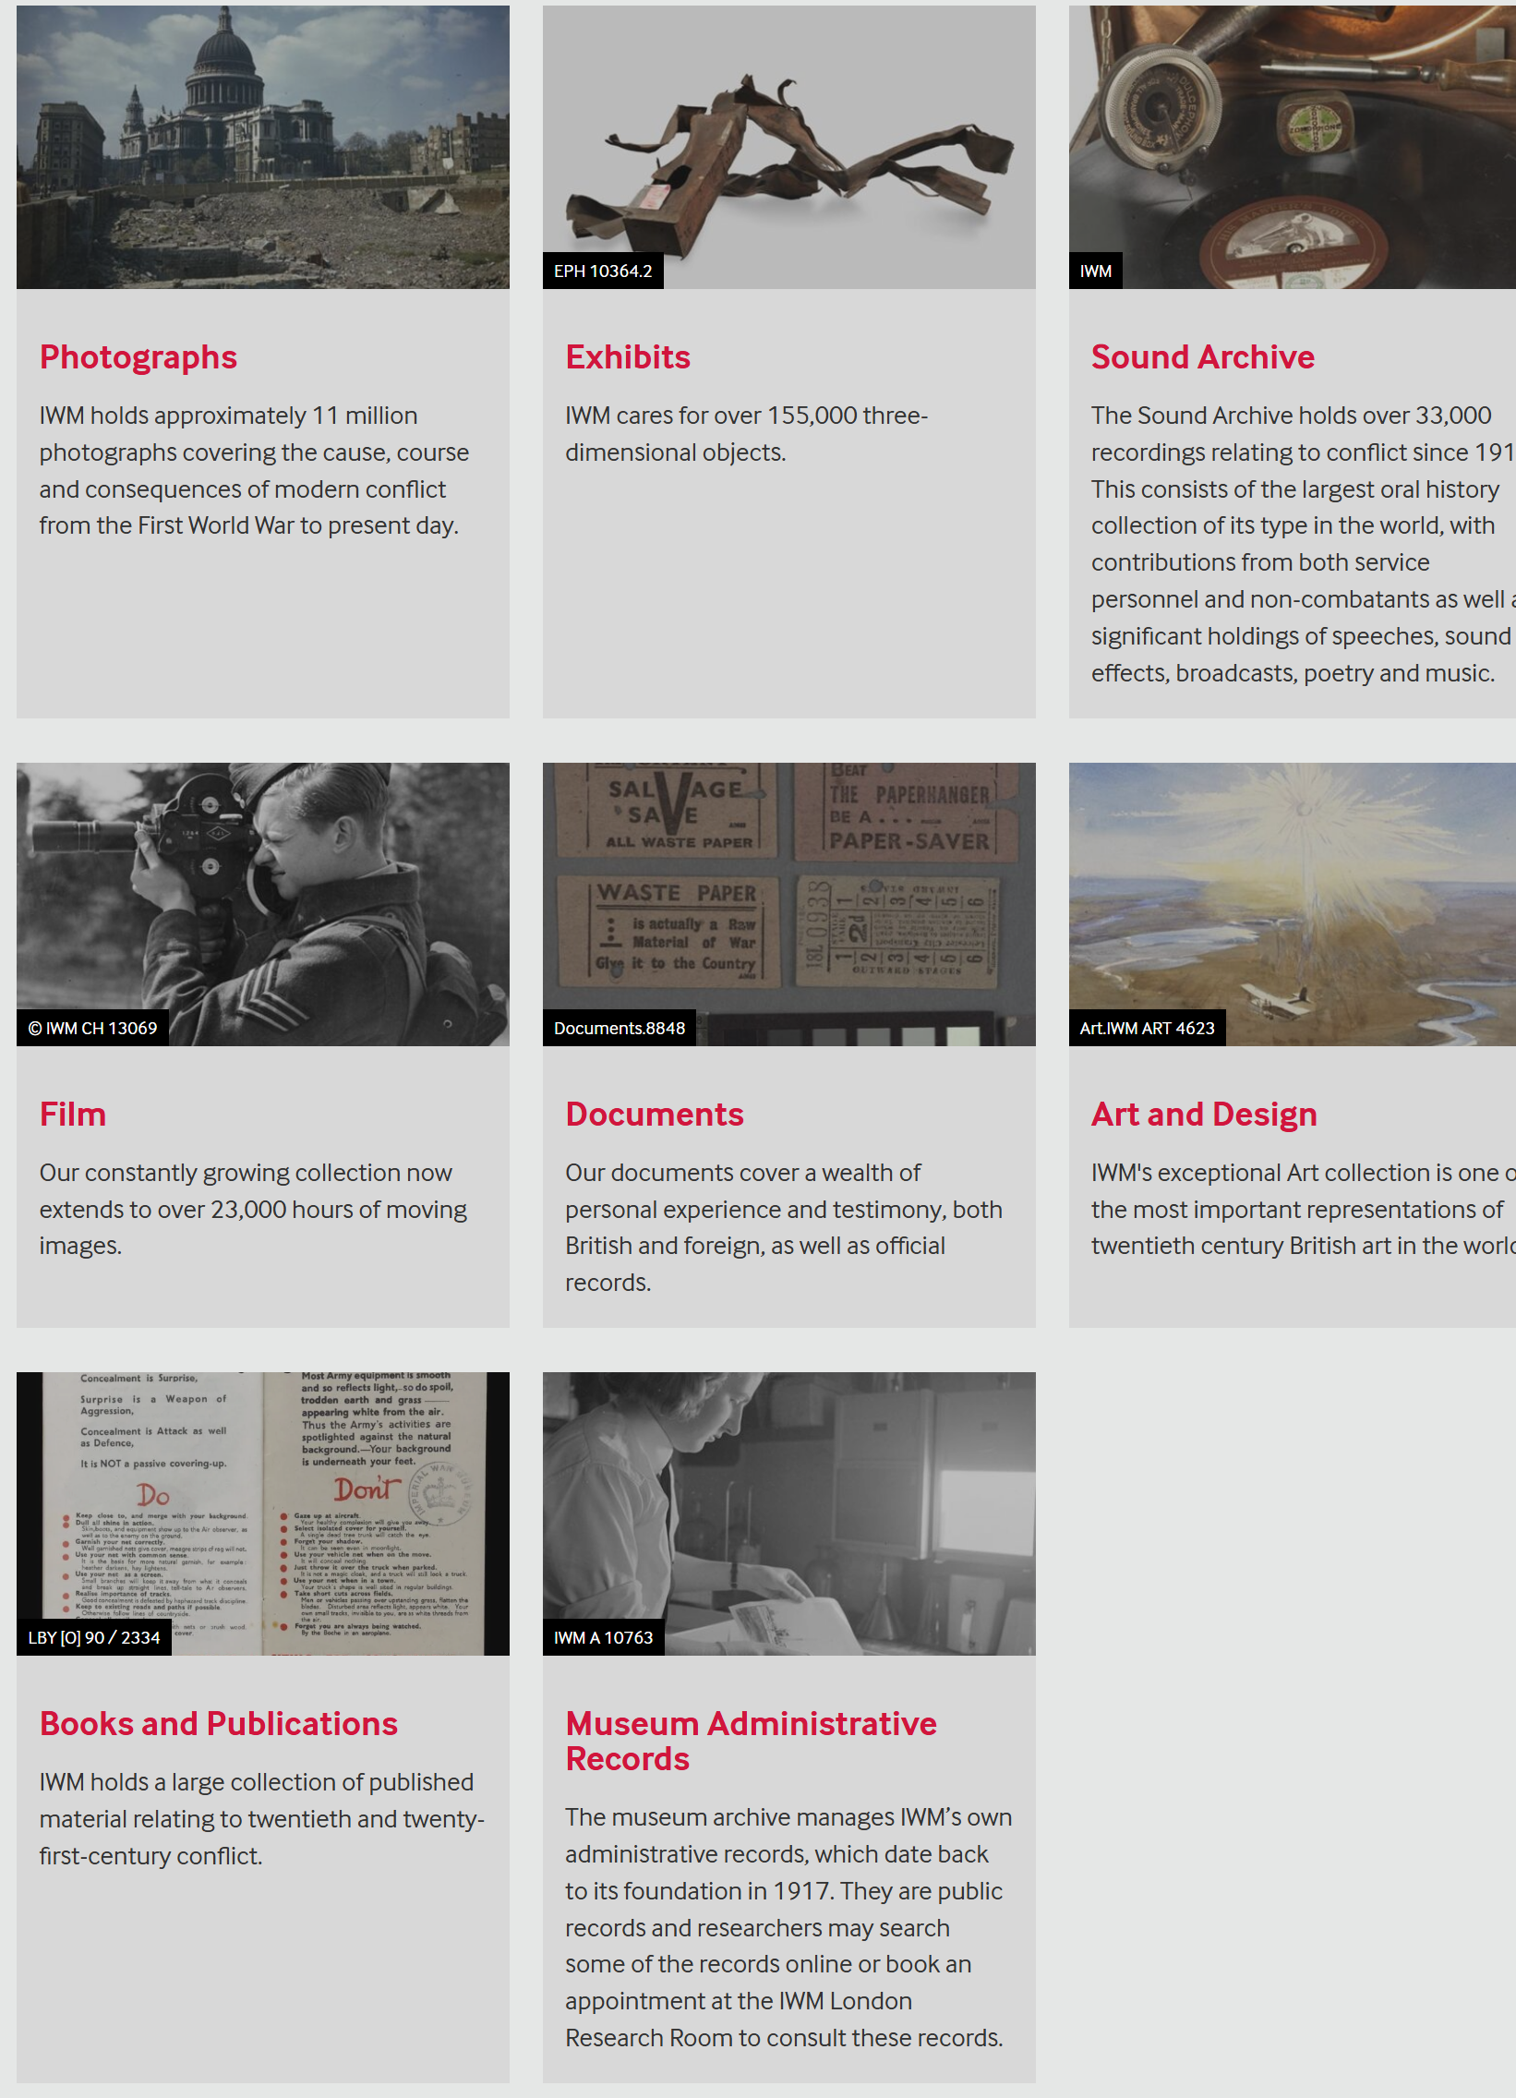
IWM Collections
Over 33.5 million items:
covering photographs, exhibits, sound archives, film, documents, art, books, and administrative records.

Slide 3
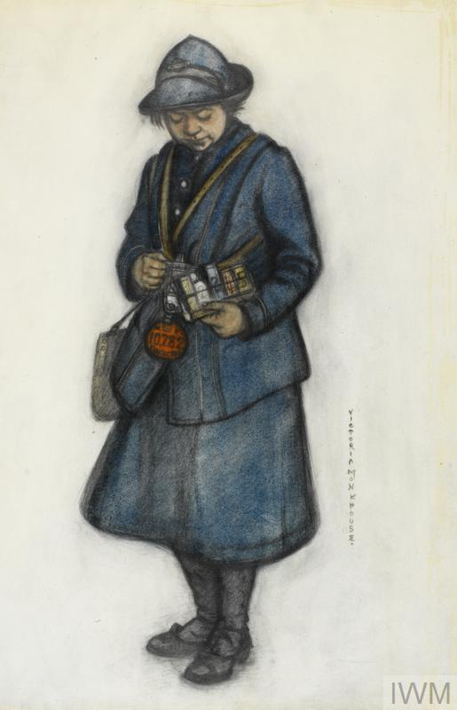
Challenges
Very large collection, with varying rates of metadata, etc.
Copyright restrictions mean some of our born digital collection is only available via certain routes, i.e. in the Research Room.
Our audiences reflect our status as a museum with global connections.
IWM ART 2316

Slide 4
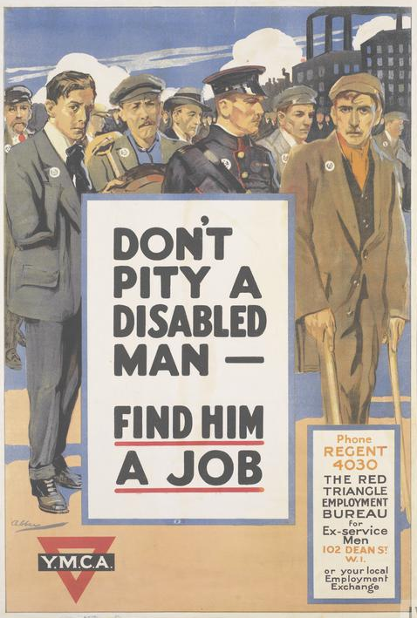
Access for Disabled Users in the Sector
The overwhelming majority of cultural organisations ‘do not directly consider accessibility issues when creating digitized content’ and ‘digital content remains frequently inaccessible to persons with disabilities – particularly to those with vision, hearing, motor, or cognitive impairments.’
- A. Darvishy, J. Manning, ‘Accessible Digital Documentary Heritage’ (UNESCO, 2020).
Art.IWM PST 13211

Slide 5
Legal Considerations
Public collections beholden to:
Equality Act 2010.
Public Sector Bodies Accessibility Regulations 2018.
At present, the 2018 regulations do not include:
(f) reproductions of items in heritage collections that cannot be made fully accessible because of either—
(i) the incompatibility of the accessibility requirement with either the preservation of the item concerned or the authenticity of the reproduction; or
(ii) the unavailability of automated and cost-efficient solutions that would easily extract the text of manuscripts or other items in heritage collections and transform it into content compatible with the accessibility requirement.
          The Public Sector Bodies (Websites and Mobile Applications) (No. 2) Accessibility Regulations 2018.

Slide 6
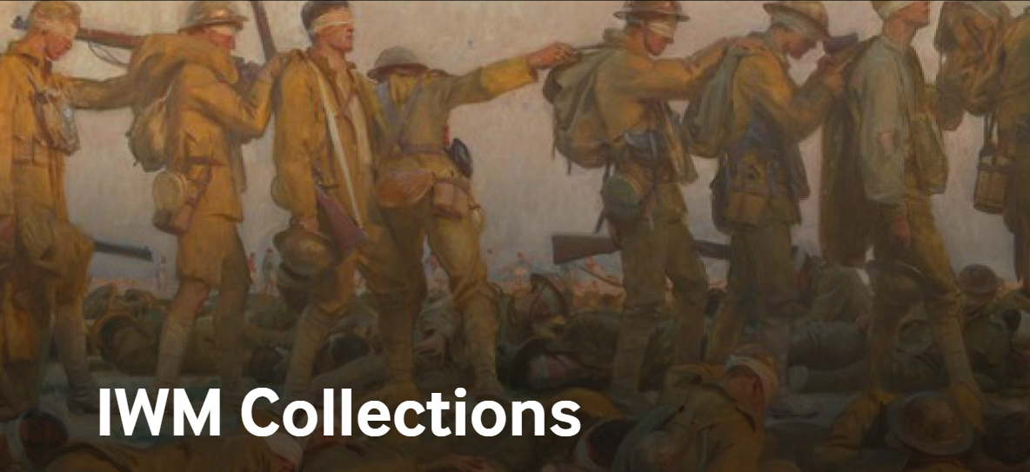
IWM webpages
Confusing.
Complicated.
Difficult to customise.
Inaccessible to some users.

Slide 7
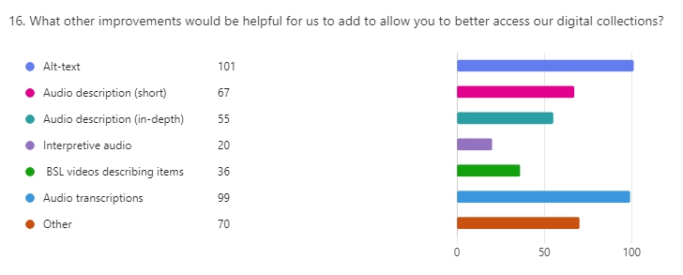
What our users want

Slide 8
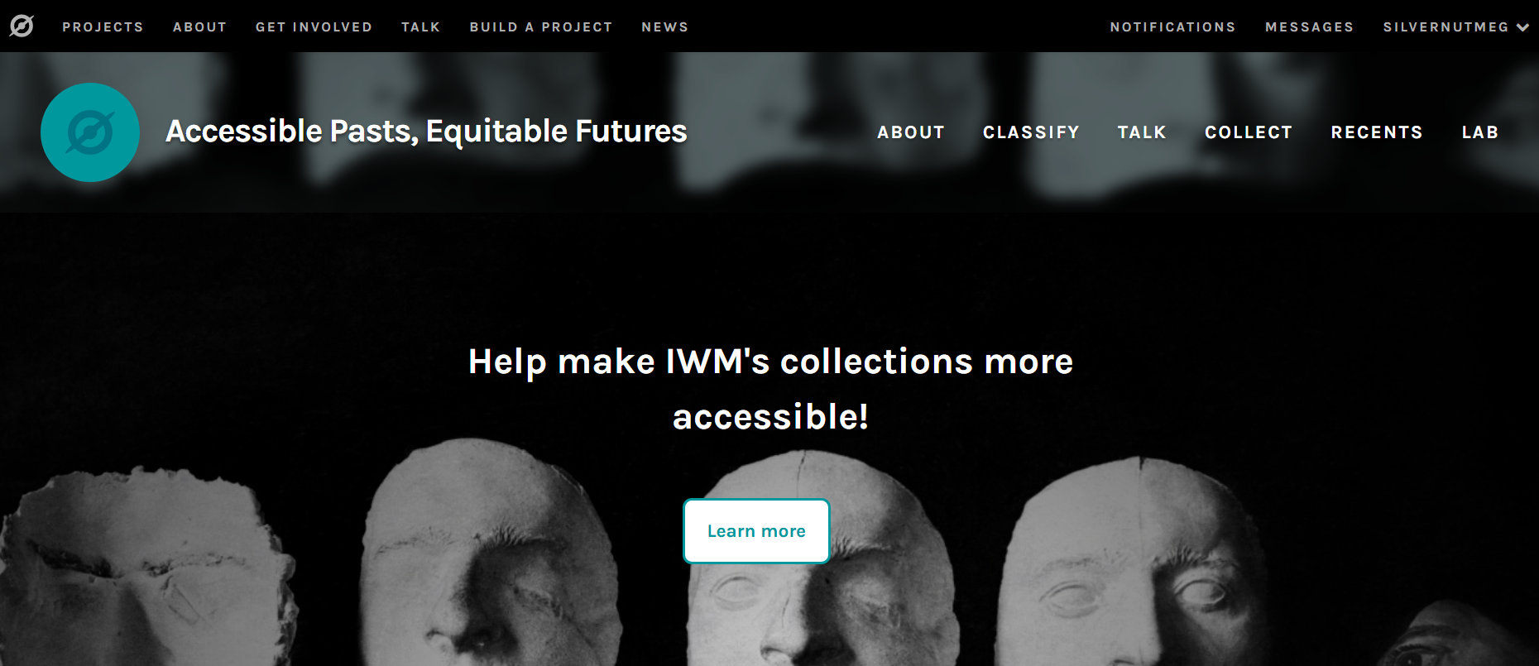
Zooniverse and digital volunteering

Slide 9
How can we create an accessible collections portal?
Follow WCAG (Web Content Accessibility Guidelines) 2.2 AAA standard, with additional thinking around cognitive load and language.
Questions
Where does the access data sit? In the catalogue or elsewhere?
What do we do about access friction?
How can we present the digital collection at multi-varying levels to suit different user groups?

Slide 10
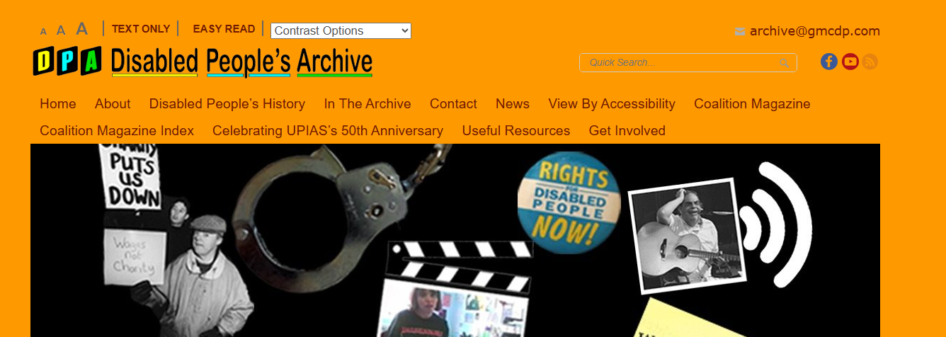
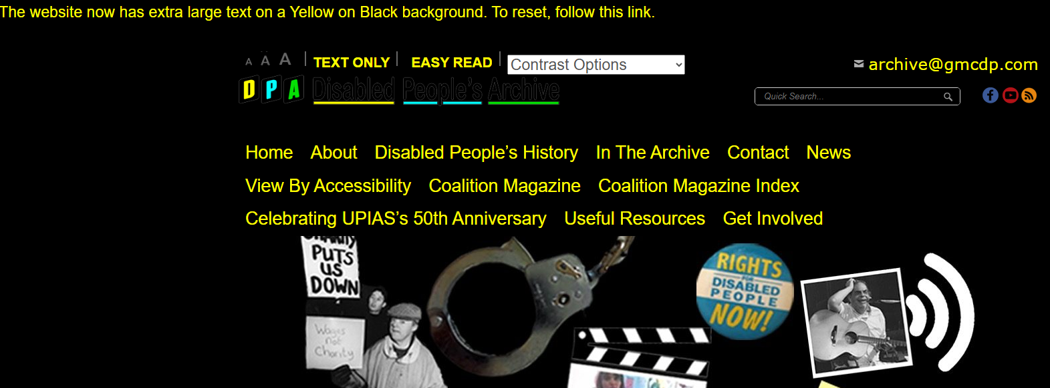
Disabled People’s Archive Website

Slide 11
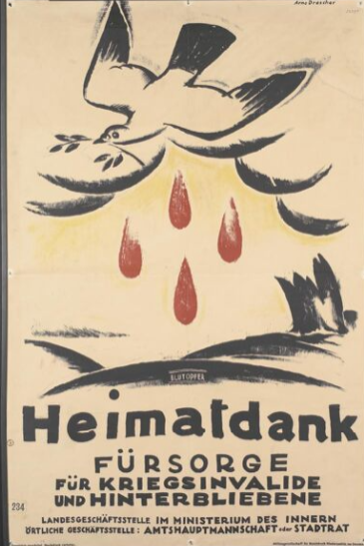
Recommendations
Research first! What do your disabled users actually want?
Test, test, test(!) with multiple user groups.
Hire an accessibility expert to co-design processes.
Develop internal guidelines for how and when to involve disabled users and access experts and planning and development stage.
IWM PST 7233

Slide 12
‘If the services were advertised as accessible and seeking to improve this, that would help! It's about the mental load of working out what's accessible as much as the accessibility itself’

Slide 13
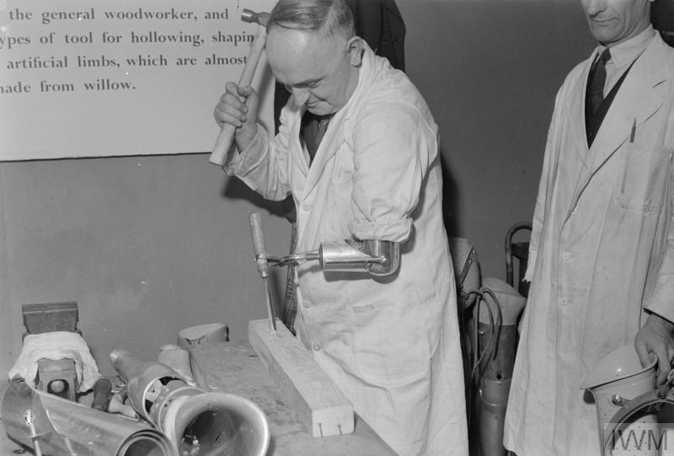
Thank you
amfoster@iwm.org.uk
apef@iwm.org.uk
IWM D 22552

