Slide 1


Does Microsoft 365 preservation have to be hard?
A worked example
Jon Tilbury
Chief Innovation Officer & Founder
November 14th, 2023

Slide 2
MS365 components and features
Four principal services
  SharePoint (Lists and Libraries)
  OneDrive (Files)
  Exchange / Outlook (Email)
  Teams (Channels, Chat, Meetings, Files)
All services combine hierarchy with items comprising unstructured content files and structured data
Retention management provided by Microsoft Purview
Access via Browser or API Interface
Storage location unknown (region only)

Slide 3
MS365 preservation requirements
Transfer
  Manually transfer items, folders, services from within MS365
  Transfer using retention labels from within MS365
  Transfer can be copy (keep in MS365) or move (copy then delete)
  Transfer must be complete – content files, database records, hierarchy
Discovery
  Discover preserved records from within MS365 – no need to use external system
  Must apply existing MS365 access control rules to preserved content
Preservation
  DP services must be complete, embedded and automatic (durable bit level preservation, format preservation, context management via metadata)

Slide 4

How you could implement it?
Microsoft 365 Tenancy
Transfer platform
Digital
Preservation
SharePoint
Manual transfer
Teams
MS User
Exchange
Retention label transfer
Outlook
Search
Access Control
Index
View and download

Slide 5
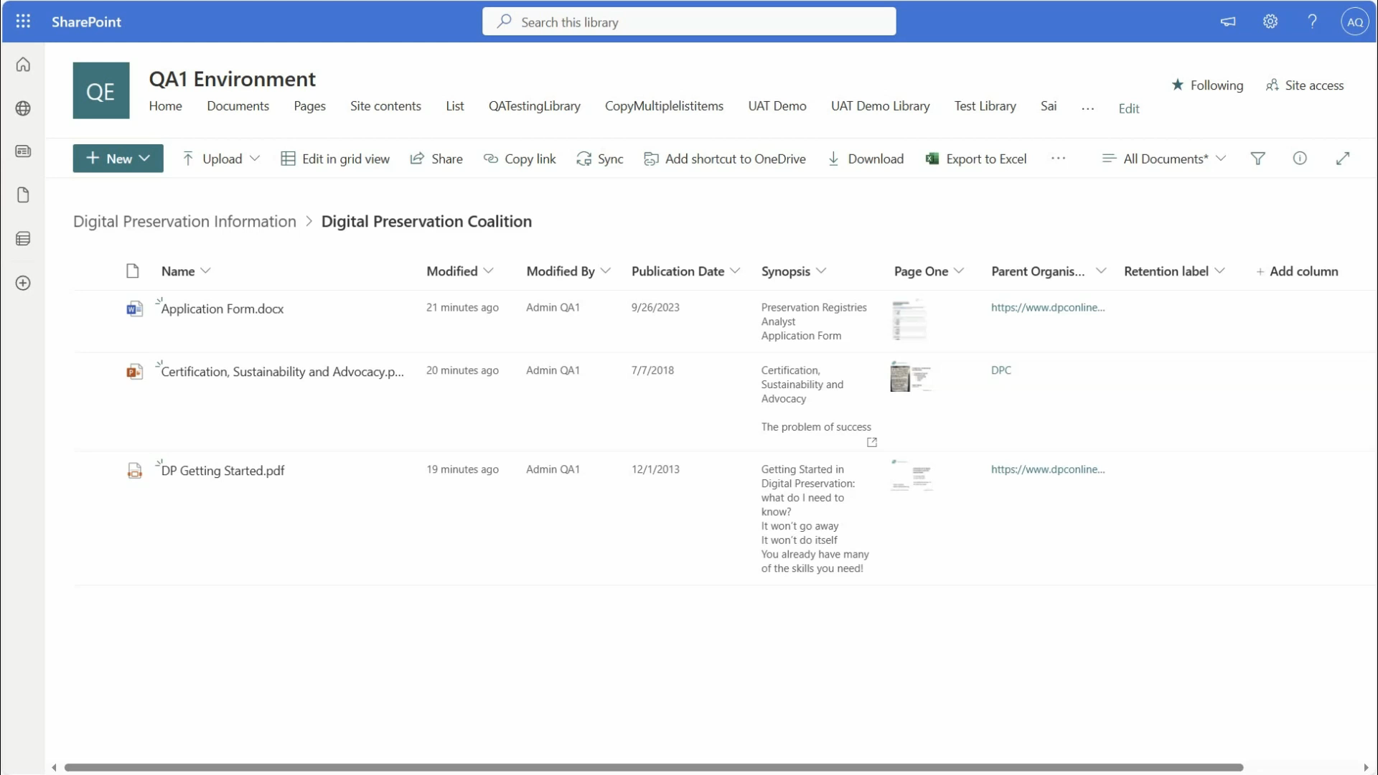
The user’s view

Slide 6
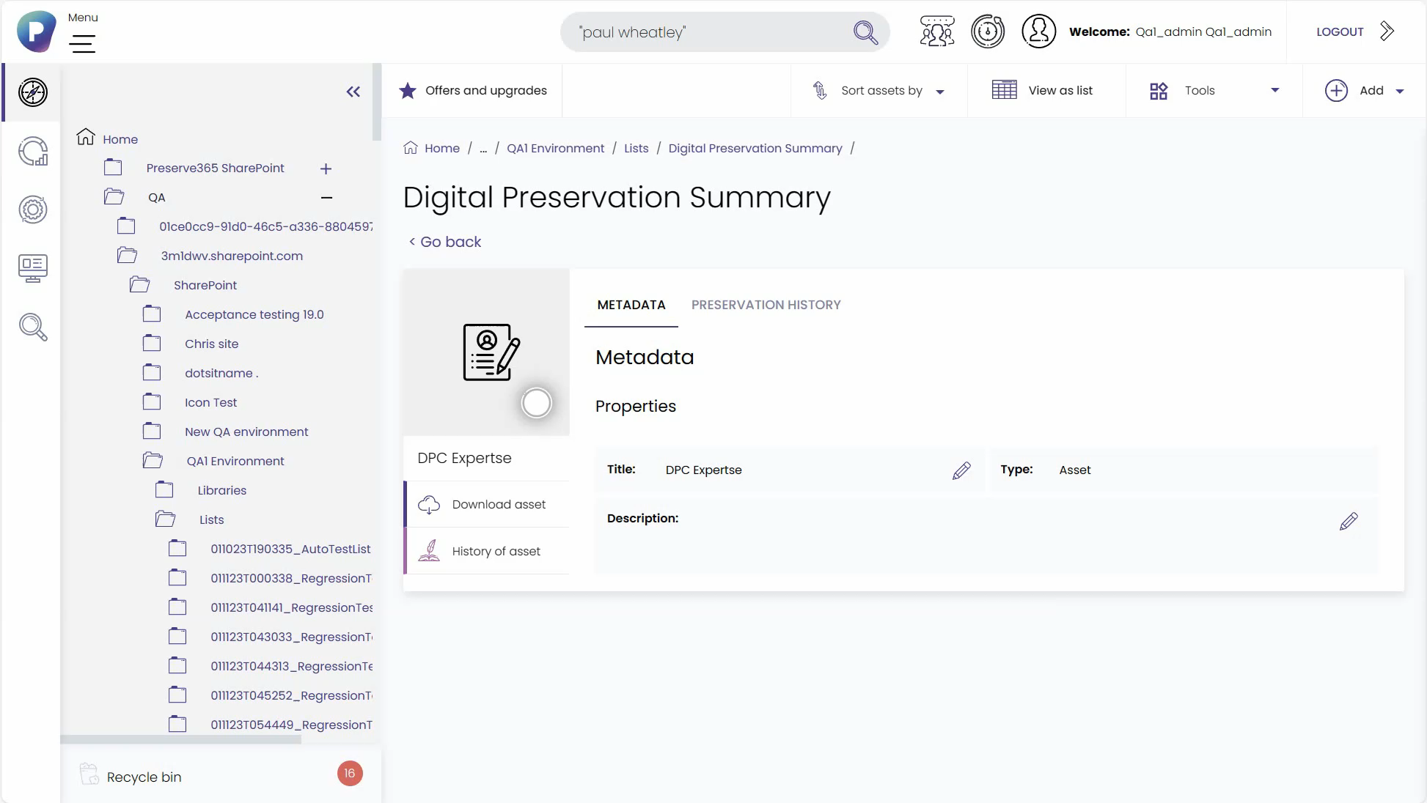
The DP Expert view

Slide 7
MS365 preservation requirements
Transfer
  Manually transfer items, folders, services from within MS365
  Transfer using retention labels from within MS365
  Transfer can be copy (keep in MS365) or move (copy then delete)
  Transfer must be complete – content files, database records, hierarchy
Discovery
  Discover preserved records from within MS365 – no need to use external system
  Must apply existing MS365 access control rules to preserved content
Preservation
  DP services must be complete, embedded and automatic (durable bit level preservation, format preservation, context management via metadata)

Slide 8
Challenges
User mindset – database record view vs content file view ​
Handling MS365 versions (content files, metadata, retention rules)
Post-transfer changes to access control of preserved content
Security rights of the application​
Content changed on transfer
Using Purview to conduct retention management on preserved content​
Changes to the Microsoft APIs​
Microsoft API throttling​
Need for advanced MS365 licences​
Is using a cloud hosted DP system a risk?

Slide 9
Where are we now?
Customer trials underway
Initial release (SharePoint) in December 2023
Works with cloud hosted Preservica in Azure or AWS
Further Microsoft 365 embedding under consideration (Teams, Exchange, OneDrive) based on feedback
To register your interest in Preserve365® - head to preservica.com/preserve365

Slide 10

Does Microsoft 365 preservation have to be hard?
The answer is...no!
    info@preservica.com
    preservica.com
    @preservica
    @dPreservation

