Slide 1




Towards a National AI-Enabled Repository for Wales
Reyer Zwiggelaar | Aberystwyth University | rrz@aber.ac.uk
Sarah Higgins | Aberystwyth University | sjh@aber.ac.uk
Project Team | Gemma Evans, Vicky Jones, Colin Sauze, Cory Thomas
Main Project Partners Scott Lloyd - Royal Commission on the Ancient and Historical Monuments of Wales Sally McInnes – National Library of Wales
Archives & Records Council Wales Forum, 7 November 2022

Slide 2



Participants
Partners | Support from
Aberystwyth University – Computer Science (PI) and Information Studies (CoI) National Library of Wales (NLW) Royal Commission on the Ancient and Historic Monuments of Wales (RCAHMW) Archives and Records Council Wales CADW Canolfan Beddwyr Dictionary of the Welsh Language Digital Preservation Coalition Eisteddfod Genedlaethol Cymru Wales Higher Education Libraries Forum Welsh Government | Bangor University Cardiff Metropolitan University Cardiff University Open University in Wales Swansea University University of South Wales

Slide 3
Aims
As a start point for AI-enabled cross-repository knowledge discovery
To address the data silos across Wales
To bring together both creator and custodian communities in Wales
To scope a new repository for data with no obvious home
To scope - all data (in Wales) of interest to arts and humanities research
Bilingual by design

Slide 4
Work strands
Co-creation through focus groups with a wide range of stakeholders (organisational)
Prototype development (technical)
Scoping study development

Slide 5
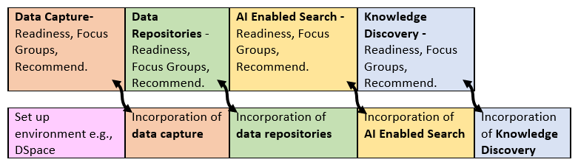
Co-creation Feedback Loop
Information gathered in focus groups (both online and in-person)
Post group questionnaires distributed
Information gathered was fed back to the software and AI developers

Slide 6
Focus Groups
Held in different towns/cities in Wales
2 sessions for each topic with same questions
  online and in-person
All interested stakeholders together
Follow-up questionnaires for further details
Rich quantitative and qualitative datasets
Good understanding of requirements emerged
Data Capture
26 April Aberystwyth
8 in-person, 12 online
Data Repositories
18 May Bangor
5 in-person, 21 online
AI Enabled Search
16 June Swansea
3 in-person, 15 online
Knowledge Discovery
14 July Online
15 online
AI-Model Testing
23 September Aberystwyth
27 September online
17 in-person, 19 online
Participants included:
Arts and Humanities Scholars, Librarians, Archivists, Museum Curators, Research Data Managers, Lexicographers, Computer Scientists

Slide 7
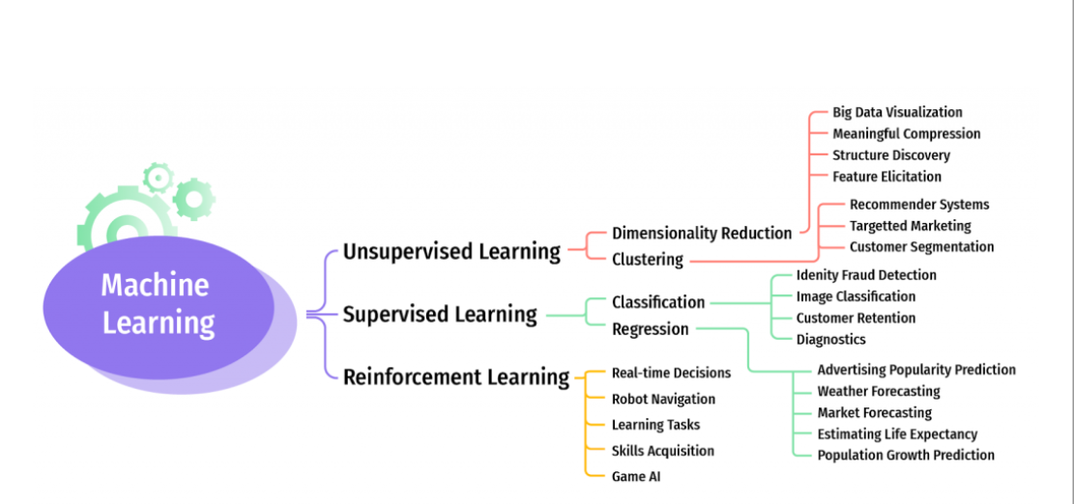
Types of AI
Source: www.ingeniovirtual.com

Slide 8
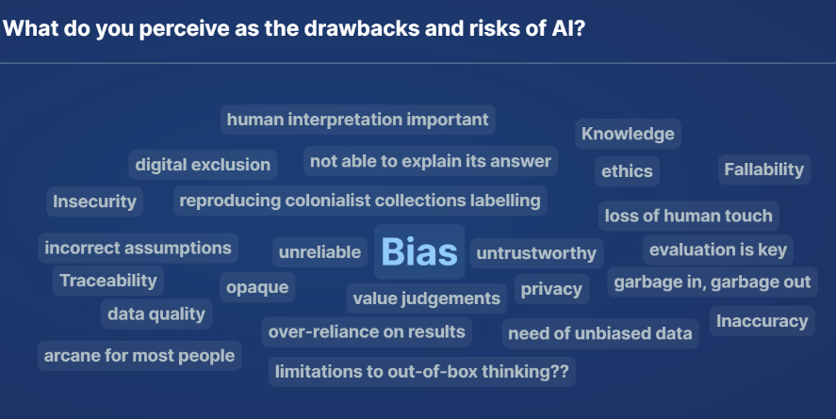
AI Risk Perception
17 respondents (focus group 3)

Slide 9
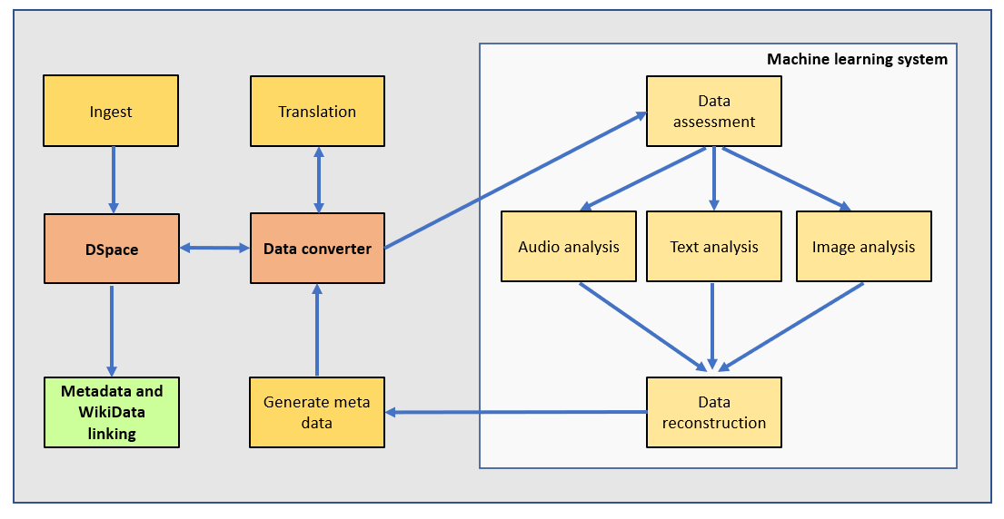

Prototype
Technical Architecture

Slide 10
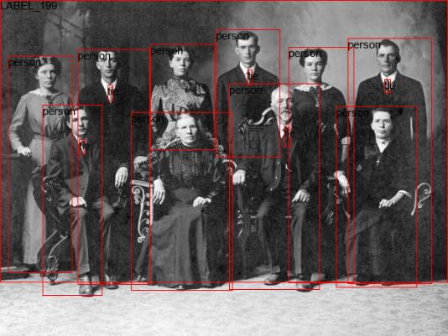
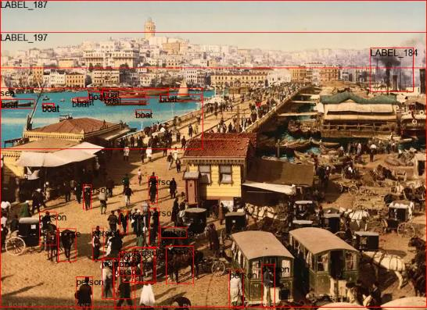
Prototype
Image Analysis – Segmentation Analysis
Source: https://www.istockphoto.com/photos/old-group-photo-photos
Source: https://www.businessinsider.com/images-worlds-greatest-citieshistory-2017-3

Slide 11
Prototype
Text Analysis
Source: Bartrum Genealogical Project DOI: 10.20391/40837b6f-1887-4afd-9c6e-9b7e3a122693

Slide 12
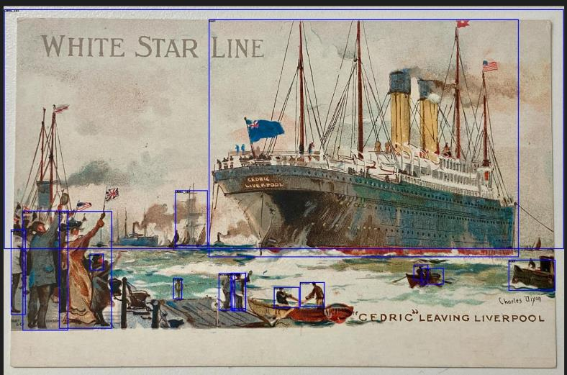
Prototype
Text and Image Analysis
Extracted text
CEDRIC " LEAVING LIVER POOLWhite Star lineline.contribution to# the greatest to
Segmentation model analysis
person, boat, label 192
Detection model analysis
{'44_27_1245_1954': 'liner, ocean liner'}
Source: People’s Collection Wales: https://www.peoplescollection.wales/items/1885021

Slide 13
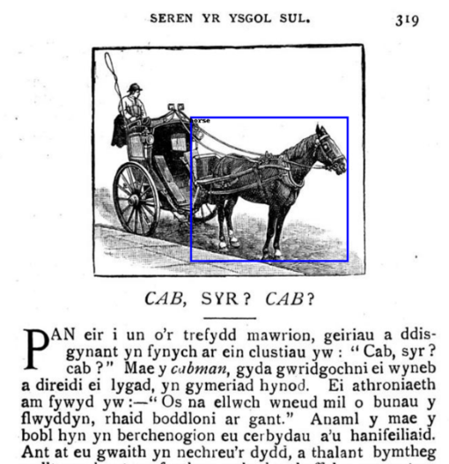
Prototype
Added Translation
Segmentation Model
horse
Detection Model
{'164_181_267_294': 'horse cart, horse-cart’}
Extracted Welsh
‘gynant yrfynych airein clustiau yiw : “Cab, ‘, ‘cab? “ Macy cubman, gyda gwridgochni ei Wy’, ‘a direidi ei lygad, yn gymeriad hynod.’
Auto Translation
‘they cry out the words in our ears: “Cab, cab?” Macy cubman, with the redness of his mischievous egg in his eye’
Actual Translation
‘they cry out the word in our ears: Cab, sir? cab? "The cabman, with the redness of his face and mischief in his eye, is a remarkable character.

Slide 14
Top 3 Findings
Prototype includes:
  Data and metadata ingest
  Data conversion and translation
  Metadata enhancement through:
    Image detection
    Semantic segmentation
    OCR
    Text summarisation
    Application of ontologies
    Bilingual interpretation
    Data linking
    Metadata re-ingest.
  Georeferencing
Evidenced need, appetite, and stakeholder requirements, for an AI-enabled distributed repository across Wales’s HEIs and GLAM institutions.
Established the need for additional trusted storage and access to ‘estray’ data
Prototype technical methodology for AI-enabled discovery identified and tested

Slide 15
Additional Findings Organisational Strand
5 data types are priority: databases, text files, audio files, images and websites of funded research projects.
Next priority is: geo-spatial data and audio-visual files.
Need for a mandatory profile of Dublin Core.
Use of FAIR data principles and Creative Commons open licences (e.g., CC0/CC BY)
Need for an ethical governance framework
Sustainability needs be built-in from the outset - funding model, environmental impact and long-term preservation
NDSA Levels or the DPC’s Rapid Assessment Model assessment for trustworthiness
90% accuracy of AI-model acceptable (with a clear indication of human and AI-derived (meta)data provided).

Slide 16
Additional Findings Technical Strand
Identification and implementation of a set of AI-models that can be orchestrated and trained.
Scripting requirements established for re-ingesting AI-generated enhanced metadata.

Slide 17
Outcomes
Scoping study report
  Detailed technical specification
  Post-construction operational costs
AI enabled discovery prototype
Co-creation by data curators and creators across Wales
Contribution to the UK TDR landscape
Academic papers (forthcoming)

Slide 18

Future development
Legend
Web Service
End Users
GPU Process
Shell Script
External
Repositories
Data storage
Manual
process
Local Server in
Automatic
A bilingual AI-enhanced interoperable discovery layer based on a distributed custody and storage model
An API for both display and re-ingest of AI-enhanced metadata
A trusted storage environment for extra storage and estray data
A training framework based on the FAIR Principles to include: data preparation and ingest, metadata generation, data protection legislation, intellectual property rights and open licencing, repository assessment frameworks, AI functionality and ethics.
Establishment of an ethics board to develop - ethical governance framework and to oversee developments
Dspace
Metadata
Aberystwyth
process
storage
Data
Downloader
Dspace importer
Additional
Machine
Training
Learning
Manual
Processes
Image
Metadata
Annotation
Text
Analysis
Audio
Generation
of Data for
Analysis
Analysis
Training
Models
New models
Additional Processing in the Cloud or
Data
on Supercomputing Wales
Downloader
Machine Learning Processes
Text
Image
Audio
Metadata
Analysis
Analysis
Analysis
Generation

Slide 19
Expected Benefits
More sophisticated and intuitive discovery
Auto-translation of resources and metadata
Discovery across collections
Discovery across both metadata and data it describes
Metadata interoperability and enhancement
Name recognition enables person or organisation-based discovery
Place-name and geospatial recognition for location-based discovery interface

Slide 20


