Slide 1


A call for a community framework for implementing ML and AI
15 March 2023
Notes:
Abbey

Slide 2
How might we…
Develop a shared framework that
helps our organizations and teams
responsibly operationalize AI?
Notes:
Meghan

Slide 3
Making progress on elements of a shared framework
Resource/tool | Outcome
Shared Statement | Supporting trustworthy & responsible AI practices
Organizational Profile | Addressing practical challenges
Organizational Statement | Ensuring accountable operationalization
Design Principles | Assessing & decision-making
Risk & Benefit Analysis Matrix | Prioritizing coherent & traceable practices
Data Processing Plan | Transparency & standards via documentation
SPOILER!
Notes:
Meghan - In this talk, we’ll share more about reasons why we …
And share how we’ve been approaching elements necessary to include in an framework to operationalize ML/AI in LAMs
Framework for adopting ML/AI (evaluating toward adoption) in our contexts - Libraries & Archives
Framework would be better/valuable if done in concert with others in the same realm

Slide 4
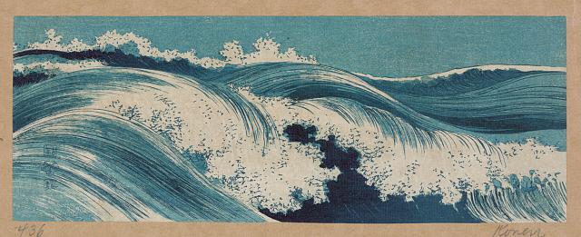
Need for domain-specific tools to adopt AI in LAMs
Riding the wave of technology change
Uehara, Konen, 1878-1940, artist, Hatō zu (Waves), 1 print : woodcut, color ; 9.2 x 24.8 Fine Prints: Japanese, pre-1915, Library of Congress Prints & Photographs collection. https://www.loc.gov/pictures/item/2008660478/
Notes:
Abbey

Slide 5
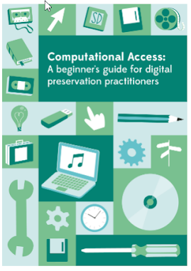
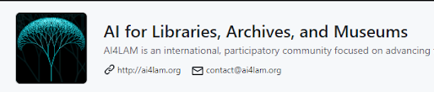
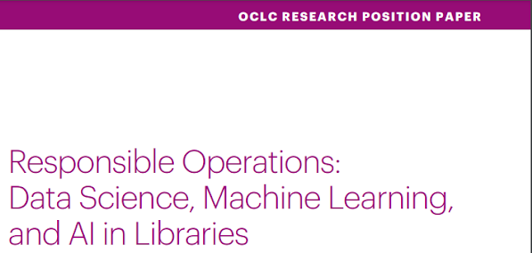
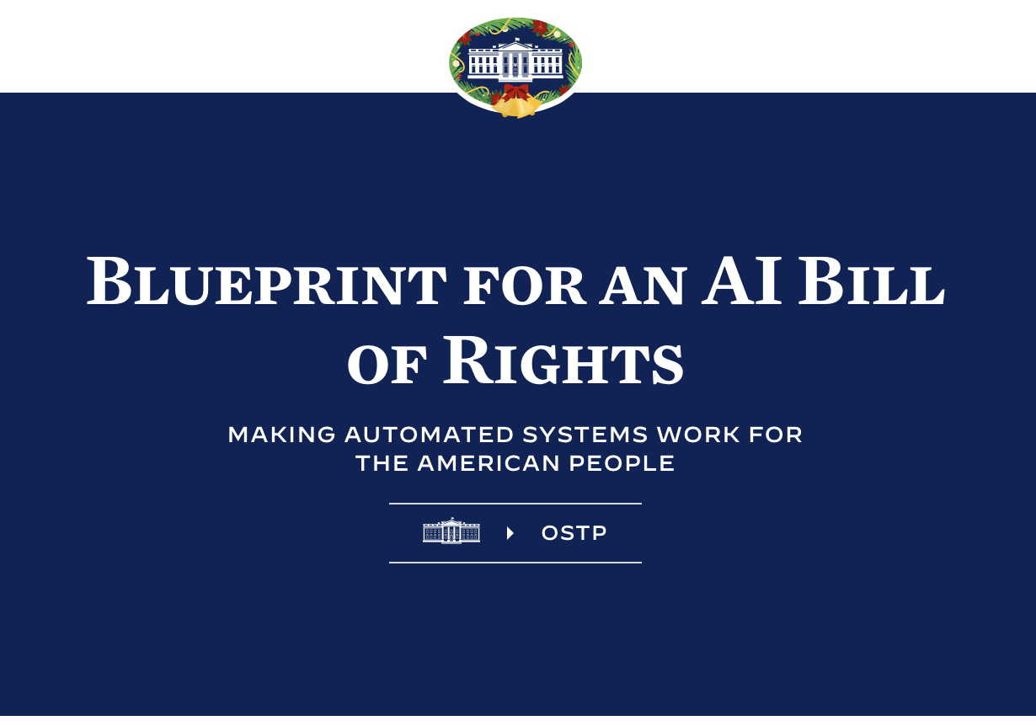
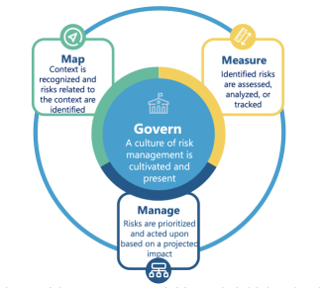
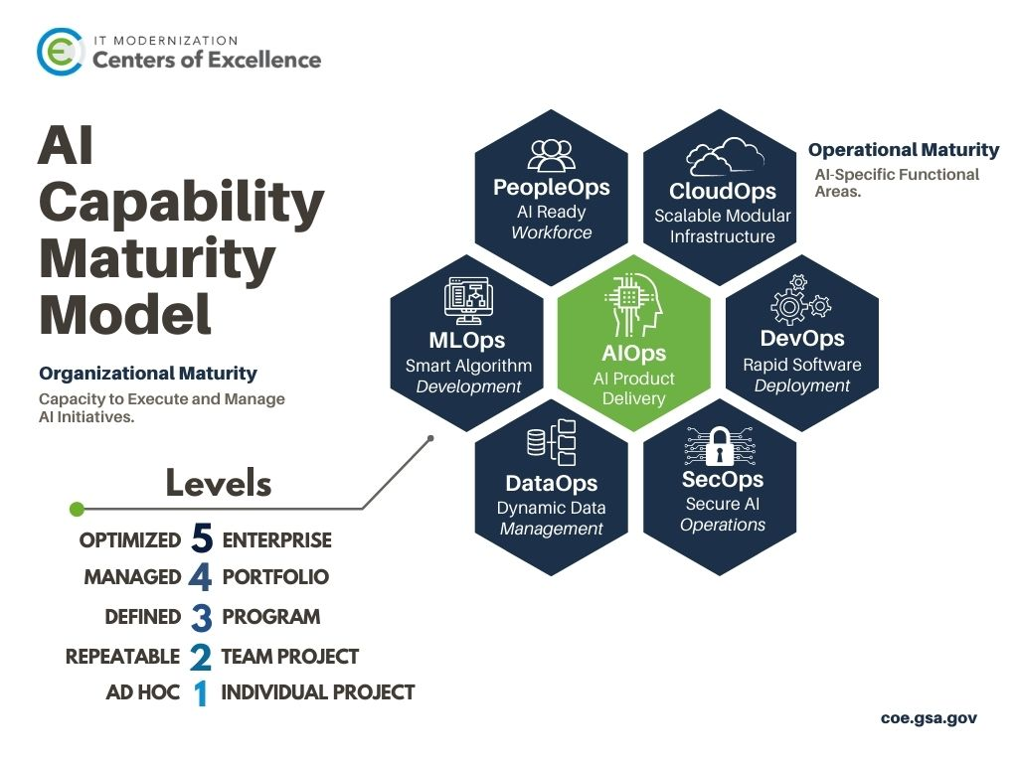
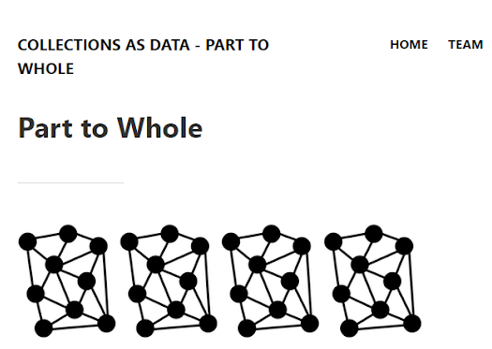
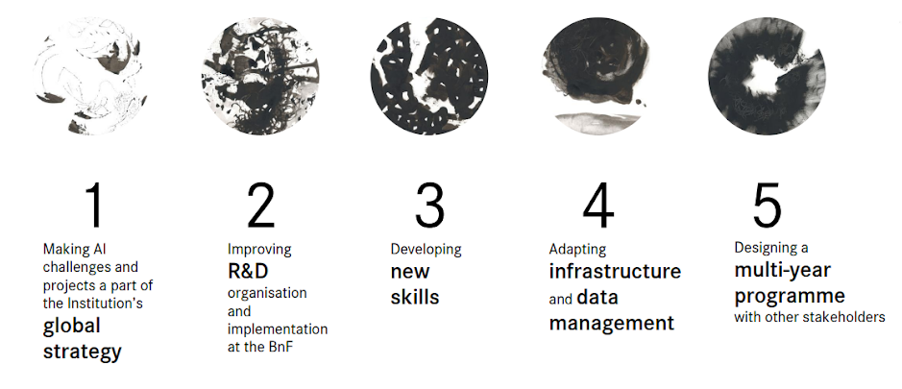
Building on momentum
And more!
Notes:
Abbey

Slide 6

About LC Labs
Residencies
Experiments
Convenings
Staff Details
Fellowships & Internships
Innovators in Residence
Grants
Demonstration experiments
Innovation IDIQ
Professional events
Working Groups
Data Jams!
Notes:
Abbey

Slide 7
LC Labs & ML recommendations
LC Labs Summary Recommendations | (potential) Next Steps
Cultivate responsible practices Study inherent bias in data, analyze risk to humans and organizations (NN, UNL experiments, ML+Libraries report) | Co-develop design principles & risk frameworks for AI in LAMs
Develop appropriate solutions via iteration Consider end-user needs and journeys (HITL, Experimental Access) | Research user needs & prototype solutions
Make available training data for wider use & explore customized solutions Commercially trained models don’t perform well with historic and cultural content (Speech to Text, ML+Libraries) | Share training data & LAM-specific models
Combine machine learning and crowdsourcing Human feedback is essential for accurate performance and informed decision-making (NN, HITL) | Experiment: staff-enhanced ML workflows & mobile-first public prototypes
Sponsor interdisciplinary and interagency collaboration Technical, curatorial and reference expertise and input are needed for system/service design (CCHC) | Knowledge exchange: internal working groups & external network building
Support staff skills development Augment staff skill and capabilities (CCHC) | Partner with universities & technical training organizations
Explore infrastructure, policy, and capacity Iterate toward transforming infrastructures and policies to build capacities at scale (UNL, HITL, Experimental Access, CCHC) | Support ML/AI roadmap via experimentation & innovative acquisitions/partnerships
Notes:
Meghan

Slide 8

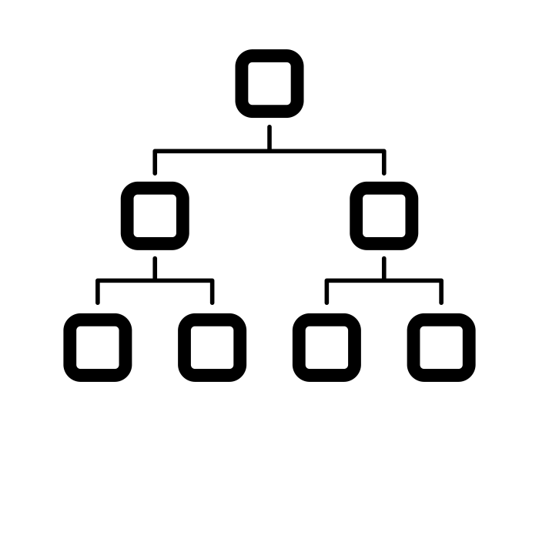


LC Labs planning tools for implementing AI
Organizational Profile
Discovery at Scale
Enabling Research Use
Business Use Cases
Augmenting User Services
Risk & Benefit Analysis Matrix
Articulate user stories
Determine risks & benefits
Document data readiness
example:
Data Processing Plan
Data label +
Model card +
Data provenance +
Other domain-specific information
Design Principles
Reflect system goals and aims to help guide decision-making
Example: By The People – Concordia Design Principles: Trust and Approachability
Notes:
Abbey

Slide 9
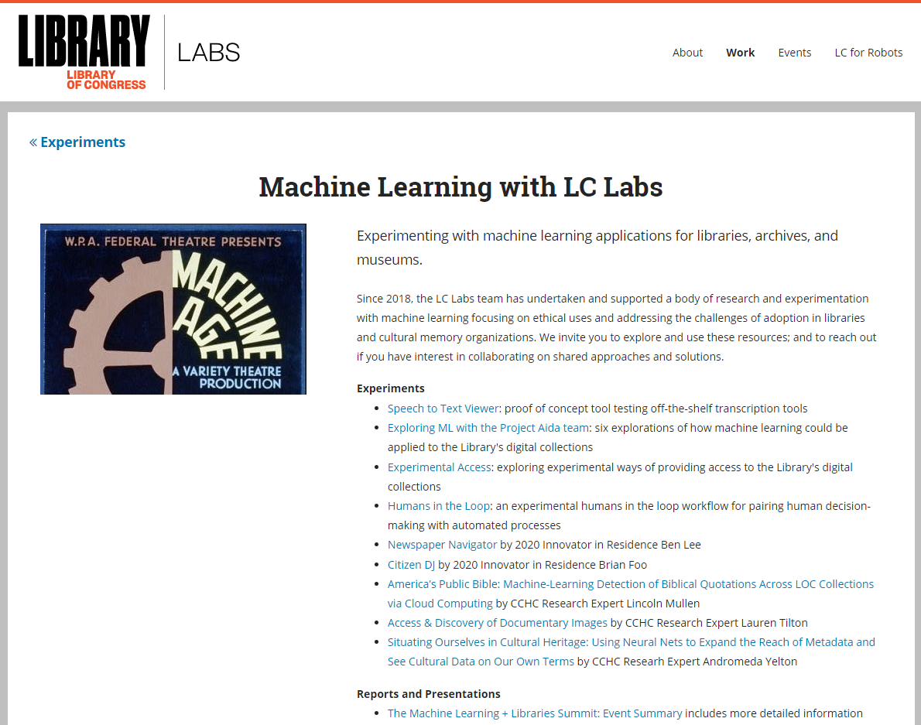
https://labs.loc.gov/work/experiments/machine-learning/
Notes:
Abbey

Slide 10
Thank you!
For More Information
Web: https://labs.loc.gov/work/experiments/machine-learning/
Points of Contact
  Abigail Potter, abpo@loc.gov
  Meghan Ferriter, mefe@loc.gov

