Slide 1

Appraising Video
A Machine Learning (ML) Success Story

Slide 2
AVA
(Archives Video Appraiser) is a ML and automation tool that generates archival selection recommendations with an accuracy of ~85% and has resulted in 1.5-person day savings per month.
AVA

Slide 3

AVA (Archives Video Appraiser) Goal
The goal of the AVA project was to develop a tool to facilitate the appraisal of WBG born-digital moving image records and then automate the staging of permanent videos for ingestion into the Digital Vault and the destruction of non-permanent videos when appropriate.
If successful, the project would mean reduced decision-making and transfer time and an increase in the accuracy of our appraisal decisions.

Slide 4










World Bank Staff can request for Video Conferences (VC) to be recorded by a central function.
Videos are stored centrally after an event concludes.
Batches of videos, grouped by month, are sent to the Archives for evaluation for preservation. The appraisal & selection process dictates those videos which are preserved and those which are destroyed.

Slide 5


AVA Project Process
Training data:1000 Videos and MANUAL Appraisal Decisions
extensive collaboration among
WBG archivists
and IT staff
Testing of AVA’s recommendations against manual decisions
Notes:
Creating AVA required an extensive collaboration between the WBG archivists and the IT staff assigned to the project. Initially, extensive knowledge exchange was needed as the archivists learned about ways to use machine learning and the IT team learned about how the appraisal and selection process for born-digital moving images was being performed manually.
The actual implementation was an iterative process involving training on an initial set of 1000 pre-appraised video conference recordings and subsequent testing of results against manual decisions. It was during these efforts that we discovered that we needed more sample videos that had already been through the manual appraisal and selection process, forcing us to increase the training set to 3000 videos.

Slide 6
AVA Project Process
Training data: 3000 Videos and MANUAL Appraisal Decisions
Iterative process led to discovery that a larger training set of videos was needed.
3000 instead of 1000
Testing of AVA’s recommendations against manual decisions
Notes:
Creating AVA required an extensive collaboration between the WBG archivists and the IT staff assigned to the project. Initially, extensive knowledge exchange was needed as the archivists learned about ways to use machine learning and the IT team learned about how the appraisal and selection process for born-digital moving images was being performed manually.
The actual implementation was an iterative process involving training on an initial set of 1000 pre-appraised video conference recordings and subsequent testing of results against manual decisions. It was during these efforts that we discovered that we needed more sample videos that had already been through the manual appraisal and selection process, forcing us to increase the training set to 3000 videos.

Slide 7

What does it look like in practice?
Generates preliminary appraisal decisions.
Accepts or rejects recommendations.
AVA
ARCHIVIST
Moves videos into either preservation or deletion staging areas.
Notes:
AVA performs a series of preconfigured actions based on Machine Learning to generate a preliminary appraisal recommendation for each video. These recommendations are then validated by an archivist before AVA moves videos either into a preservation staging area or a designated deletion staging area.

Slide 8
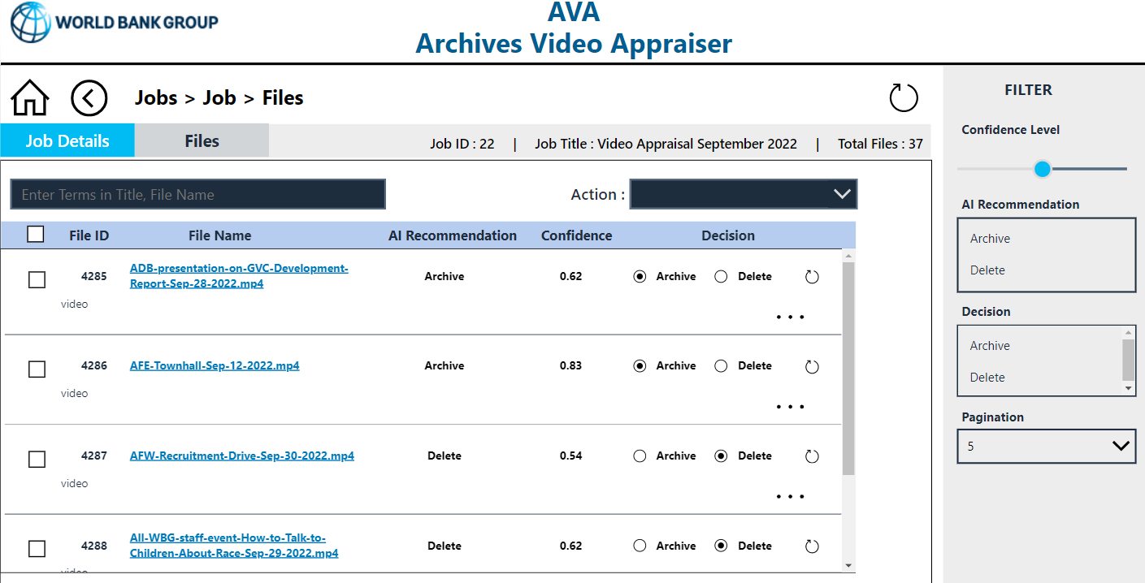

Slide 9


Slide 10
Ways AVA Saves Archivists’ Time
Takes only 10 minutes to generate recommendations for 200 videos
Detects empty and soundless videos
Archivists need only 30 minutes to verify and take any corrective action
Saves 1.5-person days per month
Reduces manual errors
Increases appraisal decision accuracy
AVA
Notes:
AVA’s makes recommendations with ~85% accuracy.
AVA detects empty and soundless videos.
AVA takes10 minutes to generate recommendations for 200 videos. Archivists need only about 30 minutes to verify and take any required corrective actions.
Using AVA has resulted in 1.5-person day savings per month, a reduction of manual errors, and an increase in appraisal decision accuracy!

Slide 11
AVA Lessons Learned
AVA is effective and saves time
Identifying a representative set of training data required a high initial time investment
Ongoing, human-driven, iterative training is required to increase accuracy
Our use case had very straightforward criteria. Scaling AVA to tackle more formats and complex criteria will present greater challenges
We must remain vigilant to reduce bias included in our training data.
AVA
Notes:
AVA is effective and saves time!
Identifying a representative set of training data required a high initial time investment for the archivists.
Ongoing, human-driven, iterative training is required to increase accuracy.
This use case required evaluation of straightforward criteria. Scaling AVA to tackle larger collections of mixed formats with more complex selection criteria will likely present greater challenges.
We must remain vigilant to reduce bias included in our training data.

Slide 12
Q&A
Jeanne Kramer-Smyth
jkramersmyth@worldbankgroup.org
https://www.worldbank.org/en/archive/aboutus/archives-video-appraiser-poster-presentation

