Slide 1

AI in historical archives
Between automation and augmentation
Tobias Blanke, Charles Jeurgens, Giovanni Colavizza, Julia Noordegraaf

Slide 2
Introduction

Slide 3
Archives and AI
Encompass professional, cultural and societal consequences of automated systems for recordkeeping processes and for archivists.
Survey article.
We use AI as a proxy for machine learning
“Archives and AI: An Overview of Current Debates and Future Perspectives”. Journal on Computing and Cultural Heritage. https://dl.acm.org/doi/10.1145/3479010
Notes:
Tobias

Slide 4
Method
Focus: Intersection of AI and record keeping in archives.
Select relevant articles from a curated list of journals, by manual sift through all issues 2015-2020.
Discard purely technical work on archival materials, in the absence of an archival reflection, nor archival work in the absence of an explicit reference to AI.
Expand by reference lookup + same selection criteria.
Final selection of 53 articles for discussion: not a systematic survey, but a representative set.
Notes:
Tobias

Slide 5
The tradition of archives

Slide 6
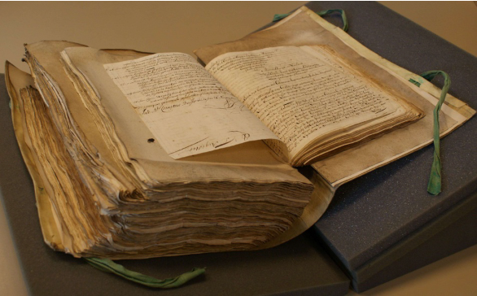
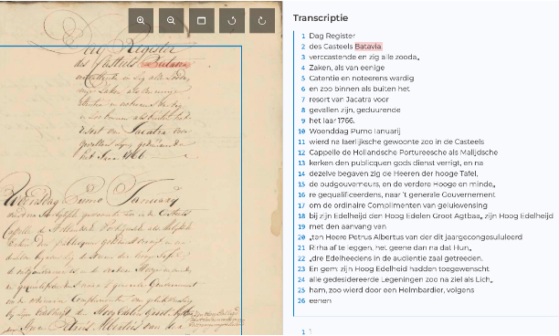

Theoretical and professional considerations
Reconfiguring archives from aggregates of records to data:
  Traditional principles come under pressure, e.g., provenance and original order as the main means to organize and access records.
  Opportunity of new means of access, e.g., indexation by contents.
Notes:
Charles

Slide 7
Theoretical and professional considerations
Reconfiguring archives from aggregates of records to data:
  Traditional principles come under pressure, e.g., provenance and original order as the main means to organize and access records.
  Opportunity of new means of access, e.g., indexation by contents.
Archival principles can (should) be applied to data used in AI systems:
  Provenance, appraisal, contextualisation, transparency and accountability are all often lacking in machine datasets.
Notes:
Charles

Slide 8
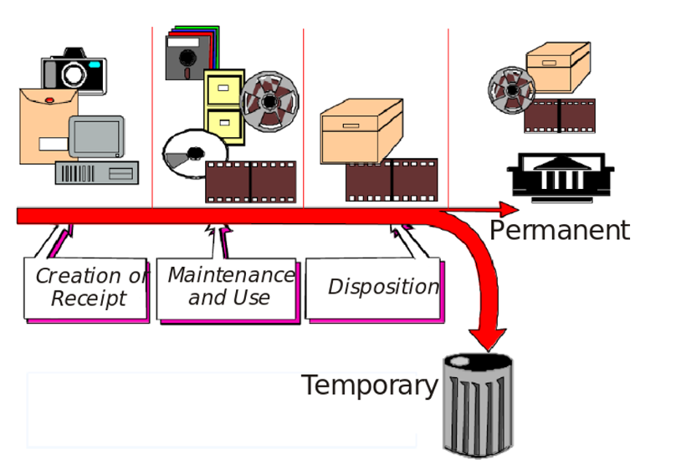
Traditional Life Cycle View

Slide 9
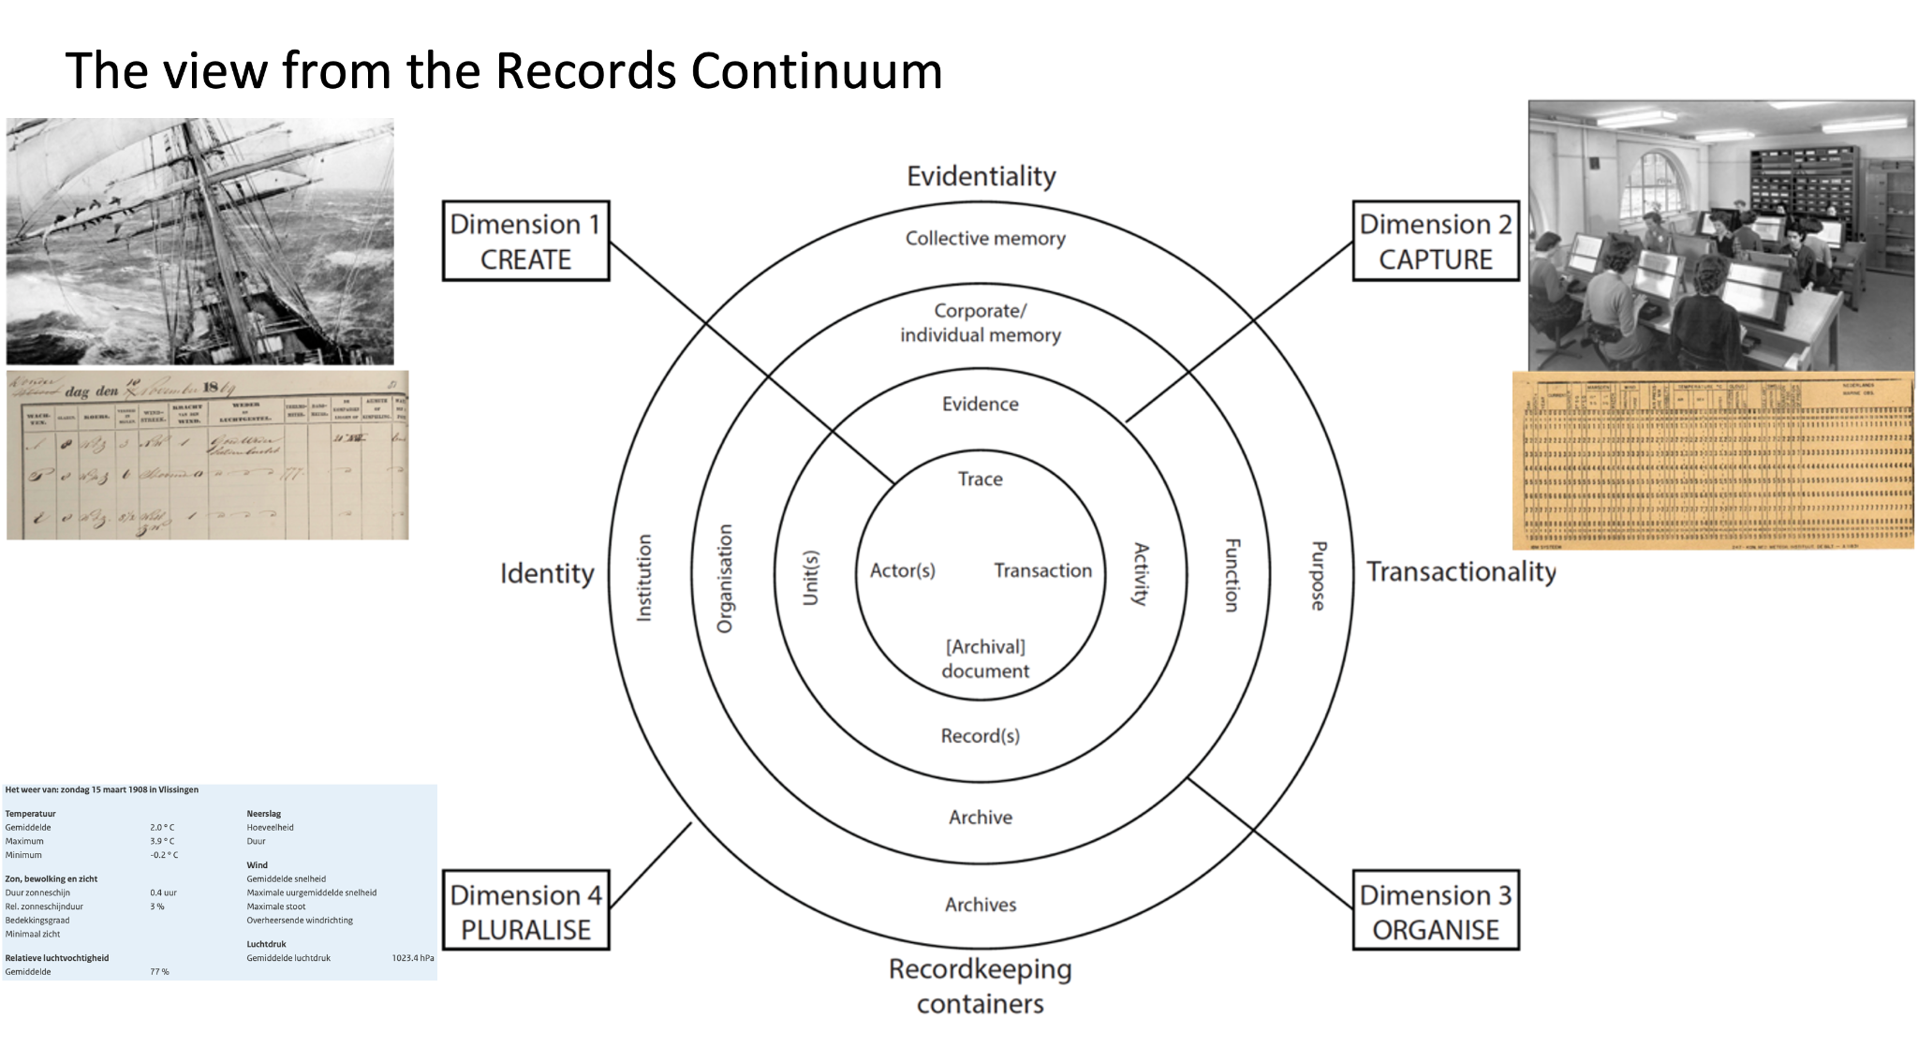

Slide 10
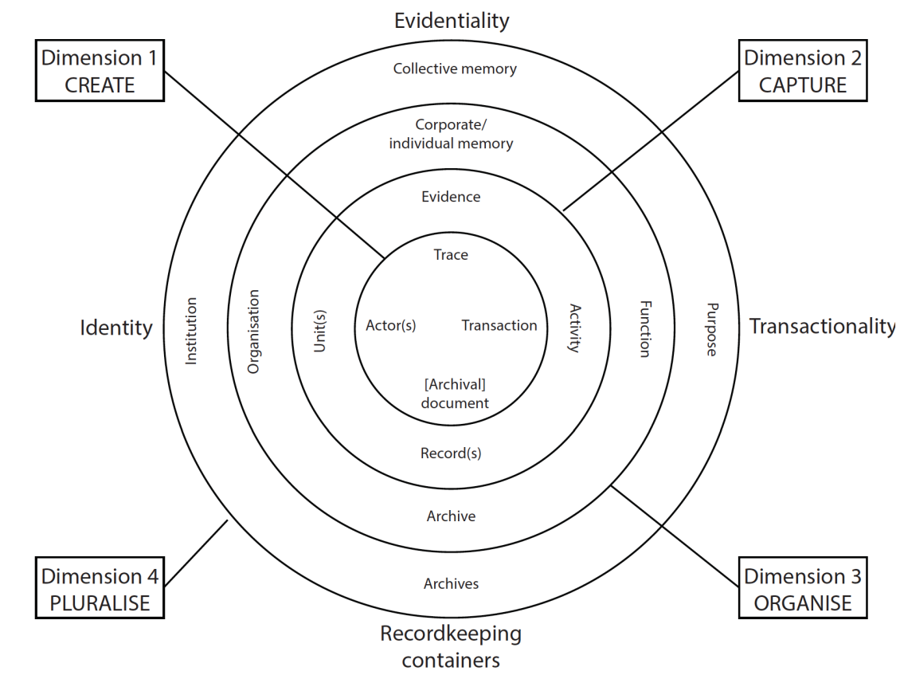
The view from the Records Continuum
Least related work
Most related work
Notes:
Charles

Slide 11
Two AI and archives examples

Slide 12
Structure of Analysis
Theoretical and professional considerations
Automating recordkeeping processes
Organising and accessing archives
Novel forms of digital archives and recent emerging trends

Slide 13
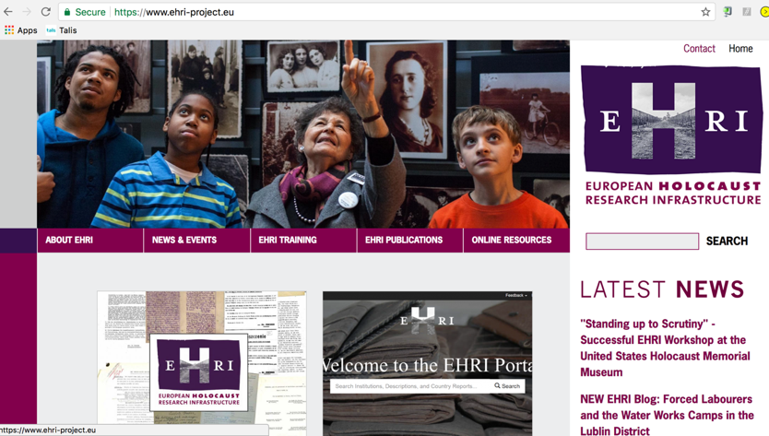
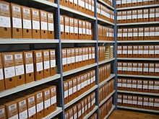
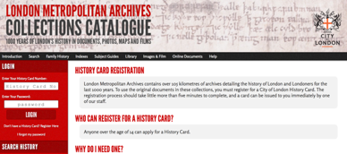
European Holocaust Research Infrastructure: Archives as Big Data

Slide 14
Theoretical and Professional Considerations
Archival Organisation
New Meta(data)

Slide 15
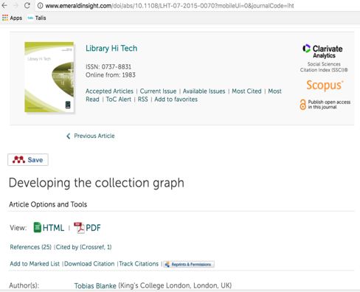
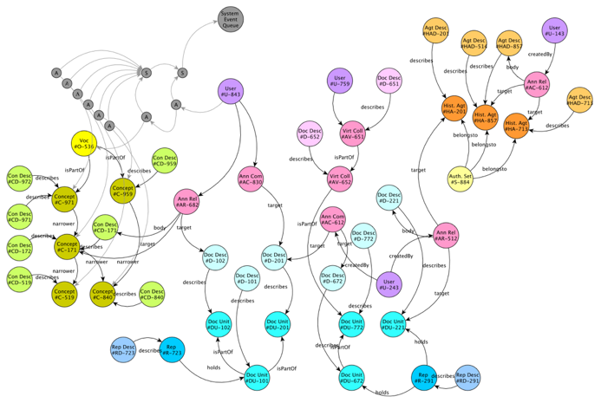
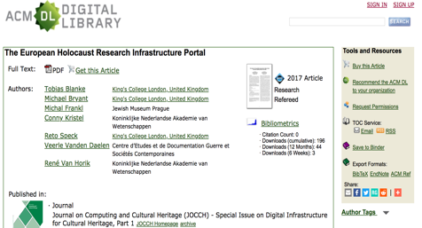
Archive Graph
Authorities
User generated
content
Thesaurus
Collections

Slide 16

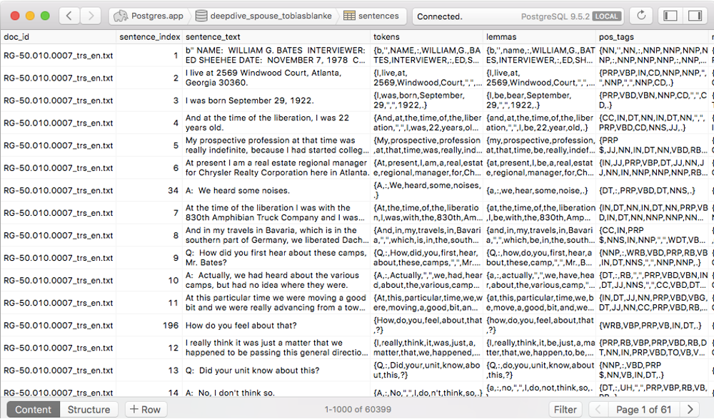
Archives and AI:
Complexity challenge
A deep dive with Standford’s
Ultimately, the aim is to extract not just entities such as place, time, organisation, etc. but relationships between entities
US Holocaust Memorial Museum testimonies
From 120+ MB of text over 2 GB of data in a database!!
A 15-fold increase

Slide 17
New archives and Emerging trends
Distant Reading of Archives

Slide 18
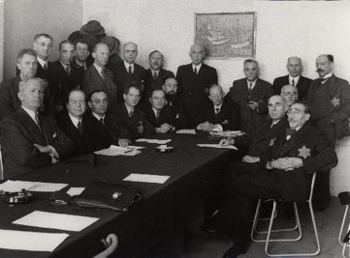

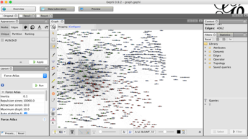
Names and Networks
Aim: Specifying community relations
Method: Network visualisation.
Sources: Digitised archive of the Jewish Council of Amsterdam and Friesland

Slide 19
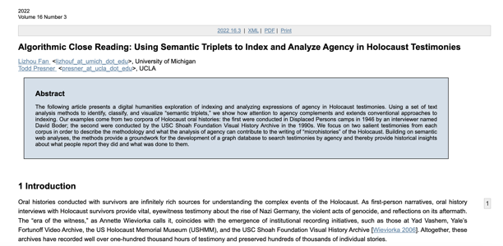
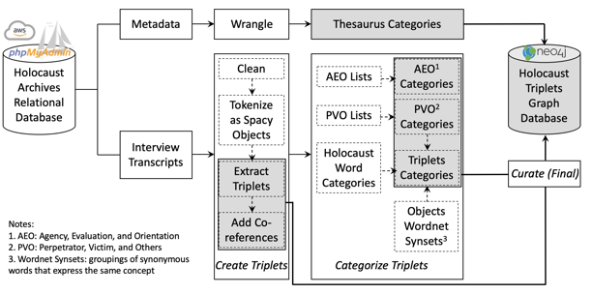
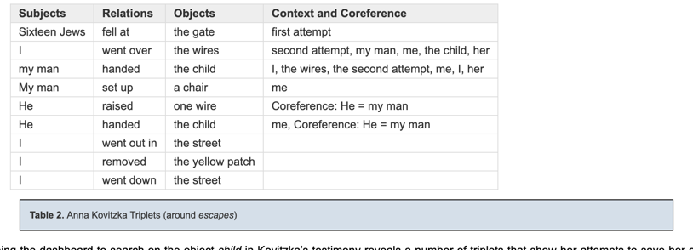
Micro-historical Acts of Resistance: Rediscovering agency at scale

Slide 20
Conclusion

Slide 21
Gaps in terms of transforming the many experiments into lasting archival theory, practice and infrastructure.
Improving trust into AI techniques by developing a stronger ethical framework and better understanding of their impact on research practices.
Make recordkeeping contributions to the advancement and appropriate use of AI, by bringing expertise on provenance, appraisal, contextualisation, transparency and accountability to the world of data.

