Slide 1
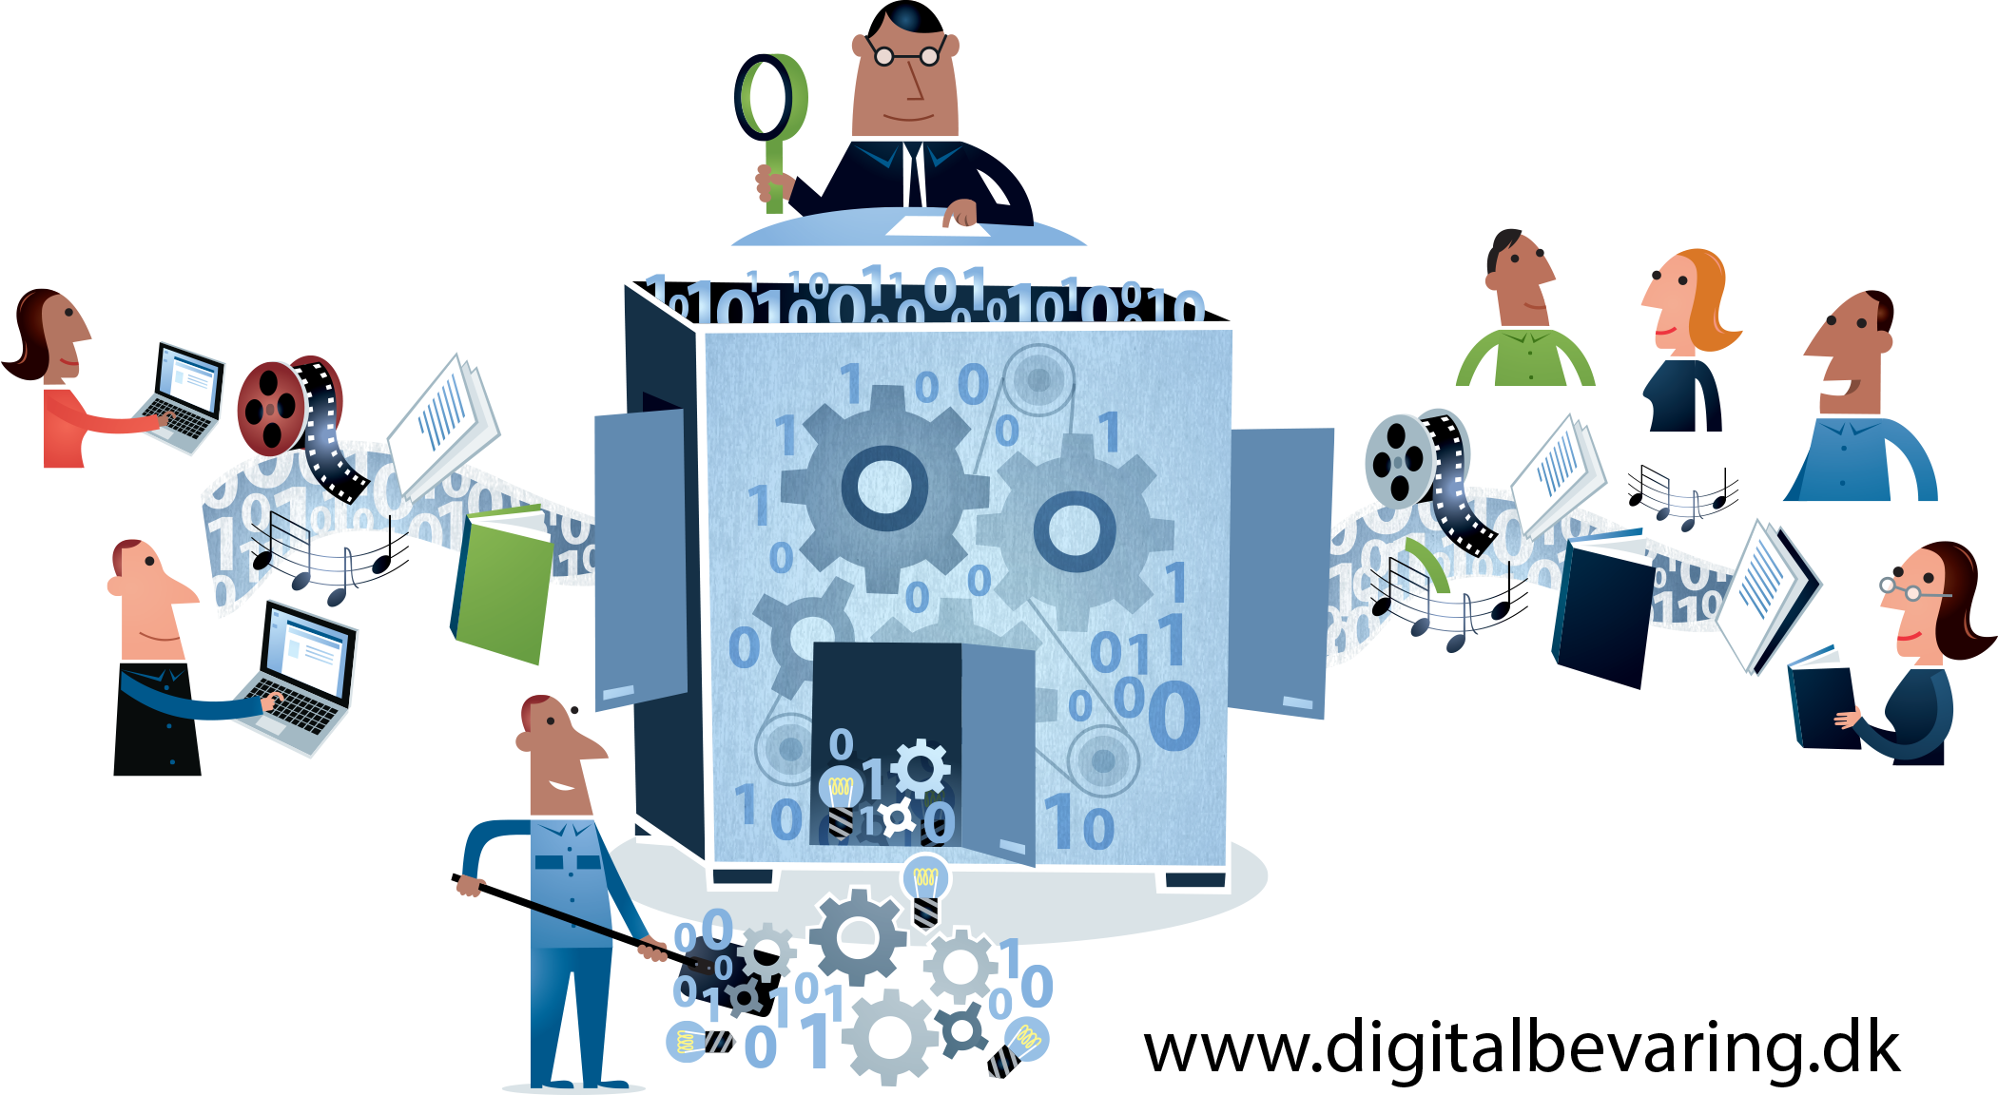
Digital Preservation is…

Slide 2
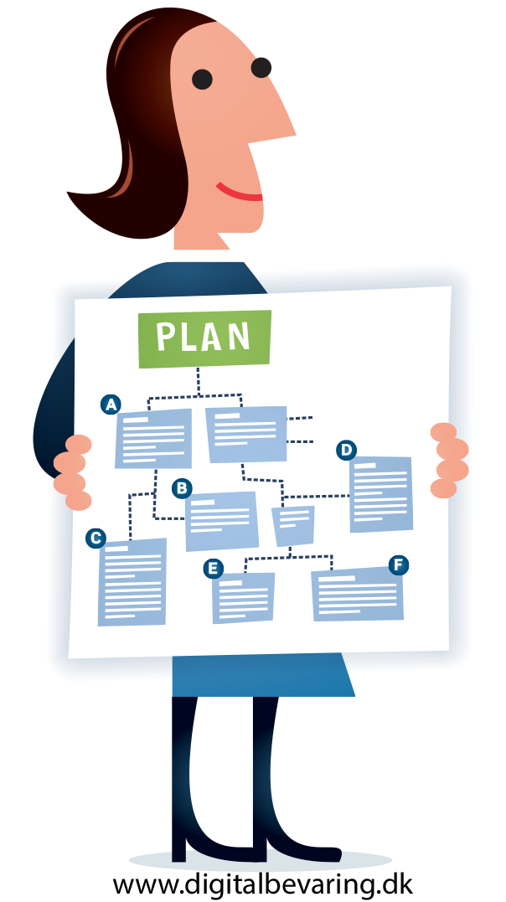
Taking Action…
Planning and developing strategy and policy
Monitoring, planning, administering and managing digital materials, systems and workflows
Assigning the appropriate level of preservation activity for a given set of digital materials

Slide 3
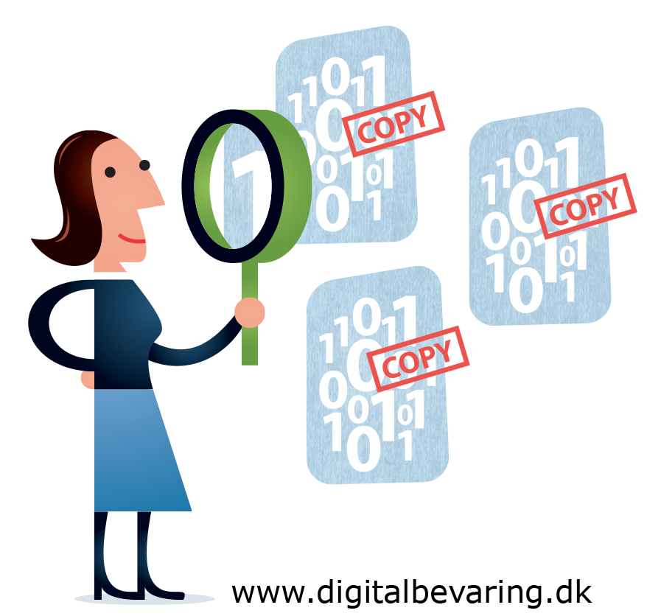
Understanding Digital Materials…
Knowing what we have and capturing necessary documentation and metadata
Ensuring continued integrity and authenticity
Only keeping what we need through careful and informed appraisal and selection
Using appropriate standards to make digital materials more robust and resilient
Adding value to the organisation’s digital materials over time

Slide 4
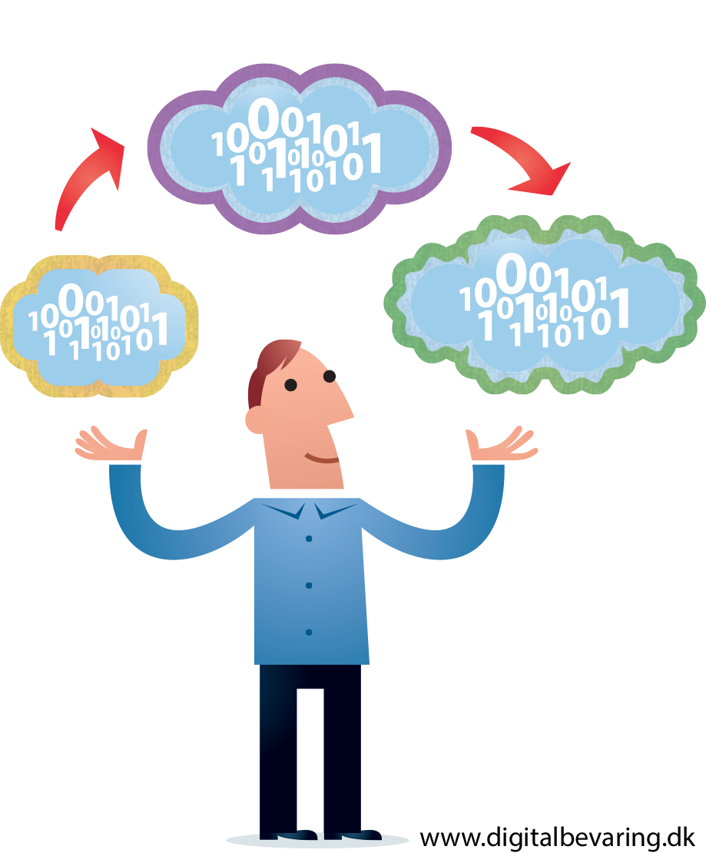
Responding to Change…
Keeping up with the shifting technological landscape,
Ongoing liaison with data creators, data users, solution providers, IT departments, records managers, marketing teams, policy makers and more
Supporting the needs of users through access and training
Enacting cross-organisational business change, so that digital preservation becomes business as usual

Slide 5

Digital Preservation Is More Than…
Digitization, backing up, storage, public access and discovery.
Buying an off-the-shelf product and considering it ‘done’
A technical problem, it is also a cultural one
A fashionable trend, it’s a continuing change for all organisations.

Slide 6

For [Insert Sector]
[Add Sector Specific Issues]

Slide 7
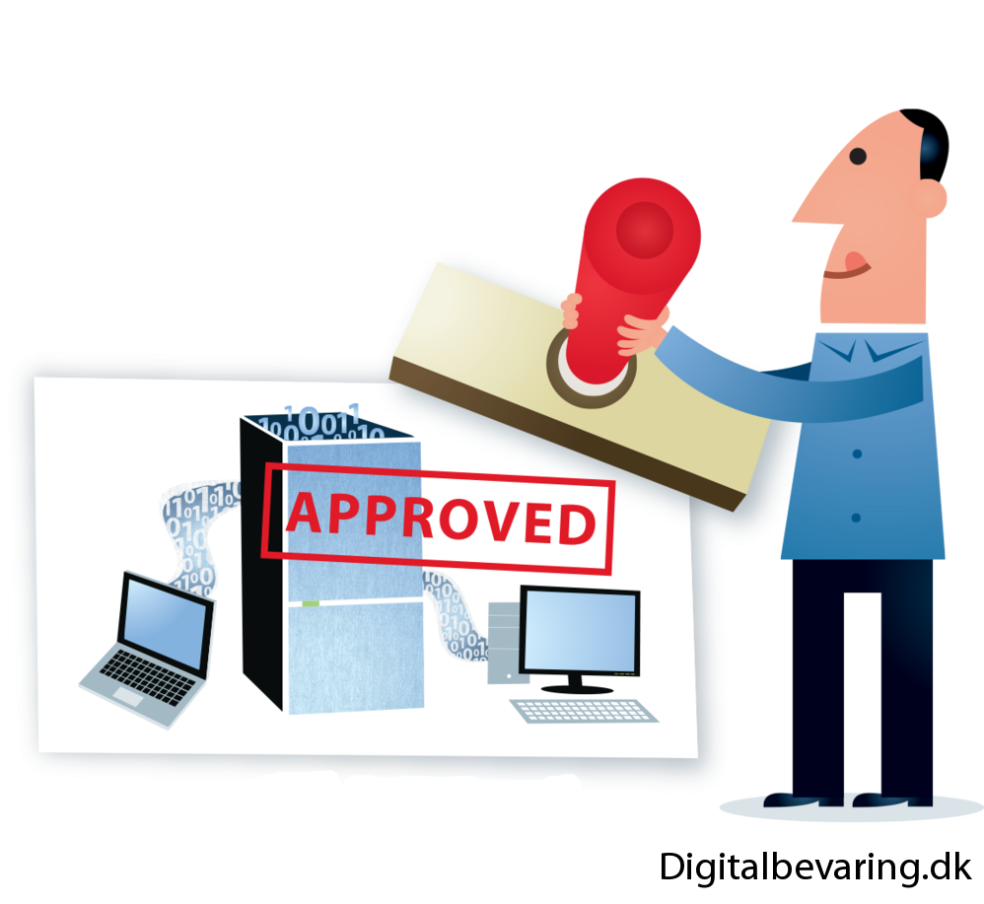
Ultimately….
Essential infrastructure for any organisation – like the power grid or plumbing
Necessary to secure our digital legacy
Should be a primary concern for all

