Slide 1
PREMIS, METS and preservation metadata: emerging trends and future directions
Eld Zierau
The Royal Library of Denmark

Slide 2
Introduction
My background
Masters in Computer Science in 1989
At the Royal Library of Denmark since 2007
  Strategy and design of preservation systems
  Creation of preservation policies and strategies
  Policies of using preservation metadata
PhD in Digital Preservation in 2011
Currently at the Royal Library
SIFD – the digital library
Management, dissemination and preservation
Packaging and re-packaging for Bit Repository
WARC, METS, PREMIS
Framework for OAIS and Distributed Digital Preservation

Slide 3
Contents of this presentation
Practices at The Royal Library
  Strategies and policies
  Putting it into practice
Challenges
  Expressing preservation levels and intellectual entities
  Preserving preservation metadata
  Expressing preservation levels and intellectual entities over time
An example on the bit level
  Risks mitigated in bit preservation
  Bit integrity/safety, confidentiality and availability
Types of preservation Levels
  How to express them – also over time
Identification of intellectual entities
  How to express them – also over time
Summary

Slide 4
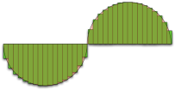
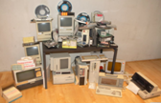

Preservation Strategies
Logical preservation
  Migration
  Emulation
  Technology
  preservation
  Bit preservation
Digital preservation
Logical preservation
Bit preservation
…
0101100010001000

Slide 5
Currently at The Royal Library
Strategy and policies
  Bit preservation
  Logical preservation
Putting it into practice
  The chosen Metadata Standards
  The Digital Library infrastructure
  The Danish Bit Repository Framework

Slide 6
Metadata Standards and use
METS document <mets>
Inspired by the Australian way
http://www.dlib.org/dlib/march08/pearce/03pearce.html
METS header <metsHdr>
<agent>
Descriptive metadata <dmdSec>
<altRecordID>
Wrapped MODS
<mdWrap><xmlData>
<metsDocumentID>
…
Wrapped ??? Video <mdWrap><xmlData>
Wrapped PREMIS object part
<mdWrap><xmlData>
Wrapped AES sound <mdWrap><xmlData>
Administrativ metadata <amdSec>
Wrapped MIX images <mdWrap><xmlData>
Technical metadata <techMD>
Wrapped MODS
<mdWrap><xmlData>
Rights metadata
<rightsMD>
Wrapped PREMIS rights part
<mdWrap><xmlData>
Digital provenance metadata <digiprovMD>
METS element
Wrapped ??? <mdWrap><xmlData>
MODS element
Analog/digital source metadata <sourceMD>
PREMIS element
Wrapped PREMIS agent part
<mdWrap><xmlData>
MIX element
File metadata <fileSec>
AES element
To be decided
Structural Map <structMap>
Wrapped PREMIS event part
<mdWrap><xmlData>
Structural link metadata <structLink>
Will be included
Behavior metadata <behaviorLink>
Wrapped PREMIS preservationLevel part
<mdWrap><xmlData>
May be left out
Notes:
Vil søge at følge Australierne

Slide 7
Digital Library infrastructure
Preservation
Dissemination
Prefer static
Standards
Prefer dynamic
Simplicity
New technology
Add value
BR
Fast access
Access
Ingest
Management
Representations
with metadata

Slide 8
Challenges with metadata
Preserving preservation metadata (if …)
Expressing preservation levels
Expressing preservation levels over time
Expressing Intellectual Entity identifiers
Expressing Intellectual Entity identifiers over time
We need to look more closely on bit preservation to define levels and levels over time

Slide 9


A General View of a Bit Repository
Elements in bit preservation:
Number of copies
Independence between copies
Frequency of integrity checks
Organisation & techniques designed and arranged and used for long-term bit preservation
Integrity check
Bit sequences
Coordination
Bit Repository
General System Layer
Pillar Layer
Pillar1
Pillar 2
Pillar 3
Pillar 4
Pillar 5
Pillar 6
Pillar 7
Pillar 8
…

Slide 10



Integrity – Bit error
Risk: Bits can change value
Error has occurred in Backup
File is corrupted
Error is not discovered
Cannot determine which file is intact
File in form
of bit stream
Solutions:
No backup. All are copies of data
Vote on which copy that is the right one

Slide 11
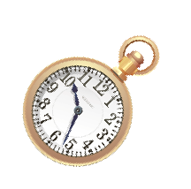

Bit error – System Layer
Bit Repository (BR)
System Layer
Pillar Layer
…
Solutions:
System layer checks and follow-up on basis of comparing copies
Minimum three voters, optimize by checksums

Slide 12
Integrity – Bit error
Risk: Bits can change value
Error has occurred in Backup
File is corrupted
Error is not discovered
Cannot determine which file is intact
File in form
of bit stream
A0953B7
Solutions:
No backup. All are copies of data
Vote on which copy that is the right one
Introduce checksums of files to discover errors

Slide 13
Integrity – Bit error
Risk: The same error occurs for more copies
Same hardware
Same software
Same vendor

Slide 14


Integrity – Bit error
Risk: The same error occurs for more copies
Same hardware
Same software
Same vendor
…
Unix
…
…
Windows
Mac OS
Solutions:
Different hardware solutions
Different vendors
Different software (OS, interpreters, etc.)

Slide 15
Integrity – Disasters
Risk: All copies are damaged at the same time
Natural disasters
Attacks in connection with war or terror

Slide 16


Integrity – Disasters
Risk: All copies are damaged at the same time
Natural disasters
Attacks in connection with war or terror
Solutions:
Different geographical locations

Slide 17
Integrity – Organisation
Risk: Errors/mistakes are made by the same person/org.
The same person has access and has delete rights
The same person makes procedural mistakes

Slide 18



Integrity – Organisation
Risk: Errors/mistakes are made by the same person/org.
The same person has access and has delete rights
The same person makes procedural mistakes
Solutions:
Different organisations

Slide 19

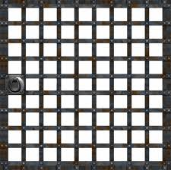
Confidentiality
Risk: Unauthorised gets access to confidential data
Unauthorised gets access to Bit Repository
Unauthorised gets access to data from Bit Repository
Encryption can conflict integrity
A0953B7
Solutions:
Authentication of users of pillars with copies
Encryption internally on pillar
Hardware secured in locked rooms

Slide 20

Confidentiality – System Layer
Bit Repository (BR)
System Layer
System Layer
…
Pillar Layer
…
A09537
Likewise on System layer

Slide 21
Availability
Risk: Cannot get access as required
Cannot get any response on request
Processing not possible in reality
Processing can conflict confidentiality
and bit safety
Solutions:
Specialised pillar with distributed architecture

Slide 22


Availability
Bit Repository (BR)
System Layer
…
Pillar Layer
…
Solutions:
Redirection if access to a pillar is down
Distributed requests to different pillars
Scaling
Diversity,
…
Depends on what is required

Slide 23

Bit Repository Offering Solutions
BR
General System Layer
Pillar Layer
Pillar 1
Pillar 2
Pillar 3
Pillar 4
Pillar 5
Pillar 6
Pillar 7
Pillar 8
Pillar 9
…
Media
Data safety
Access speed
On-line
Off-line
Organisational placement
Geographical placement
…
Bit safety
Availability
Costs
Confidentiality

Slide 24
Bit Safety
Value | Comment for preservationLevelType = BitSafety
Max | Maximum bit safety
VeryHigh | Very high bit safety
High | High bit safety
Medium | Medium bit safety
Low | Low bit safety
VeryLow | Very low bit safety
Min | Minimum bit safety
from http://id.kb.dk/vocabulary/

Slide 25
Bit Safety
Value | Comment for preservationLevelType = BitSafety
Max | Maximum bit safety
VeryHigh | Very high bit safety
High | High bit safety
Medium | Medium bit safety
Low | Low bit safety
VeryLow | Very low bit safety
Min | Minimum bit safety
Policy:
As high bit safety that we can get
Strategy 2013:
10 copies spread over 3 continents, both optical and magnetic medias,
checked every …
Strategy 2050:
8 copies ; at lest 2 on Mars, at least two written to DNA, checked every …

Slide 26
Confidentiality
Value | Comment for preservationLevelType = Confidentiality
Max | Maximum confidentiality
VeryHigh | Very high confidentiality
High | High confidentiality
Medium | Medium confidentiality
Low | Low confidentiality
VeryLow | Very low confidentiality
Min | Minimum confidentiality
from http://id.kb.dk/vocabulary/

Slide 27
Confidentiality
Value | Comment for preservationLevelType = Confidentiality
Max | Maximum confidentiality
VeryHigh | Very high confidentiality
High | High confidentiality
Medium | Medium confidentiality
Low | Low confidentiality
VeryLow | Very low confidentiality
Min | Minimum confidentiality
Policy:
Only restricted access, where it is as hard as it can get for others
when skipping encryption
Strategy 2013:
No more than 2 copies, that are secured on off-line medias …
Strategy 2050:
??? …

Slide 28
Availability
Value | Comment for preservationLevelType = Availability
Max | Maximum availability
VeryHigh | Very high availability
High | High availability
Medium | Medium availability
Low | Low availability
VeryLow | Very low availability
Min | Minimum availability
…

Slide 29
Logical Preservation
Value | Comment for preservationLevelType = logicalStrategy
Migration | Migration of digital material to keep data interpretable
Emulation | Emulation of digital material to keep data interpretable
Technical | Technology preservation to keep data interpretable
…

Slide 30
Preservation Level information
preservationLevelType | Comment
Bit safety | Bit preservation
Confidetiality | Bit preservation
Availabilityl | Bit preservation
Logical Preservation Strategy | Logical Preservation
…
Policy
  With institution preservation policies
  Same over time
  Express values
Strategy
  Requirements for fulfilment with current technologies …

Slide 31
Preservation Level in metadata
<digiprovMD CREATED="2013-01-18T19:28:01.456+01:00" ID="Premis1">
<mdWrap MDTYPE="PREMIS">
<xmlData>
<preservationLevel xmlns:xlink="http://www.w3.org.1999/xlink" xsi:…”>
<preservationLevelValue>bitSafetyHigh</preservationLevelValue>
<preservationLevelDateAssigned>2013-01-18T19:28:01.458+01:00
</preservationLevelDateAssigned>
</preservationLevel>
<preservationLevel xmlns:xlink="http://www.w3.org.1999/xlink" xsi:…”>
<premis:preservationLevelValue>logicalStrategyMigration
</premis:preservationLevelValue>
<preservationLevelDateAssigned>2013-01-18T19:28:01.459+01:00
</preservationLevelDateAssigned>
</preservationLevel>
<preservationLevel xmlns:xlink="http://www.w3.org.1999/xlink" xsi:…”>
<preservationLevelValue>confidentialityLow</preservationLevelValue>
<preservationLevelDateAssigned>2013-01-18T19:28:01.460+01:00
</preservationLevelDateAssigned>
</preservationLevel>
</xmlData>
</mdWrap>
</digiprovMD>
Notes:
Skal laves mere

Slide 32

Identification in the future
15AE9513
Object
Service Provider
Object id. &
Service
Producer
Con-sumer
Object id.
Object
15AE9513
Notes:
5:15

Slide 33
Preservation Level in metadata
<techMD CREATED="2013-01-18T19:28:01.426+01:00" ID="PremisObject1">
<mdWrap MDTYPE="PREMIS:OBJECT">
<xmlData>
<object xmlns:xlink="http://www.w3.org.1999/xlink" xsi:…”…>
<objectIdentifier>
<objectIdentifierType>UUID</premis:objectIdentifierType>
<objectIdentifierValue>41d153d0-0099-11e2-9397-005056887b67
</objectIdentifierValue>
</objectIdentifier>
…
<linkingIntellectualEntityIdentifier>
<linkingIntellectualEntityIdentifierType>UUID
</linkingIntellectualEntityIdentifierType>
<linkingIntellectualEntityIdentifierValue>
41d153d1-0099-11e2-9397-005056887b67
</linkingIntellectualEntityIdentifierValue>
</linkingIntellectualEntityIdentifier>
</object>
</xmlData>
</mdWrap>
</techMD>
Notes:
Skal laves mere

Slide 34
Summary
PREMIS, METS and preservation metadata:
emerging trends and future directions
Preserving preservation metadata
  Which and how
Some challenges for the future
  Definition of preservation levels and intellectual entities
  Expressing preservation levels and intellectual entities
  Expressing preservation levels and intellectual entities over time

Slide 35

Questions and Comments

Slide 36

Extra Slides

Slide 37
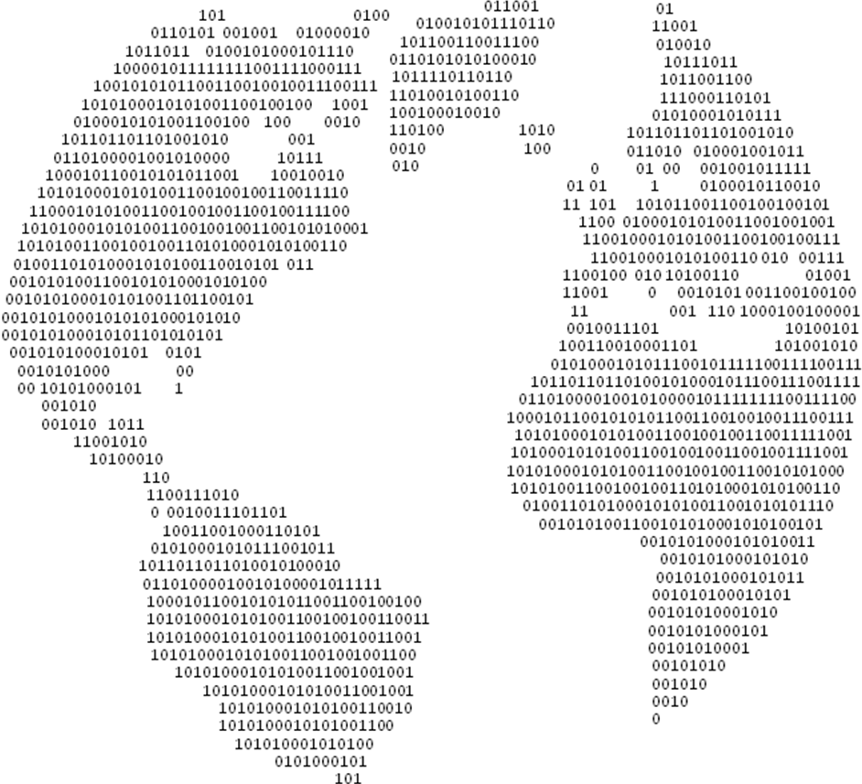
A Holistic Approach: Three Main Results
…
IR-BR Model
to define and delimit BR on a conceptual level from other aspects of digital preservation
Representation Concept
to define repr. that are bit preserved and to find requirements to bit preservation
Evaluation Methodology
to choose between different bit preservation solutions, as part of finding the optimal solution
Institution Repository (IR)
Institution Repository (IR)
Institution Repository (IR)
Bit Repository (BR)
?
?
?
General System Layer
√…
Pillar Layer
Pillar 1
Pillar 2
Pillar 3
…
1
0
1
1
0
0
0
√
√

Slide 38
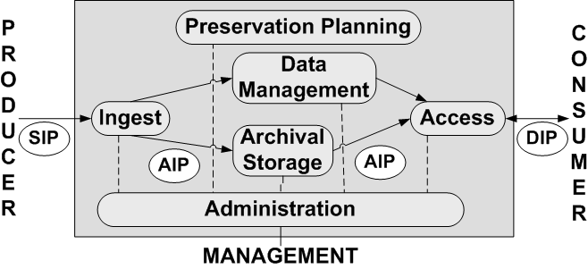













OAIS/DDP research project
Research project that investigate combination of
OAIS reference model
Distributed Digital Preservation (DDP)
Participating projects/institutions:
…

Slide 39
Position based like ARC and WARC
WARC is an ISO standardised enhancement of ARC
WARC/1.0
WARC-Type: warcinfo
WARC-Date: 2012-08-27T15:50:16Z
WARC-Record-ID: <urn:uuid:21d07350>
Content-Type: application/warc-fields
Content-Length: 46
application: id.kb.dk/gatekeeper/releasetest17
WARC/1.0
WARC-Type: resource
WARC-Target-URI: urn:uuid:15AE9513
WARC-Date: 2012-08-27T15:50:14Z
WARC-Record-ID: <urn:uuid:15AE9513>
Content-Type: image/tiff
Content-Length: 139803706
II*1214i
eeciRGB v2
P`p¡²ÃÔå,>PcuÁÕèü$8Ma
…
WARC package ID
Summary
15AE9513
IKKE FÆRDIG:
Måske ikke med

Slide 40
The DK Bit Repository case
SLA 2
System: Technique, Organisation, Costs Pillar 2: Technique, Organisation, Costs
Pillar 3: Technique, Organisation, Costs
SLA 1
System: Technique, Organisation, Costs Pillar 1: Technique, Organisation, Costs
Pillar 3: Technique, Organisation, Costs
Bit Repository (BR)
General System Layer
Technique, Organisation, Costs
Pillar Layer
Pillar 1
Technique
Organisation
Costs
Pillar 2
Technique
Organisation
Costs
Pillar 3
Technique
Organisation
Costs
Pillar 4
Technique
Organisation
Costs
Pillar 5
Technique
Organisation
Costs
…
General System Layer
Royal
Library
State & Univ.
Library
National
Archives
State & Univ.
Library

Slide 41
Services
SLA 2: low bit safety level, high confidentiality
…
SLA 1: Medium bit safety level, fast access
Bit Repository (BR)
Bit Repository (BR)
Bit Repository (BR)
An institution makes service level agreement about specific services
A service level agreement per ”source” of data with specific requirements
The service level agreement will be based on:
  The institutions need for services
  Risk analysis made for the institution
  Cost/benefit-analysis made for the institution
The service level agreement is based on the different components in the Bit Repository

Slide 42

Package and storage related requirem.
Requirement 1:
Independence of storage platform
Requirement 2:
Package format allows flexible packaging
Requirement 3:
Allow update records
1
2
Bit Repository
Different
package sizes
optimal for
different
media/storage
…

Slide 43
Preservation related requirements
As for preservation formats
mitigate risk of losing means to understand the format
Requirement 4:
Must be standardised format
Requirement 5:
Must be open
Requirement 6:
Must be easy to understand
Requirement 7:
Must be widely used in bit repositories
Requirement 8:
Must be supported by existing tools
Requirement 9:
Must be able to include digital files unchanged
As for preservation formats
mitigate risk of loosing access to documentation and tools for interpretation
As for preservation formats
mitigate the risk of introducing errors or later difficulties in interpreting
As for pres. formats
If adopted widely, it may stay longer
As for preservation formats
trust in quality and future existence of the format
No conversion
e.g. compression
needed in XML
<objectstream>
Fasdnigfndsgnjdflvknswlæg,åpw6i3s<v,LGKwev</objectstream >fmweklFMwlfme
</objectstream >

Slide 44
Identification related requirements
Requirement 10:
Must facilitate identifiers for a digital object
Especially a challenge
when the object is ’a file’
15AE9513
Object
Service Provider
Object id. &
Service
Producer
Con-sumer
Object id.
Object
15AE9513
?
15AE9513

Slide 45
The PREMIS standard
PREMIS
Preservation Metadata: Implementation Strategies
Primarily used for Digital provenance
Example of fields of special interest:
  preservationLevel
  linkingIntellectualEntityIdentifier
Hosted at Library of Congress
http://www.loc.gov/standards/premis/ http://www.loc.gov/standards/premis/v2/premis-2-2.pdf http://www.loc.gov/standards/premis/v2/premis.xsd

Slide 46

Reasons for id. requirements
Leave it 100% to the bit preservation solution
  Risk since it is crucial information in preservation – outsource of responsibility
  Eliminate possible optimisation of packaging more files or files and metadata in the same packages
Naming files with the identifier
  file name is not part of the file itself
  restrictions to how files are named
  may not make same sense in the future
Put identifier into files as inherited metadata
  would need to change original bits
  knowledge of how to extract identifiers
  from file formats
Wrap files and identifier in a package format
  requirements for the abilities of the
  package format
15AE9513
put the id. with the file
?
15ae9513.abc
15AE9513.ABC
15αε9513.αβχ
Year 2052
?
FileId:
15AE9513
…
Year 2052
15AE9513

Slide 47
List of Preservation related requirements
Req.1: Independence of storage platform
Req. 2: Package format allows flexible packaging
Req. 3: Allow update records
Req. 4: Must be standardised format
Req. 5: Must be open
Req. 6: Must be easy to understand
Req. 7: Must be widely used in bit repositories
Req. 8: Must be supported by existing tools
Req. 9: Must be able to include digital files unchanged
Req. 10: Must facilitate identifiers for a digital object
Not exhaustive list
of requirements!!!

Slide 48
Main contents of PREMIS
object
  Describes whether it is a 'file', 'representation', or 'bitstream‘
  Contains e.g. object identifier, preservation level, significant properties and relationships
event
  Aggregates metadata about actions.
  Contains e.g. event identifier, event type (creation, migration, …), and other event details
agent
  Describes the agent that can have different roles in relation to an event or object
  Contains agent identifier and possibly other informaiton like name and type etc.
rights
  Describes rights and permissions specifically related to digital preservation
  Contains e.g. rights statements and possible extions with other metadata

Slide 49
Can be wrapped in METS
Metadata Encoding and Transmission Standard
  Container format with:
  Descriptive metadata
  Information describing intellectual contents
  Administrative metadata
  Necessary information for preservation:
  Technical metadata
  Technical information
  Rights management
  The information necessary to restrict its delivery to those entitled to access it
  Digital provenance
  The information on the creation and subsequent treatment of the digital object
Structural metadata
The information on the internal structure of a digital object
…

Slide 50
Preservation Metadata Challenges
Currently at The Royal Library
Strategies and policies
Putting it to practice
Challenges
Preserving preservation metadata
Expressing preservation levels over time
An example
Digital preservation strategies
Bit Repository with bit preservation
Risks mitigated in bit preservation
Confidentiality and availability
Preservation Levels
How to express them
How to express them over time
PREMIS, METS at the Royal Library of Denmark

Slide 51
Inspiration: The Danish Bit Repository
Partners:
The Royal Library, The State and University Library,
The National Archives
Goals :
Cost effective shared solution
Receive bits and deliver bits in intact form (>100 years)
Challenges :
Mission and goals
Value of material (bit safety – preservation levels)
Confidentiality requirements
Service requirements (ingest, access, processing, …)
  Only bits

Slide 52
The IR-BR Model – consider place
Logical Object
IR in org. C
Ref:
“Cross Institutional Cooperation on a Shared
Bit Repository”
by
Eld Zierau and Ulla Kejser
ICDL 2010
Best international paper
IR in org. A
IR in org. B
Technology watch
Planning & strategy
…
Technology watch:
Logical preservation
Planning & strategy
…
IR: Institution Repository
IR
Ingest
IR
Access
IR
Preservation Planning
…
…
Logical object, metadata, …
IR
Data Management
Policies: storage,
disaster recovery, …
BR
PRO-
DUCER
BR
CON-
SUMER
Policies: storage (BR),
disaster recovery IR level), …
IR
Administration
BR MANAGEMENT
Bit streams, id., origin
IR
Archival Storage
Bit streams, id.
Technology watch: Media …
Planning & strategy
…
BR: Bit Repository
BR
Ingest
BR
Access
BR
Preservation Planning
Bit streams, id., origin, audit trail
BR
Data Management
BR
Administration
Policies: storage (BR),
disaster recovery IR level), …
BR
Archival Storage
BR as ‘IR archival storage’
but there are more to it!!!
Notes:
Pas på

Slide 53
Digital Library infrastructure
Fedora solutions
Just started development
Preservation
Dissemination
Prefer static
Standards
Prefer dynamic
Simplicity
New technology
Add value
BR
Fast access
Access
Ingest
Management
Representations
with metadata
Danish bit repository being put to production
Repackaging metadata – into WARC

