Slide 1


Structured Expert Judgement
June 2020
Dr Martine J. Barons
With thanks to Dr Anca Hanea

Slide 2
EXPERTS ARE OFTEN CONSULTATION FOR:
Framing and structuring of a problem
Identifying variables and relationships
Sources of data / Data
Quantifying uncertainty
  Uncertain parameters (uncertain quantities, probabilities)

Slide 3
Structured expert judgement
Pre – Elicitation
Define problem
Find experts
Find facilitator
Find validation data
Frame
Elicitation
Post – Elicitation
Aggregate experts’ judgements
Feedback
Post-hoc analysis of results

Slide 4
WHAT IS THE BEST WAY TO DO IT?
Nobody knows!
…but we know more experts are necessary
…and we agree that the following are important:
Preparation and planning
The selection, phrasing and sequence of questions
The aggregation of multiple judgements
Documentation of the process

Slide 5
Conditions that characterise ‘wise crowds’:
diversity of opinion
independence
decentralisation (individuals draw on their own local knowledge)
aggregation (having a suitable means to generate a group judgement from multiple individual estimates).

Slide 6
Phrasing & Sequence of questions
What questions we ask the experts, and how we ask them, influence their answers
Psychologists have studied the process of making judgements in uncertainty
Heuristics and cognitive biases

Slide 7
Aggregation
The process of deriving a single probability (distribution) or a single estimate to represent the knowledge of a group of experts
  Divergent opinions on how best to do this
  Mathematical versus behavioural

Slide 8
Structured Expert Judgement
An elicitation protocol that:
asks questions with clear operational meanings
follows transparent methodological rules
mitigates psychological and motivational biases
includes the possibility of identifying the experts
allows empirical control
is thoroughly documented

Slide 9
Questions
What % of a watermelon is water?
_______________ _________________ _________________ 5% 95% 50% Lower plausible bound Upper plausible bound Best estimate

Slide 10
Validation data for empirical control
Calibration / performance / seed variables needed
Scores for good performance
  Calibration / Statistical accuracy
  Informativeness
Use scores as weights

Slide 11
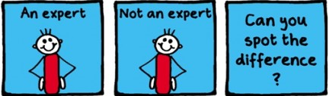
Weighting schemes

Slide 12
Cooke’s Protocol
Requires that experts assess uncertainty for variables for which we (will) know the true values:
Calibration / performance / seed variables
Assumption – the future performance of the experts on the variables of interest can be judged on the basis of their past performance on the seed variables

Slide 13
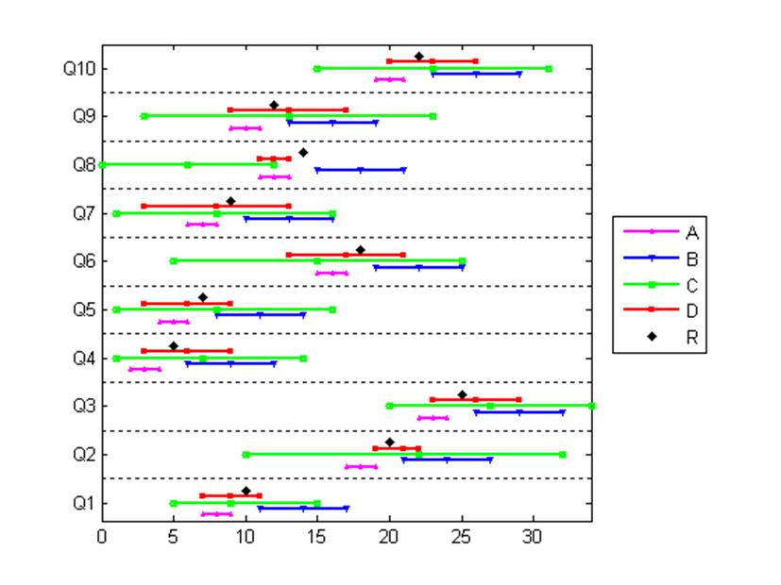
Range graphs
calibration questions example
4 experts, 10 calibration questions, correct answer marked.

Slide 14
IDEA (Investigate, Discuss, Estimate, Aggregate)
Pre – Elicitation
Define problem
Find experts
Find validation data
Frame
Train
Elicitation
Individual Investigation & 1st set of individual estimates
Feedback and facilitated Discussion
2nd set of individual Estimates
Post – Elicitation
Aggregate experts’ judgements
Feedback
Post-hoc analysis of results

Slide 15
IDEA minimises Cognitive biases
The 1st individual assessment avoids anchoring on other people estimates
The discussion between rounds reduces the effect of the availability bias
The 2nd individual anonymous assessment reduces dominating effects and group think
The way we ask the questions reduces the anchoring & overconfidence

Slide 16
IDEA protocol :
What we’ve learned
Feedback and facilitated interaction are crucial
Discussion induces very weak dependence and helps improve experts‘ performance
aligns expert opinions in the direction of the truth
Mathematical aggregation is essential
Equal weighting may be outperformed by unequal weighting
Performance measures should determine the weights (when unequal)

Slide 17
IDEA :
Use in Diagram
Involved archivists from a range of archives to be as general as possible
Used performance weighted aggregation
Facilitated discussion between archivists
Provided data where there was none
Quantified uncertainty
Enabled the model to be completed

