Slide 1
Bacardi Digital Preservation
Current work and Future Goals
Samantha Case, Assistant Archivist
Notes:
Hi everyone, I’m happy to be here today and to give you a look inside the Bacardi archives and talk a bit about how we are approaching digital preservation. My name is Samantha and I’m an Assistant Archivist for Bacardi, but more specifically I work for John Dewar and Sons in the east end of Glasgow. I work there with my manager, Jacqui Seargeant, who is also the Global Heritage Manager for Bacardi. I have been there for almost a year and a half, and I was brought on to work with the digital project.
As I go through the presentation, please feel free to stop me with any questions.

Slide 2
Bacardi Group Archives and Heritage Collections
Notes:
So first off, I’m going to talk a little bit about the Bacardi archive and heritage collections as whole, just to give you all some idea of where we were starting from with the digital project.

Slide 3
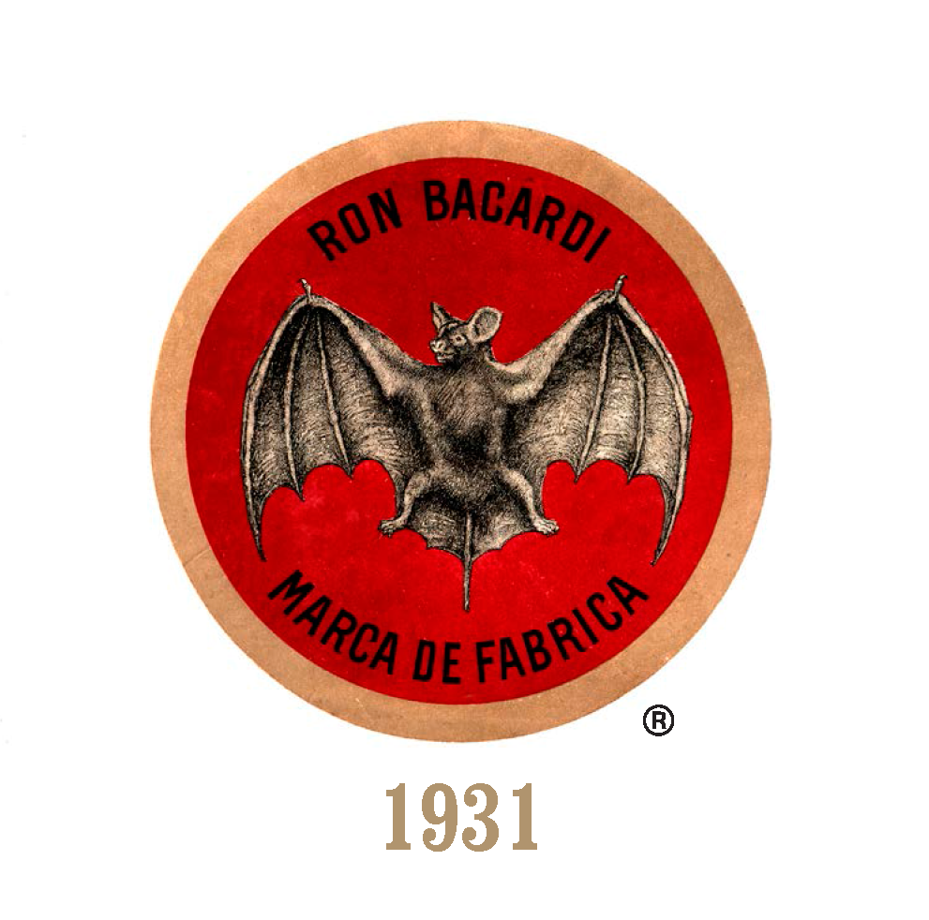
BACARDI HERITAGE
Who are we?
The largest privately held spirits company in the world
158 years old, passing through 7 family generations
Over 200 brands and labels
Sold in over 170 countries
Over 20 production facilities in 12 countries
Archive collection in Miami, USA
Notes:
So, who is Bacardi?
Bacardi is the largest privately held spirits company in the world. It has over 7000 employees around the world and is 158 years old, passing through 7 family generations.
We have over 200 brands and labels, including many heritage brands such as Bacardi rum, Dewar’s Whisky, and Martini Vermouth. Other well known brands include Bombay Sapphire, Grey Goose, Eristoff Vodka, and Cazadores and Patron tequilas.
There are many stories from the archive which make the brand what it is today, including the story of the fearless founders and their drive to innovate and build the company.
Even the bat symbol is a piece of our history.
The story behind the iconic BACARDÍ bat device started over a century and half ago, as founder Don Facundo Bacardí Massó began making his rum in the original Santiago de Cuba distillery. His wife, Doña Amalia Bacardí Moreau, noticed a colony of fruit bats hanging in the rafters, likely attracted there by the sweet smell of molasses in the air. Recognizing the bat as a symbol of family unity, good health, and fortune to her husband’s homeland of Spain and the Cuban Taíno Indians, she suggested to adopt the bat device to the BACARDÍ bottle, differentiating BACARDÍ rum from other products at a time when many consumers on the island could not read or write. And so began the era of "el Ron del Murcielago".

Slide 4
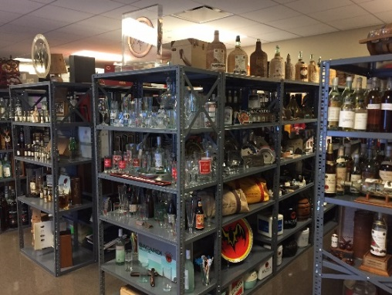
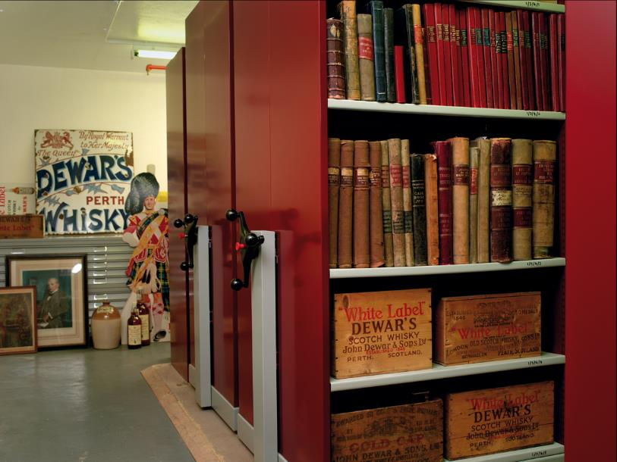
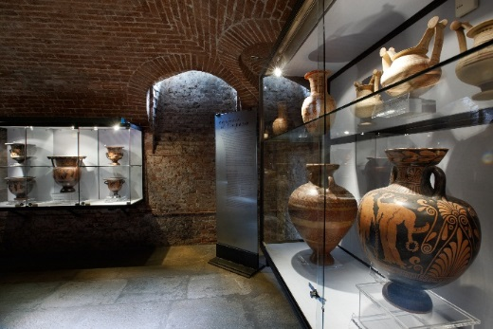
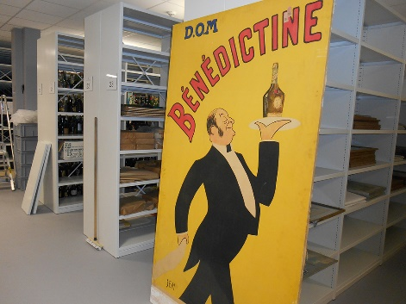
BACARDI HERITAGE
Main Archive Collections / Locations
BACARDÍ (1862): Miami
MARTINI (1863): Pessione, Italy
DEWAR’S (1846): Glasgow
5 Distilleries: Glasgow
BOMBAY Gin (c1959): Glasgow
BÉNÉDICTINE (1863): Fécamp, France
OTARD Cognac (1795): Fécamp, France
NOILLY PRAT (1813): Fécamp, France
Museum Collections
BÉNÉDICTINE (1863): Fécamp, France
MARTINI Museum of Wine: Pessione
Emilio Bacardi Museum: Miami
Notes:
These are all our amazing historical collections – which include both business archives and impressive museum collections. There are six members of staff across four locations, in Glasgow, Pessione, Fecamp, and Miami. These are not just brand archives, but also company archives, though the brand name is what is written just to keep it simple.
For our heritage brands, the archives are the natural heart of the brands, and our archivists therefore need to be closely involved in marketing and other core business.
The majority of these collections have been professionally managed and developed over the past 20 years or so. What survived before then was often a question of luck and members of the company nurturing the collections within the company offices. Our Scotch whisky and gin archives came to Glasgow in 1999 shortly after Bacardi purchased these brands from Diageo (1998). Add more detail here.
In addition to our heritage brands, we do have some modern archives for more current brands, such as Grey Goose. It is just over 20 years old, so by necessity many of their records are digital. Similarly, the Bombay Sapphire colleciton, which I have been working on, has boxes an boxes of CDs, some with presentations from the 1990s, which in some cases are the only records that have made their way to the archive from that time period.
I would add, these are not just a brand archives, but company archives – but company names are too long for this slide.
CUBA: Left cuba in 1960 with the revolution - assets seized

Slide 5
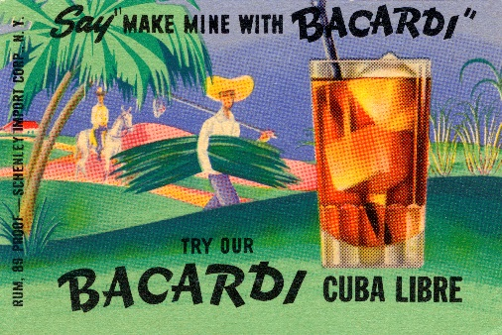
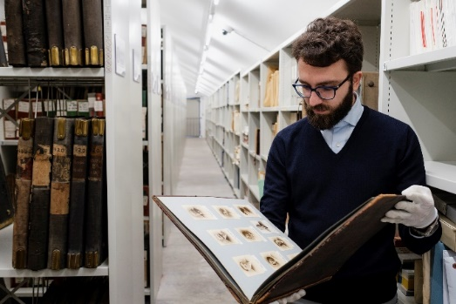
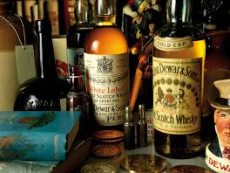
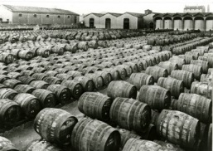
BACARDI HERITAGE
  Our archive collections include:
  Corporate Records
  Financial Records
  Legal Records
  Production Records, including recipes
  Property Records, including plans
  Marketing, advertising and POS
  Labels, packaging and bottles
  PR and press cuttings
  Photographs and films
  Medals and Awards
Notes:
The collections include a wide variety of items in many different formats, from correspondence and financial ledgers, to marketing and advertising materials, POS and production items like cooperage tools. This variety makes them absolutely fascinating – the documents and information heavy items tell us a lot about our brands in the past, and the beautiful, visual items are inspiring and engaging, especially for our marketing teams.
We do try to collect only the records which have long term historical significance, but that is often a fairly subjective process as it is not always clear at the time what may be useful in future.
Some of what has survived is purely accidental (as in many archives), but going forwards we are trying to be more controlled and deliberate about what we bring into the archive.

Slide 6
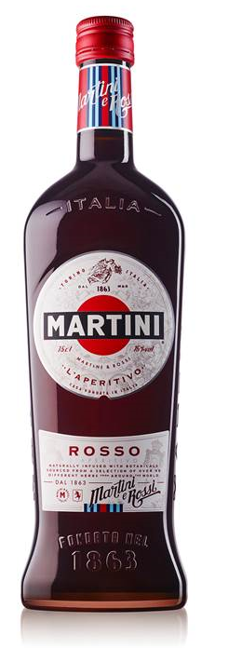
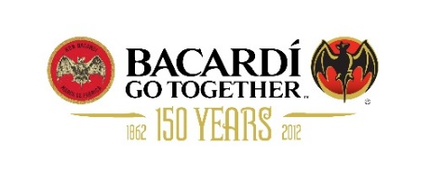
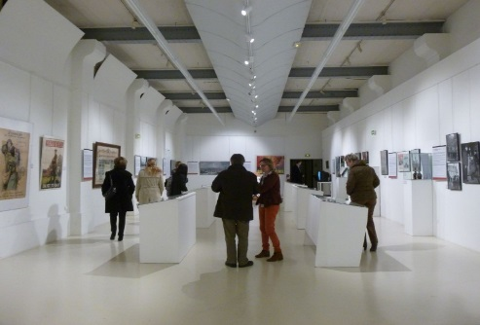
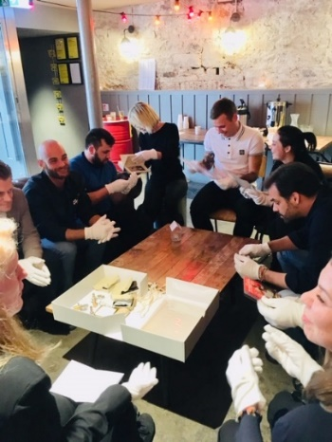
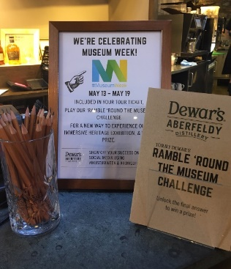
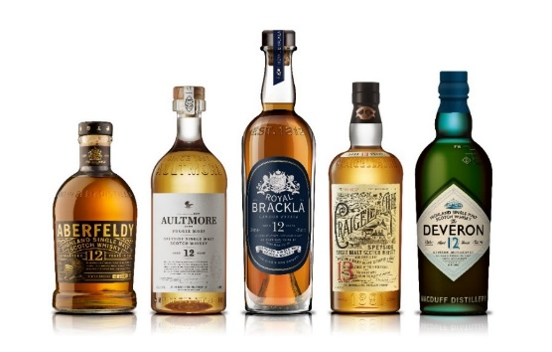
BACARDI HERITAGE
Celebrations
Exhibitions
Advocacy
Brand homes
New product development
  Brand Building
Notes:
The influence of our heritage can be seen in various aspects of the business, including in brand building, anniversary and other celebrations, advocacy, in our brand homes, exhibitions, and often in new product development.

Slide 7
Digital Preservation at Bacardi
Notes:
So now that you know the context of the Bacardi brands, I’ll talk more about what we are doing with digital preservation.
There are three of us that have been working on this project, but no one works solely on digital at the moment.

Slide 8
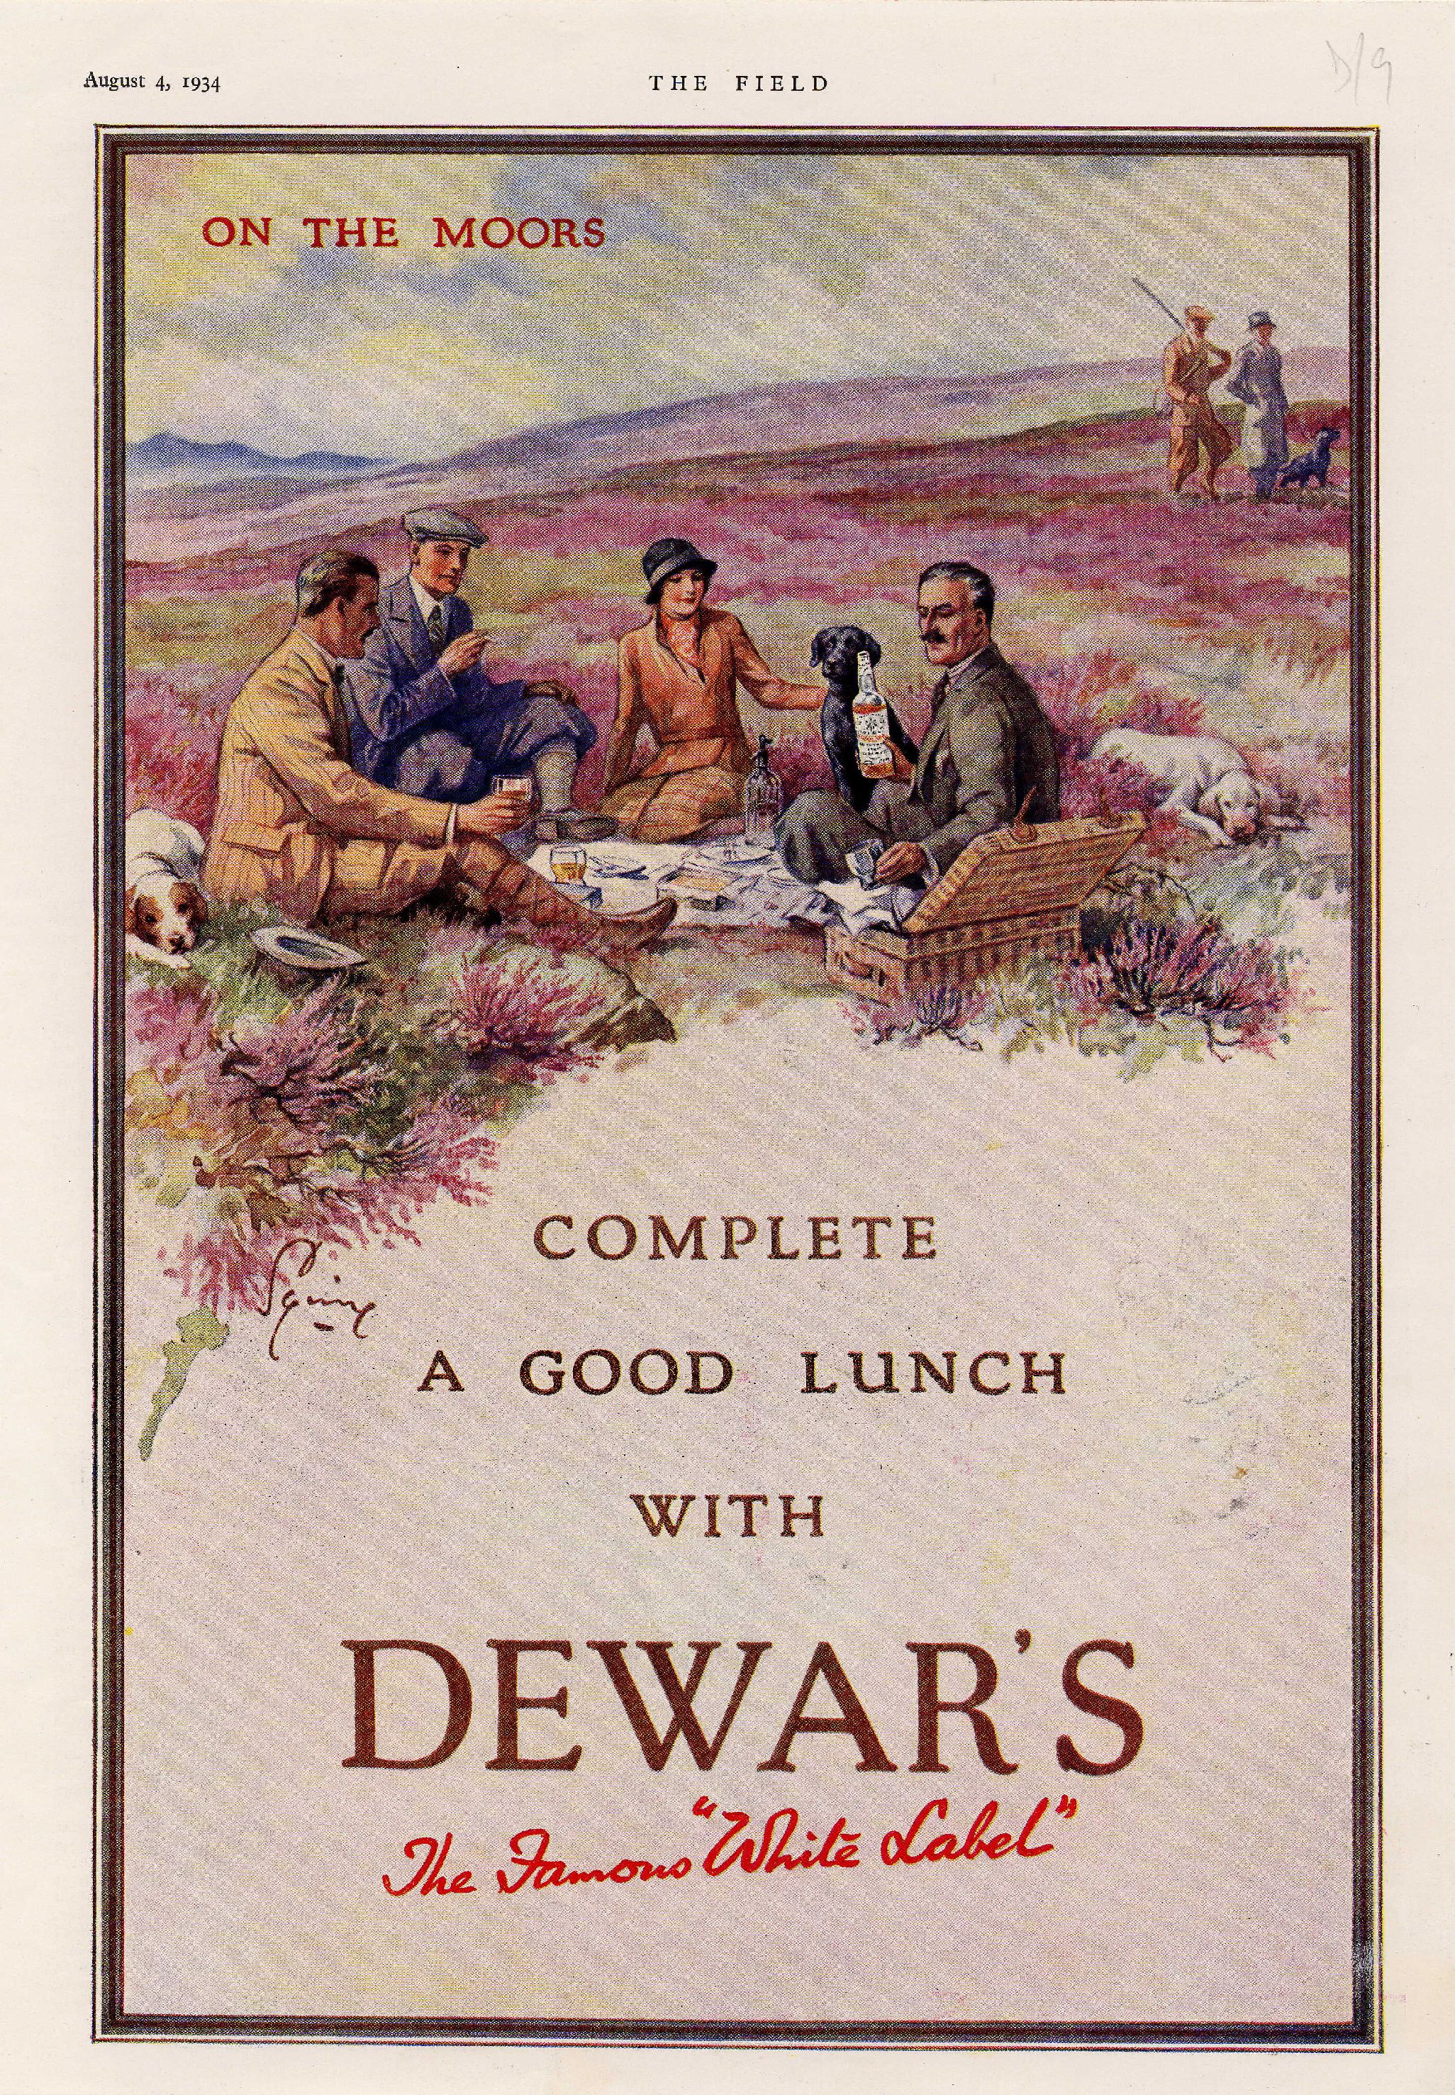
Current Activities
Conducting a records survey of the UKOC
Accessioning digital records
DPC RAM self assessment
Investigating digital preservation systems
Set up a SharePoint site
Migration of records on at-risk media
Digitisation of heavily used items
A digitised Dewar’s advert, 1934
Notes:
This is a list of our current activities that relate to digital preservation, and I’ll go into more detail in the next few slides.

Slide 9

Records Survey
Conducted to understand what records the company is holding and creating
Stage 1: Survey design
Stage 2: Senior management buy-in
Stage 3: Conduct the survey
Challenges:
  Confusion regarding what we are trying to achieve
  Not understanding their role in creating records that are of archival interest
Notes:
To begin with, I’ll explain our records survey.
The goal was to understand what records the company was holding and creating. This was largely a survey of digital records, as the majority of people no longer produce physical records. Currently there is potential for loss of records when staff leave, offices move, or business systems change, and something needs to be done to mitigate this loss.
Conducted in the UK, mostly in Glasgow but also over Skype with brand home teams in Laverstoke and Aberfeldy.
There was a survey done in 2011 by an archivist, but her contract was not permanent, and therefore when she left and there was a sole archivist remaining, this project went on the back burner. It takes a lot of work to try to get people to remember to transfer records to the archive, and without a dedicated records management system, it has not been feasible to keep up with the recommendations made at the time.
Stage 1: Based on that survey and other resources in the archive community, I designed a records survey. I originally designed it to be completed by the individual prior to meeting with them, with little assistance from the archivist. There was a list of record types included, which they were meant to amend as appropriate.
Stage 2: We then explained the project to senior members of the company. (this came after survey design as we needed a survey to actually show them). We spoke to the Director of the UKOC, and subsequently to directors and managers for each business function. The goal was to get their approval for the project and ensure that they knew what we were actually looking for when it came to conducting the survey. It is important to include IT in these discussions, as they will have information on what systems are being used throughout the company and will have recommendations on who to speak to about those systems. After gaining their approval, we created a list of who to interview (which included senior management as a priority). This list grew as people recommended members of their staff who would be useful for us to speak to.
Stage 3: We started the process by sending prospective interviewees an email introducing the project, with a copy of the survey and the results from the previous records survey attached. The original idea was that they would have the survey filled out before we came to speak with them. In reality, most people were so busy that this didn’t happen, so we instead simply started every meeting with the survey questions. This ended up being a useful exercise, as often by discussing the questions with the individual, other information of interest was elicited, as well as other directions of enquiry.
We then asked if we can see how they actually arrange their files on their computer. The reason for this is because if you ask people what records they think are of value, they often don’t think any records are. By actually looking at their files, we can see and explain to them how various files do actually have historical significance. The results from these discussions are recorded in an excel spreadsheet.

Slide 10
Records Survey: Questions Asked
Name:
Email:
Job Title:
Department:
Background at Bacardi:
Please describe your responsibilities and/or main job functions:
Do you use a digital system to manage aspects of your business (ie SAP, CAPEX, etc)?
Who are the key people / departments you work with?
How does your team share information among members?
Do you organize your email in any way?
Do you use SharePoint?
What records of yours do you think are of long-term historical value?
Notes:
These are the questions that we included on the initial survey, and we also had a few sentences introducing the project, though I’m not convinced that most people read it.
We were essentially trying to understand what people did, how long they had been with Bacardi, and what types of records they were producing.
The question about digital systems was meant to inform our decision about whether any information needed to be exported from the systems that they were using. If it was transactional information, such as the data gathered about the bottling lines, it probably didn’t need to be kept. However, some departments did a large part of their work within these systems, such as NPD, and in that case, we would need to find some way of exporting either reports or documents.
The question about SharePoint was because at one point it looked like we were going to be using SharePoint extensively as a company, but it’s unclear if that is still happening.

Slide 11
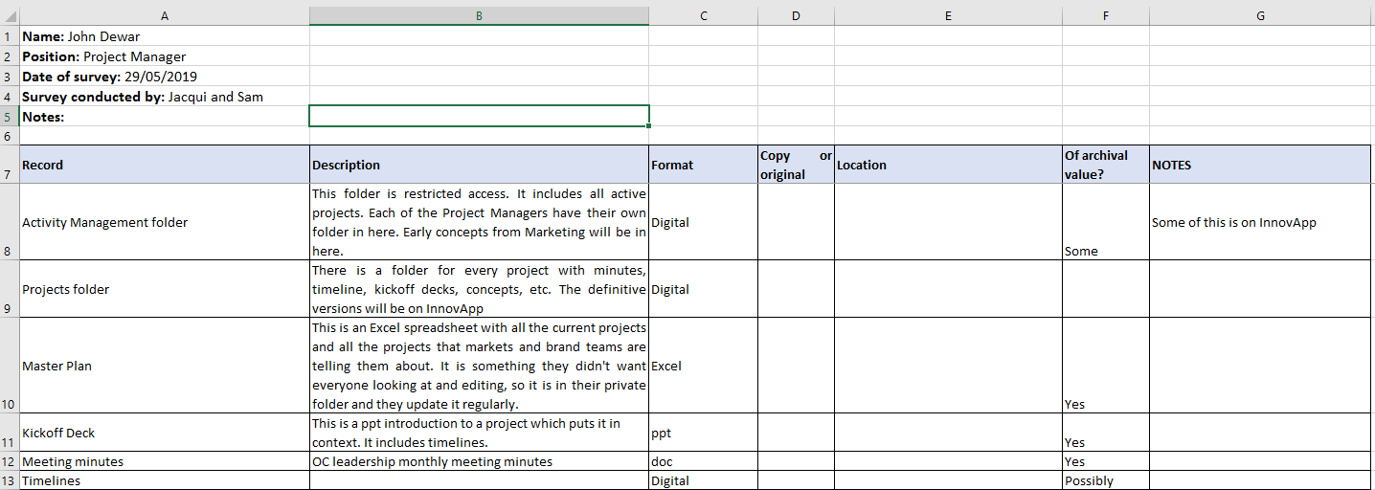
Notes:
This is how we recorded the record types that people are creating. A simple excel spreadsheet with a rundown of the folders that were being used most by each person and notes of what was in them and whether they were of archival value. We then used these excel documents to edit our retention schedules.

Slide 12
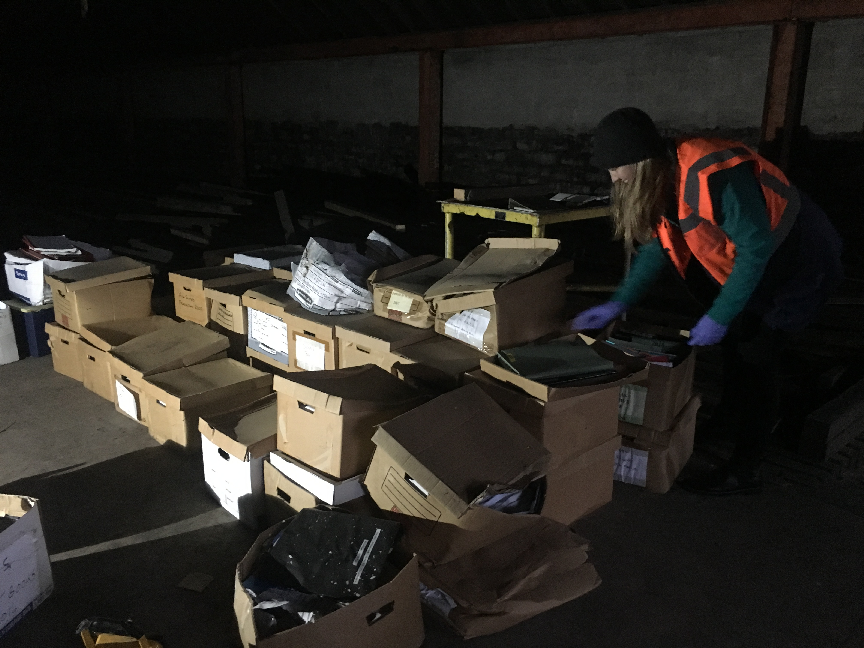
Records Survey: results and thoughts
Interviewed 45 out of 339 employees – this is a lot, senior management are of primary importance
A better understanding of our company as a whole and how employees use systems and create documents
Modification of existing retention schedules
Accessioning digital records that are of clear historical value
Gathering records at Aberfeldy Distillery, 2019
Notes:
So in the end, we identified 45 people to survey – this is obviously a lot. However, this was very much our pilot project and intended to be a learning experience, so we are okay with it having been this many people. In retrospect, possibly too many, but we wanted to make sure we really understood the business and what types of records were being created. Going forward, we do not anticipate needing to survey very many people, as this exercise allowed us to identify the main types of documents being created across the business.
The next step is for our archivists at our French and Italian locations to do a records survey at their sites, and while they are likely not to do as many surveys as we did, we want to verify our findings with their survey, so they will still speak to quite a few people. Going forward from that, it is likely that we may speak to management across the world, but not be more specific than that.
We definitely gained a better understanding of the company and of our site as a result of this activity. Because we are a production site, there are quite a wide variety of activities happening on site. This includes actual operations (bottling, blending, and movement of whisky), actual whisky and gin production at the distilleries, as well as finance, new product development, procurement, engineering, IT, logistics, health and safety, marketing, and visitor experiences. This was especially useful for me, as I had only been with the company for a few months when we started these surveys, so it allowed me to gain a better understanding of how Bacardi and the UKOC functions.
We also modified existing retention schedules based on this work. These retention schedules existed thanks to the DPA, GDPR and work that had been done to ensure compliance with GDPR, so they weren’t quite suited to archive needs. We took those lists and added the records that we had found were being produced and were worth archiving.
Possibly skip: This is a picture of us going through boxes of production records at Aberfeldy distillery. At the same time as this project we also went to each distillery and gathered modern day production records (up to about 10 years ago), so we know what logs they are producing and which ones of those we want to keep every single one of, and which only a sample. This is useful because the distilleries are in the process of switching over to keeping their logs in Excel spreadsheets, so we will need to transfer those at some point, but now we already know which of the physical records we want and can easily keep their digital counterparts.

Slide 13
Accessioning digital records
Process:
Identify records to gather (using the retention schedules developed from our records survey)
Transfer files to an external hard drive and assign accession number
Run a DROID profile on those files including generating a checksum
Back up those files on our archive cloud
Run fixity checks annually
Notes:
The goal going forward is to sift through the records that are currently on the network drives and either gain access to folders so that we can transfer documents ourselves, or in the case of private folders, have people transfer selected document types to us. Once the backlog is cleared, then going forward we would like to collect those record types that are in the retention schedules annually, perhaps by creating an archive/ heritage week where we highlight the archives throughout the company, while also reminding people to transfer their records to the archive.
The way we are currently transferring records to the archive is by going into open network folders and transferring the files we want onto an external hard drive and onto a private cloud. This is a temporary measure until we do get a preservation system, but is necessary because of people leaving the business and concerns over files being deleted.
We currently do no have a computer for quarantine, because everything being transferred is already on the company system. We have run DROID profiles for some of the records that we gathered, but we need to clarify our process for gathering records and draw up standard procedures to follow.
Ideally, we will identify records to gather, transfer them over to an external hard drive, run a DROID profile, and then back up those files on our archive cloud.

Slide 14
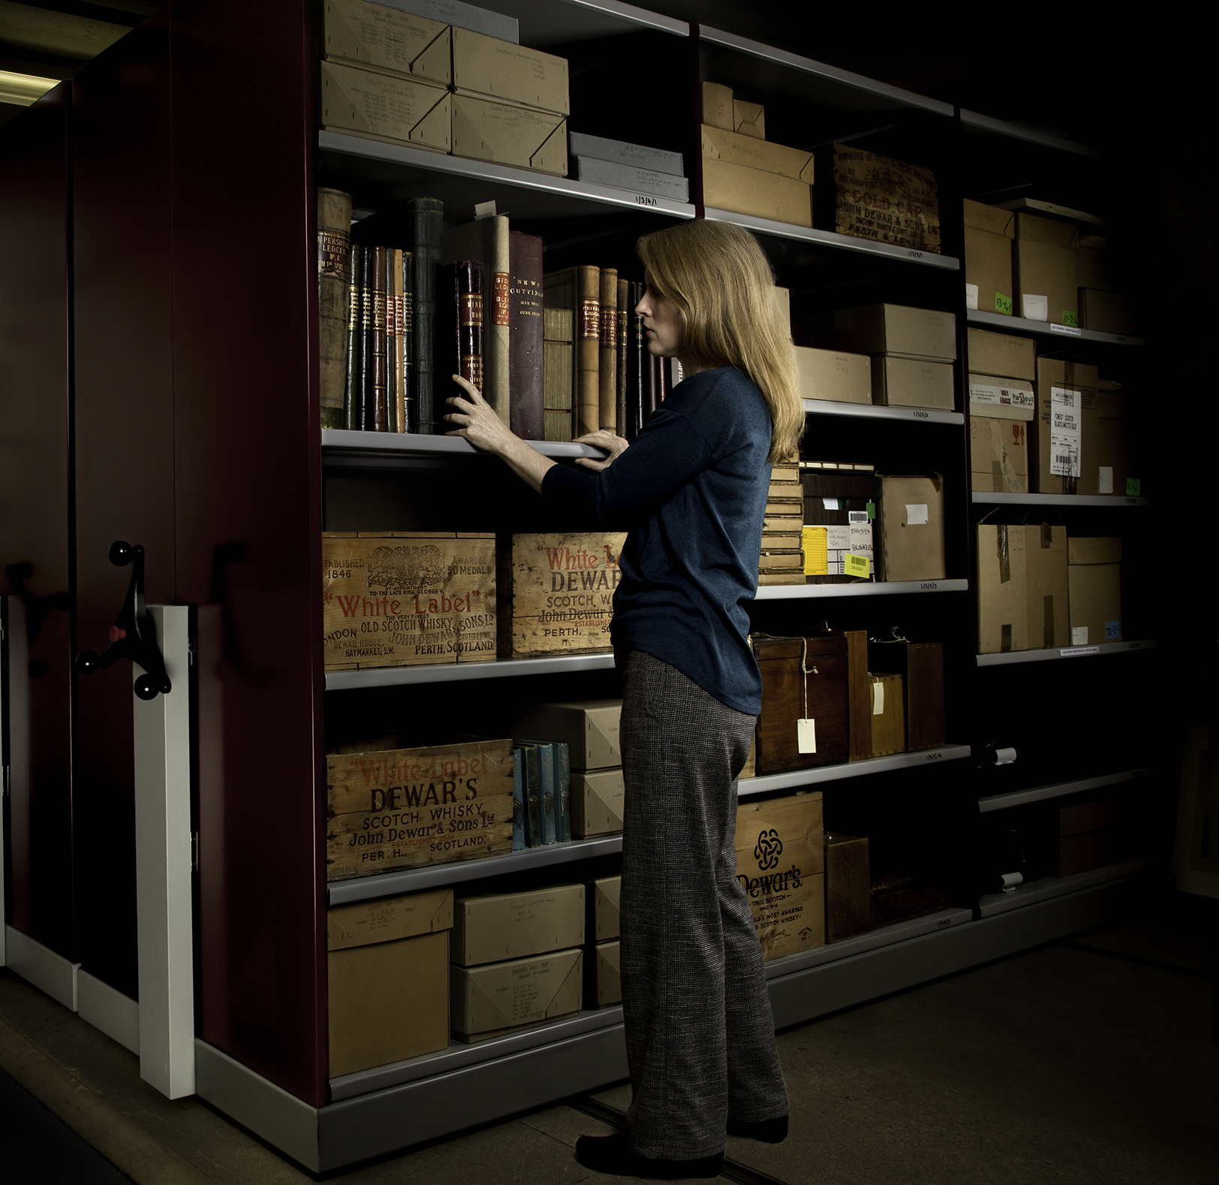
Current Activities
Conducting a records survey of the UKOC
Accessioning digital records
DPC RAM self assessment
Investigating digital preservation systems
Set up a SharePoint site
Migration of records on at-risk media
Digitisation of heavily used items
Jacqui Seargeant, Global Heritage Manager
Notes:
So here are our current activities again, along with a picture of Jacqui in our Glasgow archive.

Slide 15
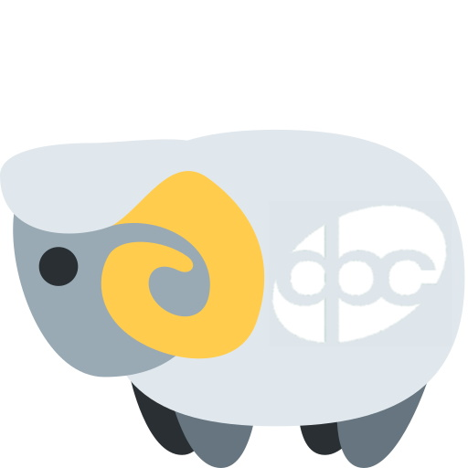
DPC RAM
DPC Rapid Assessment Model - a digital preservation maturity modelling tool
A short assessment that has allowed us to be explicit about our level in various capabilities
Allows for clear goal setting – we will be able to clearly compare our status this year and in the future because of the numbered levels
Our goals are to reach level 3 – “managed” in all capabilities
Notes:
All archivists worked on completing the assessment. It includes organizational capabilities such as policy and strategy, legal basis, and community, and service capabilities such as content preservation and metadata management.
We are currently at a level 1- Awareness on nearly all the capabilities. Essentially we are aware of digital preservation needs and what can be done to meet those needs, but we aren’t quite meeting them yet. However, I would expect that in the next year we can be at level 2- “basic” in the majority of these capabilities, and the goal is to reach level 3 – managed.

Slide 16
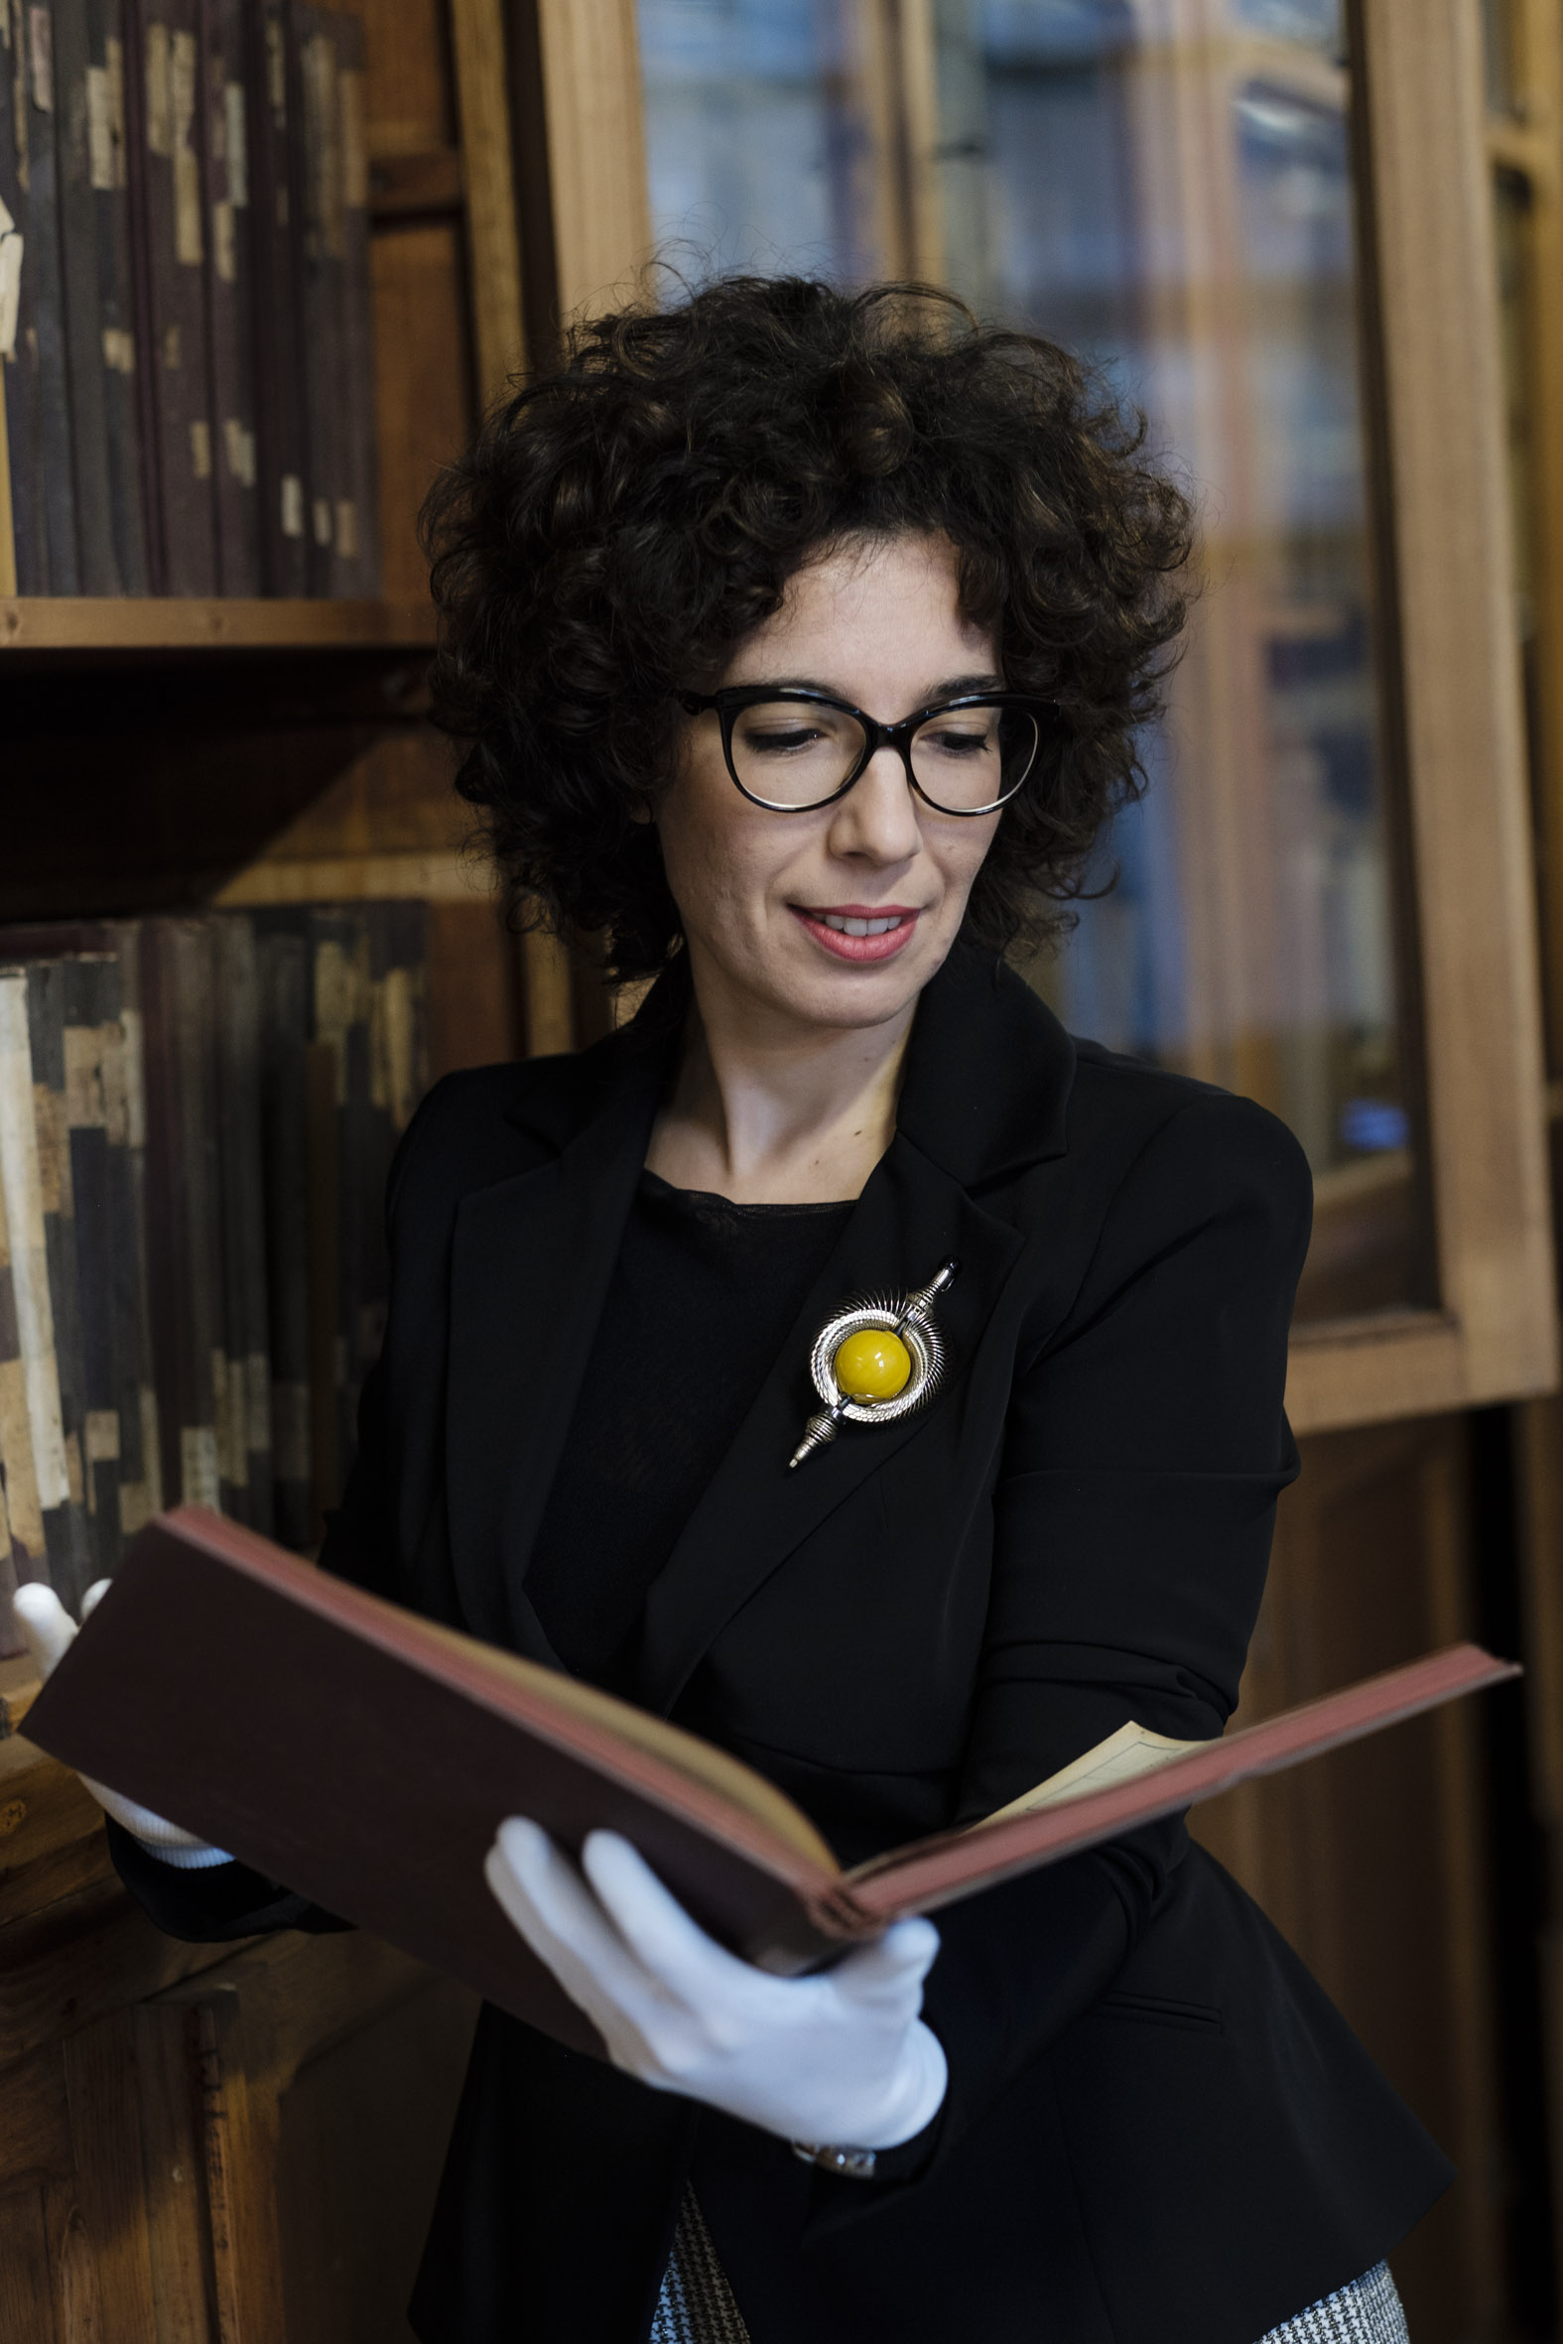
Current Activities
Conducting a records survey of the UKOC
Accessioning digital records
DPC RAM self assessment
Investigating digital preservation systems
Set up a SharePoint site
Migration of records on at-risk media
Digitisation of heavily used items
Anna Scudellari, MARTINI Heritage Curator
Notes:
This is our Martini archivist, Anna

Slide 17
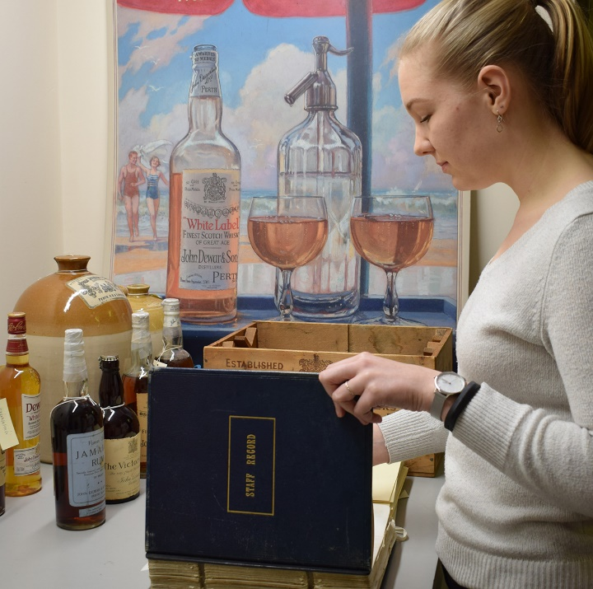
Investigating digital preservation systems
Compared open source and commercial options
  Decided we didn’t have the staffing/time resources for open source
Made a list of our requirements
Spoke to people already using various solutions
Spoke to vendors and asked for demonstrations
Work with procurement and Global IT to get buy-in and support
Notes:
So I can’t go into too much detail about where we are with digital preservation systems because we are still in the process of deciding and getting budget approval, but I can talk a little bit about what some of our considerations were and what we found helpful.
Point one
We made a list of our requirements, and what we found is that all the systems will meet the technical preservation requirements, but there are differences in the user interfaces, what kinds of access can be provided to the system, how the systems link to our catalogue, and how the companies were to interact with.
Something we found especially useful was talking to people who were already using the systems we were considering, as there is nothing like having first-hand experience of how people have found the systems. We also spoke directly to the vendors and asked for demonstrations, which was useful. Some of this happened at events like we’re at today, and some involved phone calls or face to face demonstrations.
We also have had to involve procurement and IT in the process, as they will be facilitating the procurement process.

Slide 18
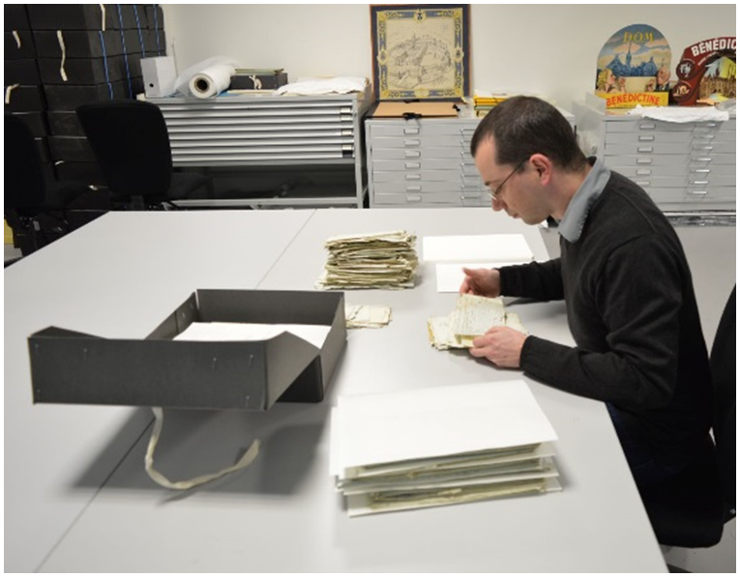
Current Activities
Conducting a records survey of the UKOC
Accessioning digital records
DPC RAM self assessment
Investigating digital preservation systems
Set up a SharePoint site
Migration of records on at-risk media
Digitisation of heavily used items
Sébastien Roncin, Heritage Curator for French Brands
Notes:
This is our French brands archivist, Sebastien.
Discuss following three points here:
Set up a SharePoint site – many difficulties with the system itself
The original reason for setting up this site was to serve as a transfer point for files for those employees who worked on a site without an archivist, and it is relatively functional. It will not be a permanent transfer solution though. We may in future change it to be a page for the archive where people can go to find out information about us.
Migration of at risk media
As I mentioned before, we do have some boxes of CDs that need to be migrated. I have migrated the ones for the Bombay Gin collection, and the next step for those will be to run a DROID profile for all of them. Hopefully this can also help us to identify duplicates, as there are well over 300 CDs, which means we cannot just look at them and know definitely whether they are duplicates.
Digitisation of heavily used items – relates to digital as we will end up storing these files in whatever system we go with. We are doing some of this in house, if they can be done on a flatbed scanner, and some out of house, if they are cumbersome bound volumes.

Slide 19
Challenges
No unified records management system
Global company – spread out over multiple countries, with only four physical archive locations
Concerns over space on company servers resulting in oldest records (unused documents) being deleted
How to transfer records from other systems, e.g. SAP, Innovap
People leaving the business and us not having a clear system for transfer in place yet
Actually understanding the files we are given
Making sure that we ingest files that are actually valuable, but also not spending too much time looking at all the details
Visibility of the archives

Slide 20
Goals and Aspirations
Implement a digital preservation system
  In future link this to our catalogue
Create/refine digital preservation policies and procedures
Develop a process to get records to the archive
Understand how to ingest records from other systems used within Bacardi
Website archiving

Slide 21
Questions?
scase@Bacardi.com

