Slide 1
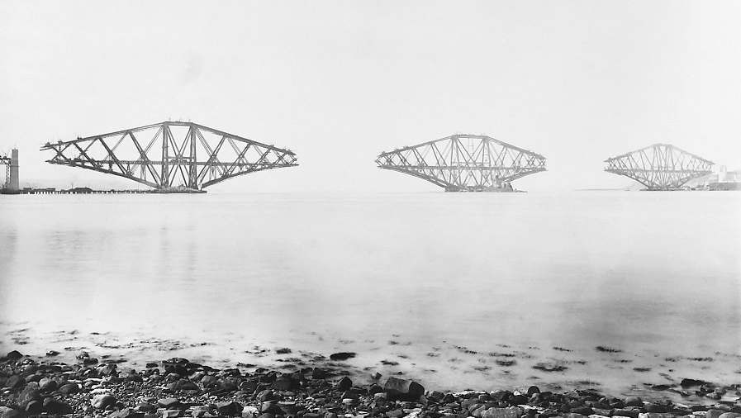

Integrating Web Archives into Existing Collections
The NRS Web Continuity Service

Slide 2
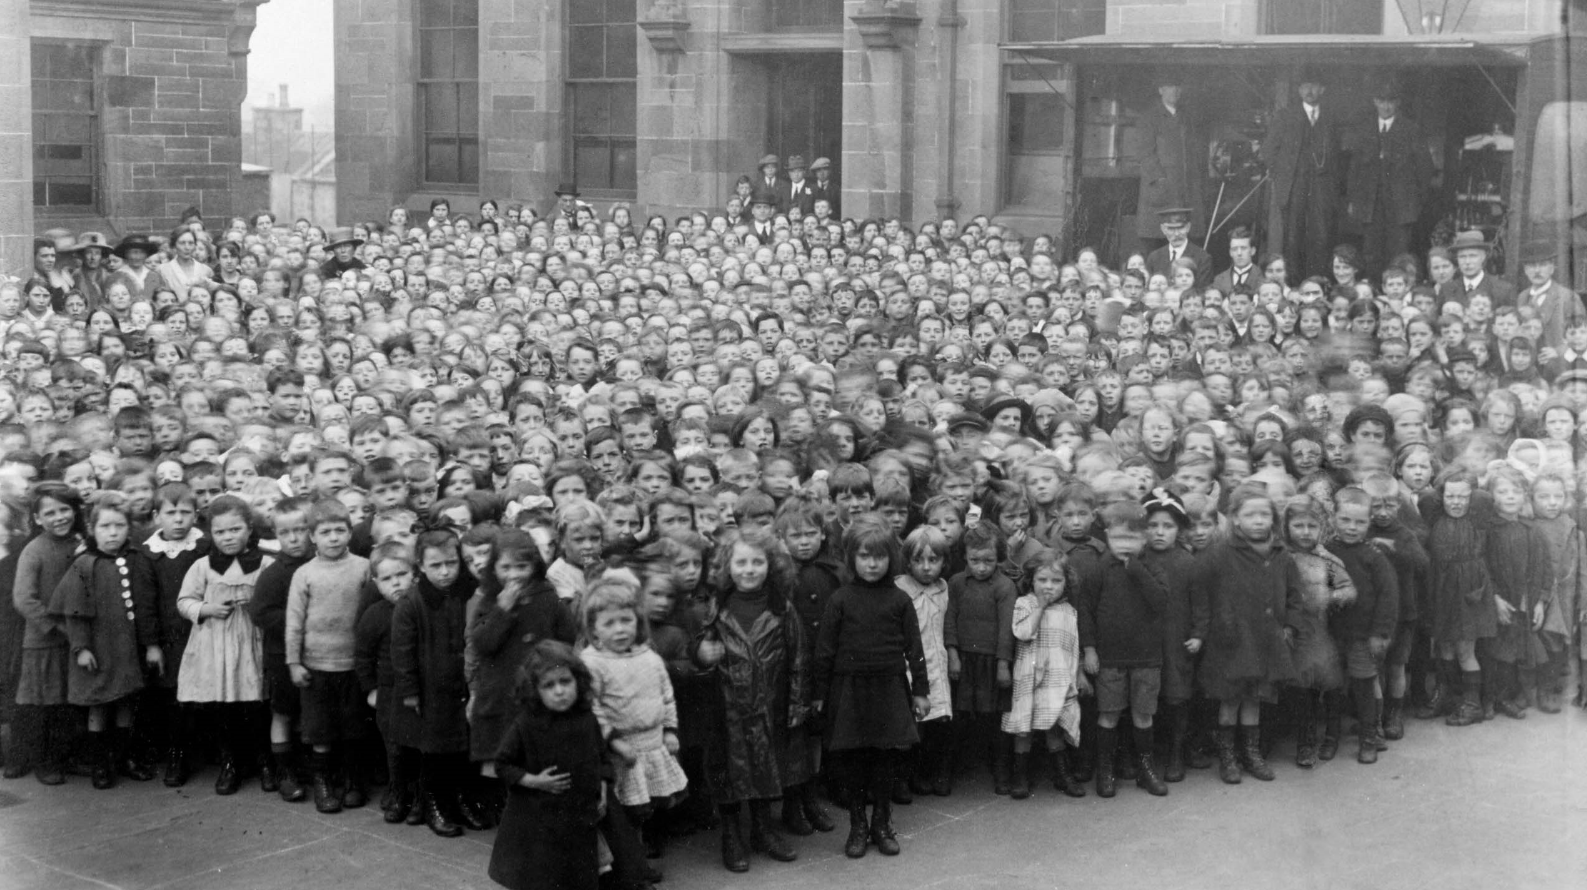
What is the Web Continuity Service?
Represented 81 clients
Since 2017 we have…
Crawled 177 websites
Archived 457 snapshots

Slide 3
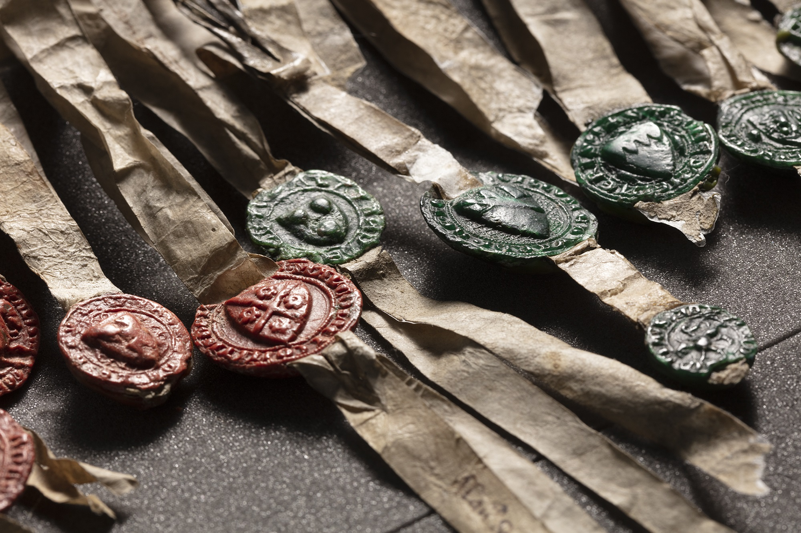

Integrating into a centuries-old collecting history
Archive of Government
Archive of Scottish Courts
Private Archive Collections
Notes:
I am going to firstly explain how we have worked to integrate web archiving into our corporate collecting remit - FOUNDATION
NRS mission statement:
“Collect, preserve, and produce information about Scotland’s people and history, and make it available to inform present and future generations”.
We’ve been doing this for a very long time. Office originated in the 13th century – Clerk of the Rolls responsible for non-current records of government
Today, statutorily, NRS is the Government archive for Scotland, the archive of the Scottish courts and judicial system <PUBLIC RECORDS>. We also hold a large collection of private archives, including those of major landowners, charities and businesses, <PRIVATE RECORDS>.
This is the collecting context for why we hold records such as the one you can see on screen – the DoA which turns 700 this year
- widely seen as Scotland’s most iconic document – record of government – a public record - held and preserved by NRS, excitingly it goes on display at NMS on 27 March – website of Arbroath 2020
We continue to select and accession PUBLIC and PRIVATE records from our depositors – ‘clients’ – around 200 public authority bodies alone.

Slide 4
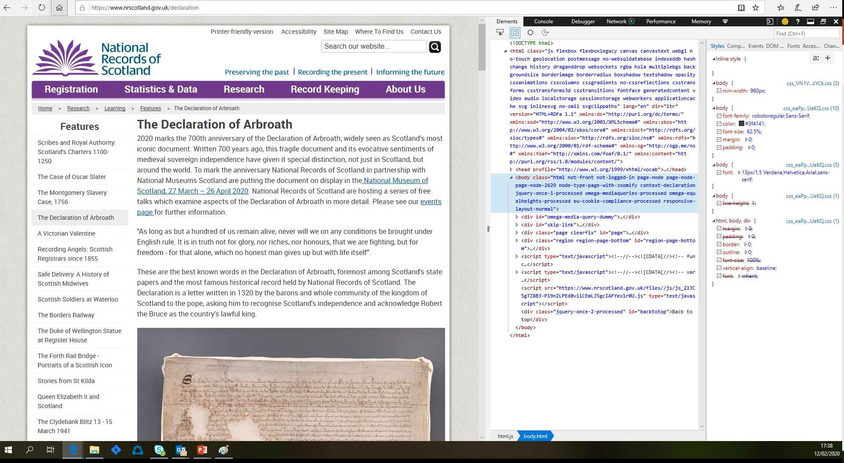
Websites = archival records
Notes:
Being a modern national archive, NRS also collects born digital records.
Corporately, NRS had been interested in archiving the websites of our depositors for some time <CLICK>
The reasoning is obvious, these websites typically contain information on:
Government expenditure
Corporate planning
Events and engagement
Processes of democracy and justice
This information are all recognised qualities of ‘public records’.
They are also now invariably published online by governments, administrations, and organisations. A trend that we needed to respond to.
PRSA – anything in which information is recorded any form- this easily includes websites.
Had tried to capture flat-file copies in early 2000s.
2015 – WCS is approved, policy required – INTEGRATE INTO EXISTING COLLECTING REMIT AND STRUCTURES

Slide 5

Foundation for integration – web archiving selection policy
Reviewed collecting legislation & policies to shape collection scope
Secured stakeholder support via web archive ‘roadshows’
  Introduced vision: integrate web archiving into NRS with associated benefits
  Outlined selection and appraisal criteria
  Show and tell of web archiving tech, process and timings
  Declared what could/could not be done at that stage – manage expectations!
Made published selection policy more informed and robust:
  Selection scope and legislative basis nailed down
  Appraisal process clearly articulated
  Permissions process and interdependency with MoUs explained
Notes:
Collective support to web archiving required - DRU part of preservation function – needed support from client engagement and public service teams
Creation of selection policy the initiative that drove this.
Other selection policies –
Useful language - the changing shape of the Scottish nation would be “naturally reflected” in the changing content and format of the records we collect -
PRSA – anything in which information is recorded any form.
SG doing more and more with the web
Stakeholder sessions
Show and tell – build trust in what you’re doing and how it’s there to support and enhance existing structures and processes
Communicate resource and budget limits and how we need to manage this carefully
Create a bit of excitement! – lead, communicate, assist
Result:
Collective buy-in
Baked into MoU, workarounds for transfer
Opened up method for WCS to consult with website owners on website plans, copyright, relationship to other types of digital content

Slide 6

Keeping our selection in tune
In-demand service – planning required to
maintain continuity
Web Continuity Working Group – ‘critical friends’
Staying transparent - published seed list in Selection Policy
Web archiving a new platform to support collections development – content, format, focus
Stay relevant, stay integrated
Notes:
A web archivist’s job is never done!
Because the Web is always changing, and because our clients continue to use the web in innovative ways, we do constantly evaluate what we are crawling, and how this may need to change and re-focus.
In-demand service – we use a commercial supplier with contractual ceilings = careful selection and crawl scheduling required
Web Continuity Working Group – our critical friends
- “scrutinize the progress, monitor its outputs and intended benefits”
- Internal and external stakeholders.
- Recent chats – YouTube, measuring redirection benefits, de-duplication
Staying transparent to our stakeholders - published seed list in Selection Policy Appendix
Tool/basis for collections an process development – content, metadata, format
- ‘Service-orientated’ websites
- Intranet crawling
Brexit – ETI – DOA!
<<<<RELEVANCE - INTEGRATION>>>

Slide 7
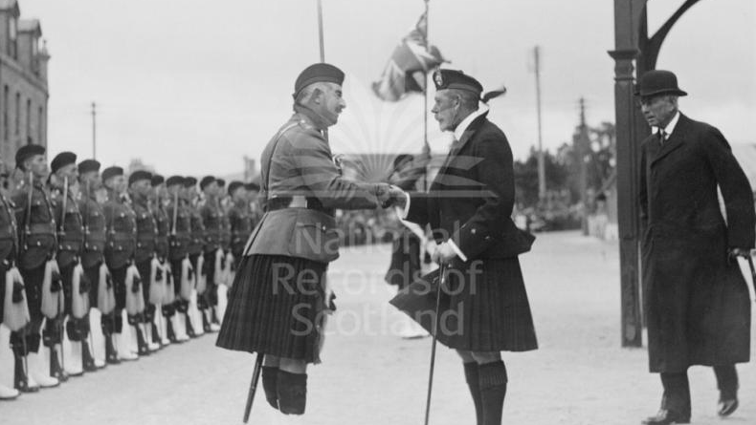
Client Engagement: working together
Client Engagement

Slide 8
Supporting Our Clients
Security
Accessibility
Continuity

Slide 9

NRS Web Continuity Service
Quality Assurance (QA) Process: What, Why and How

Slide 10
QA Process: What?
In web archiving terms, ‘quality’ is measured in terms of how complete the capture is and how this content is replayed to the user
As part of the NRS Web Archiving QA process, my job is to access, exam and verify captured web content
Perfection is almost impossible in web archiving but thanks to this process NRS deliver high standard archived web records
Only content which passes through this QA process successfully is accepted into the NRS Web Archive

Slide 11
QA Process: Why?
We want to archive websites ‘well and properly’.
“Archival materials derive their value as evidence from a combination of three qualities: content, context and structure.” – Laura Miller, Archives (2017)
Web archiving QA provides us with the tools and knowledge to capture and preserve as much of these qualities from websites as possible

Slide 12
QA Process: How?
It is essential that the same procedure is conducted on each and every crawl
Completion of the QA tasks by NRS staff will take between 30 minutes and 3 hours per captured instance and it will be done in four different browsers
Acceptable quality. NRS staff score the severity of each issue they find on a scale of 1-3 defined as follows:
  Level 1: The issue is common to the web archiving process, and cannot be fixed. The issue may be fixable, but it is not adversely affecting record quality and so can be ignored/tolerated
  Level 2: The issue is fixable and is having a mildly adverse affect on record quality. Whenever possible, effort should be made to undertake remedial action via patch crawls
  Level 3: The issue is having a severe effect on record quality and cannot be accepted. Seek provider’s advice

Slide 13
Incorporating WARC files into our Digital Archive
“The WARC (Web ARChive) file format offers a convention for concatenating multiple resource records (data objects), each consisting of a set of simple text headers and an arbitrary data block into one long file.” (PRONOM, PUID: fmt/289)
Bowl of Cereal
Cereal Bar
Web Crawl
WARC File
Process of Uploading WARC files:
Receive encrypted hard drive from Internet Archive.
WARC Files are quarantined for a period of four weeks.
DROID is used to profile and generate checksums.
Transfer time!
DROID is used again to check completeness.
Reasons for Preserving WARC files Within Our Collections:
Not just thinking of users accessing now, but ensuring these can be used in the future.
Preservation can’t be reliant on a third party supplier.

Slide 14

Making Sense of the Metadata
Service
Crawl Job Frequency
Seed ID
Serial Number
Collection
Crawl Job ID
Timestamp
File Format
Crawl Job ID
Timestamp
File Format
Service
Crawl Job Frequency
Date
Website
Serial Number
Using different suppliers – both supplied us with the WARCs but presented in different ways.
ISO WARC standard helps but there are some things the standard doesn’t cover such as naming conventions.
You need to get your head around the structure – average user would not be able to interpret the metadata.

Slide 15
Practical Challenges of Storing WARC Files
Majority of the files in our digital collections are WARC files.
Financial pressures
Time pressures – uploads can take several days.
Worth it in the long run!
WARC files are Government Records and we treat them as such.
Future cataloguing – we can effectively cross reference across the record series.

Slide 16
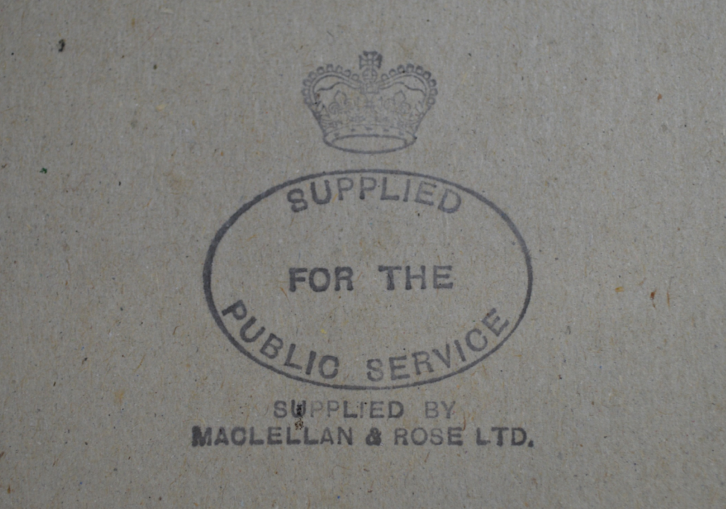
Thank You
https://webarchive.nrscotland.gov.uk
digital_records@nrscotland.gov.uk

