Slide 1


Slide 2
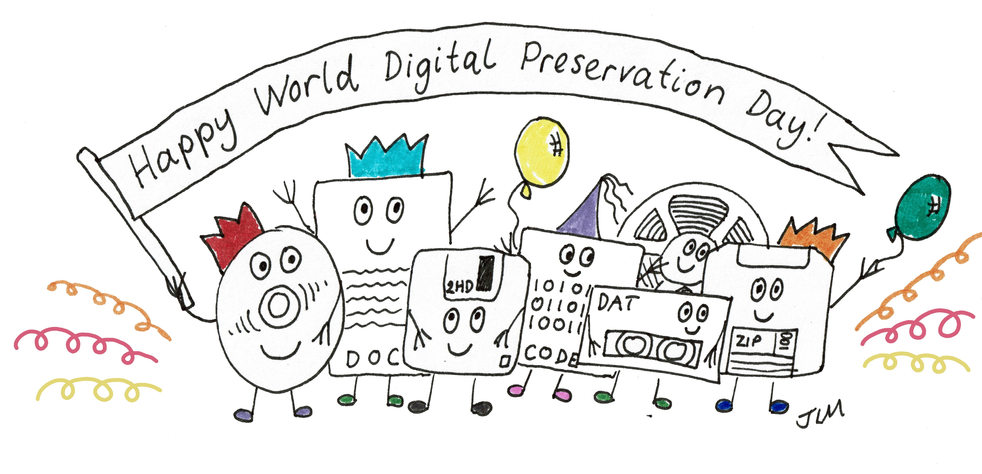
A Worldwide Celebration with a Purpose

Slide 3
Raising Awareness
Held on the first Thursday of November each year, World Digital Preservation Day raises awareness of why digital preservation matters.
Organized by the Digital Preservation Coalition and supported by networks worldwide, it celebrates the people and work that keep our digital heritage accessible.

Slide 4
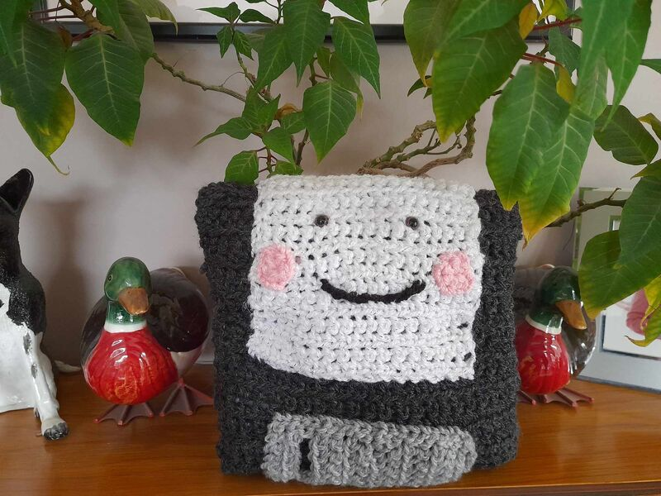
Floppy Disks, Cakes and Conversations
From cross-stitched floppy disks and USB-shaped cakes to blogs exploring digital preservation: WDPD brings people together in wonderfully creative ways.
Institutions worldwide open their doors and host events, showing what digital preservation involves and how they are safeguarding our digital legacy.

Slide 5
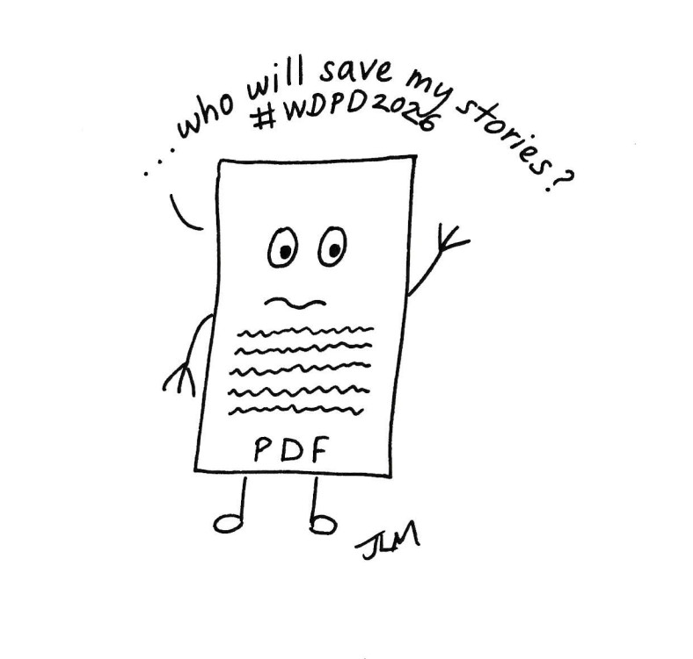
Save our Stories (SOS)
Our records, research, memories and culture increasingly take digital form. Keeping them accessible takes ongoing care.
This year’s WDPD theme is “Save our Stories (SOS): Our Digital Heritage in Danger”, and highlights what we risk losing and the action needed to protect it.

Slide 6
Today, we’re celebrating together
Our gathering is part of a worldwide day of sharing stories, exchanging ideas and making digital preservation more visible.
Thank you for being part of it!

Slide 7
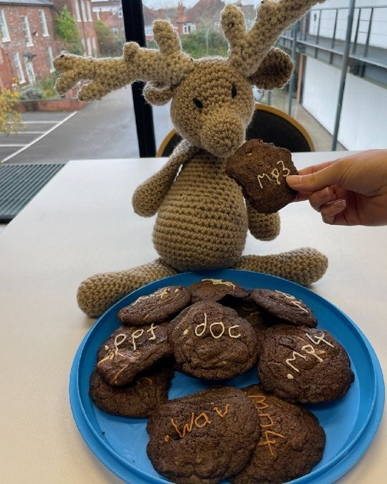
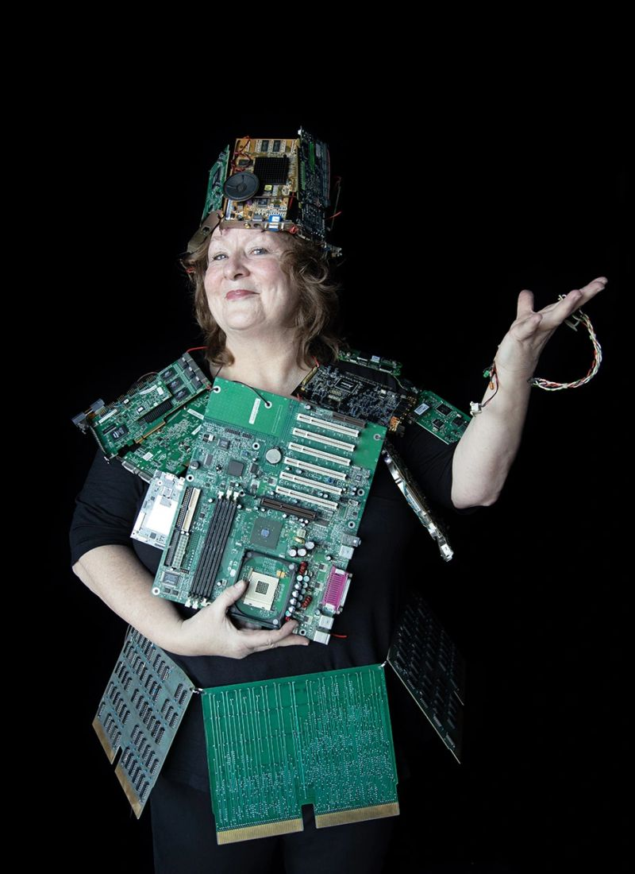
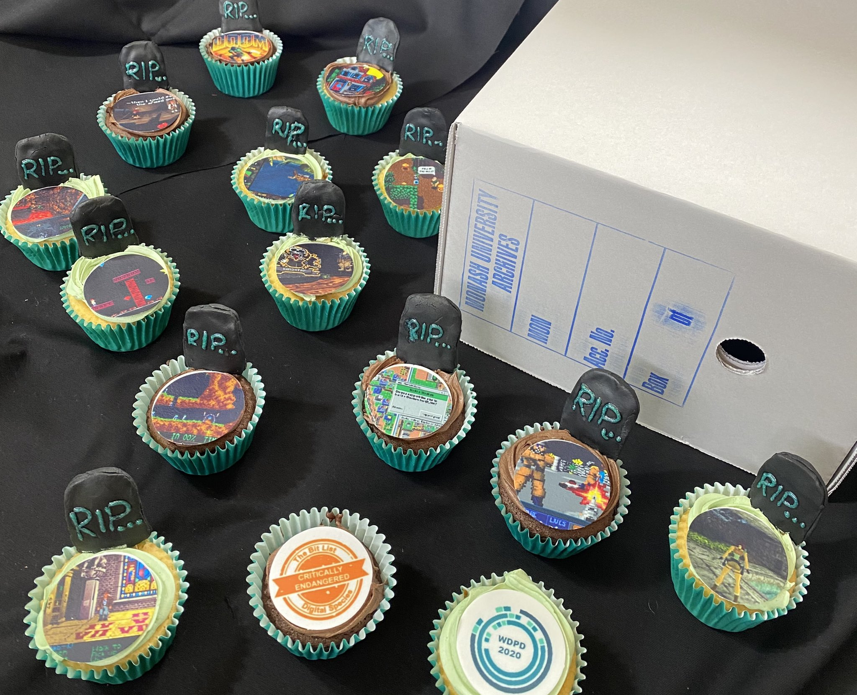
Happy World Digital Preservation Day!
#WDPD2026

