Slide 1
Going Lossy: 16 years of JP2 at Wellcome Collection
C. Henshaw, Head, Digital Production
25th Anniversary of JPEG 2000, DPC event, 19/11/2025

Slide 2
2009 – JP2 newbies
A new, long-term digitisation strategy meant we needed a new storage solution:
Scaling up to millions of images per year
Rising costs of on-premises storage
Complexities of digital asset management and preservation

Slide 3
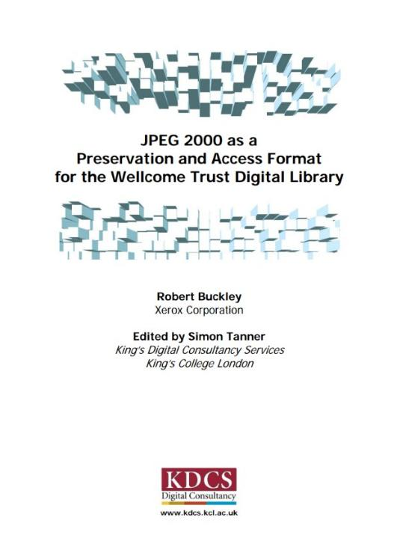
Expert
Opinion

Slide 4
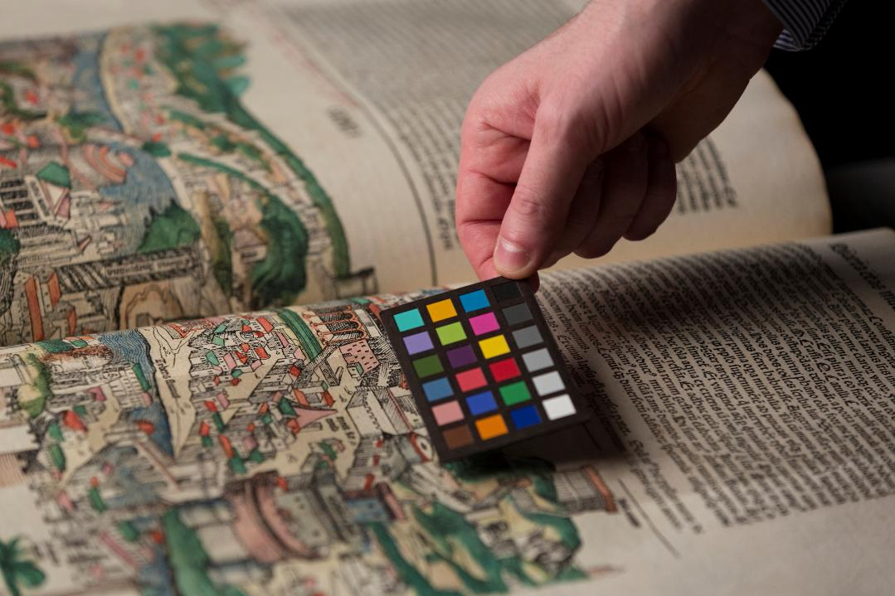
Experimentation and testing
Image of a colour target held against an illustrated book, Wellcome Collection, CC-BY.

Slide 5
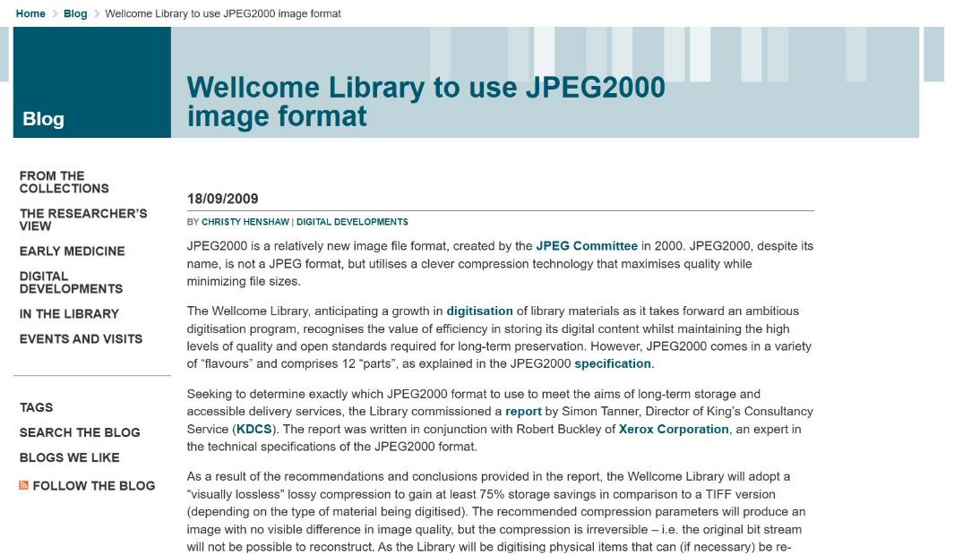
Blogging galore
(available in the Wayback Machine)

Slide 6
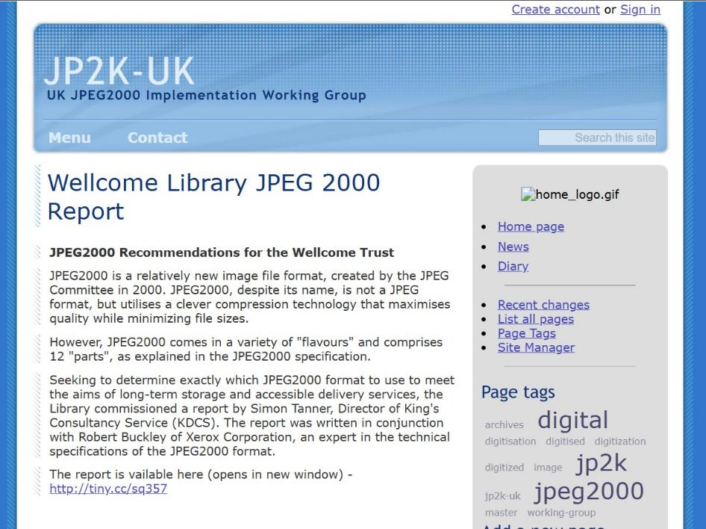
Wiki – also available in the Wayback Machine
Hurrah!

Slide 7
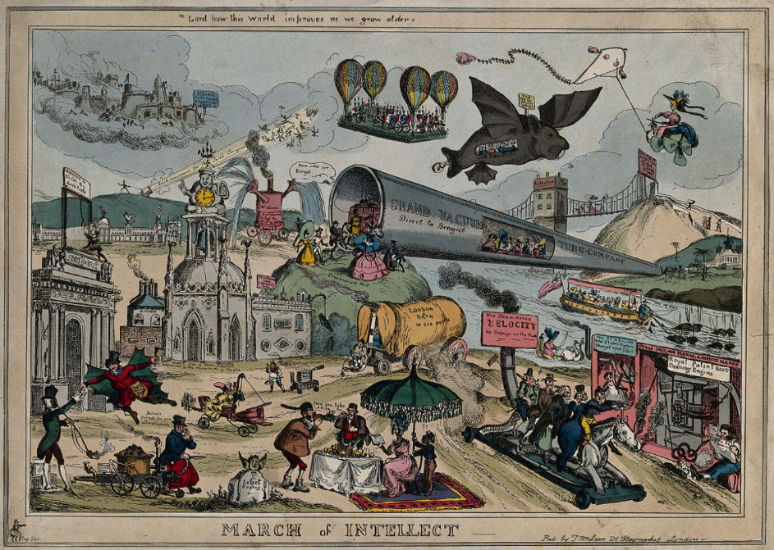

Flying to the future…
March of Intellect, W. Heath, 1829, Wellcome Collection, Public Domain

Slide 8
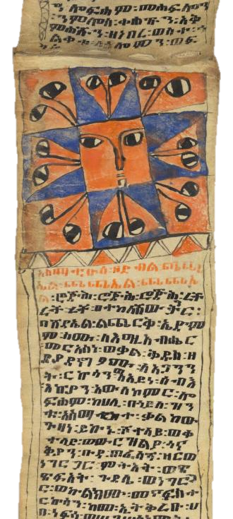
2025 – where we are now
JP2 fully embedded into workflows - >55 million lossy JP2 (10:1)
We can convert to and validate JP2s via Goobi
  JP2 and JPEG2000/MXF files delivered by vendors
  Automated harvest of JP2s from Internet Archive (using a fixed “slope” value with Kakadu tools)
  On-the-fly conversion to JPEG tiles for online access
Wellcome MS Ethiopian 11, 19th c, Wellcome Collection, Public Domain

Slide 9
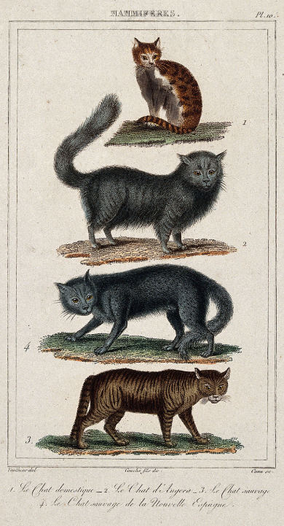
Tools
  Grok OS tool, TIFF-JP2 conversion via Goobi (parameters: -r 1024,512,256,128,64,32,16,8 -n 6 -t 1024,1024 -p RPCL -TLM –I)
  Jpylyzer v.2.1.0 validation tool via Goobi
  Kakadu v8.4, JP2-JPEG conversion (8.6 soon)
  Cantaloupe image server for dynamic image serving
  Appetiser to pre-generate thumbnails
  MediaConvert, AWS product to convert video to MP4
Four different species of cats, 19th century, Wellcome Collection, Public Domain

Slide 10
Thank you!
C.Henshaw@wellcome.org

