Slide 1

DPC, 25th Anniversary of JPEG 2000, 19 November 2025
JPEG 2000 and
Imaging Strategy at Harvard
Stephen Abrams, PhD
Head of Digital Preservation
Harvard Library
stephen_abrams@harvard.edu
preservation.library.harvard.edu/digital-preservation

Slide 2
Preservation at Harvard Library
25 years
preservation.library.harvard.edu/news/2025/10/celebrating-twenty-five-years-digital-preservation
63 curatorial units, 484 collections
>11 million objects, 120 million data files, 109 formats, 625 TB (2 PB replicated)
“
The programmatic enterprise facilitating meaningful human communication of digital-encoded information across time and ever-accumulating technical and cultural distance. A complex of actors, policies, processes, and technologies ensuring ongoing integrity, authenticity, accessibility, and usability of digital resources.”
preservation.library.harvard.edu/news/2025/11/2025-world-digital-preservation-day-why-preserve

Slide 3
Imagery is Our Most Prevalent Genre

Slide 4
JPEG 2000 is Our Most Prevalent Format
JP2
JP2
TIFF
TIFF
JPEG
JPEG
44 million JP2’s
187 TB JP2’s

Slide 5
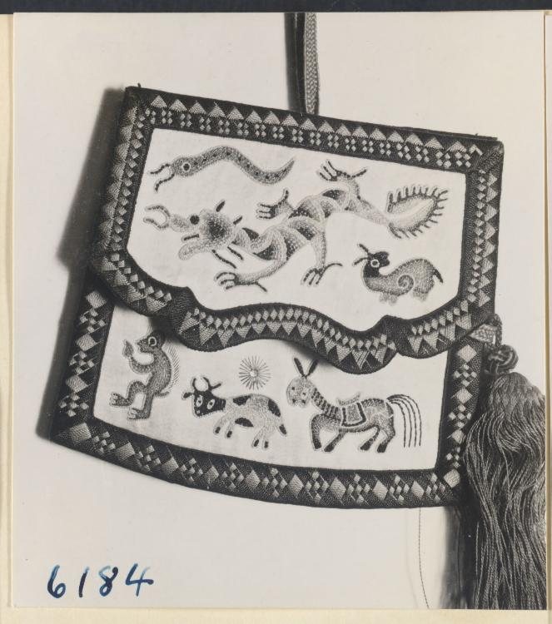
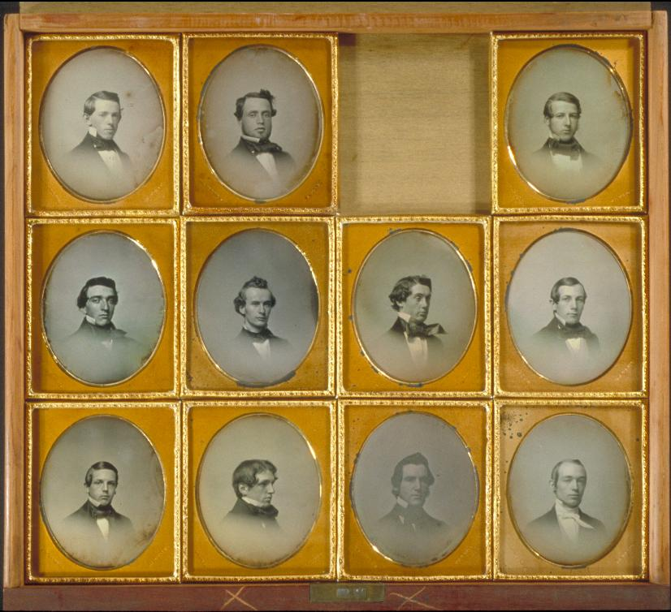
November 2000
November 2025
Harvard-Yenching Library, Bag embroidered
with six animals from the Chinese zodiac
id.lib.harvard.edu/via/olvwork95508/urn-3:FHCL:8718/catalog
Early digitization project of ethnographic
field data from the 1930s
University Archives, Daguerreotype portraits of Harvard
Class of 1852
id.lib.harvard.edu/via/olvgroup62/urn-3:HUL.ARCH:31945/catalog
Recent migration from obsolete Kodak Photo CD
format

Slide 6
Wide Gamut of Purpose
1% monochromatic
99% RGB
<1% RGB+alpha
<1% target images
21% stand-alone images
78% page image components of page-turned objects
46% archival copy
2% production copy
50% deliverable copy

Slide 7
The Master Recipe
✓
✓
✓
✓
✓
"jp2 “ file type ✓ 1 quality layer
Reversible 5-3 transform ✓ n decomposition levels
8 BPC ✓ RLCP progression
sRGB color space ✓ Error resilience
1024x1024 tile size
Developed through (lots of) experience and consistency with FADGI, Metamorfoze, and other community best practice guidance
"Off-menu" variations based on contextual need

Slide 8
Why JPEG 2000?
Robust, mature, and reliable technology
Easily adaptable to different contexts, repurposable as both archival and deliverable in a single package
Standardization through unambiguous specification
Controlled extensibility / future-proofing, e.g., we recently started using JPH / HTJ2K for delivery purposes
Size matters: We can no longer afford – financially or environmentally – to manage uncompressed imagery at scale

Slide 9
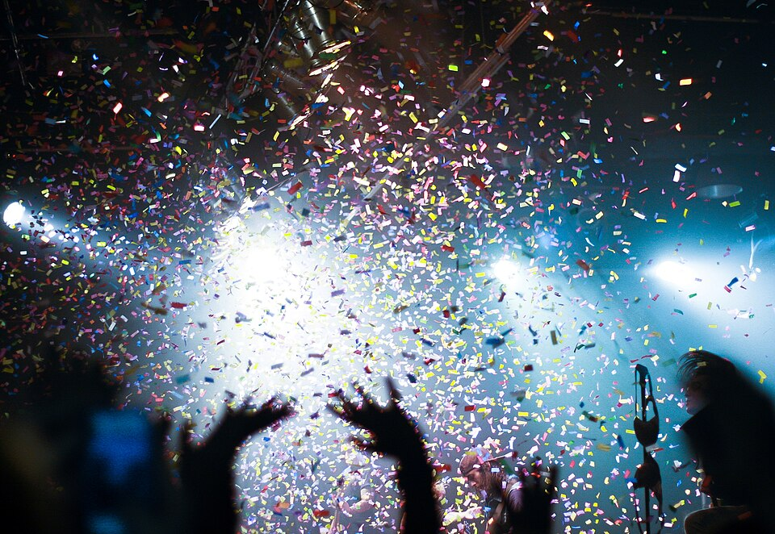
Happy Anniversary, JP2!

